Slide 1
人教版高中英语 M4U5 Theme Park
欧阳凯欣 20150201131
华南师范大学外文学院

Slide 2
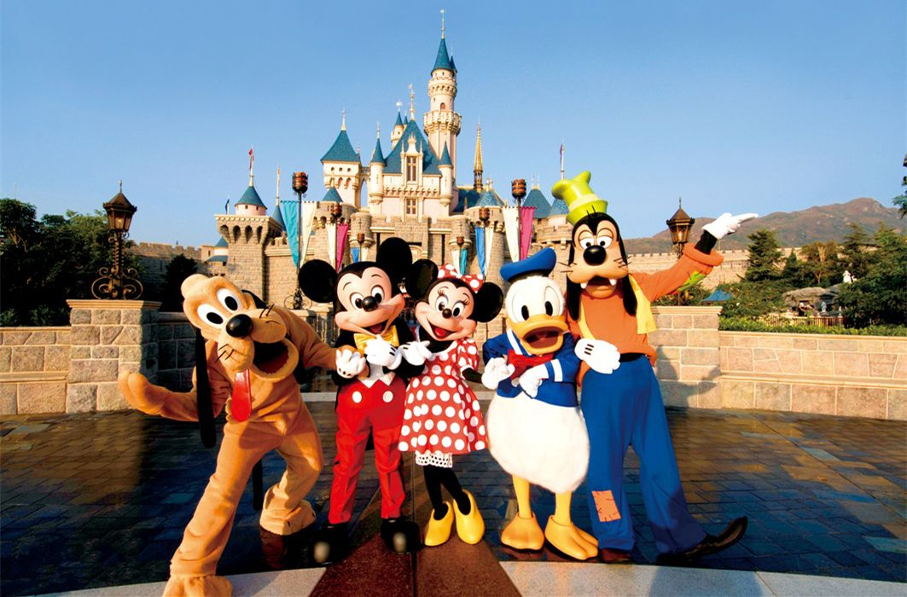
Whoa-uh-oh
It's always a good time

Slide 3
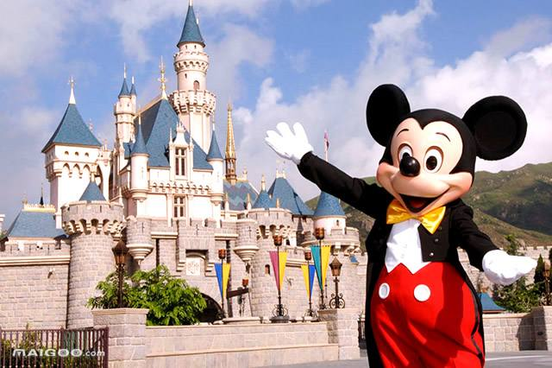
Whoa-uh-oh
It's always a good time

Slide 4
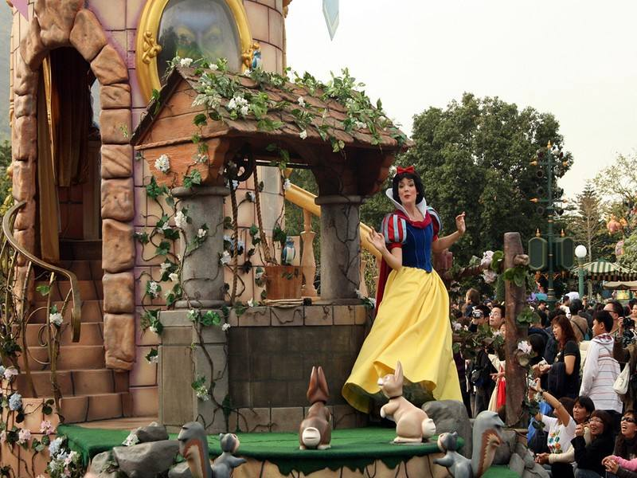
Woke up on the right side of the bed
What's up with this Prince song inside my head?

Slide 5
Hands up if you're down to get down tonight
'Cause it's always a good time

Slide 6
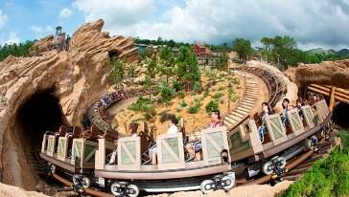
Slept in all my clothes like I didn't care
Hopped into a cab, take me anywhere
I'm in if you're down to get down tonight
'Cause it's always a good time

Slide 7
Good morning and good night
I'll wake up at twilight
It's gonna be alright

Slide 8
We don't even have to try
It's always a good time (Whooo)

Slide 9
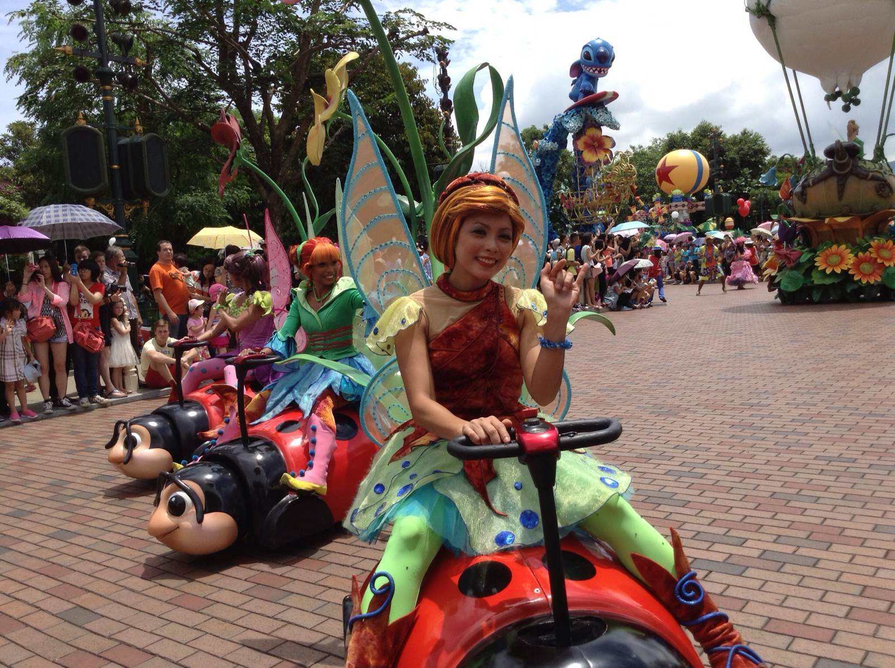
Whoa-oh-oh, oh-oh-oh, whoa-oh-oh
It's always a good time

Slide 10
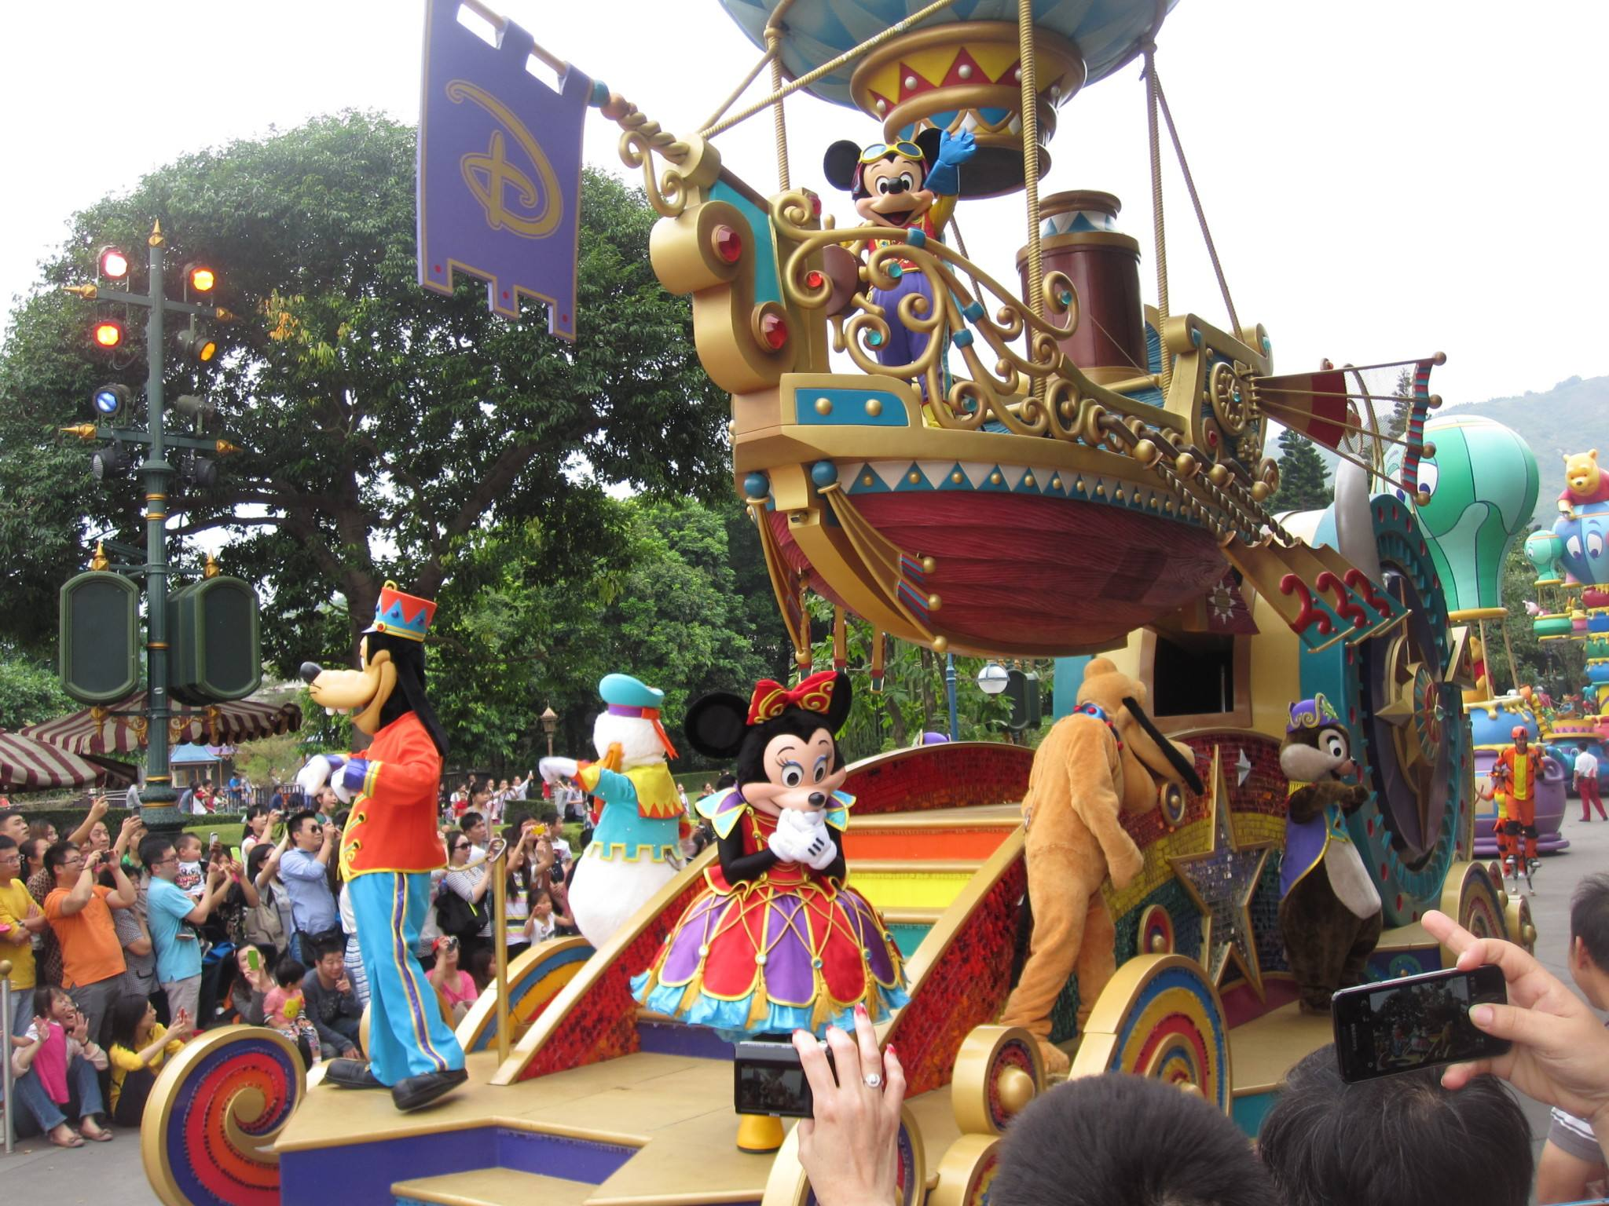
Whoa-oh-oh, oh-oh-oh.
We don't even have to try, it's always a good time

Slide 11
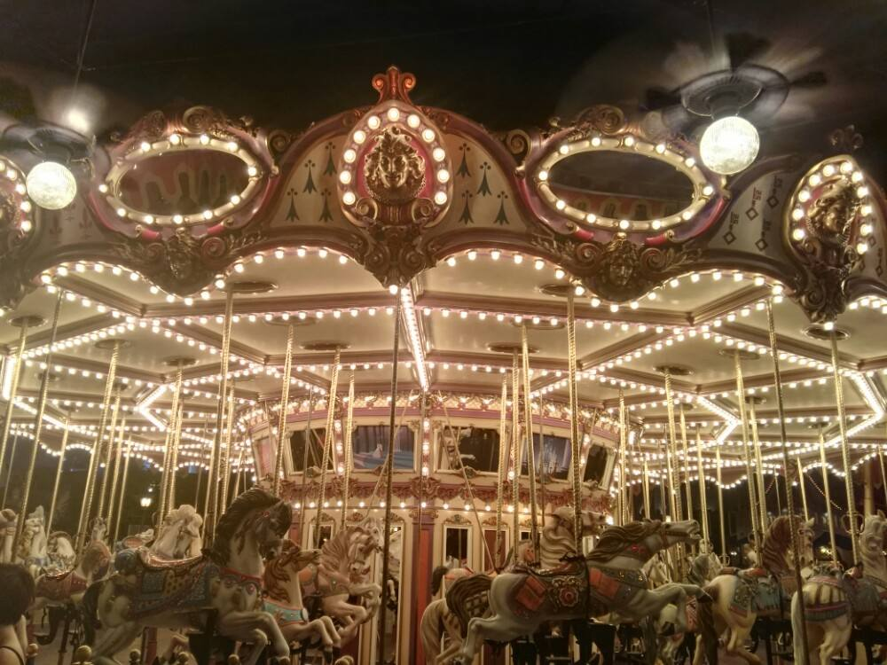
Freaked out, dropped my phone in the pool again
Checked out of my room, hit the ATM
Hang out if you're down to get down tonight
'Cause it's always a good time

Slide 12
Good morning and good night
I'll wake up at twilight
It's gonna be alright

Slide 13
We don't even have to try
It's always a good time (Whooo)

Slide 14
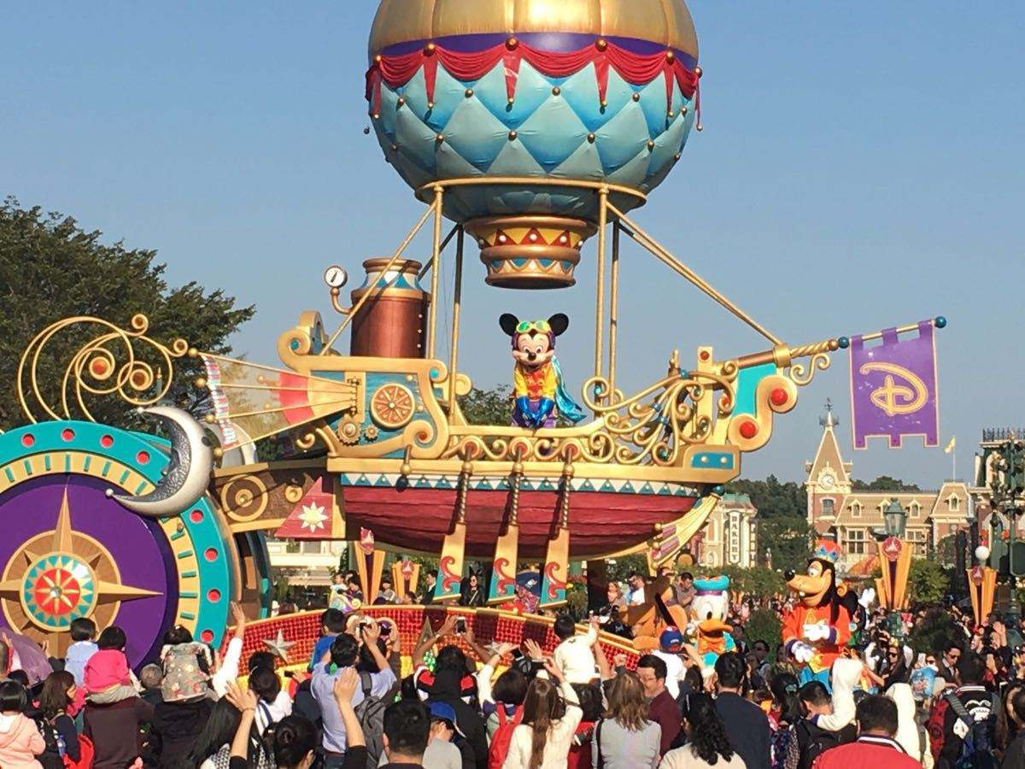
Whoa-oh-oh, oh-oh-oh, whoa-oh-oh
It's always a good time

Slide 15
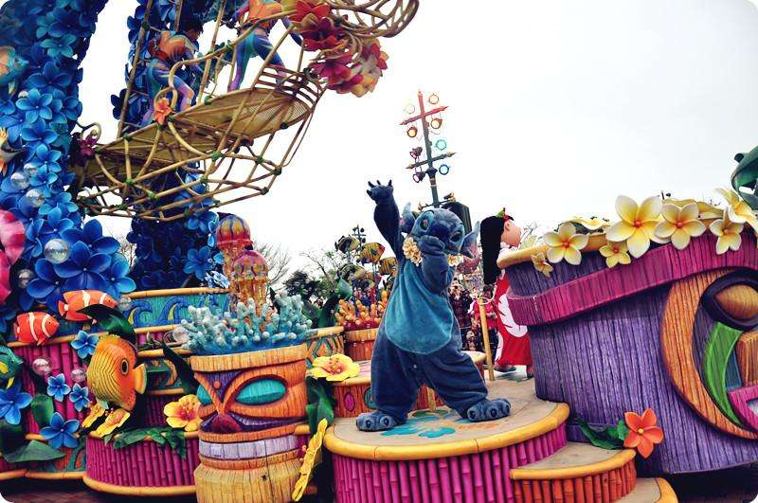
Whoa-oh-oh, oh-oh-oh, whoa-oh-oh
We don't even have to try, it's always a good time

Slide 16
Whoa-oh-oh, oh-oh-oh, whoa-oh-oh
It's always a good time

Slide 17
Whoa-oh-oh, oh-oh-oh, whoa-oh-oh
We don't even have to try, it's always a good time

Slide 18
Doesn't matter when
It's always a good time then
Doesn't matter where
It's always a good time there
Doesn't matter when,
It's always a good time then
It's always a good time

Slide 19
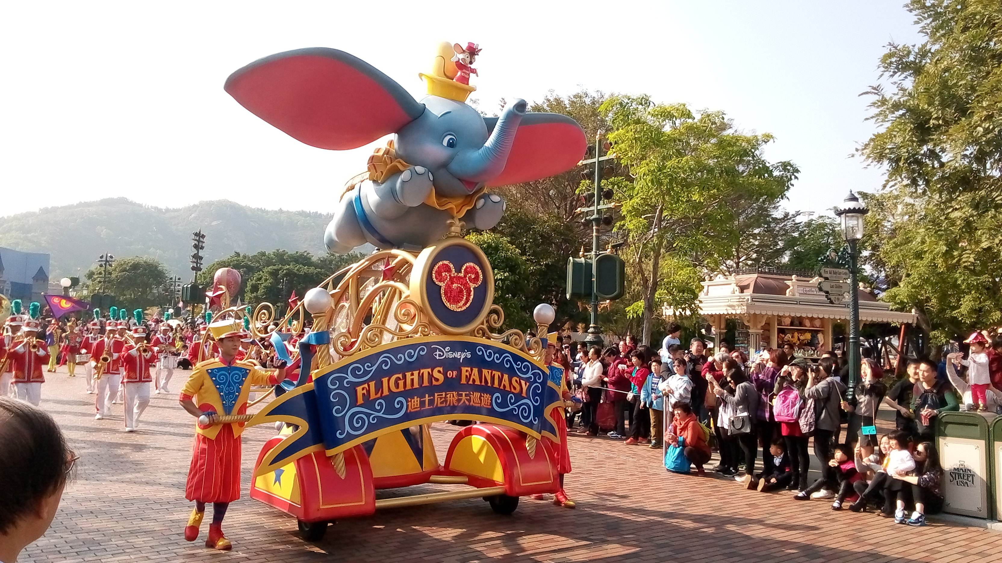
Whoa-oh-oh, oh-oh-oh, whoa-oh-oh
It's always a good time

Slide 20
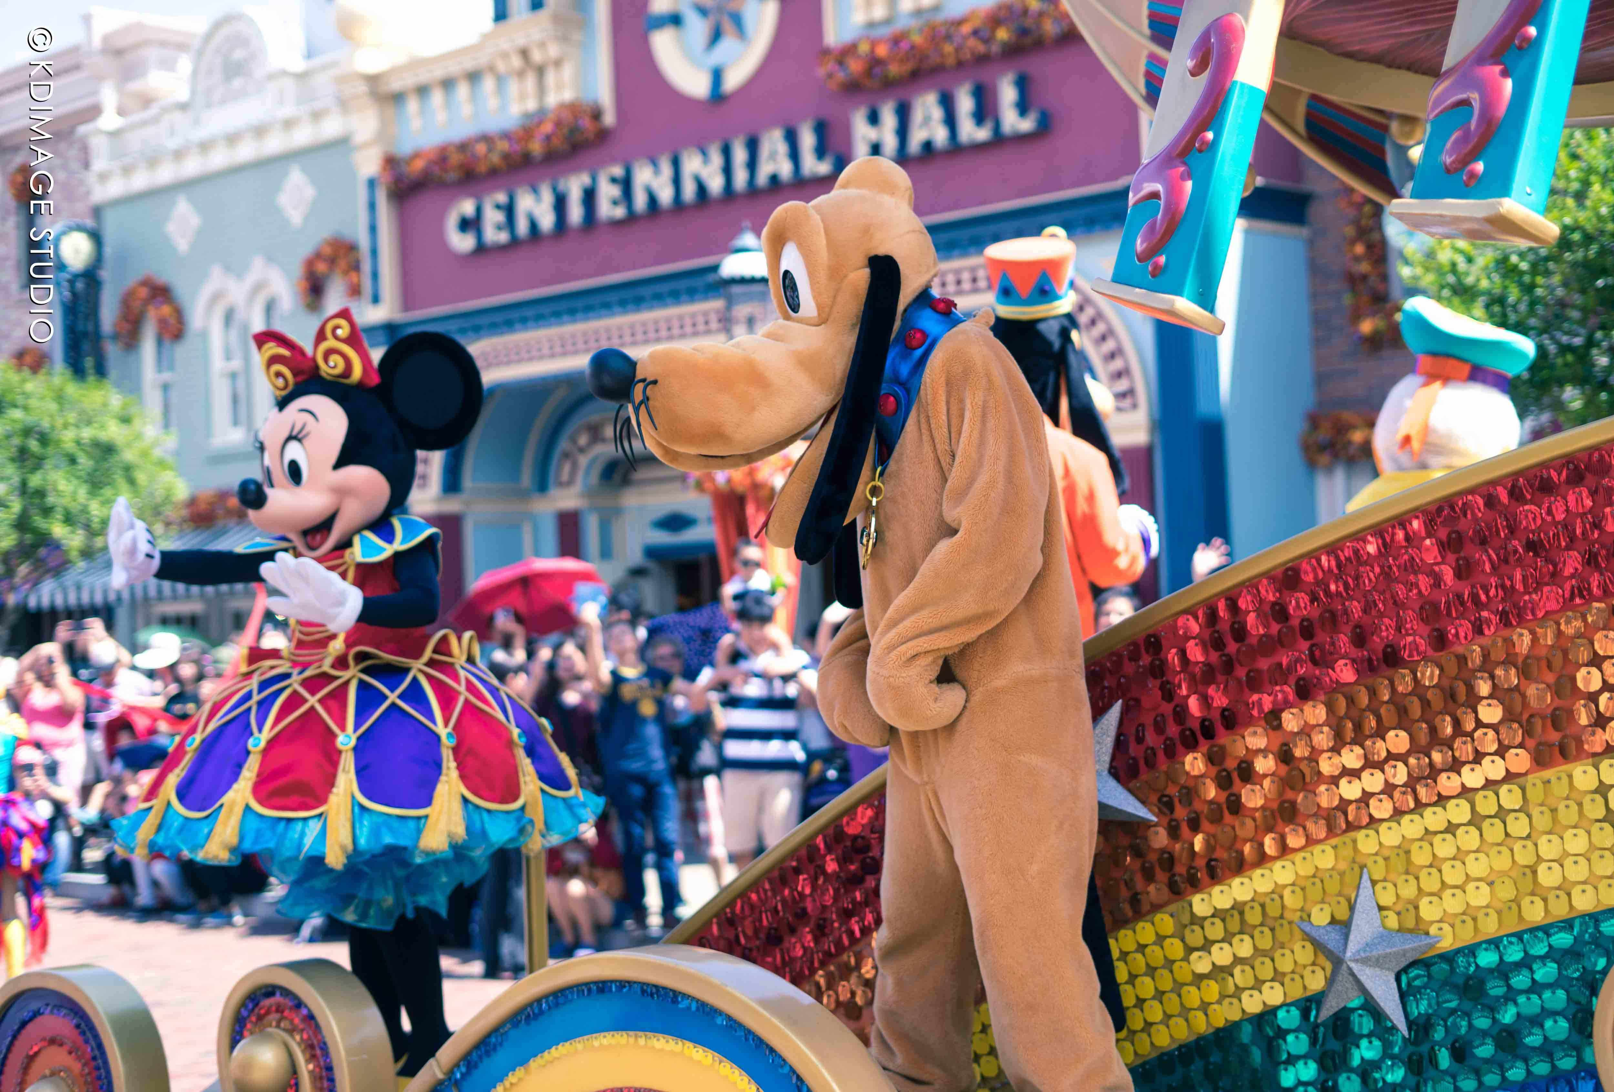
Whoa-oh-oh, oh-oh-oh, whoa-oh-oh
We don't even have to try, it's always a good time

Slide 21
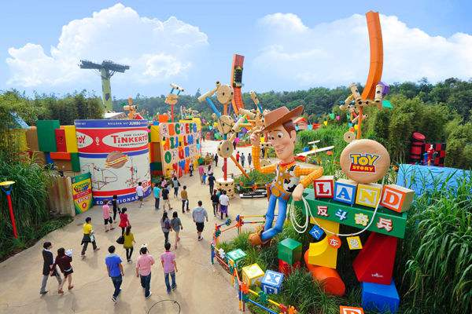
Whoa-oh-oh, oh-oh-oh, whoa-oh-oh
It's always a good time

Slide 22
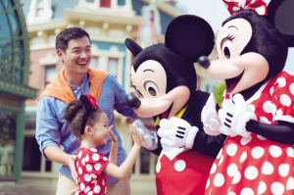
Whoa-oh-oh, oh-oh-oh, whoa-oh-oh
We don't even have to try, it's always a good time

