Slide 1
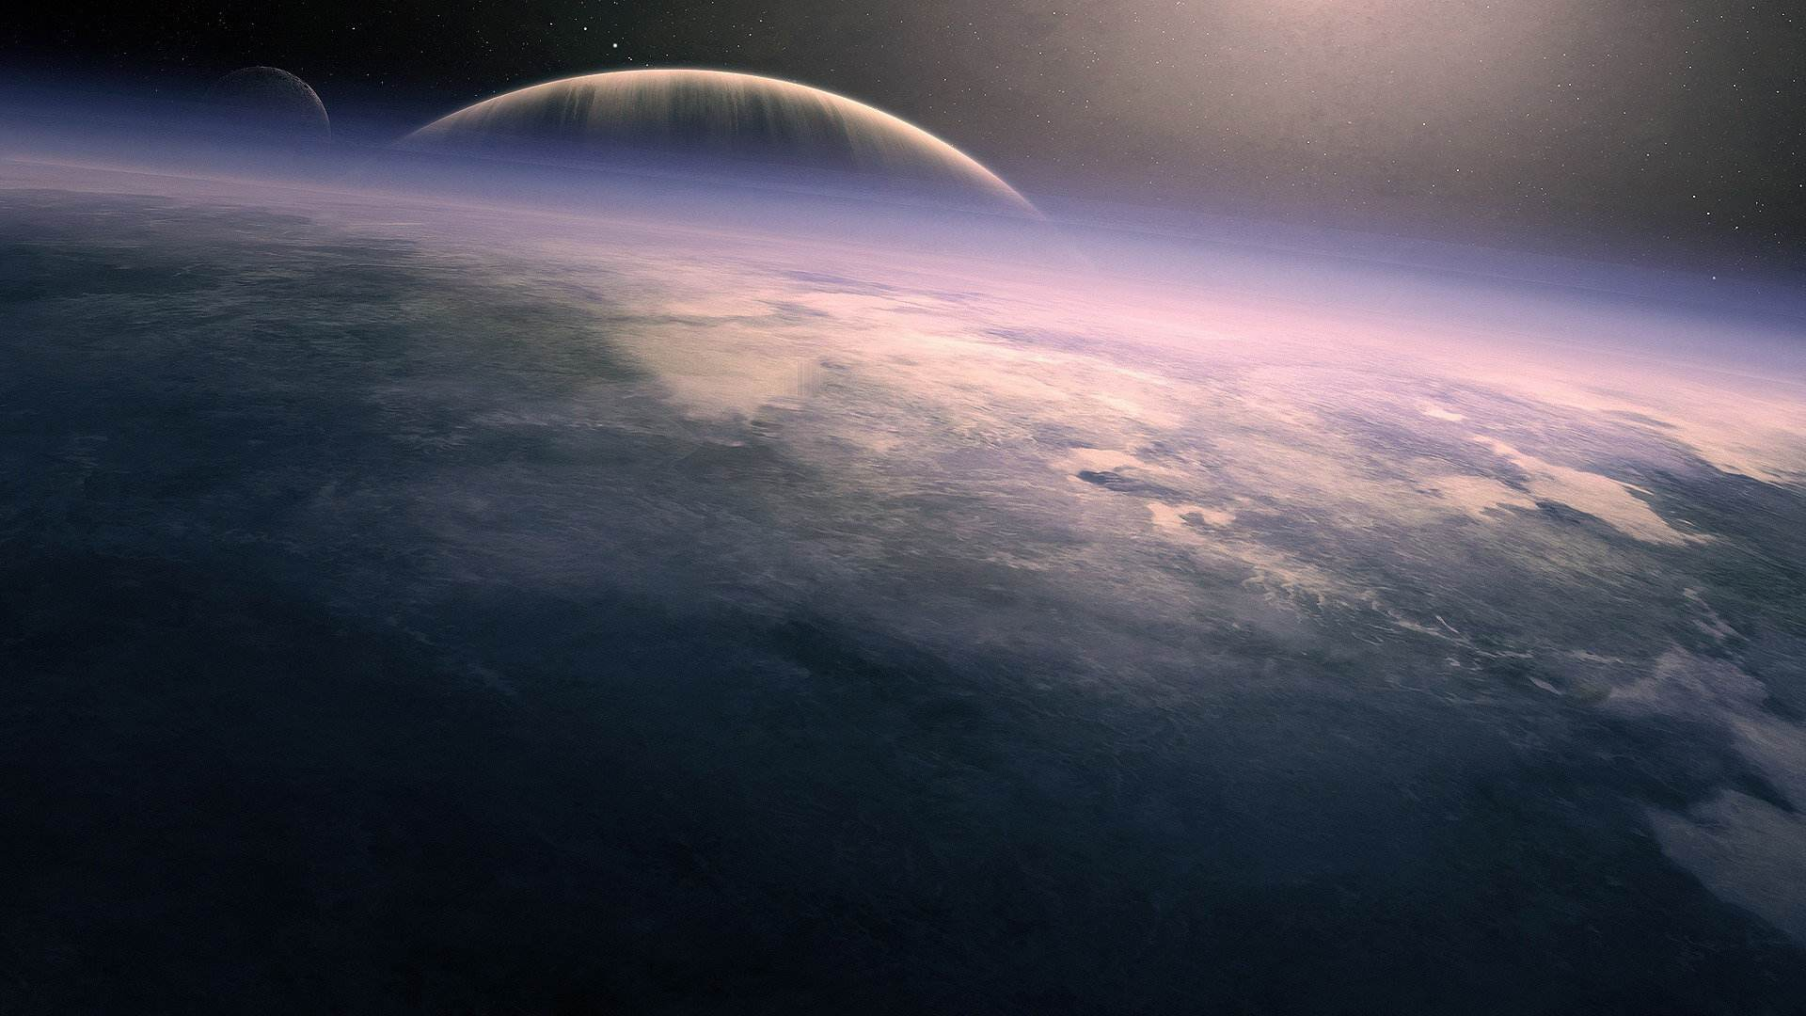
Symphony of Science
A Wave of Reason
PEP M5U1: GREAT SCIENTISTS
余颖诗-华南师范大学外文学院

Slide 2
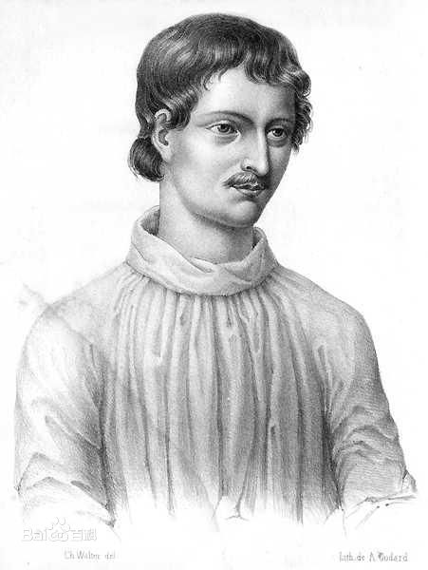
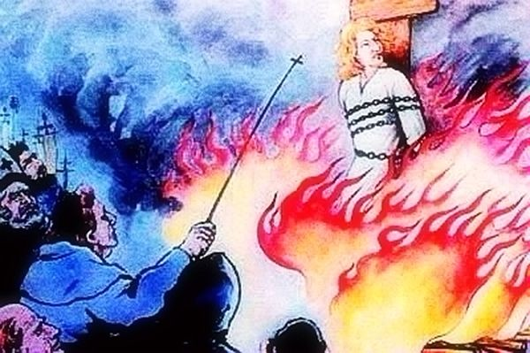
A Wave of Reason
Great Scientists
If we are not able to ask skeptical questions
To be skeptical of those in authority
Science is more than a body of knowledge
thinking
It's a way of
Then we're up for grabs
A way of skeptically interrogating
the UNIVERSE
布鲁诺

Slide 3
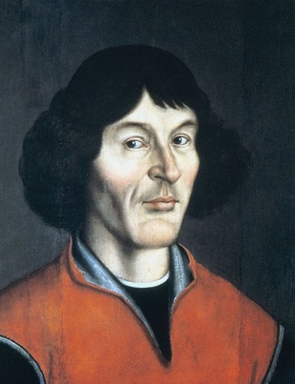
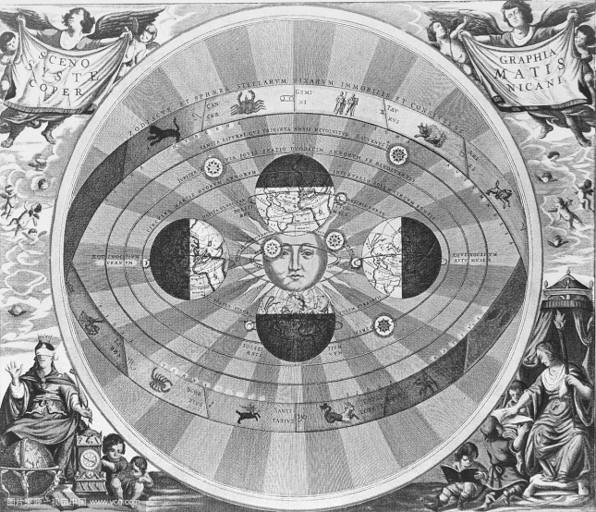
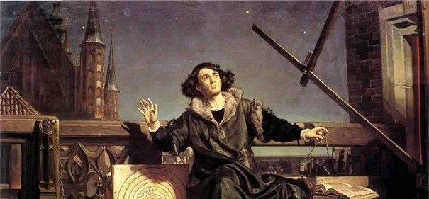
A Wave of Reason
Great Scientists
In all of science
we're looking for a balance
between data and theory
You don't have to delude yourself with Iron Age fairy tales
哥白尼

Slide 4
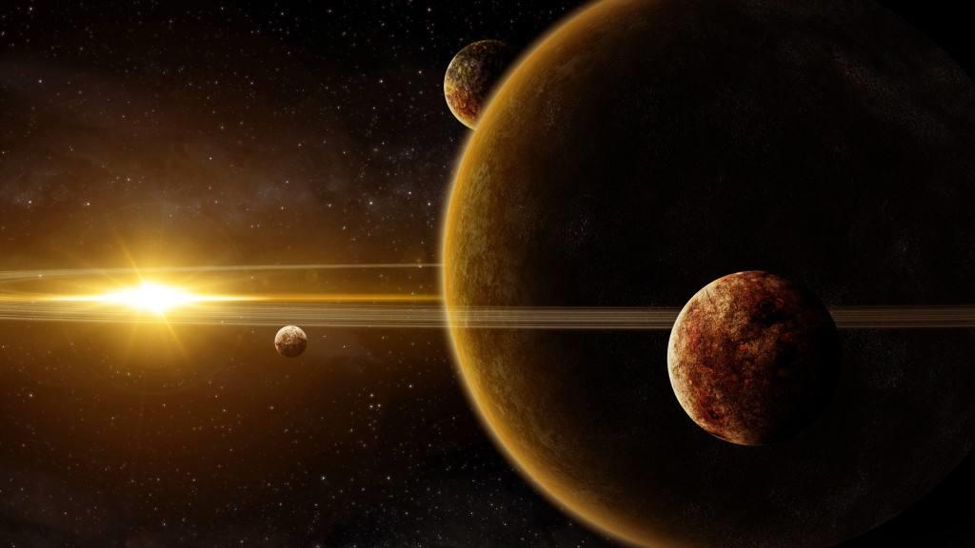
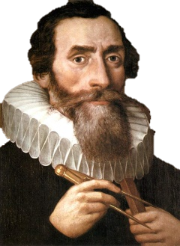
A Wave of Reason
Great Scientists
The real world, as it actually is,
Is not evil, it's remarkable
And the way to understand the physical world is to use science
The same spiritual fulfillment
That people find in religion
Can be found in science
By coming to know
If you will, the mind of God
开普勒

Slide 5
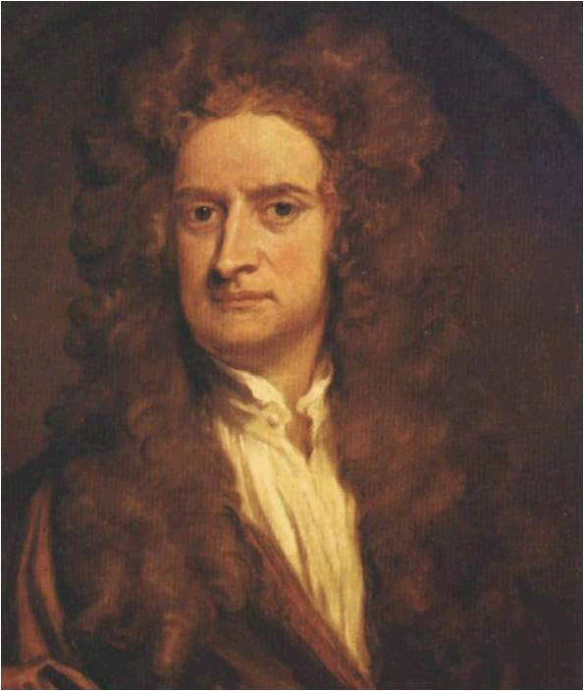
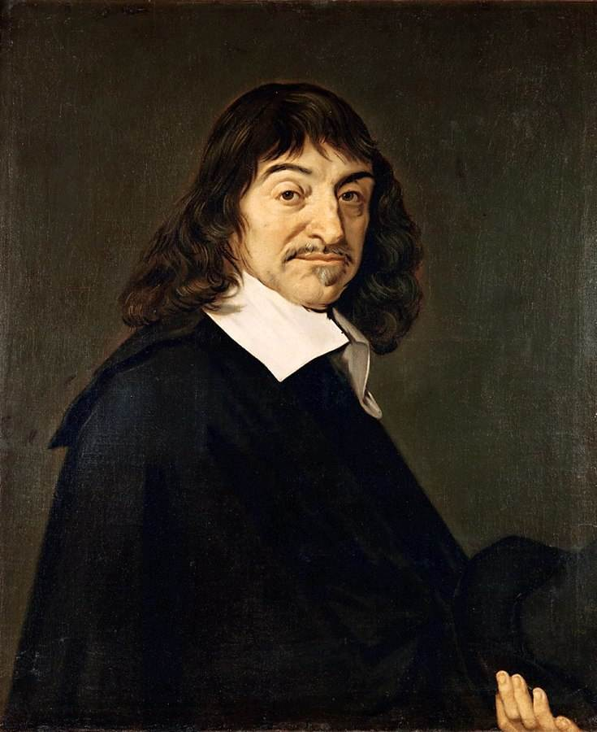
A Wave of Reason
笛卡尔
笛卡尔
Great Scientists
There is a new wave of reason
Sweeping across
America, Britain, Asia, Europe, Australia
South America, the Middle East and Africa
There is a new wave of reason
Where superstition had a firm hold
Teach a man to reason
And he'll think for a lifetime

Slide 6
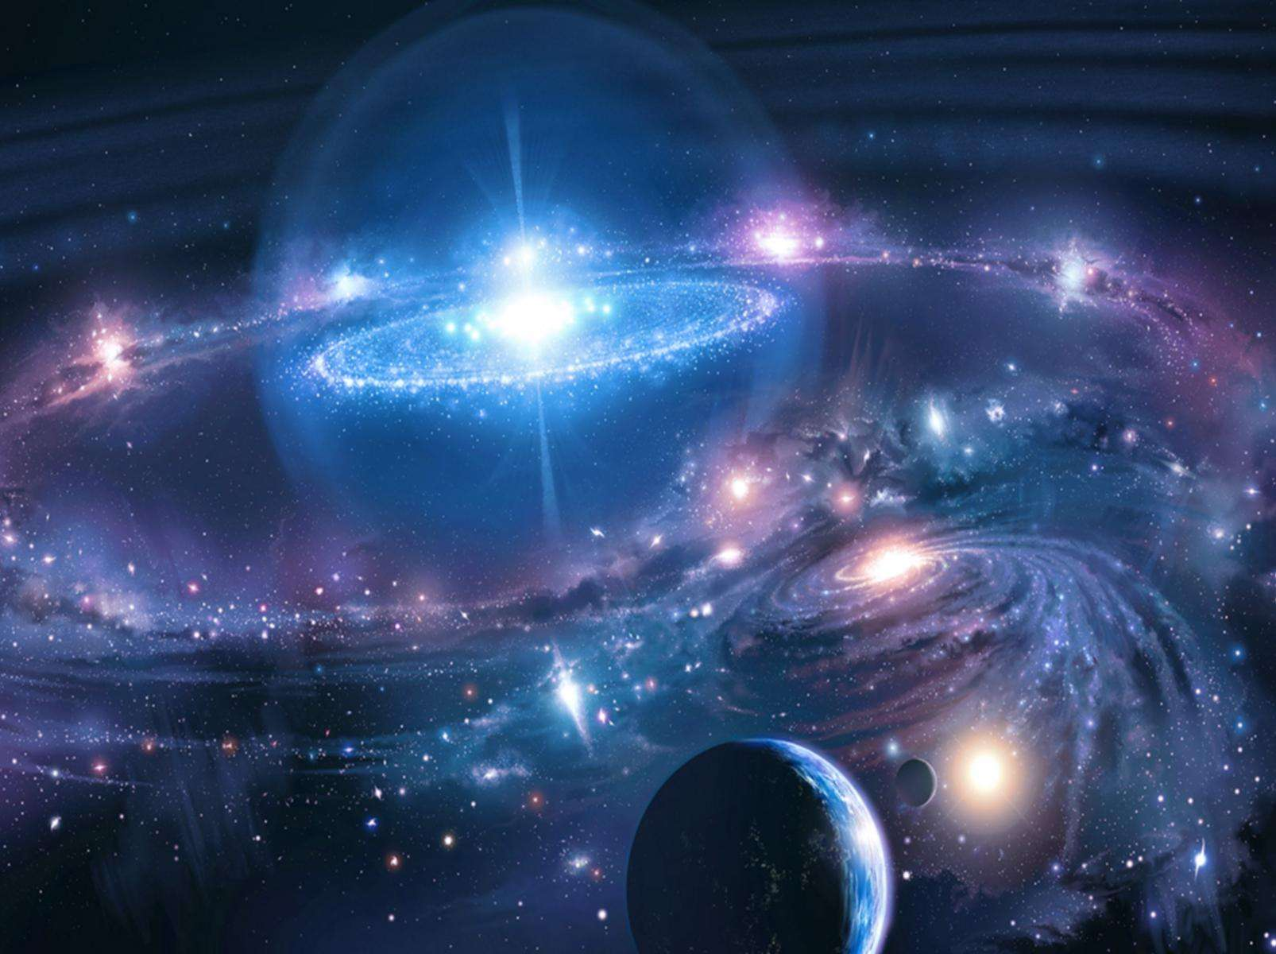

Slide 7
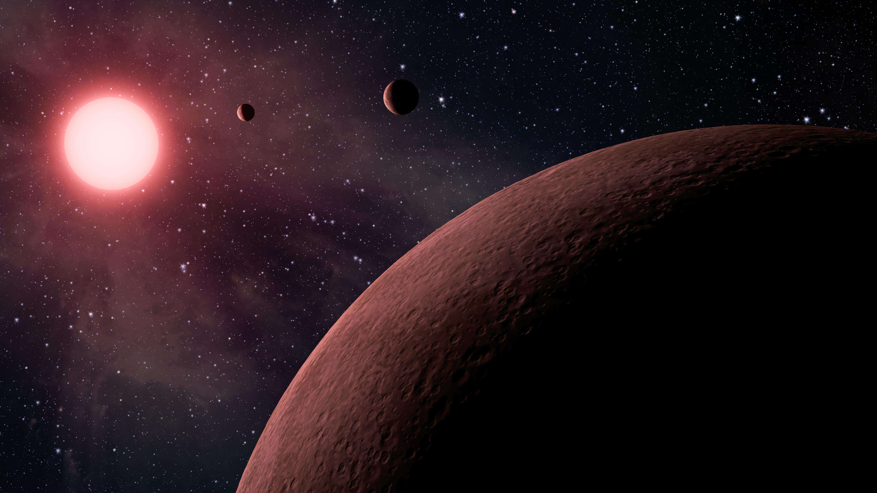

Slide 8
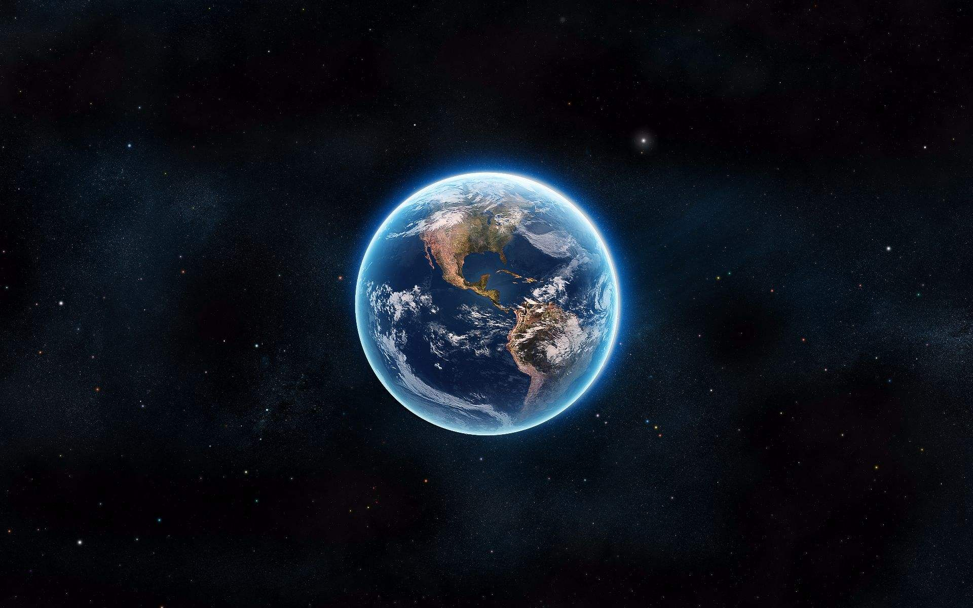

Slide 9
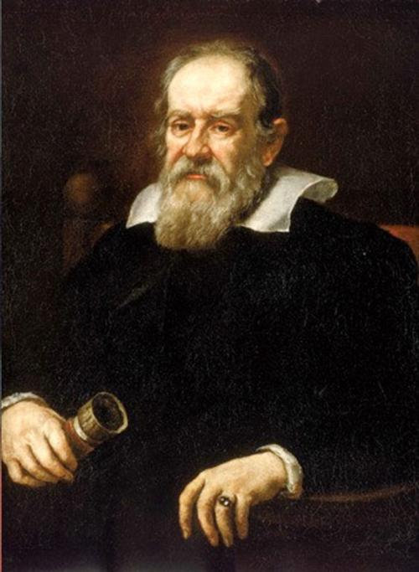
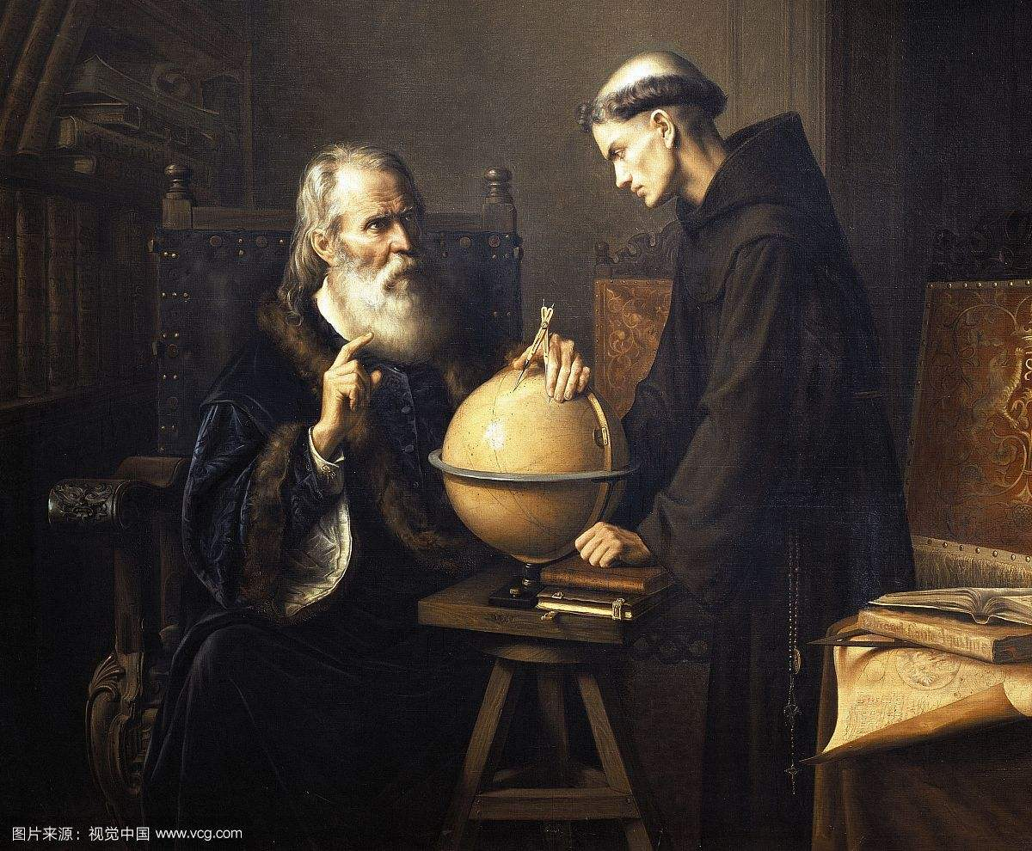
伽利略
A Wave of Reason
Great Scientists
Cosmology brings us face to face
with the deepest mysteries
wiith questions that were once treated
only in religion and myth
The desire to be connected
with the cosmos
Reflects a profound reality

Slide 10
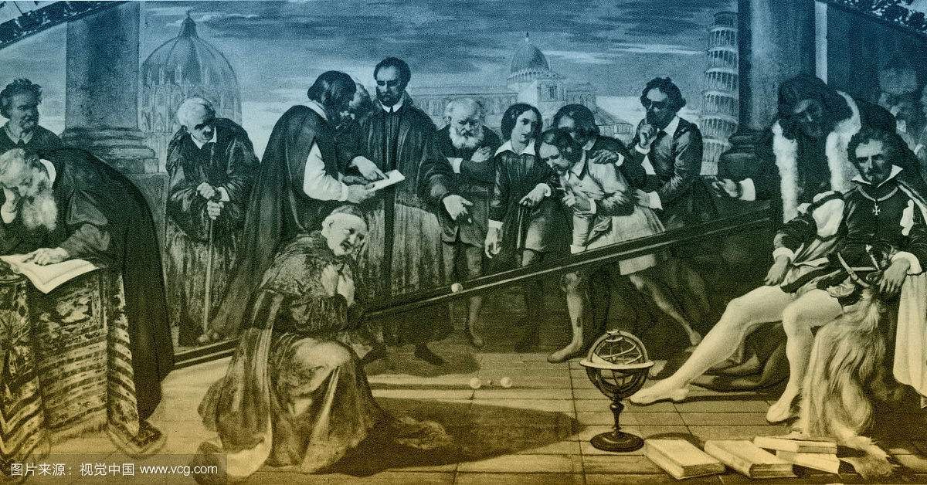
A Wave of Reason
But we are connected; not in the trivial ways
That Astrology promises, but in the deepest ways
Great Scientists

Slide 11
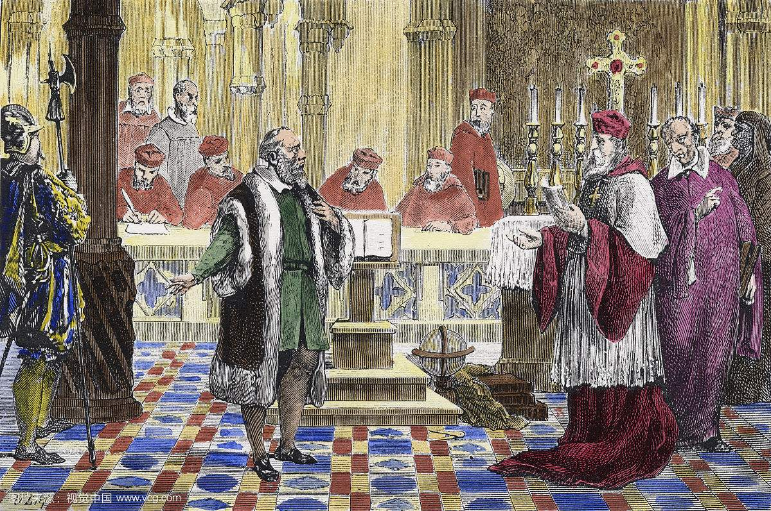
A Wave of Reason
Great Scientists
I can't believe the special stories that have been made up
About our relationship to the universe at large
Look at what's out there; it isn't in proportion

Slide 12
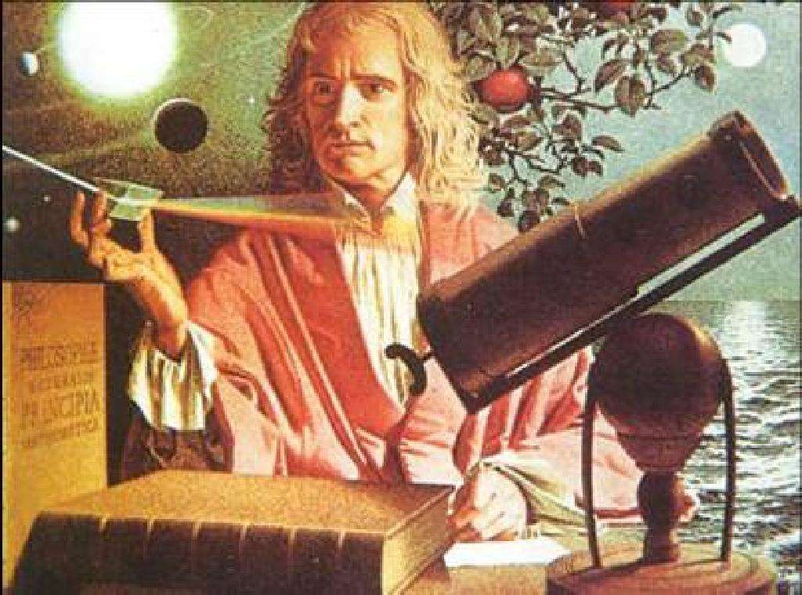
A Wave of Reason
Great Scientists
Science is more than
a body of knowledge
It's a way of thinking
A way of skeptically
Interrogating the universe
牛顿

Slide 13
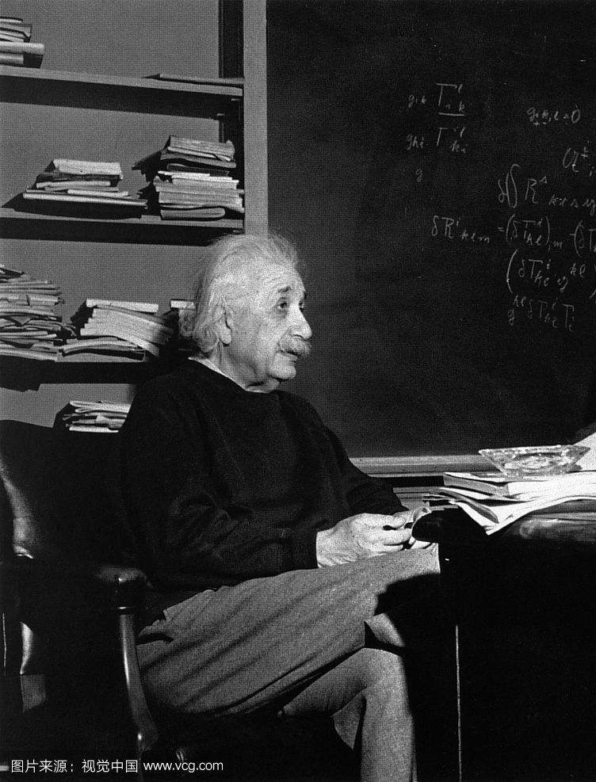
爱因斯坦
A Wave of Reason
Great Scientists
There is a new wave of reason
Where superstition had a firm hold
Teach a man to reason
And he'll think for a lifetime
There is a new wave of reason
Sweeping across America, Britain, Europe, Australia
South America, Asia, the Middle East and Africa

Slide 14
Thanks for watching

