Slide 1
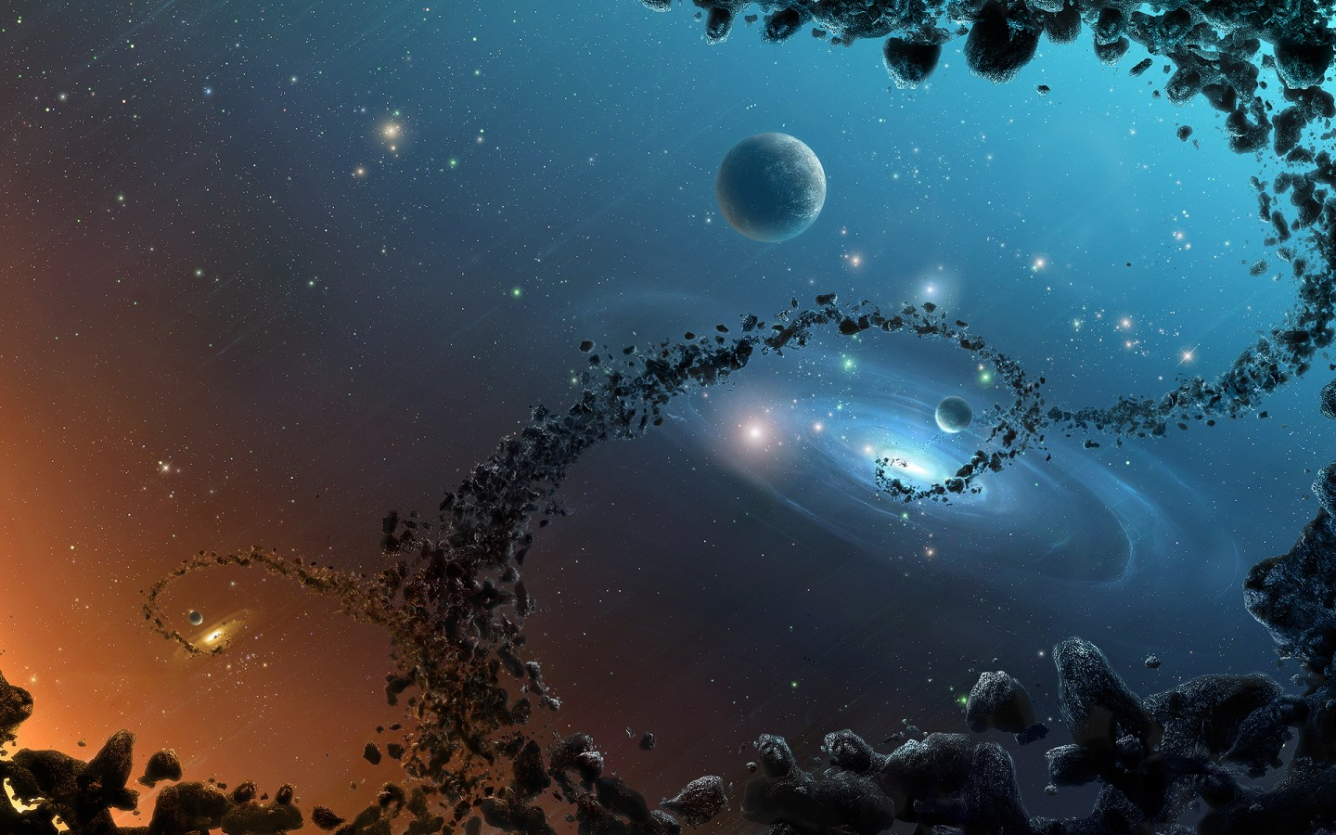
教材：人教版M5U1 Great Scientists
音乐：Shoulders of giants
作者：张思雨
单位：华南师范大学外文学院

Slide 2
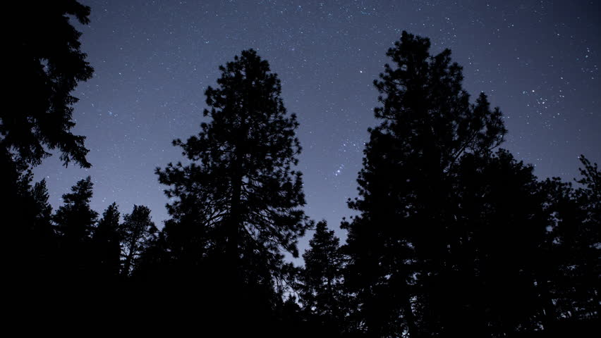
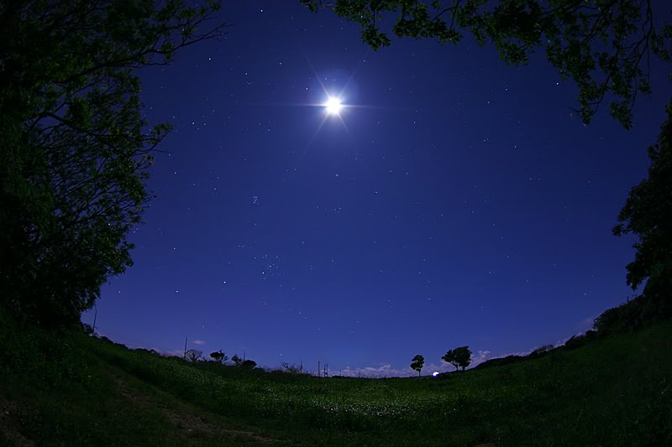
It was a calm and cloudless night but it was all still a blur

Slide 3
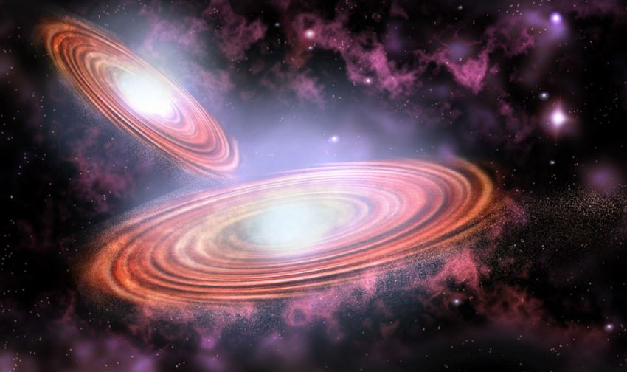
A shaking of
our Universe
was just about to occur

Slide 4
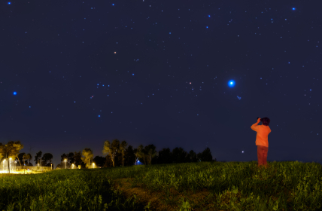
It was
Summertime…
1609

Slide 5
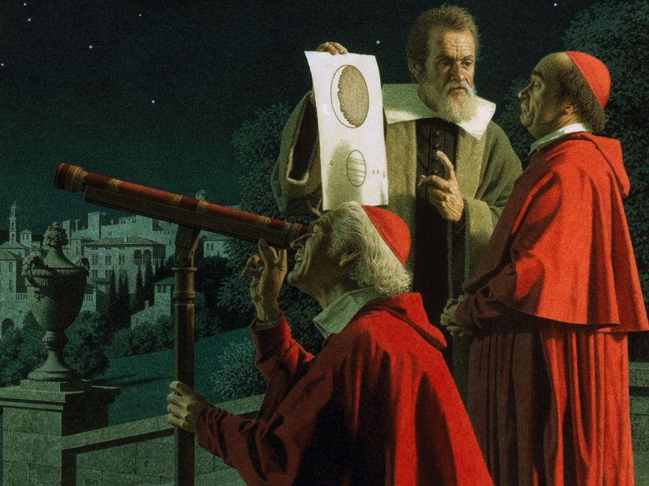
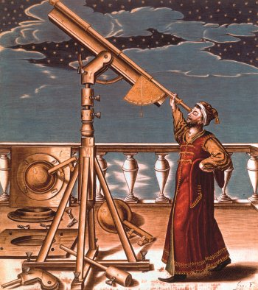
when Galileo used his telescope for the very first time

Slide 6
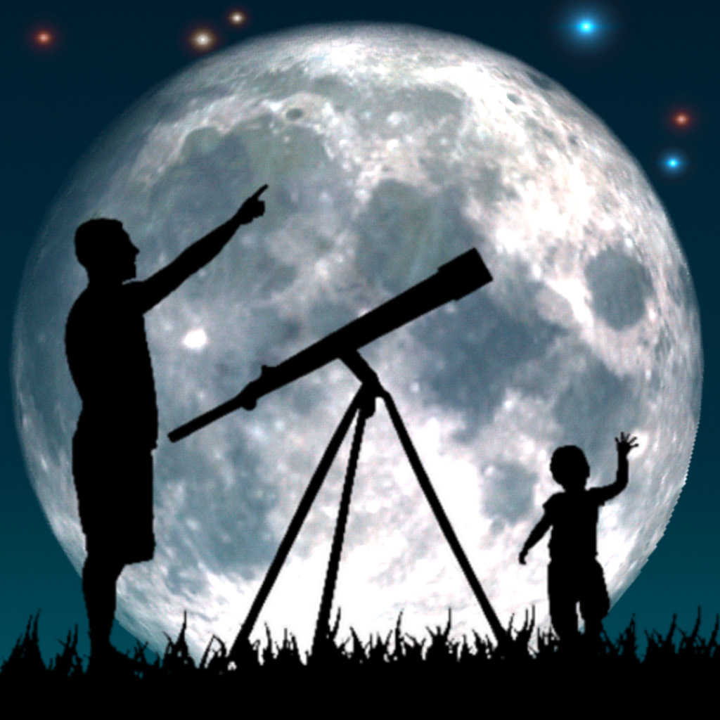
And he saw mountains & craters
on the moon

Slide 7
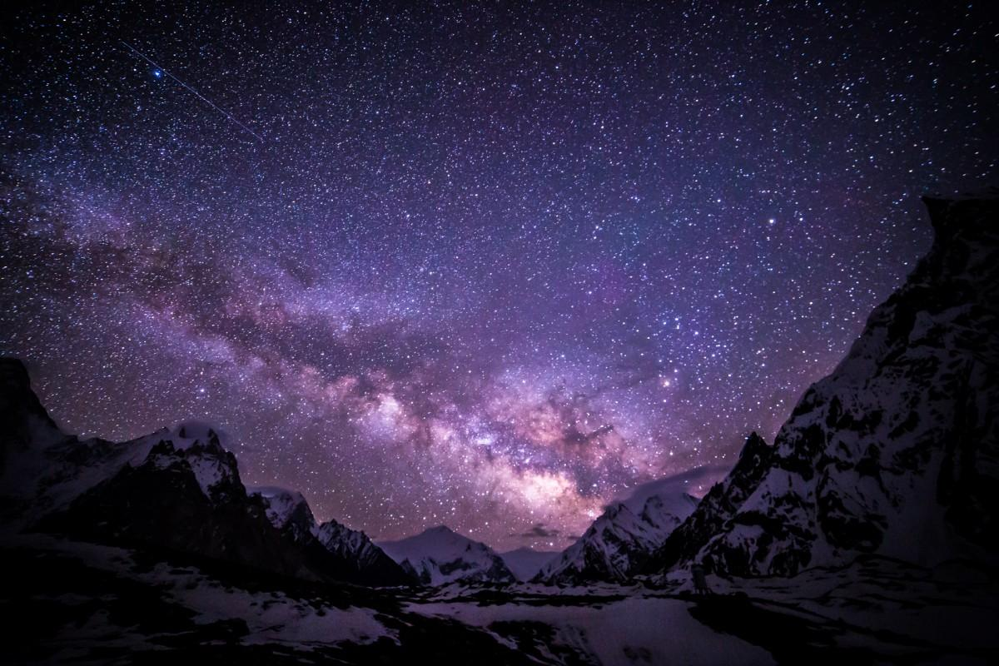
And a
Milky Way
with thousands of stars

Slide 8
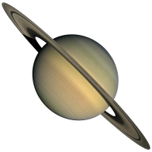
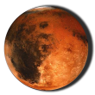
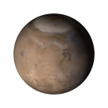
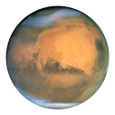
And he saw Jupiter, with four tiny moons

Slide 9
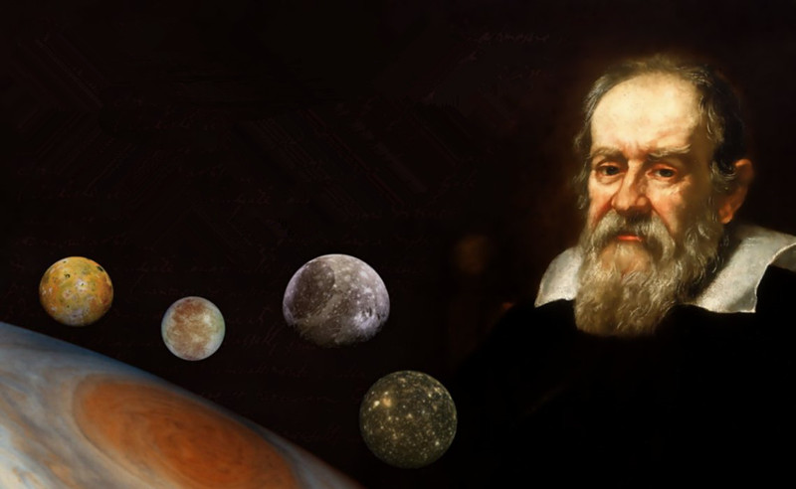
He was the only man on Earth that night who knew

Slide 10
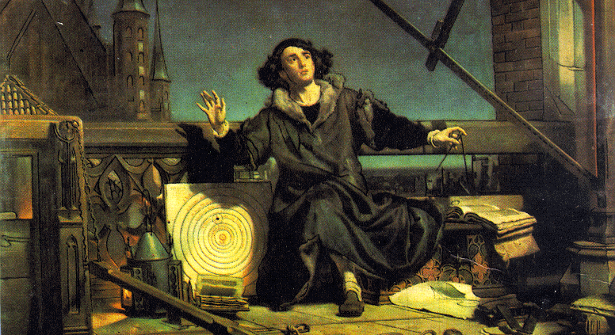
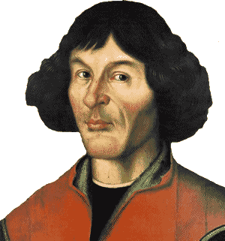
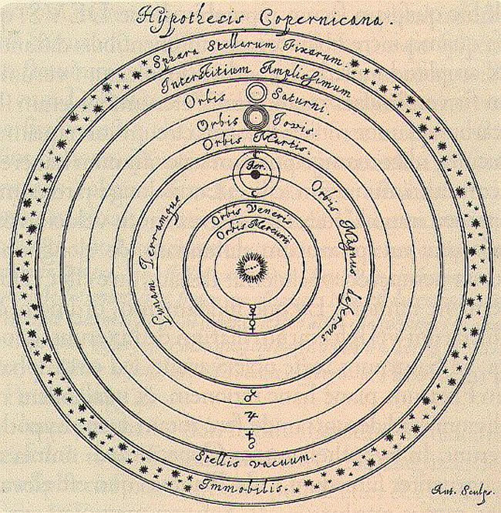
That Copernicus was right come outside with me tonight

Slide 11
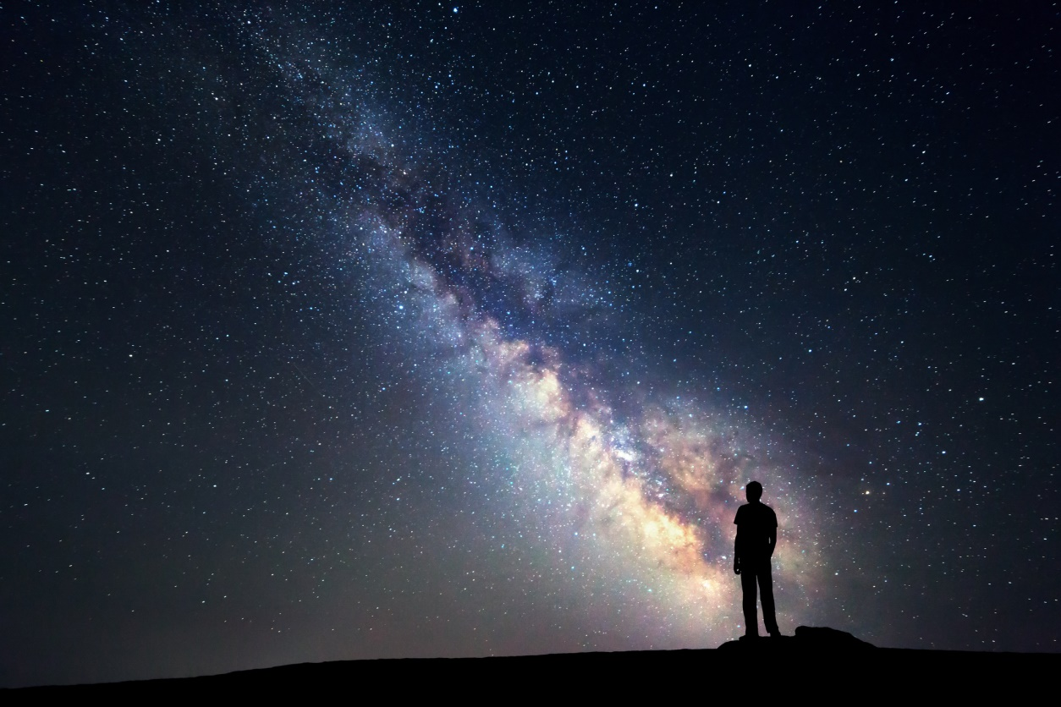
And I can show you wonders of the world to surprise and delight

Slide 12
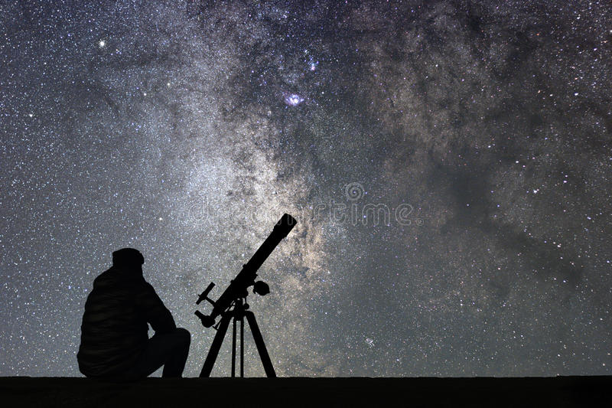
I've got
my telescope with me
just wait until you see

Slide 13
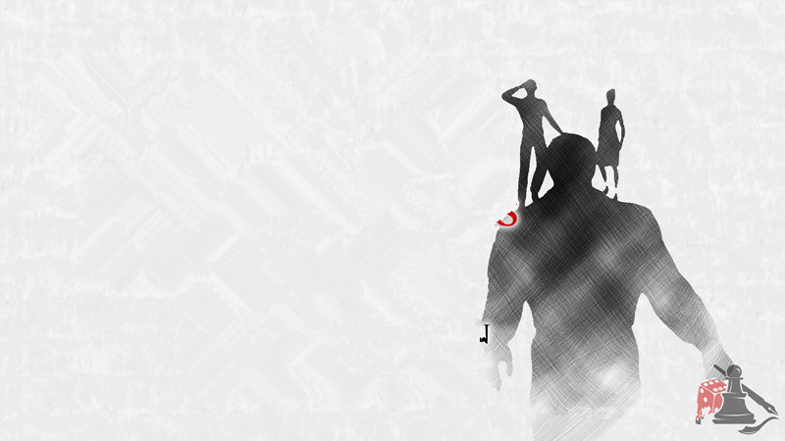
That on the
Shoulders of Giants....
... will see beyond!

Slide 14
Thank You！

