Slide 1
Great Scientists
人教版 九年级 Module 5 Unit 1
华南师范大学外文学院 周奕莹

Slide 2
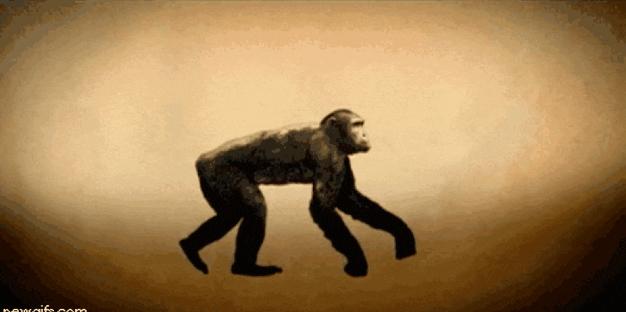

Slide 4
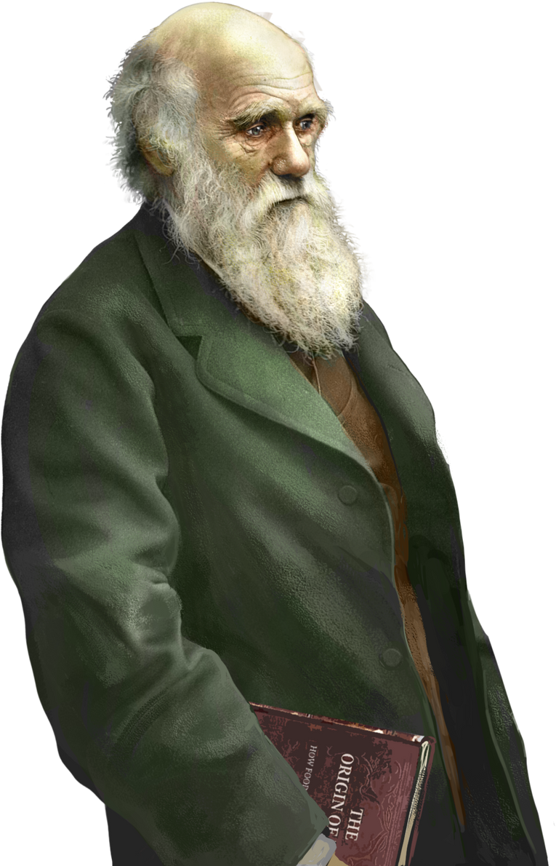
Charles Robert Darwin
查尔斯·罗伯特·达尔文
always trying this
always get stuck on
In me the scientist

Slide 5
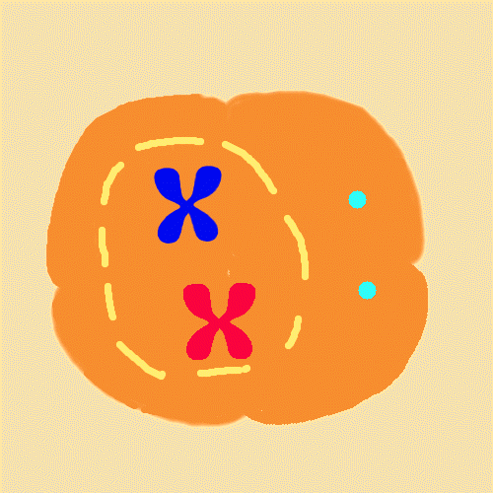
We've gotta live on science alone now
Analysis and freaky sensitivity
I try to live on science alone now

Slide 6
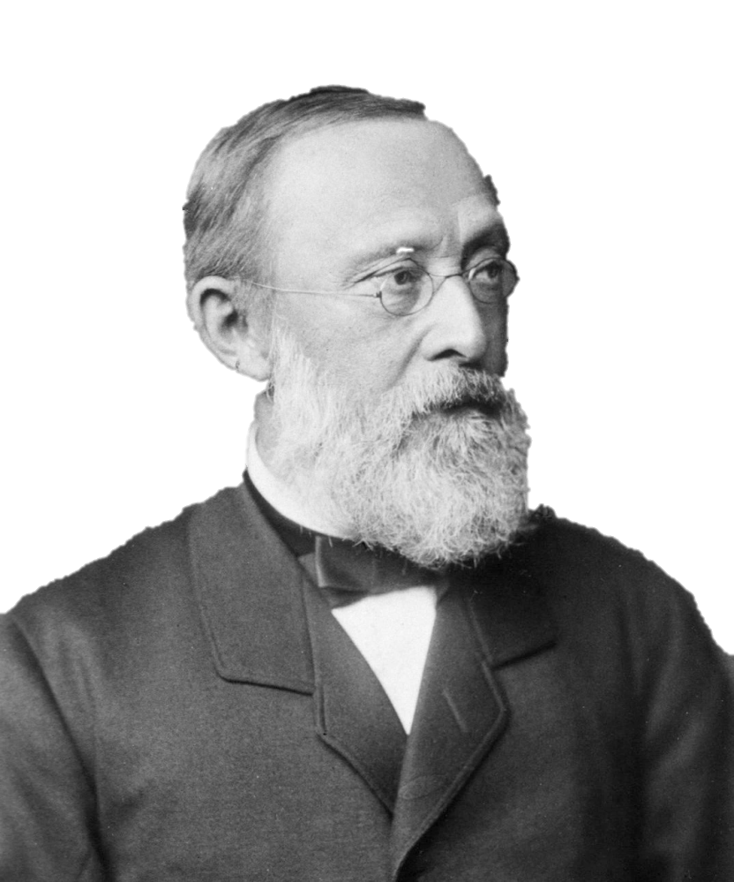
Walther Flemming
华尔瑟·弗莱明
I am a scientist
I am a scientist
I am a scientist

Slide 7
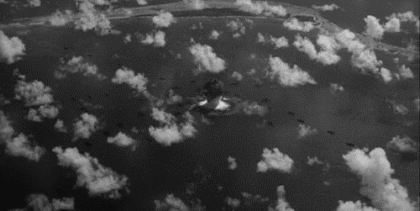
We've gotta live on science alone now

Slide 8
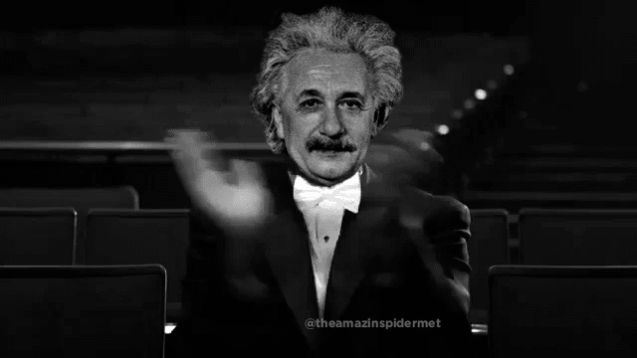
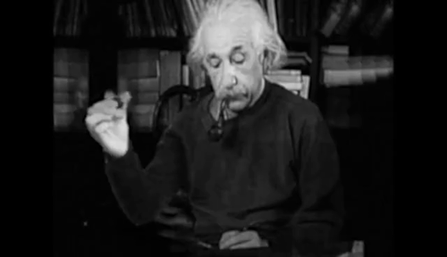

Slide 9
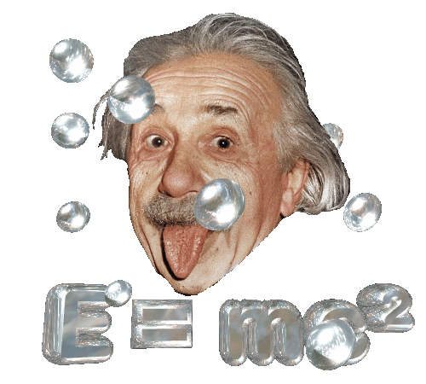
Albert
Einstein
阿尔伯特·爱因斯坦
We've gotta live on science alone now
Religiously, I'm speaking on the science 'cause

Slide 10
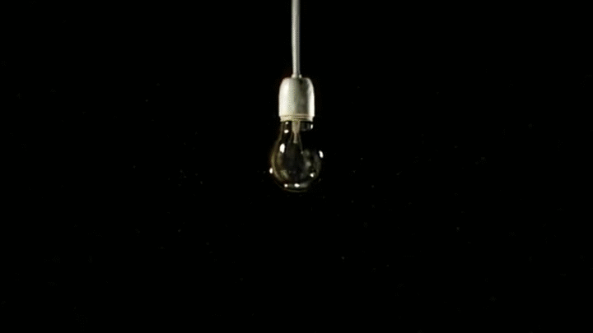
I tell you what mathematically I'm having it

Slide 11
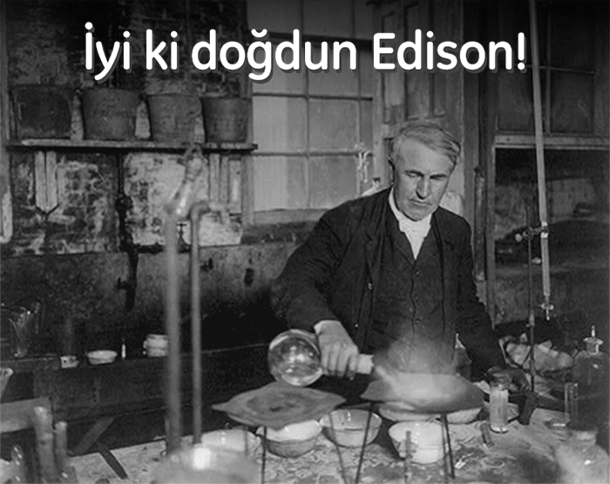
I wanna live on science alone now

Slide 12
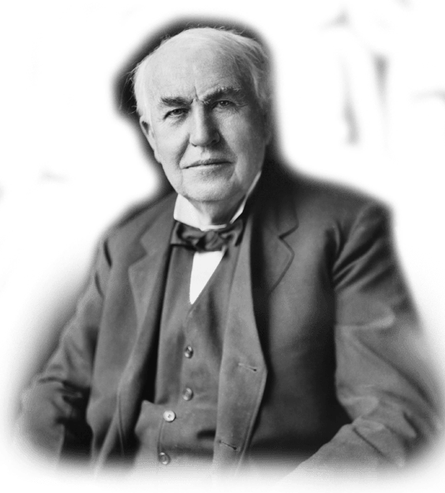
Thomas Alva Edison
托马斯·阿尔瓦·爱迪生
I am a scientist
I am a scientist
I am a scientist

Slide 13
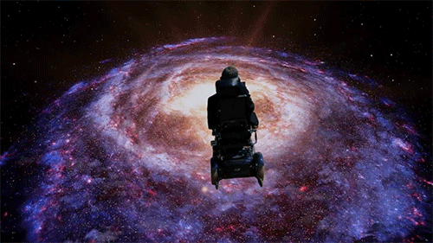
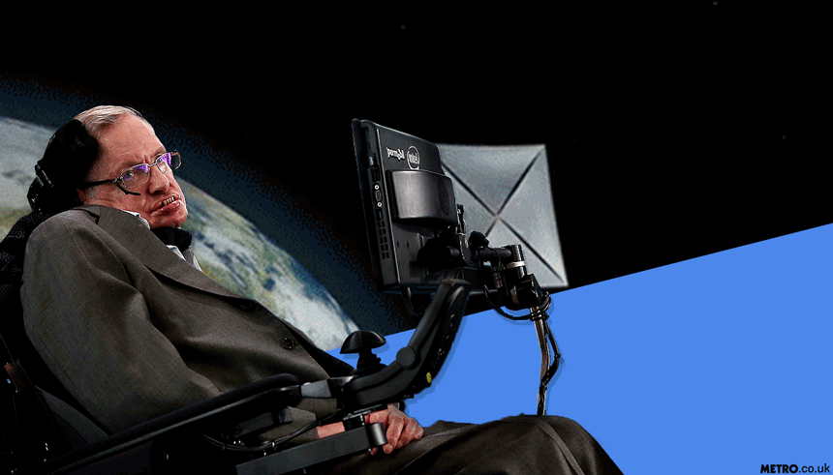
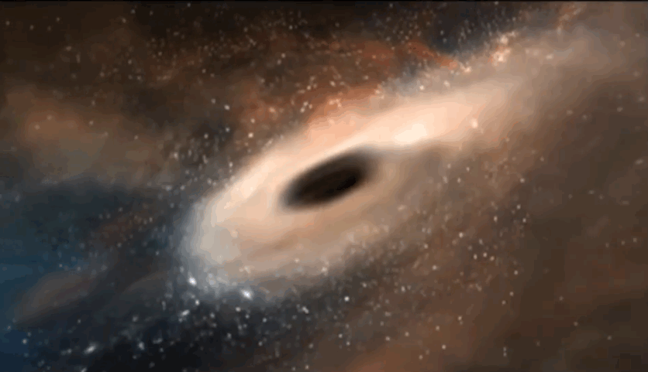
We've gotta live on science alone now

Slide 14
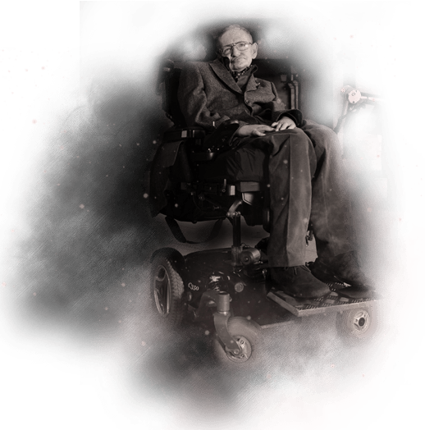
Stephen William Hawking
斯蒂芬·威廉·霍金

Slide 15
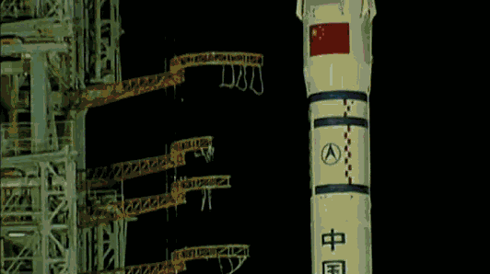
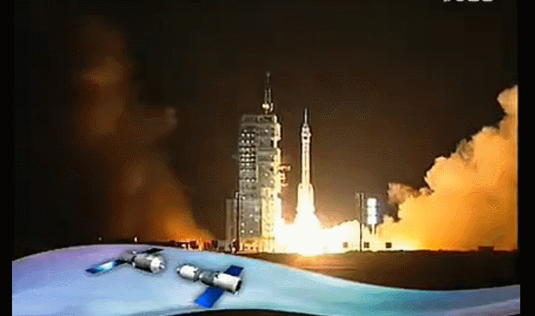
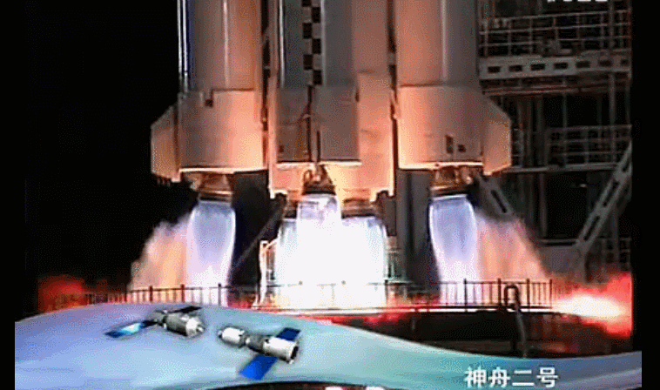
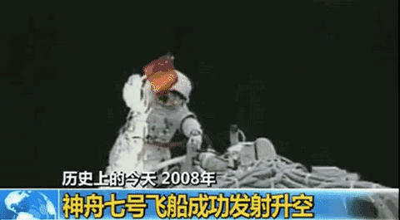
always trying this
I try to live on science alone now
In me the scientist
always get stuck on
Analysis and freaky sensitivity

Slide 16
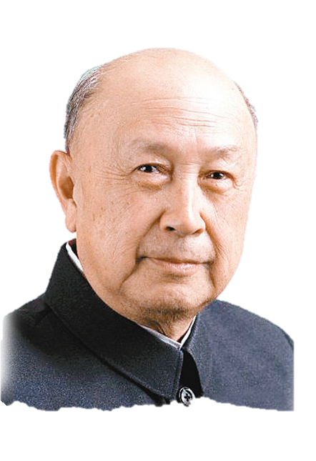
Qian Xuesen
钱学森
We've gotta live on science alone now
I am a scientist
I am a scientist
I am a scientist

Slide 17
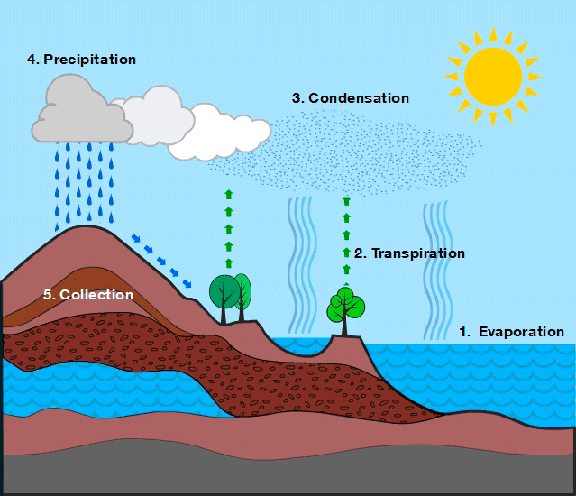
I wanna live on science alone now

Slide 18
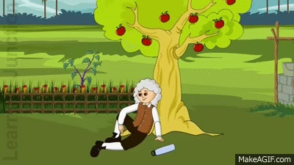
We've gotta live on science alone now

Slide 19
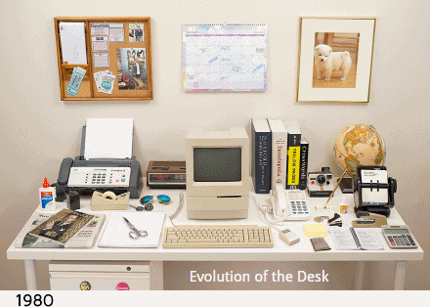

Slide 20
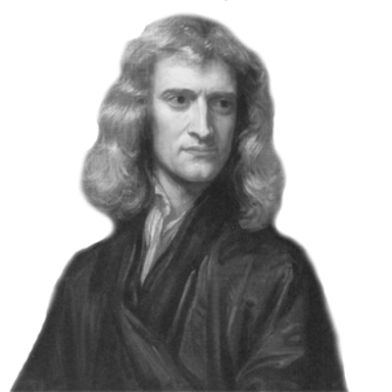
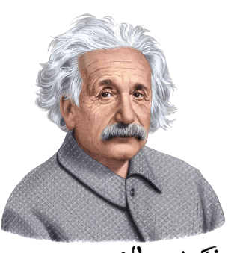
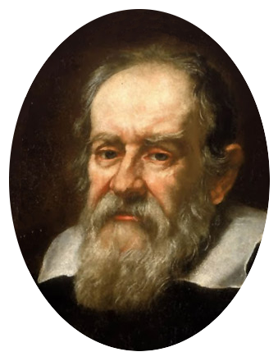
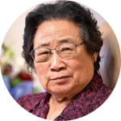
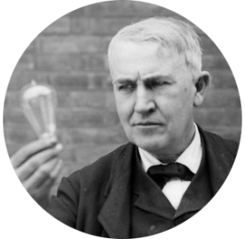
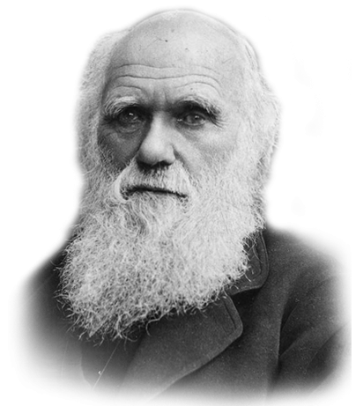
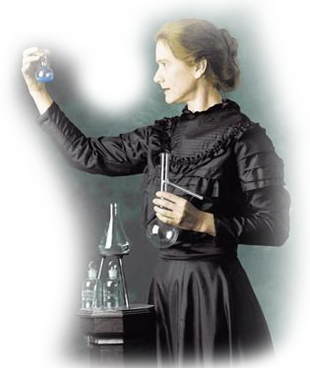
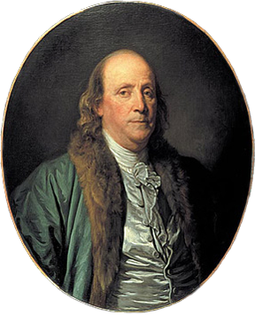
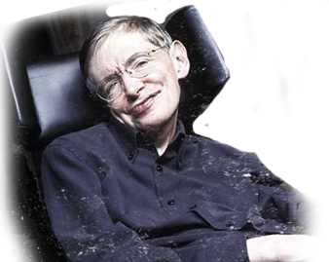
I am a scientist
I am a scientist
I am a scientist
I am a scientist
I am a scientist

Slide 21
THANK YOU
http://chn.docer.com/

