Slide 1

Land of Hope and Glory
人教版高中英语必修五 Unit 2 The United Kingdom
华南师范大学外文学院 英师5班 李锦芳 20150201125

Slide 2
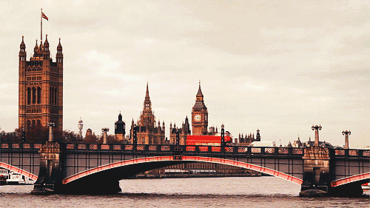

Slide 3


Slide 4
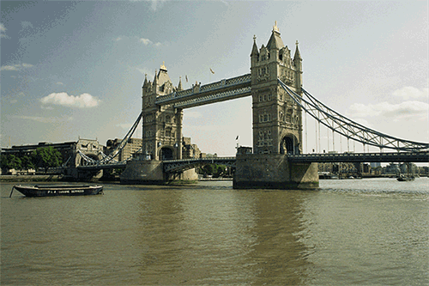

Slide 5
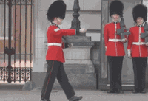

Slide 6
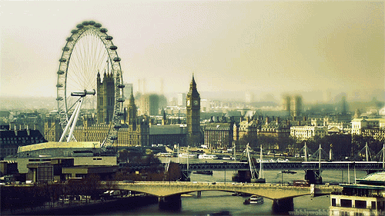
Dear land of hope

Slide 7

Thy hope is crowned.

Slide 8

God made thee mightier yet !

Slide 9
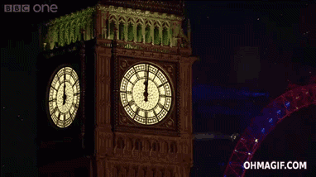
On Sov'ran brows

Slide 10

Beloved, renowned.

Slide 11

Once more thy crown is set.

Slide 12

Thine equal laws

Slide 13
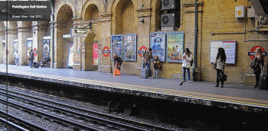
By freedom gained.

Slide 14

Have ruled thee well and long.

Slide 15
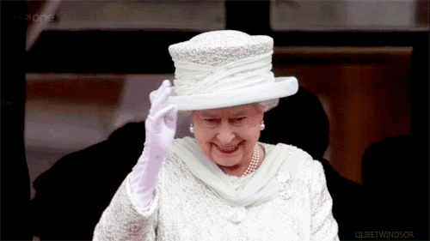
Have ruled thee well and long.

Slide 16

Have ruled thee well and long.

Slide 17

By freedom gained, by truth maintained.

Slide 18


Slide 19
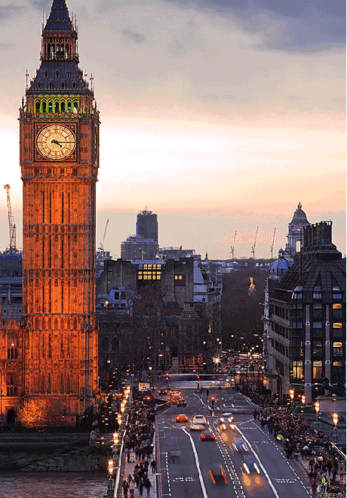
Thine empire shall be strong.

Slide 20


Slide 21
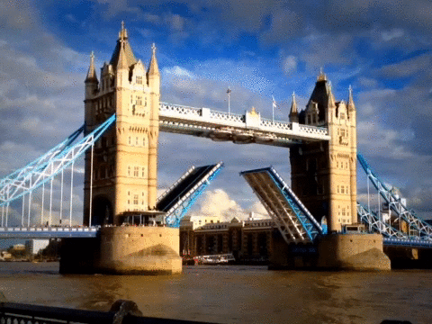

Slide 22

Land of hope and glory

Slide 23

Mother of the free.

Slide 24
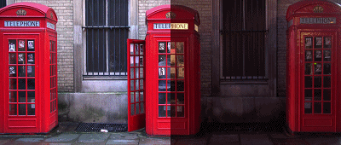
How shall we extol thee ?

Slide 25
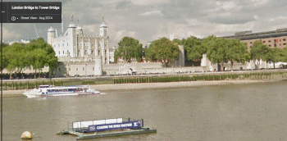
Who are born of thee ?

Slide 26

Wider still and wider shall thy bounds be set ?

Slide 27
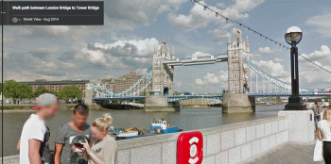
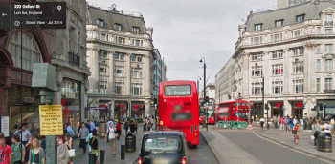
God, who made thee mighty ?

Slide 28



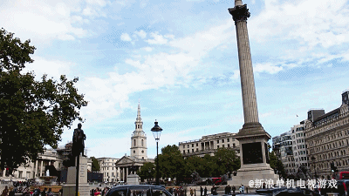
Made thee mightier yet ?

Slide 29
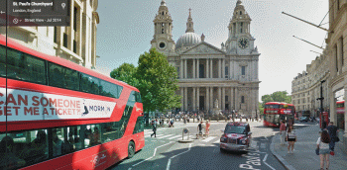
God, who made thee mighty ?

Slide 30
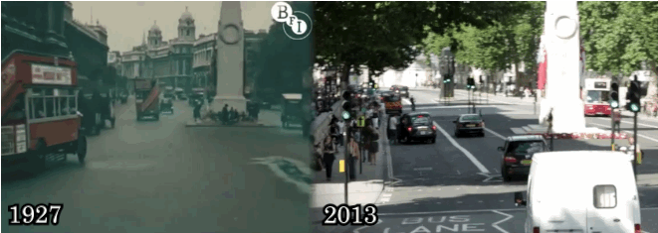
Made thee mightier yet ?

Slide 31

Land of hope and glory

Slide 32
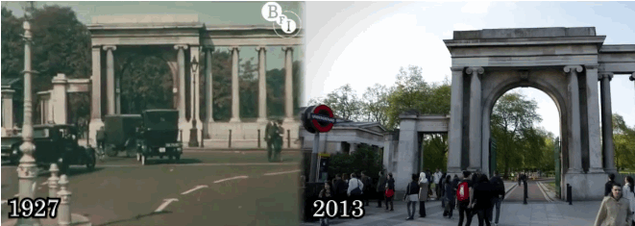
Mother of the free.

Slide 33

How shall we extol thee ?

Slide 34
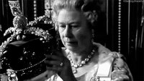
Who are born of thee ?

Slide 35
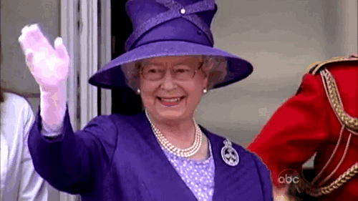
Wider still and wider

Slide 36
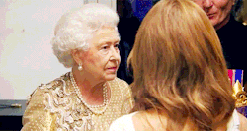
Wider still and wider

Slide 37
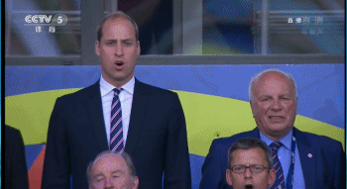
Wider still and wider

Slide 38
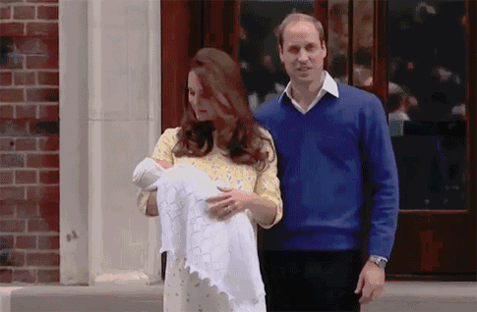
Shall thy bounds be set ?

Slide 39
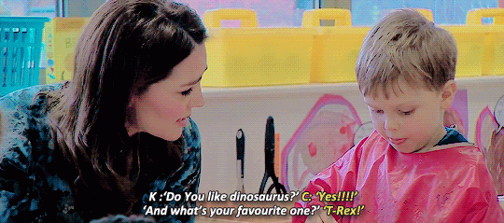
Shall thy bounds be set ?

Slide 40

God, who made thee mighty ?

Slide 41
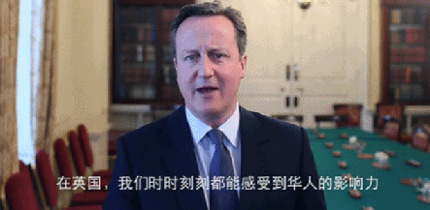
God, who made thee mighty ?

Slide 42
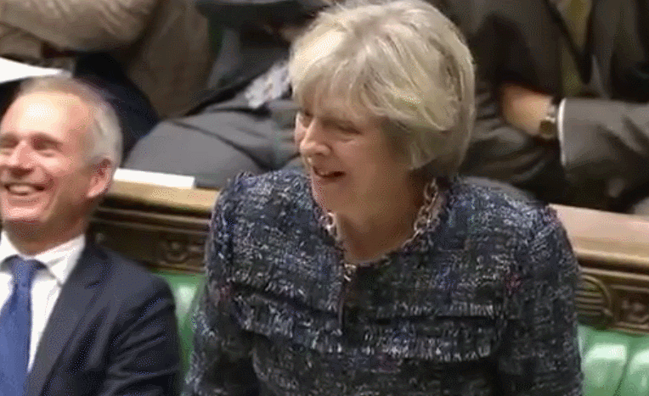

Slide 43

Make thee mightier yet ?

Slide 44
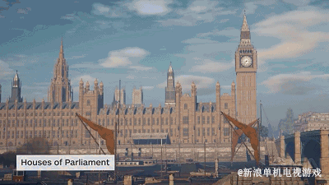
God, who made thee mighty ?

Slide 45

Make thee mightier yet ?

Slide 46
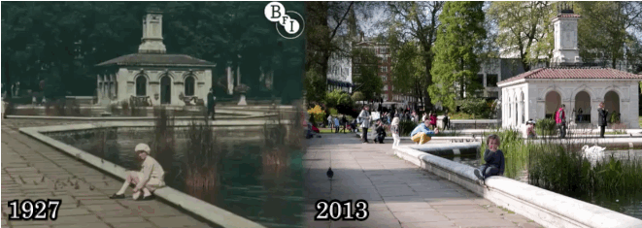

Slide 47


Slide 48
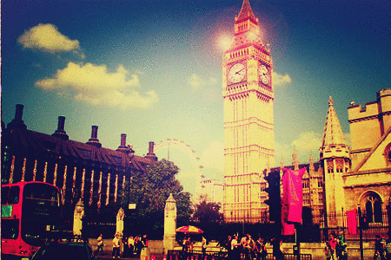

Slide 49


Slide 50


Slide 51


