Slide 1
Unit 3 Life in the future
制作者：韦苗苗
制作单位：华南师范大学外国语言文化学院

Slide 2
Are you ready?

Slide 3
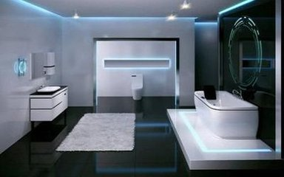
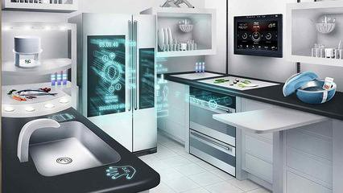
Are we in the future?Living in the future?

Slide 4
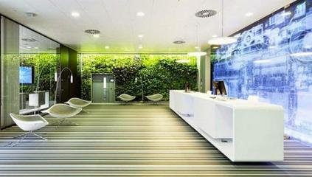
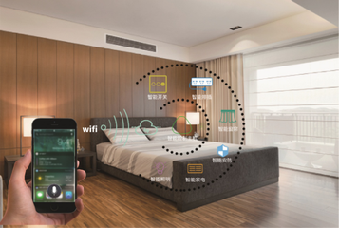
Are we in the future? Living in the future?

Slide 5
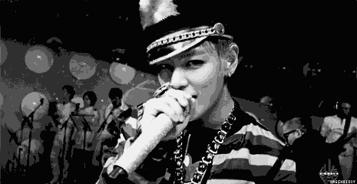
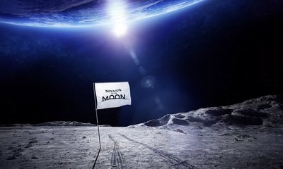
By the time we be singing once upon it
Fiends and dudes bought the tickets straight to the moon

Slide 6
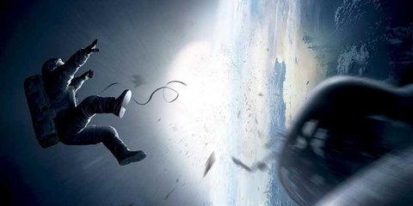
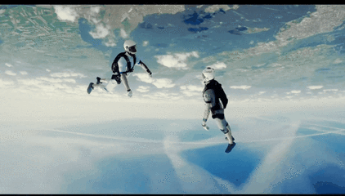
Now it's easy to float like I've flied with you
It doesn't feel like gravity is wanted

Slide 7
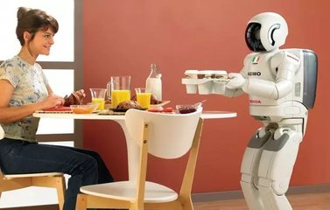
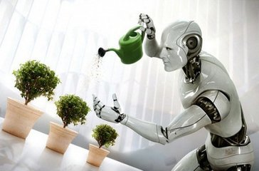
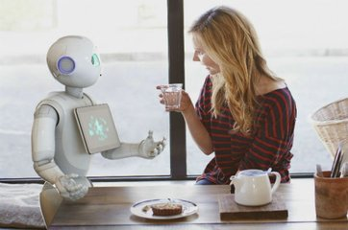
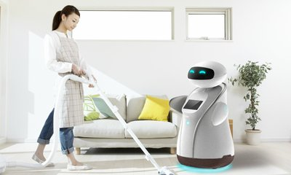

Slide 8
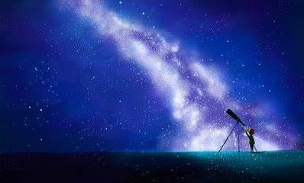
Your momma said that I like imagination
Hey, there are some stars in your eyes before we land on the moon

Slide 9
Now we're floating in that inner stellar nation
I like to put you something perfect,fine and true

Slide 10
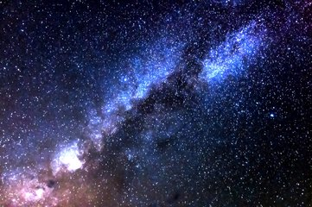
If we stumble in the dark, light up shows us who we are

Slide 11
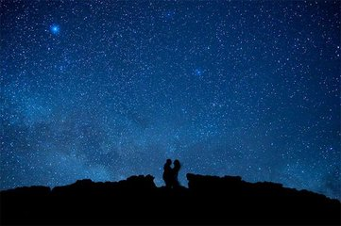
Oh, the language that you speak to me into ano---

Slide 12
Are we in the future? Living in the future? Are we in the future? Living in the future?

Slide 13
Are we in the future? Living in the future? Are we in the future? Living in the future?

