Slide 1
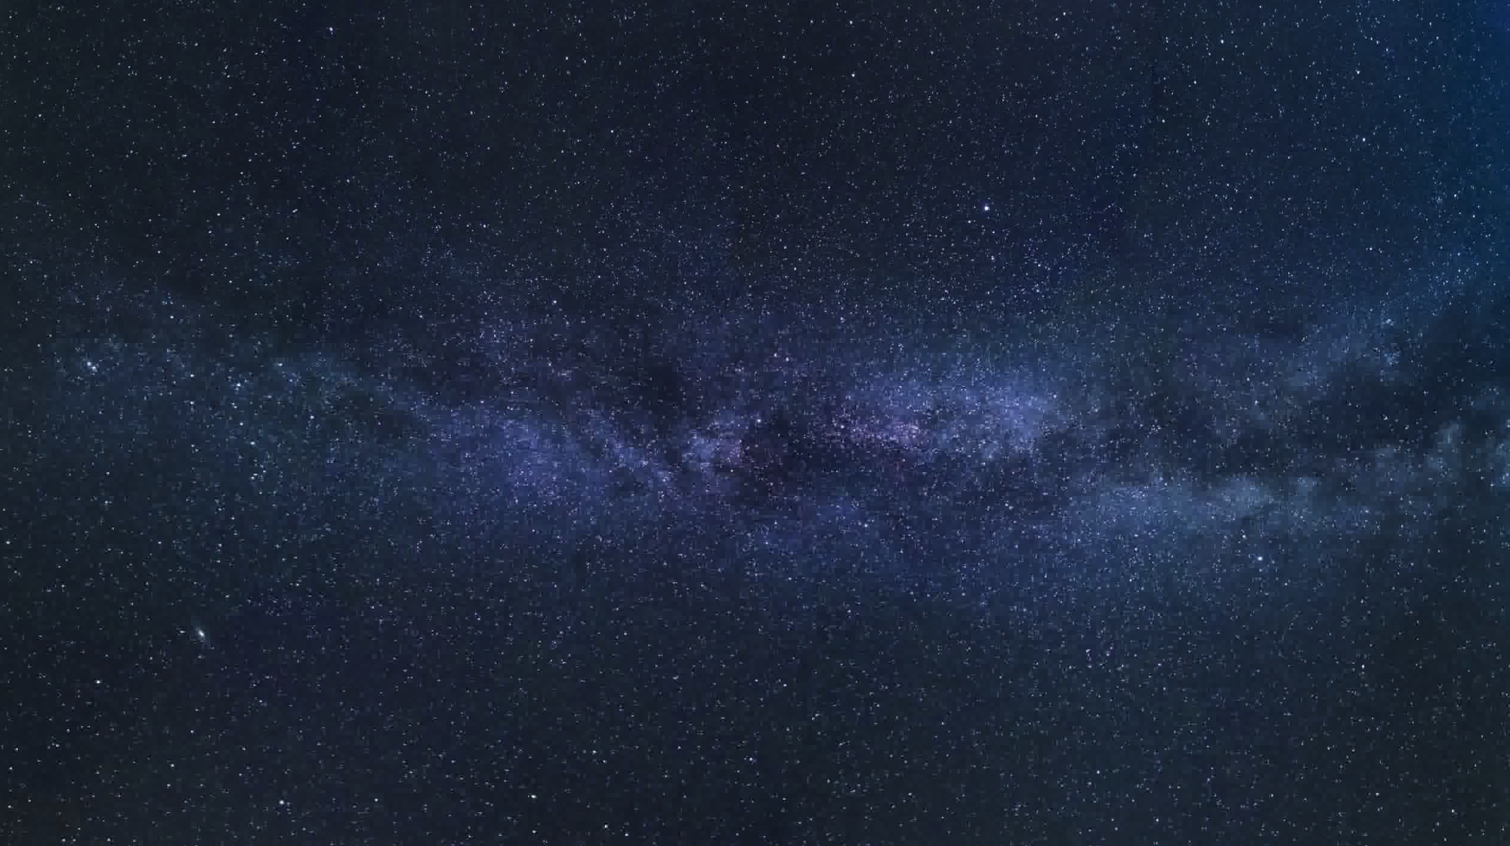
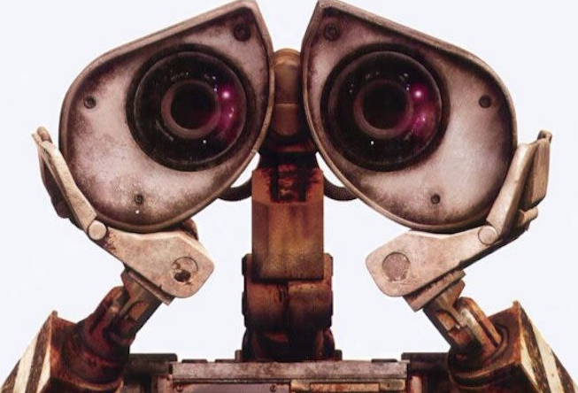
Prod. 许永倩 20150201106 英师五班

Slide 2
Down to Earth
—— WALL·E
Singer:
Peter Gabriel

Slide 3
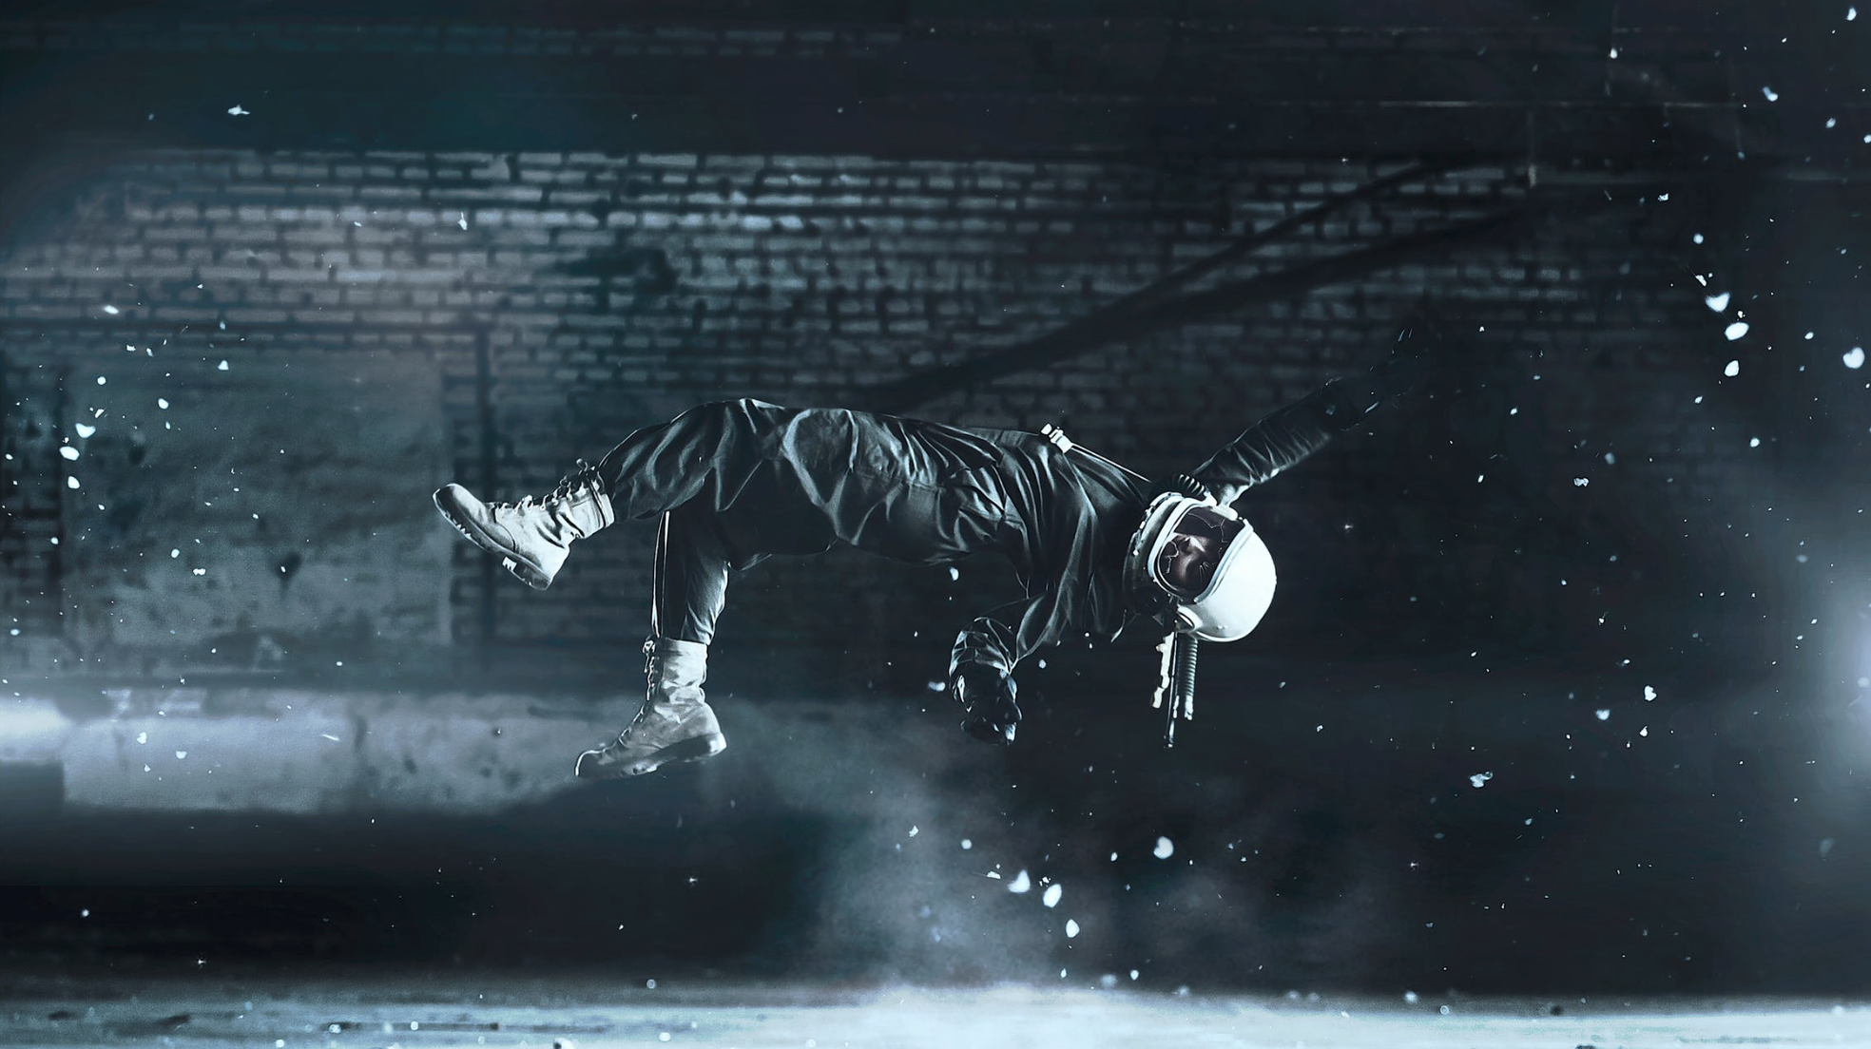
Did you think that your feet had been bound？
你是否感觉双脚受限？
By what gravity brings to the ground?
被这重力带回地面？

Slide 4
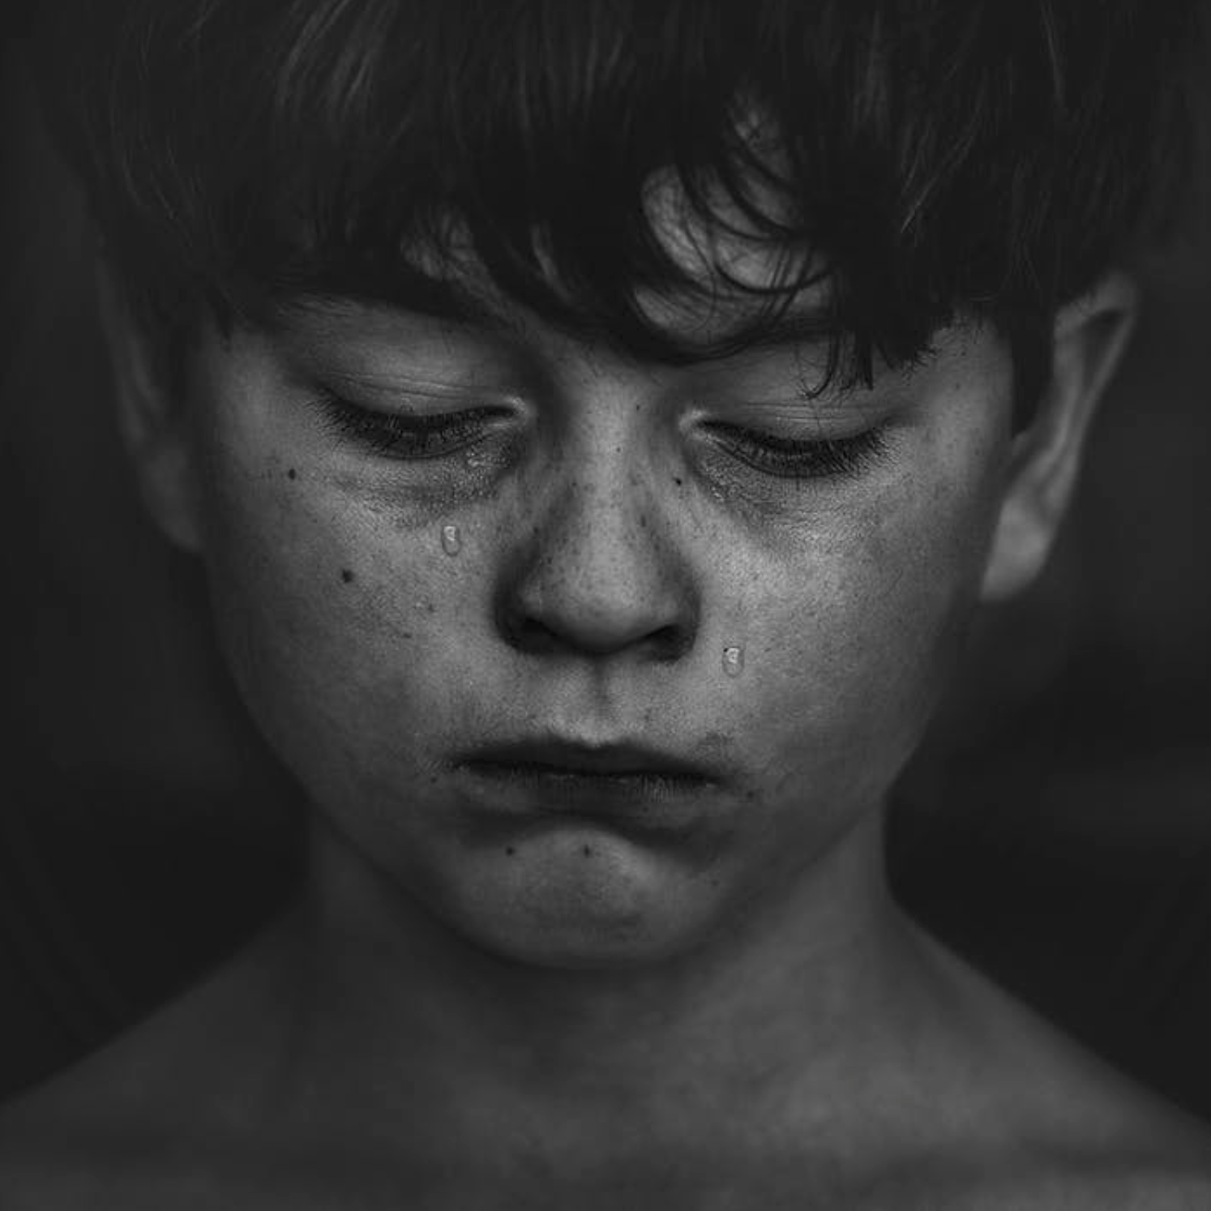
Did you feel you were tricked
你是否感觉受骗？
Well, come on down
好吧，下来吧
By the future you picked?
被你选择的未来？

Slide 5
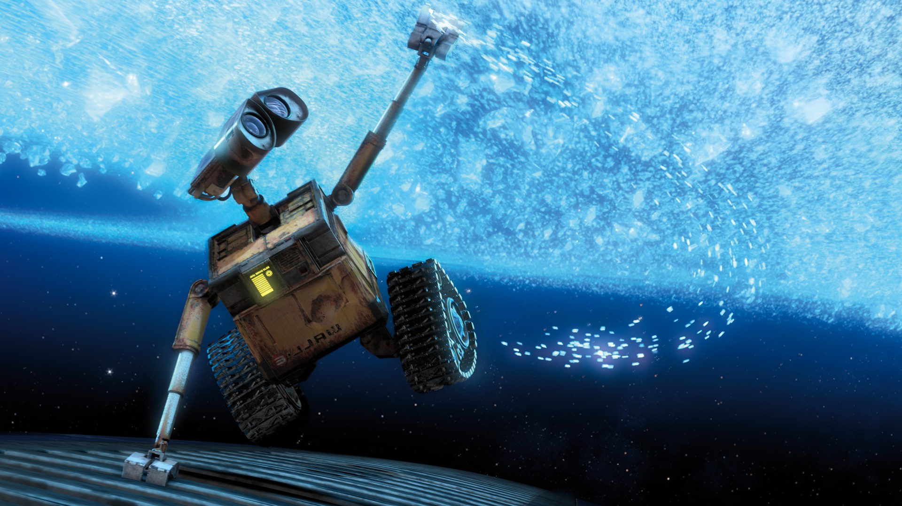
All those rules don't apply
所有这些规则都不会适用
When you're high in the sky
当你高高的在空中
So, come on down
所以，下来吧
Come on down
下来吧

Slide 6
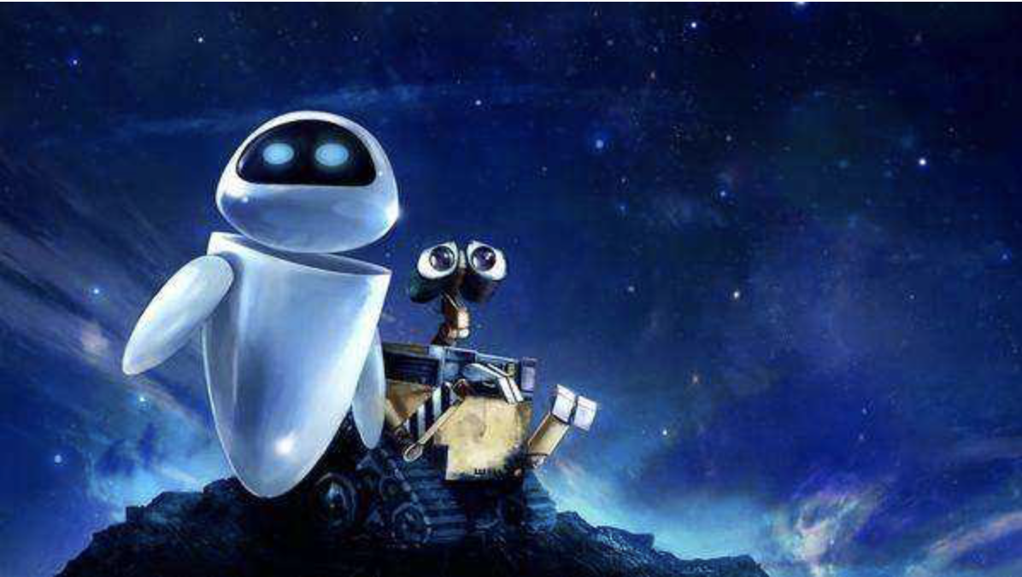
We're coming down to the ground
我们正向地面降落
There's no better place to go
没有更好的地方可去

Slide 7
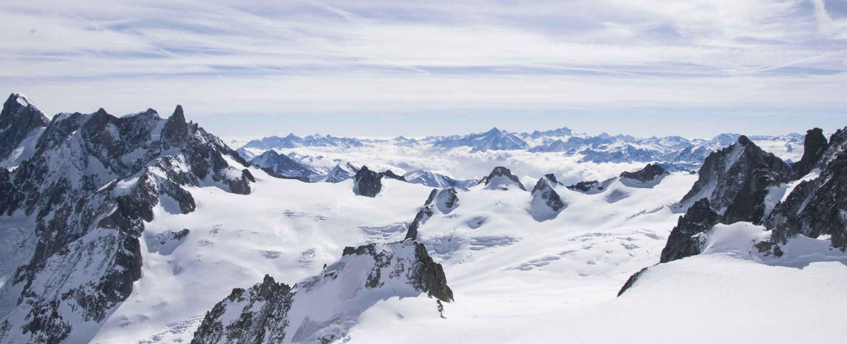
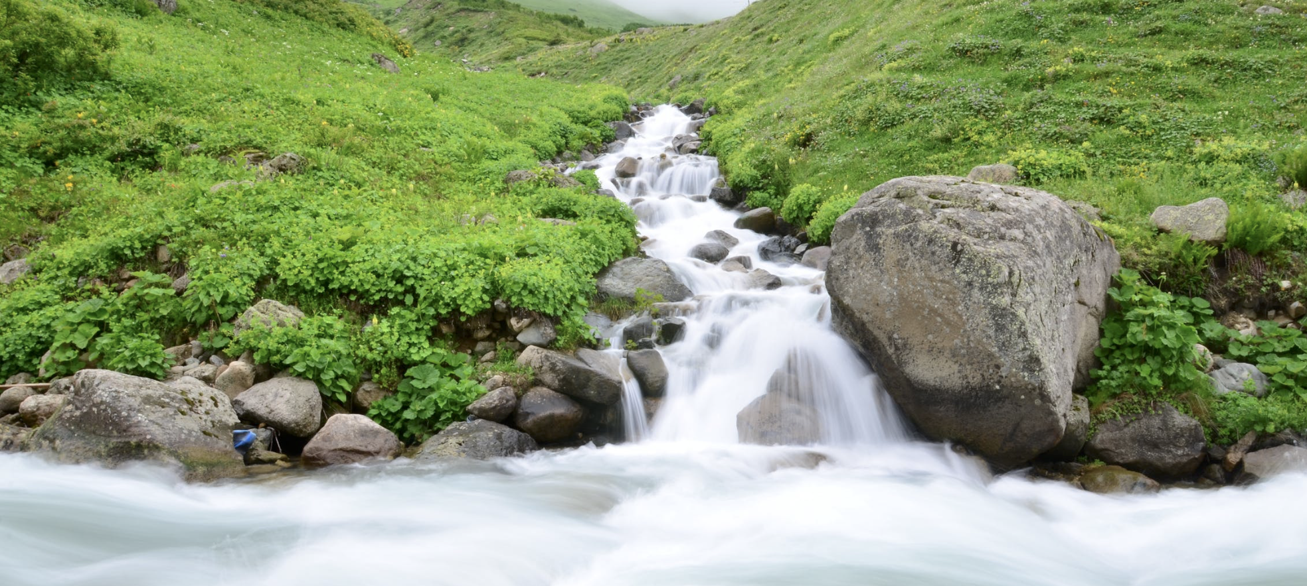
We've got snow up on the mountains
我们有白雪皑皑的山峰
We're coming down to the ground
我们正向地面降落
We've got rivers down below
我们有顺势而下的溪河

Slide 8
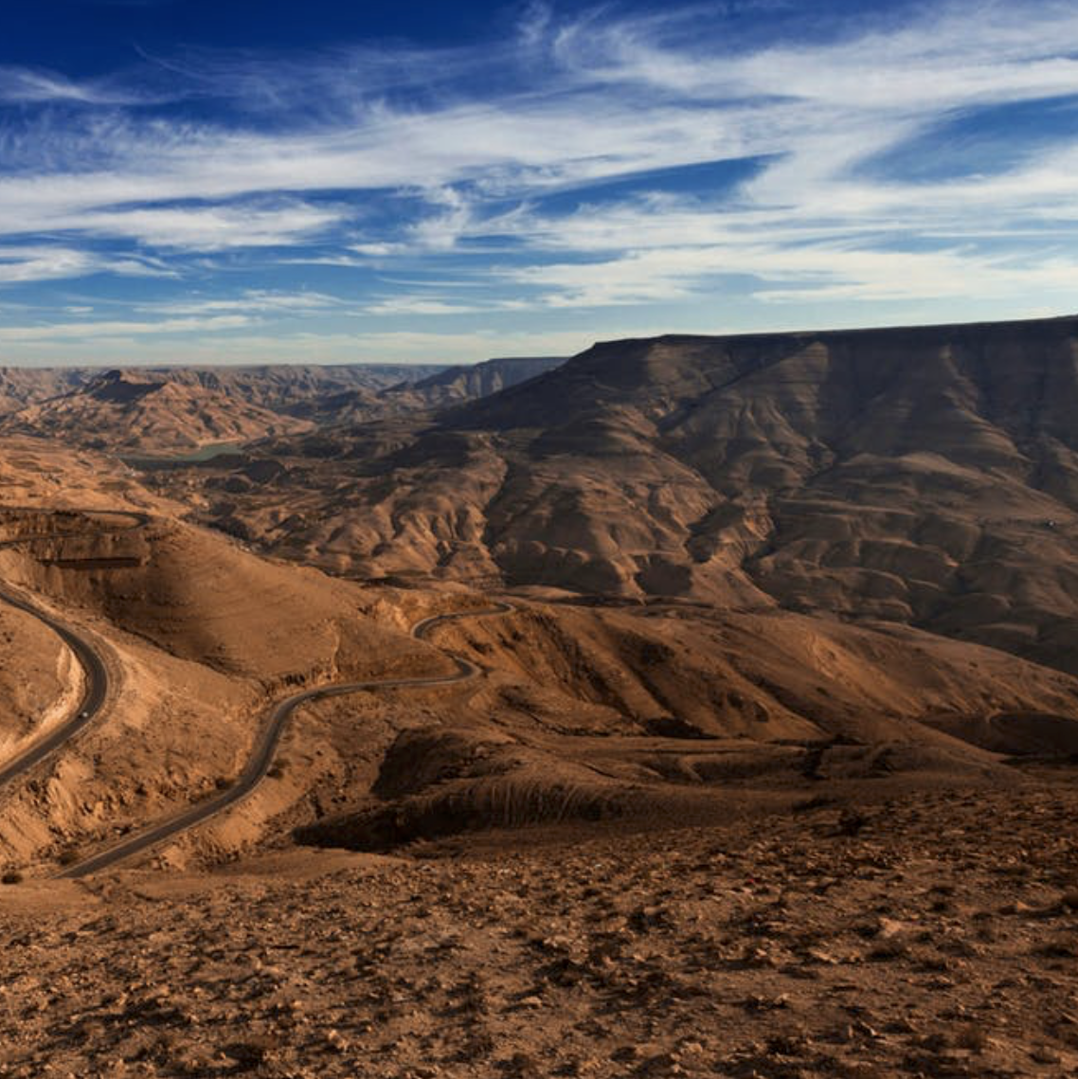
We hear the birds sing in the trees
我们能听见林中的鸟啼
We send the seeds out in the breeze
我们会在微风中播撒种子
And the land will be looked after
而且这土地也能被照料
We hear the birds sing in the trees
我们能听见林中的鸟啼
And the land will be looked after
而且这土地也能被照料
We send the seeds out in the breeze
我们会在微风中播撒种子

Slide 9
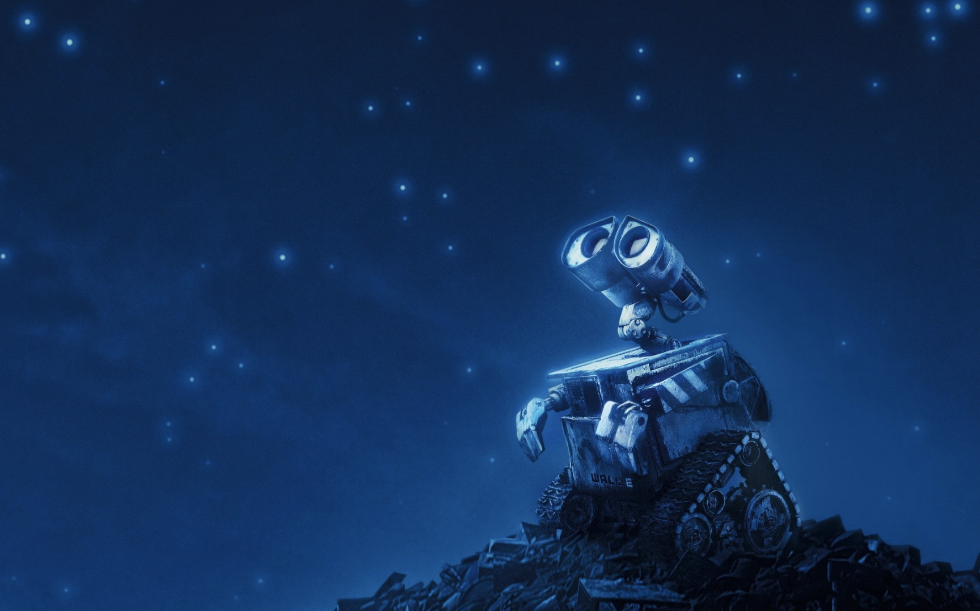
Did you think you'd escaped from routine
你还在认为你偏离了计划？
By changing the script and the scene?
因为改写了那剧本和场景？

Slide 10
Despite all you made of it
快放弃你曾经为那做的一切吧
You're always afraid
你总是在害怕
Of the change
这改变

Slide 11
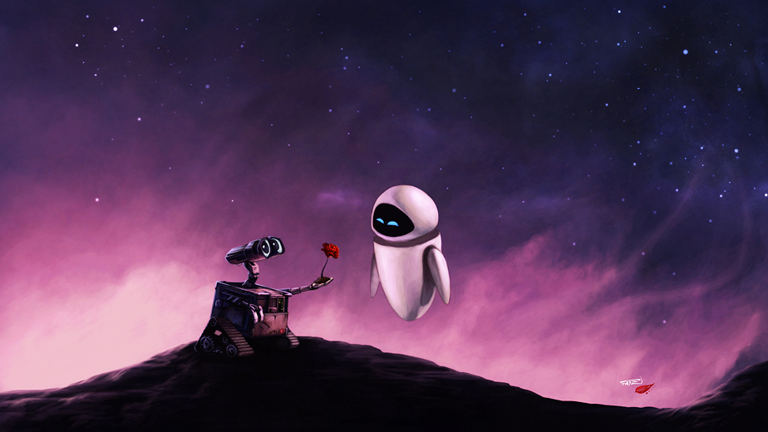
You've got a lot on your chest
因为你已经得到了很多
So come on down
所以下来吧
Well, you can come as my guest
好吧，你可以来当我的客人
Come on down
下来吧

Slide 12
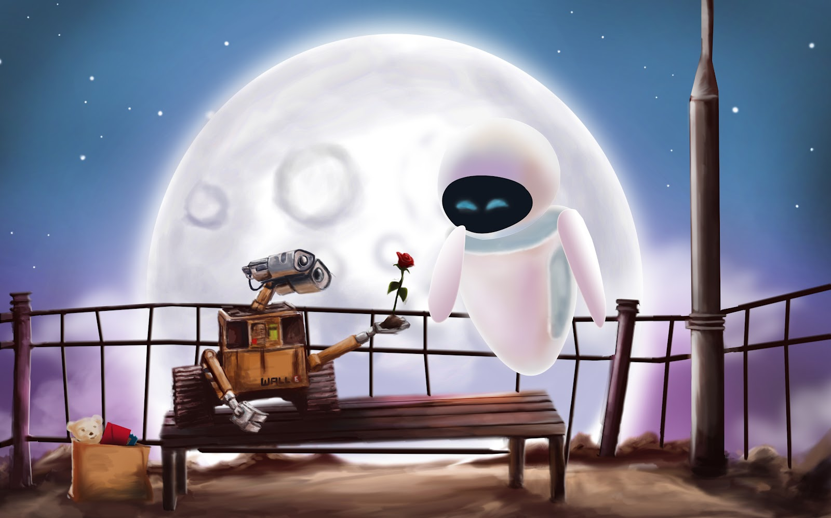
We're coming down to the ground
我们正向地面降落
There's no better place to go
没有更好的地方可去

Slide 13
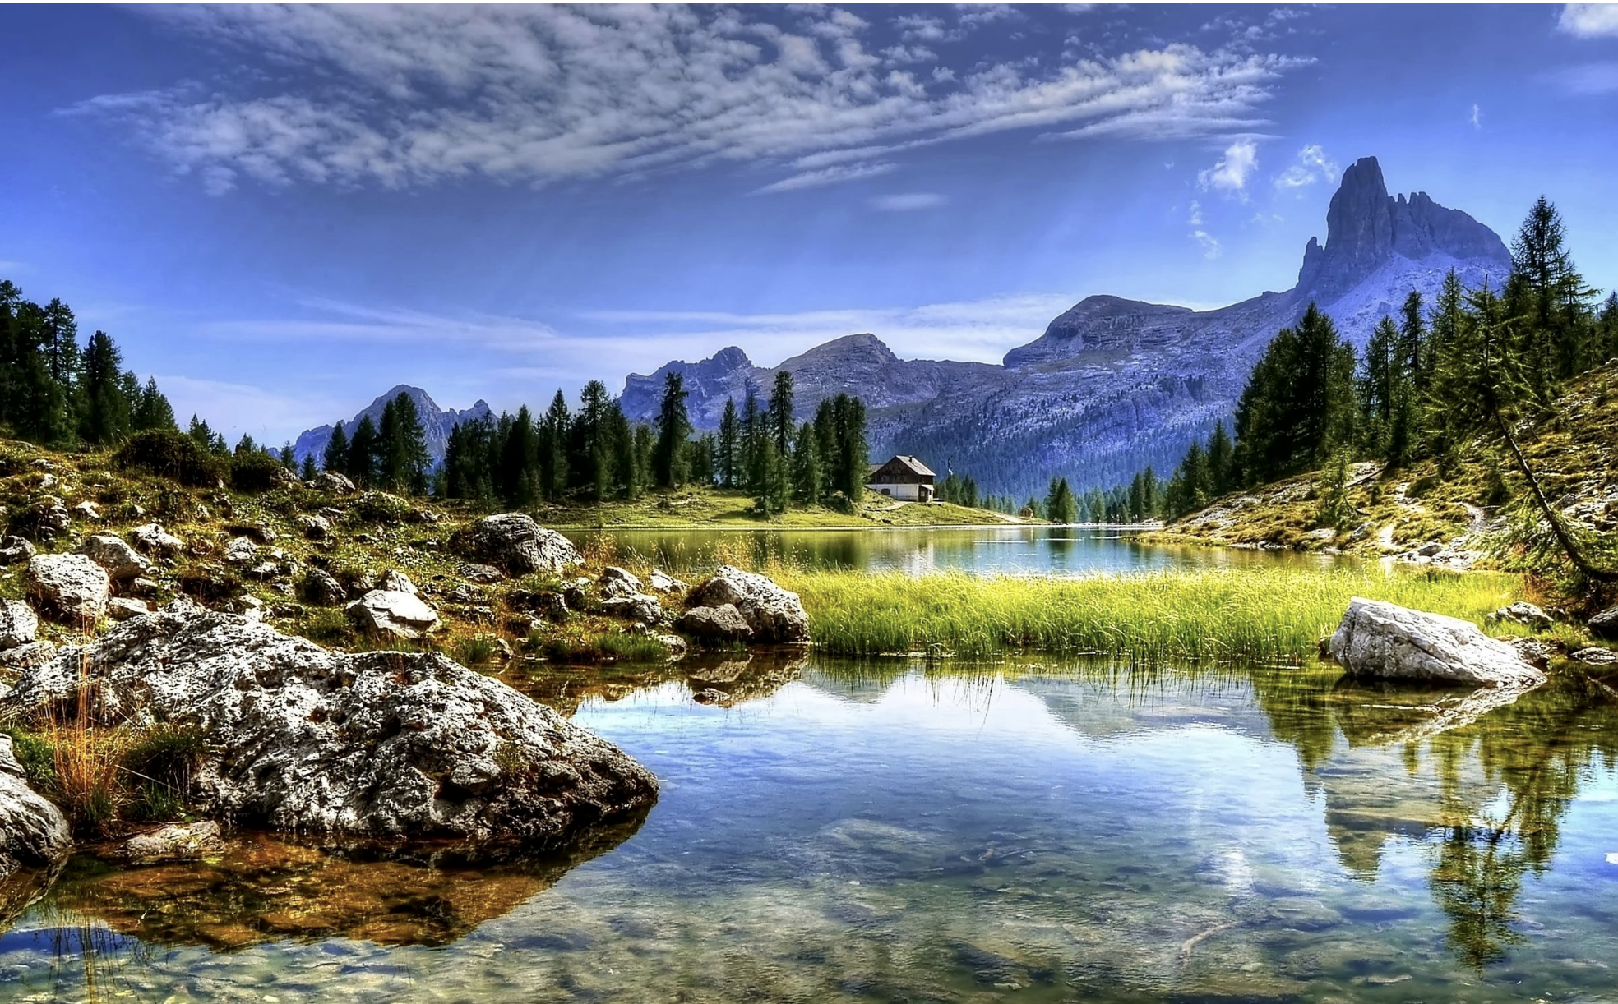
We've got snow up on the mountains
我们有白雪皑皑的山峰
We've got rivers down below
我们有顺势而下的溪河
We're coming down to the ground
我们正向地面降落

Slide 14
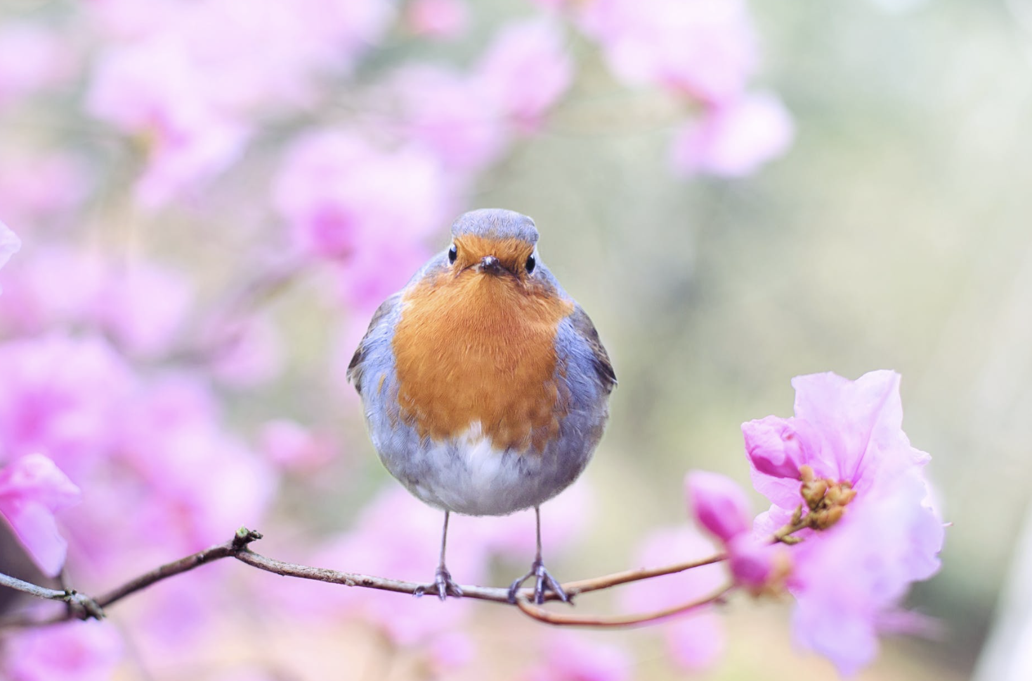
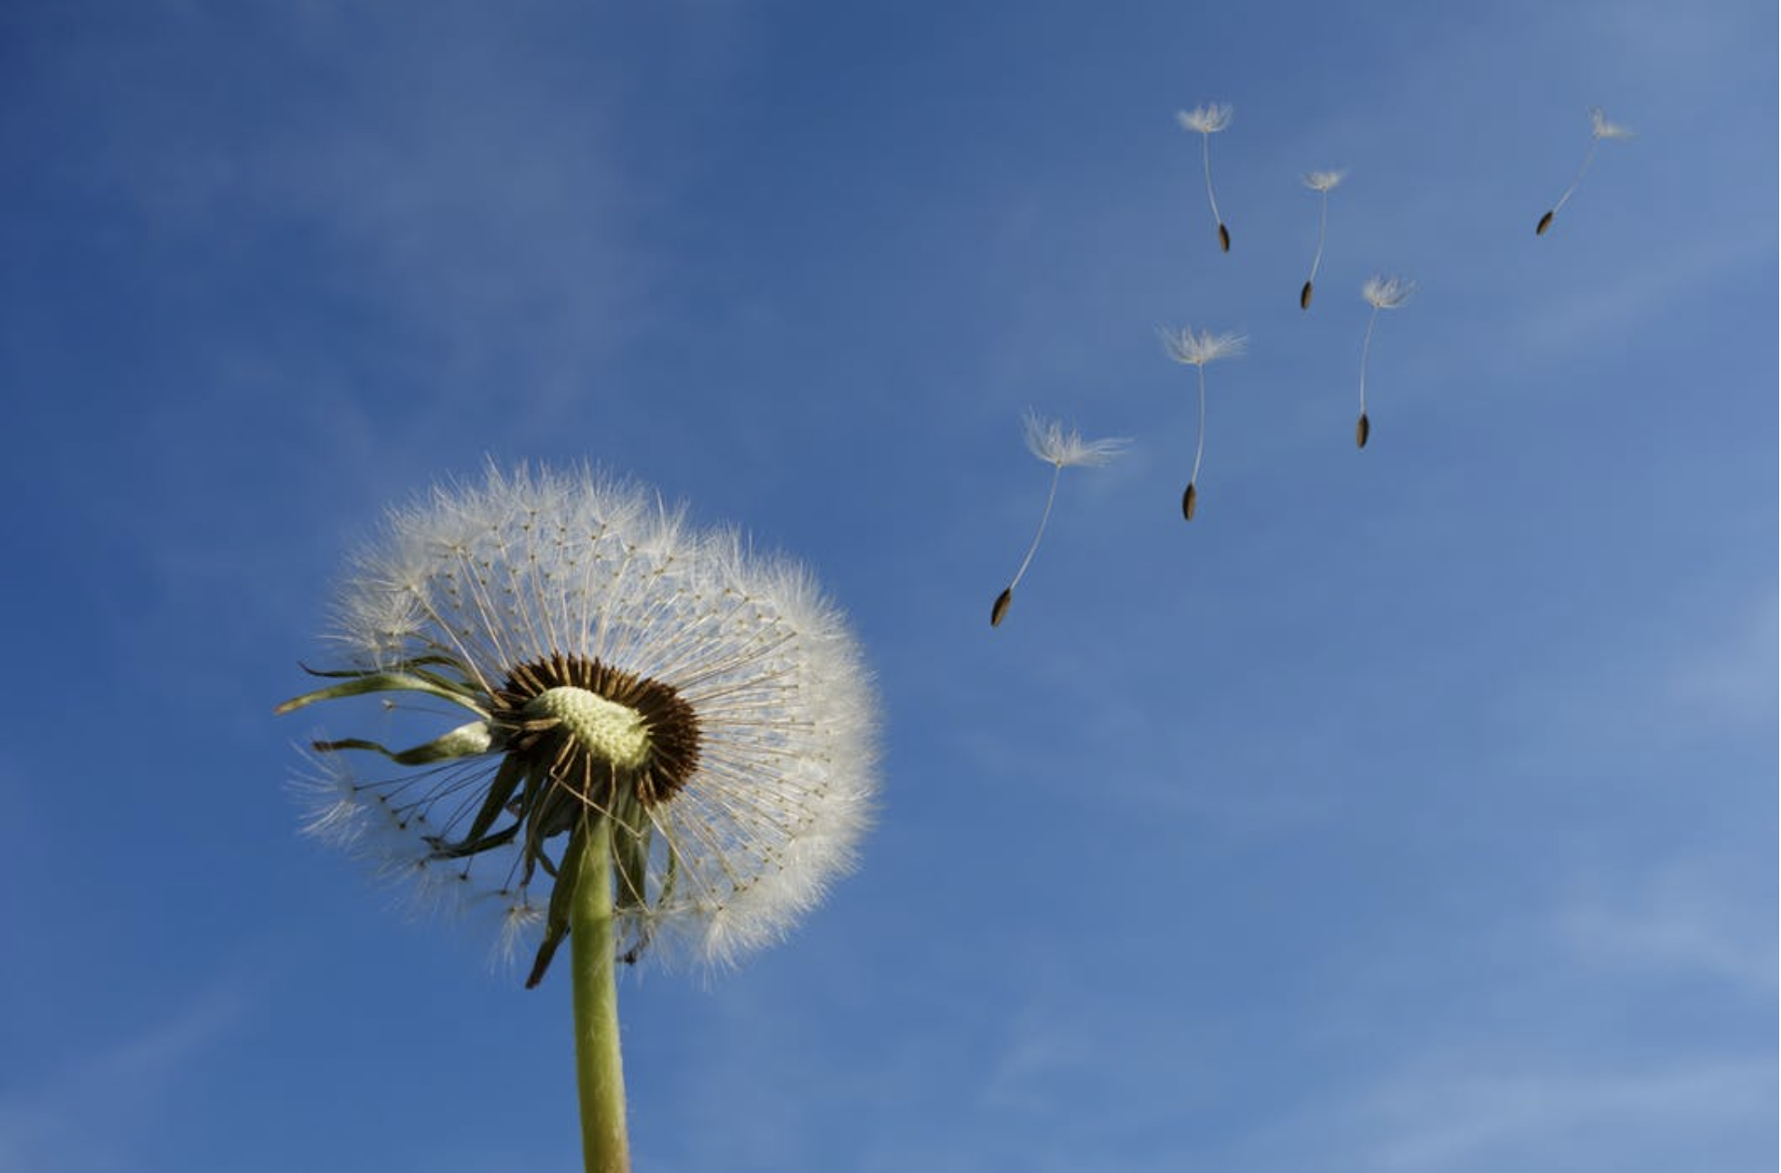
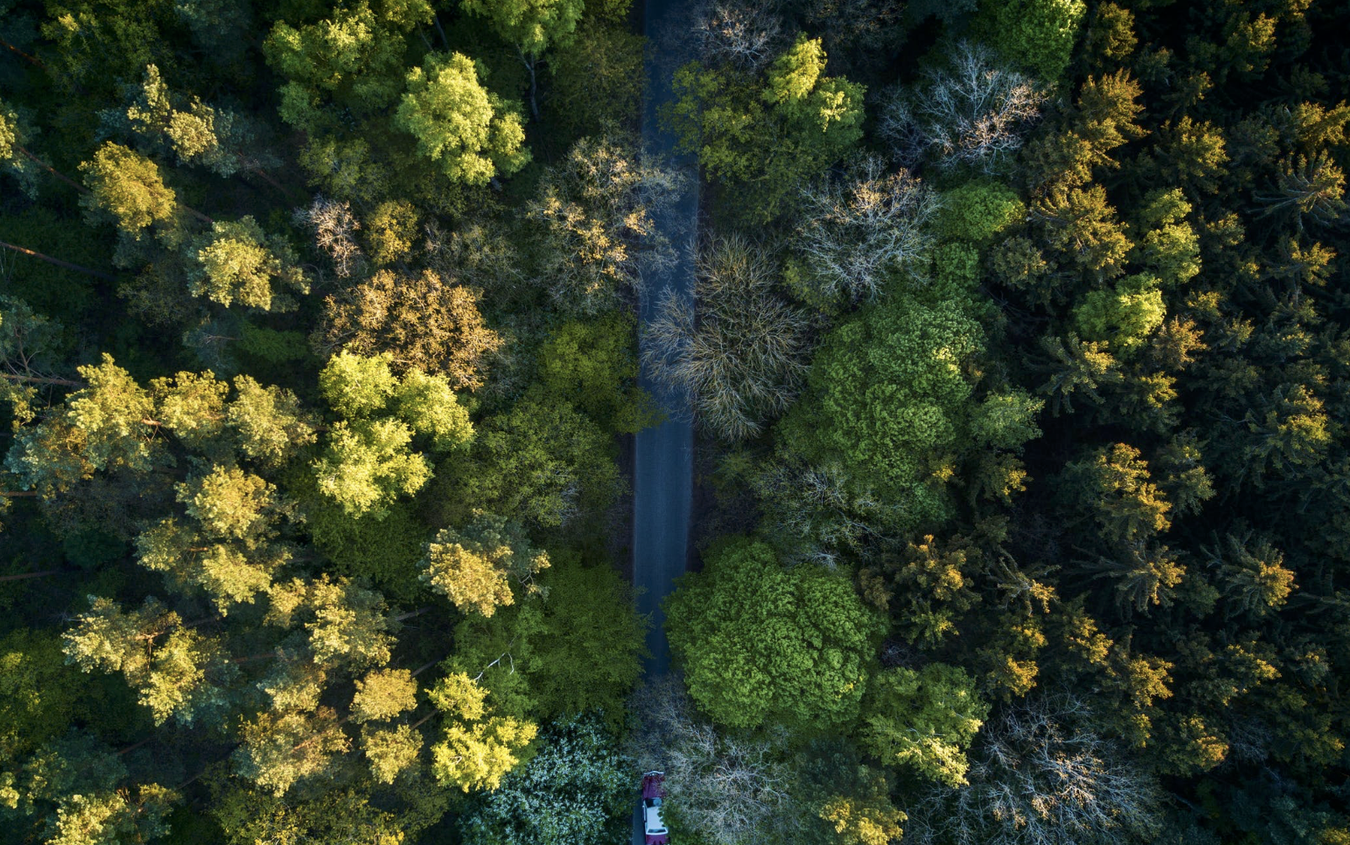
We send the seeds out in the breeze
我们会在微风中播撒种子
We hear the birds sing in the trees
我们能听见林中的鸟啼
And the land will be looked after
而且这土地也能被照料

Slide 15
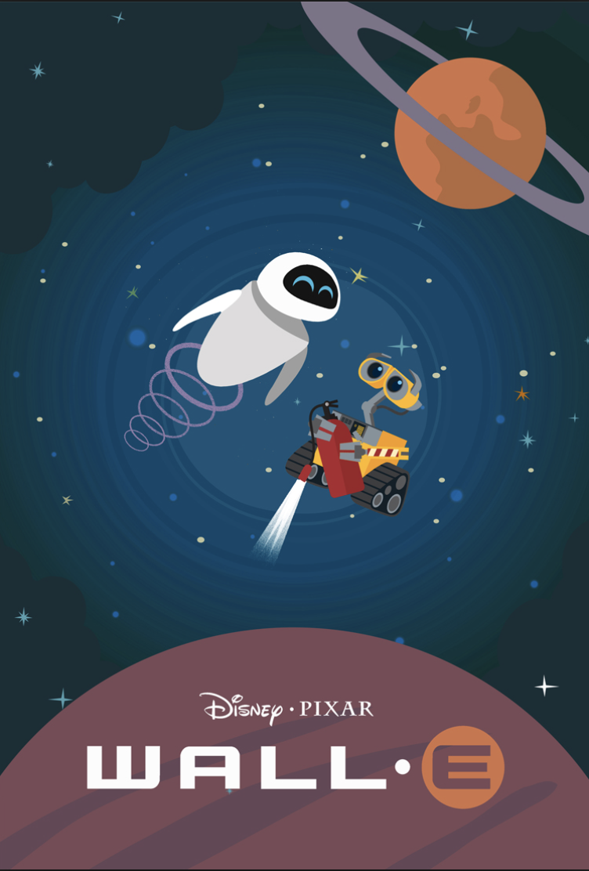
# MV FOR M5U3 LIFE IN THE FUTURE
THANK YOU
Prod. 许永倩 20150201106 英师五班

