Slide 1
M5U4 Making the news
Song: Jimmy Brown, The Newsboy
Singer: Mac Wiseman
刘怡翠
华南师范大学外文学院

Slide 2
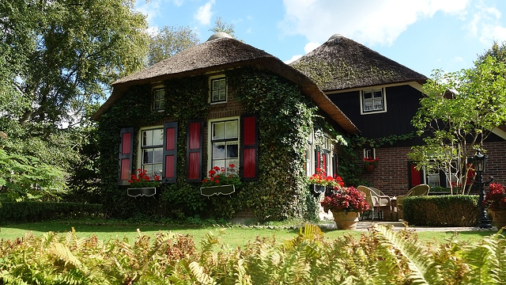

Slide 3
澳大利亚旅游相册

Slide 4
澳大利亚旅游相册

Slide 5
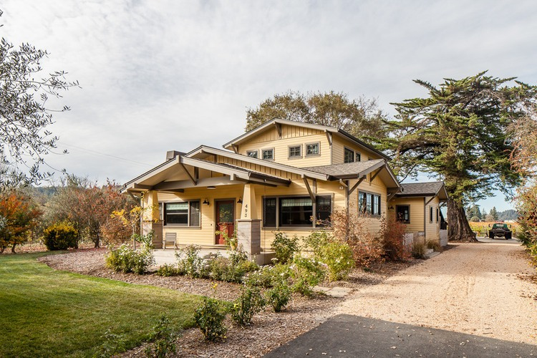
澳大利亚旅游相册

Slide 6
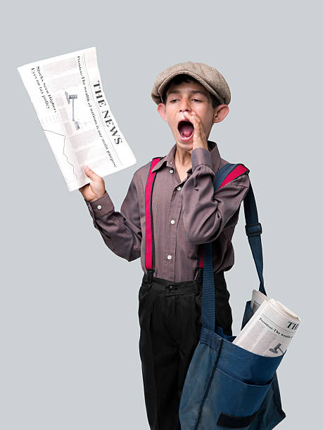
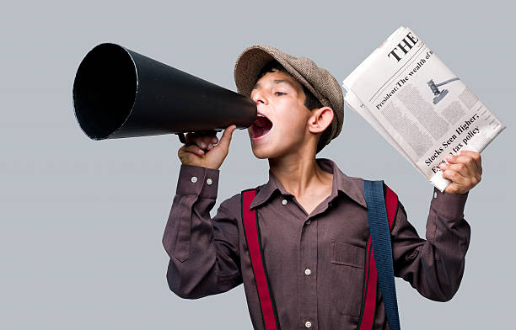
I sell the morning paper, sir
My name is Jimmy Brown

Slide 7
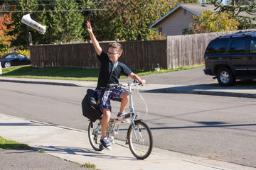
Everybody knows I am
The Newsboy of the town

Slide 8
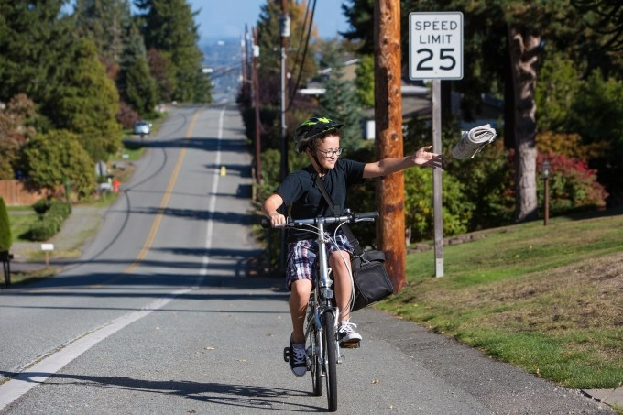
You will hear me yelling "Morning Star"
As I run along the street

Slide 9
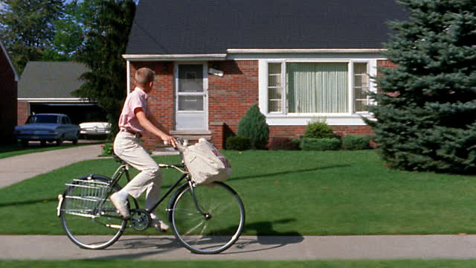
I have no hat up - on my head
No shoes upon my feet
I have no hat up - on my head
No shoes upon my feet

Slide 10
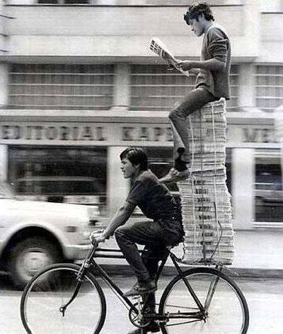
I'm awful cold and hungry, sir
My clothes are worn and thin

Slide 11
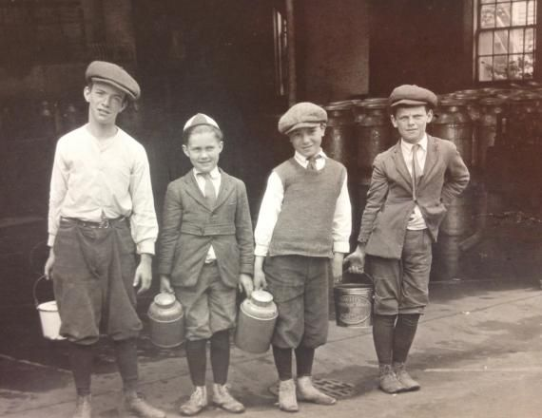
I wander about from place to place
My daily bread to win

Slide 12
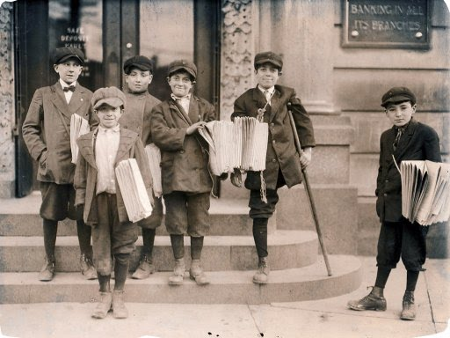
Never mind, sir, how I look
Don't look at me and frown

Slide 13
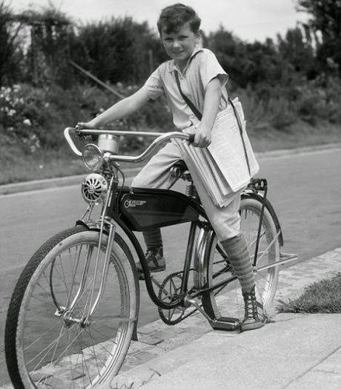
I sell the morning papers, sir
My name is Jimmy Brown
I sell the morning papers, sir
My name is Jimmy Brown

Slide 14
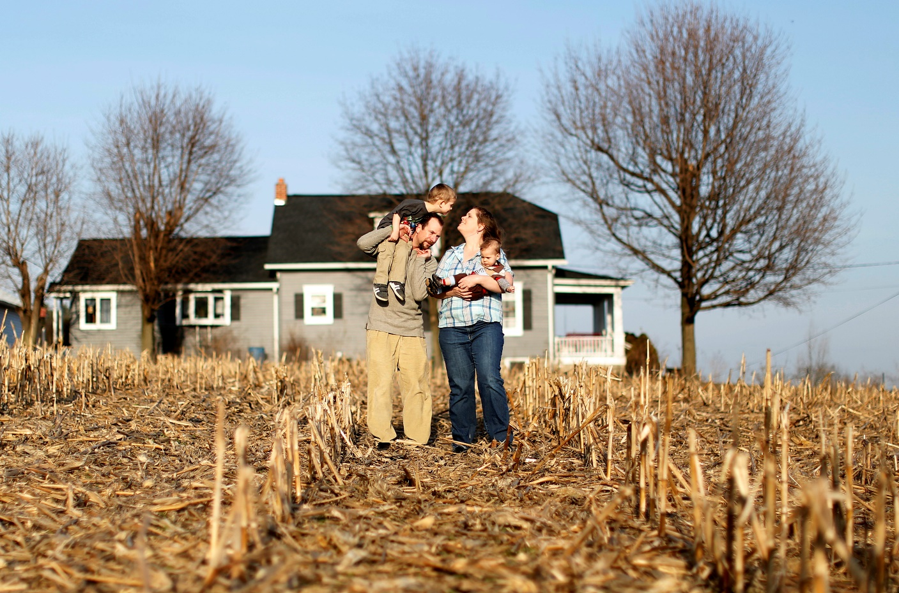

Slide 15
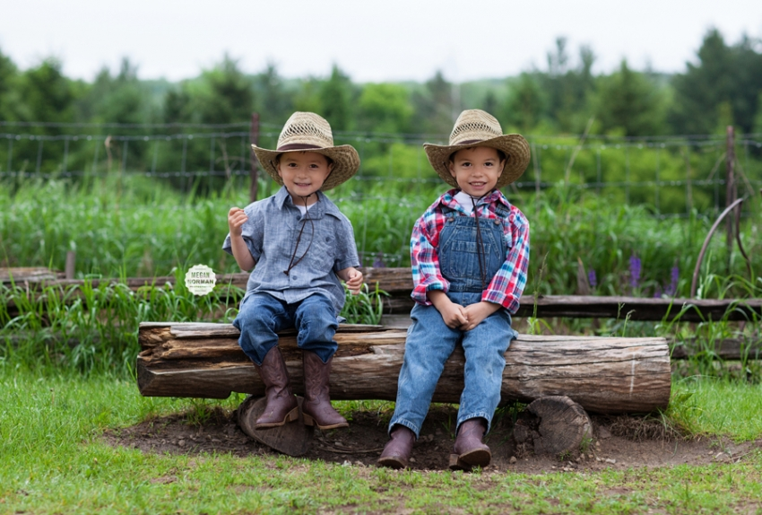
澳大利亚旅游相册

Slide 16
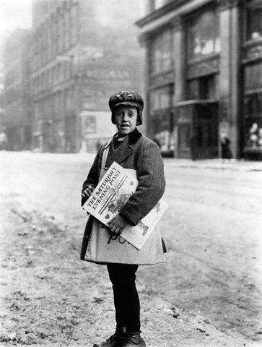
My Father died a drunkard, sir
I've heard my Mother say, and

Slide 17
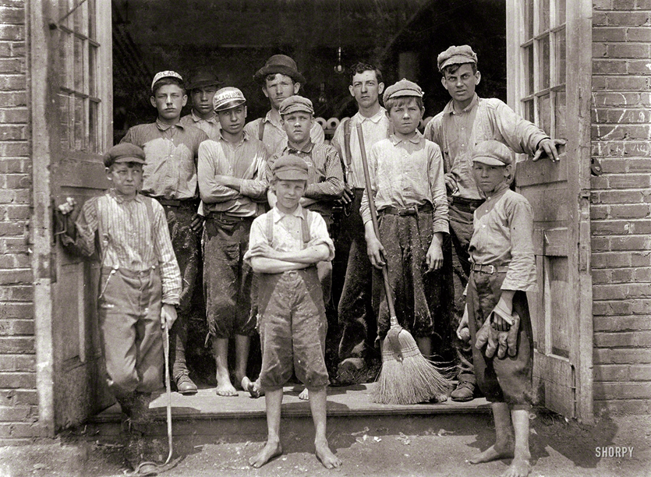
I am helping Mother, sir
As I journey on my way

Slide 18
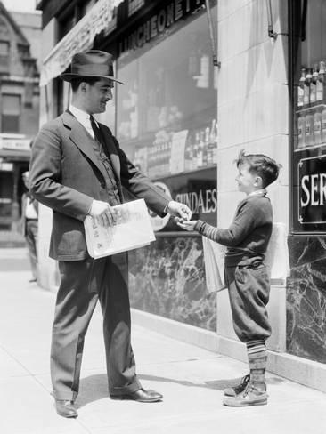
Mother always tells me, sir I've nothing in this world to lose

Slide 19
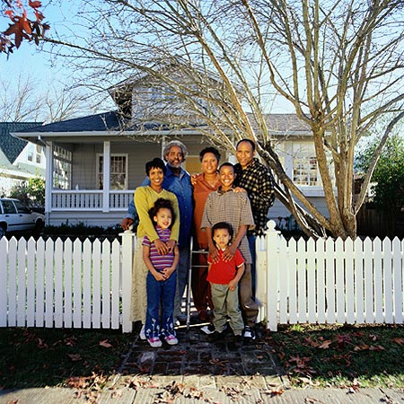
I'll get a place in Heaven, sir
To sell the Gospel News
输入标题内容

Slide 20
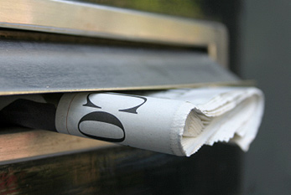
Never mind, sir, how I look,
Don't look at me and frown,

Slide 21
I sell the morning papers, sir
My name is Jimmy Brown
I sell the morning papers, sir
My name is Jimmy Brown

