Slide 1
教材：人教版 M5
单元：Unit 4 Making the News
作者：宋宁静
单位：华南师范大学外文学院

Slide 4
I work for the newspapers
Any news is good news, I always say

Slide 5
But I don't write no daily column

Slide 6
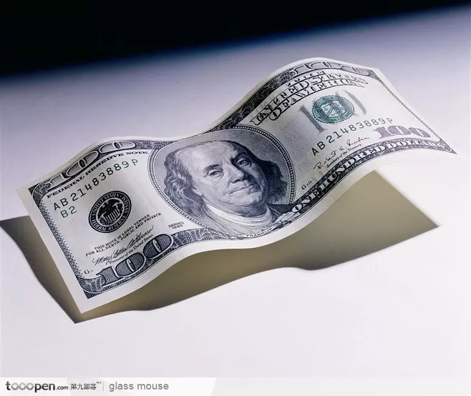

Slide 7
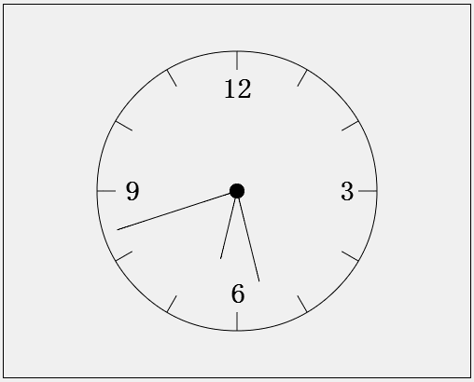
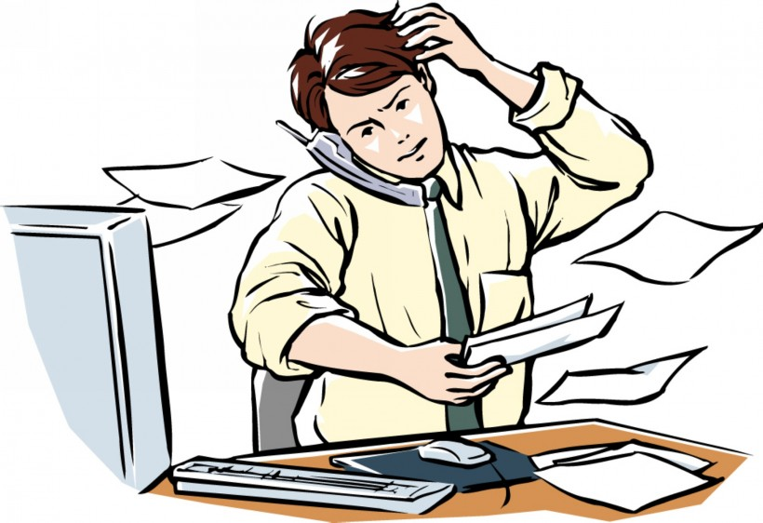
And when my workday's over
I pocket five or ten from the tray

Slide 8
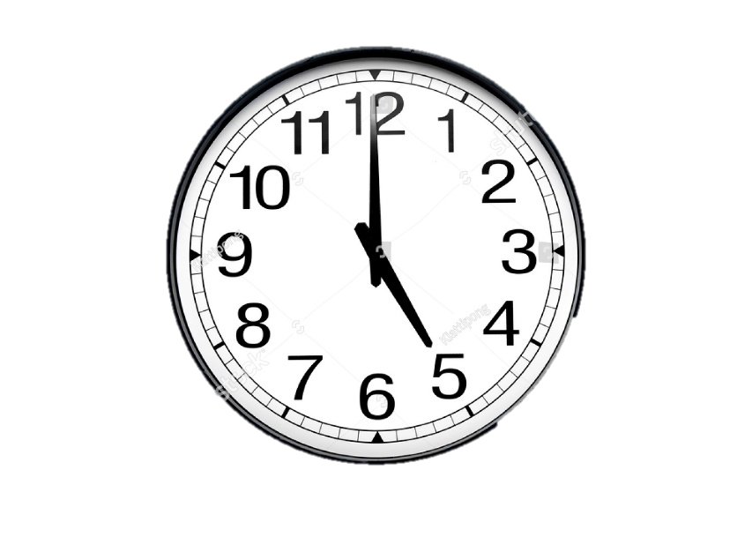
And then I start it up again at five a.m
I stack 'em up just to throw 'em away

Slide 9
Now lately, I've been thinking
What would the world do without the news?

Slide 10
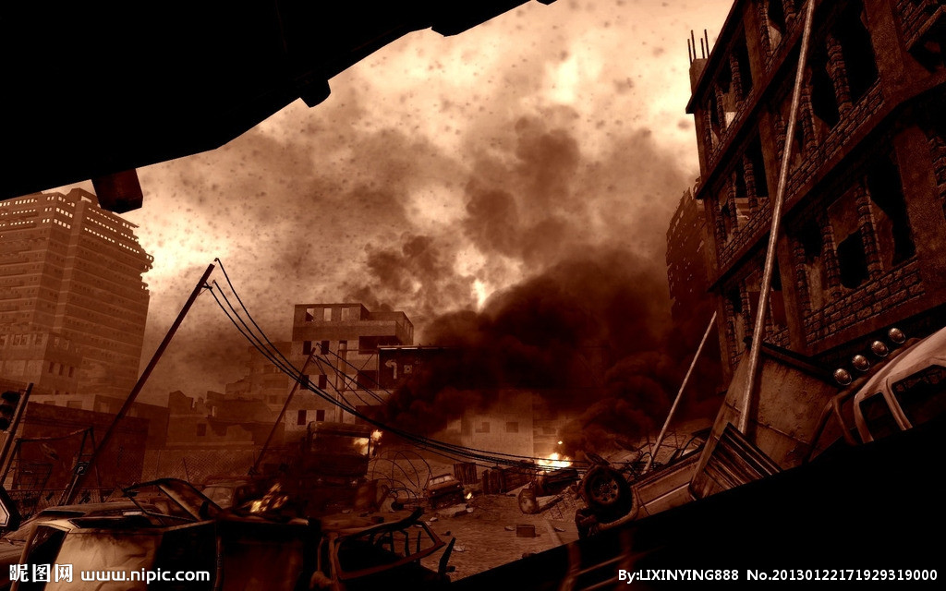
You wouldn't know when wars were started
Or when they ended––win or lose

Slide 11
It'd probably be a much better world to live in

Slide 12
But the question would be whose
And what side you're on, or who's right or wrong

Slide 13
You'd never have to choose

Slide 14
Sometimes, late at night
I can see the streets like no one else can

Slide 15
There's a lot of things going on here
That even newspapers don't understand

Slide 16
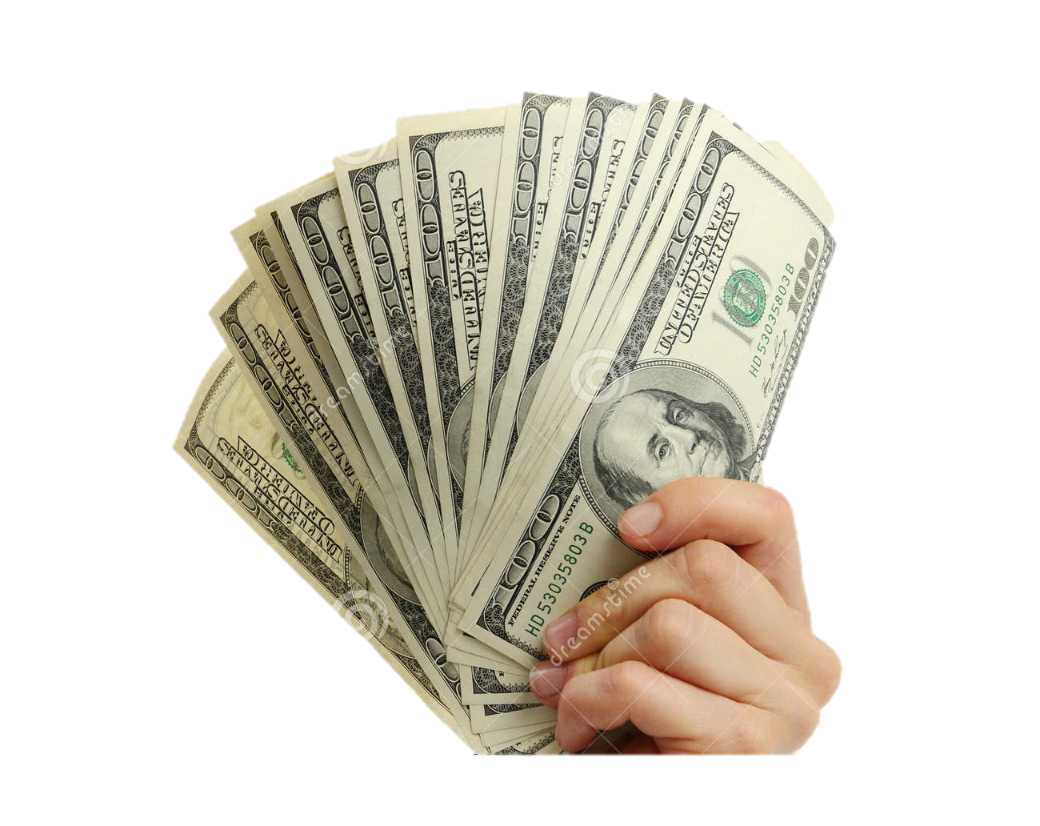
Some people got too much money
Some rob with a gun or a ballpoint pen

Slide 17
Maybe I'll get me a big black cape

Slide 18
And then they'll be runnin' from me
Lookin' over their shoulder for me

Slide 19
What's buried in the back pages
Was on the front page yesterday
And old news never dies
Though they say it just fades away

Slide 20
Crime and murder, business and politics
And international strife

Slide 21
It's all the same, find someone to blame
It's there in black and white

