Slide 1
人教版高中M5U5
Song：Ambulance Song
古嘉敏
华南师范大学外文学院

Slide 2
Got to get ready for the day ahead
There may be people in need of me

Slide 3
Put on my siren and rush to the spot
could be any emergency

Slide 4
If there is any emergency
You just can take any chance
120

Slide 5
When you needed a hospital
call me, I am an ambulance
Yes, I am an ambulance
My job is to save people

Slide 6
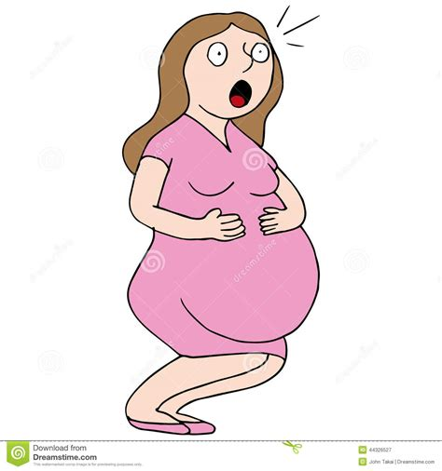
When there is an accident of a birth to reach
I know the importance of time
Carry a team of medics with me
They do a job so fine

Slide 7
If there is any emergency
You just can take any chance
120

Slide 8
When you needed a hospital
call me, I am an ambulance

Slide 9
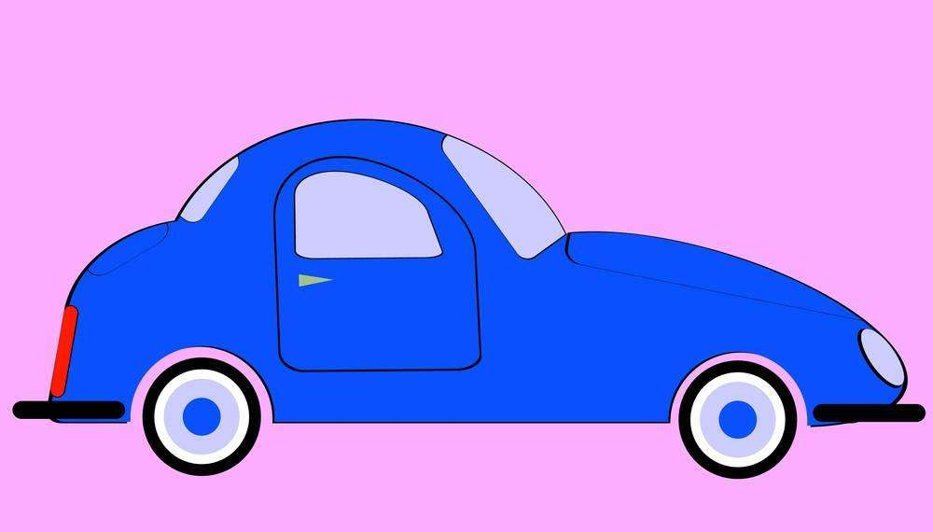
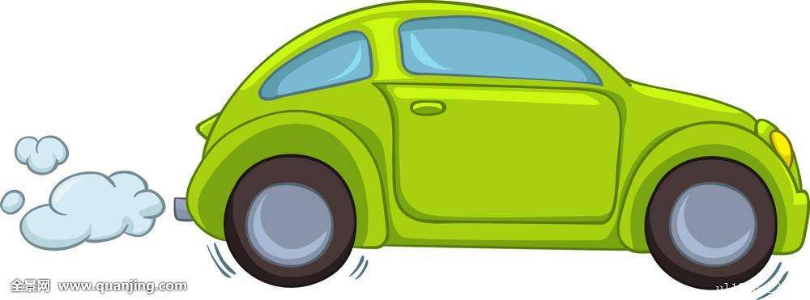
Cars may wait for me when they see me
on the road
Because they know it is an emergency

Slide 10
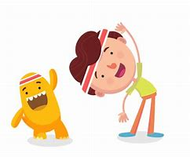
Got to get ready for the day ahead
There may be people in need of me

Slide 11
Put on my siren and rush to the spot
could be any emergency

Slide 12
If there is any emergency
You just can take any chance
120

Slide 13
When you needed a hospital
call me, I am an ambulance
Yes, I am an ambulance

Slide 14
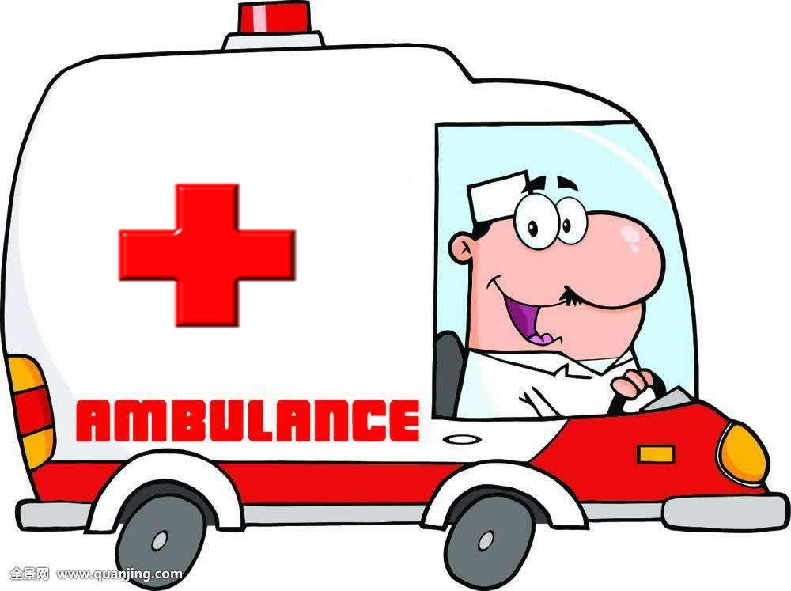
Hope you don’t need to call me
But if you do, I will be there

Slide 15
