Slide 1
Module5 Unit 5 First aid 人教版 黄胜男 华南师范大学 外文学院

Slide 2
There’s a place in your heart
And I know that it is love

Slide 3
And this place it was brighter than
tomorrow

Slide 4
And if you really try
You’ll find there’s no need to cry

Slide 5
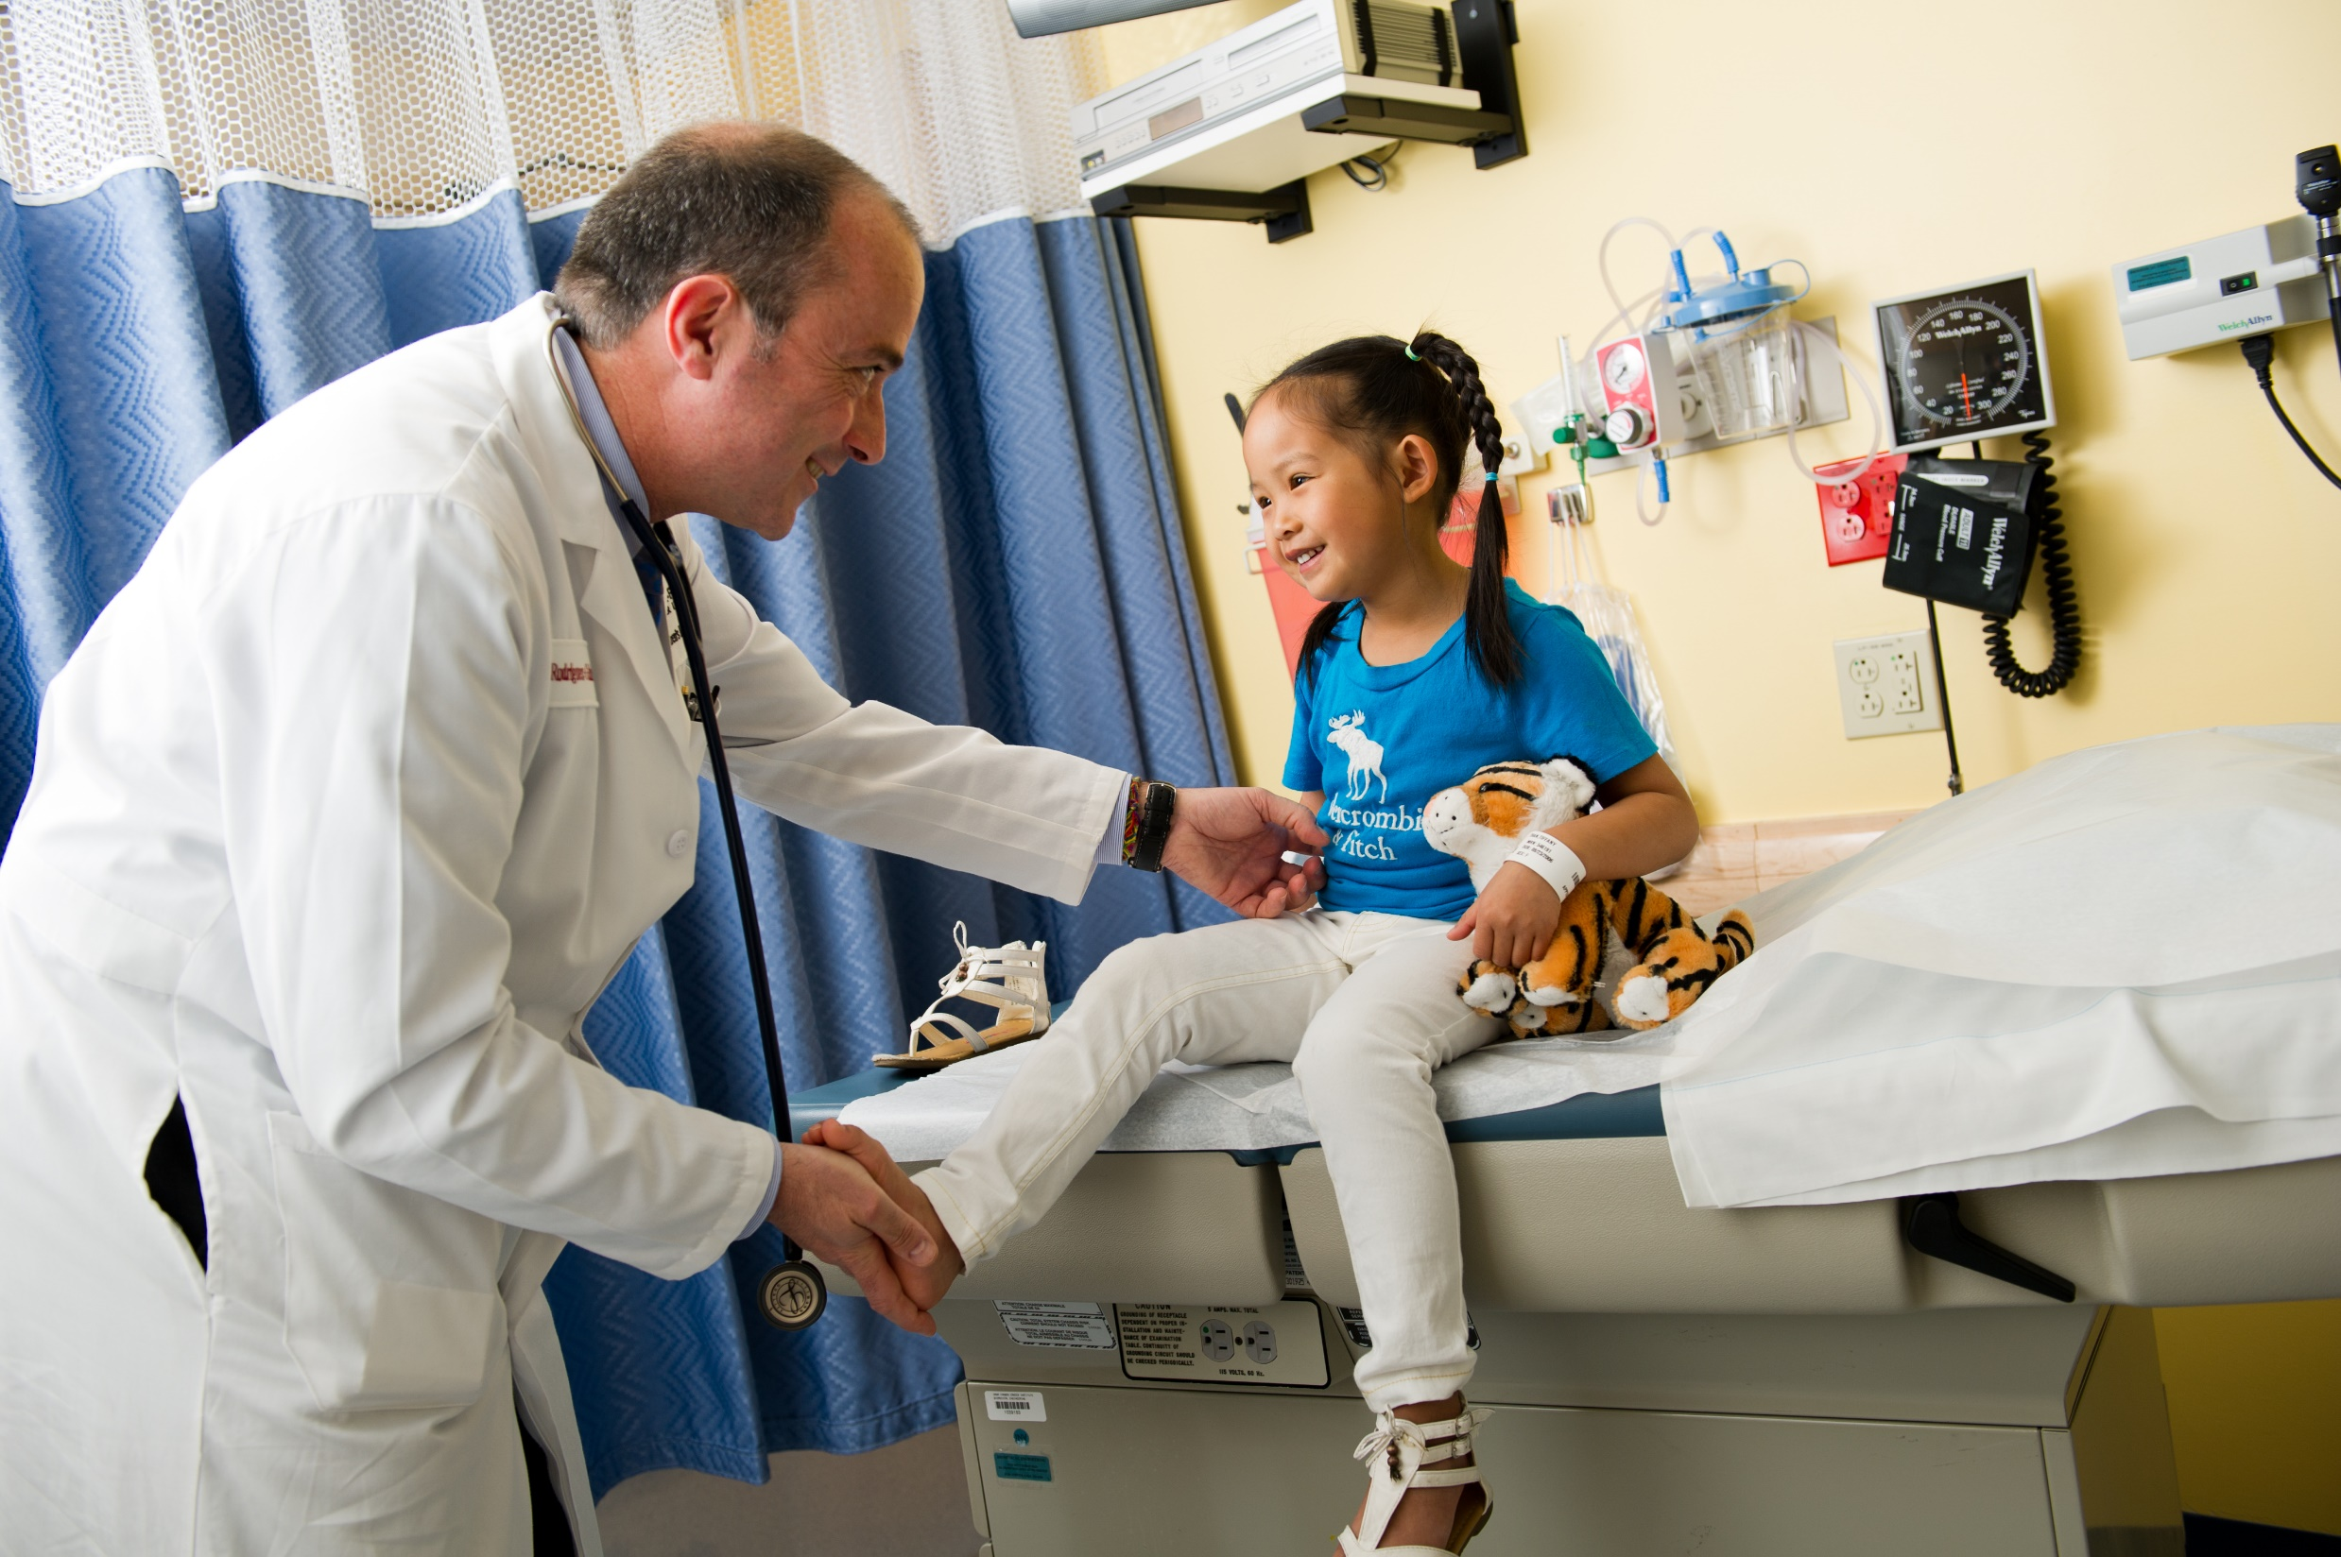
In this place You’ll feel there’s
no hurt or sorrow

Slide 6
There are ways to get there
If you care enough for the living

Slide 7
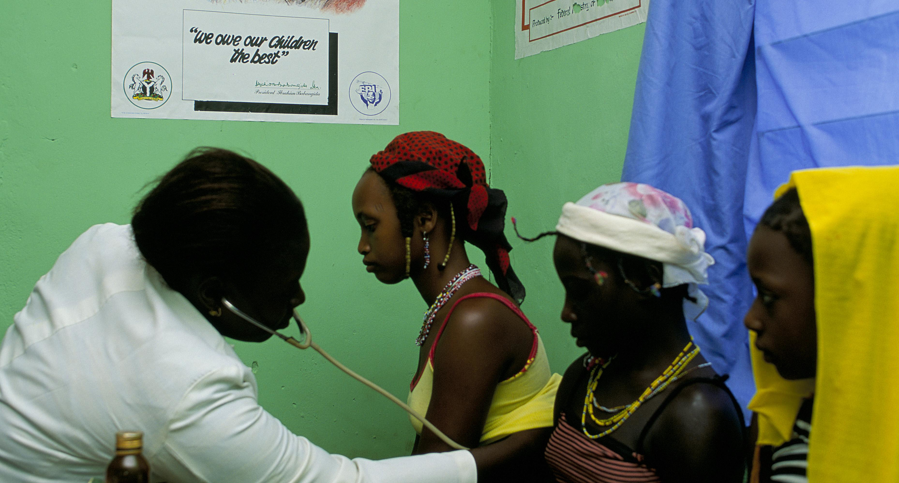
Make a little space
Make a better place

Slide 8
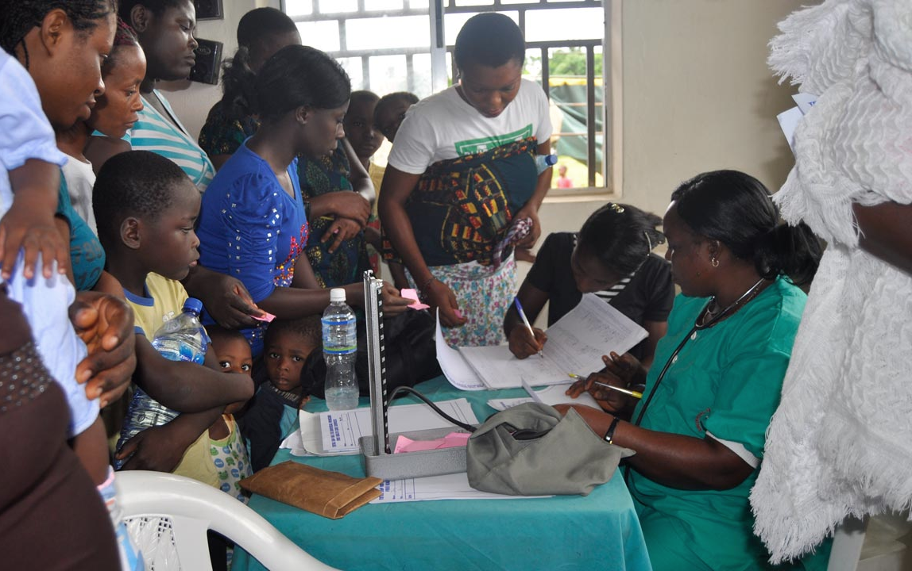
Heal the world Make it a better place
For you and for me and the entire human race

Slide 9
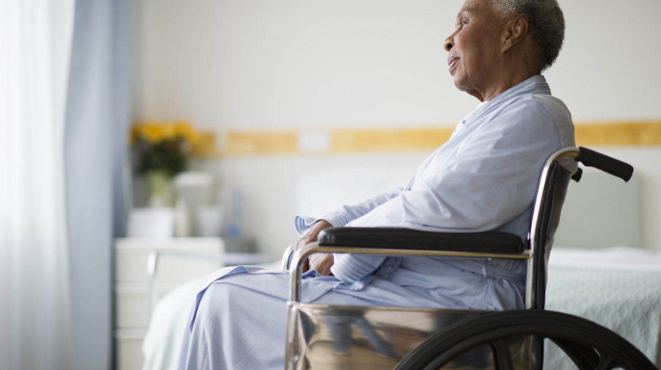
There are people dying
If you care enough for the living
Make a better place for you and for me

