Slide 1
PEP M6U2
Poem
A Few Simple Forms of English Poems
作者：马梓容
单位：华南师范大学外文学院

Slide 2
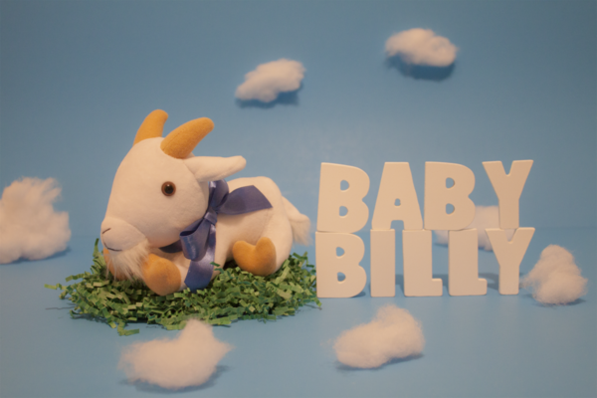
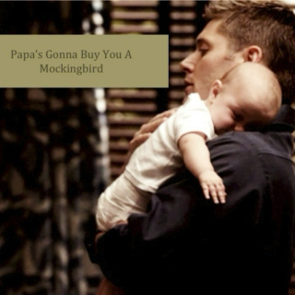
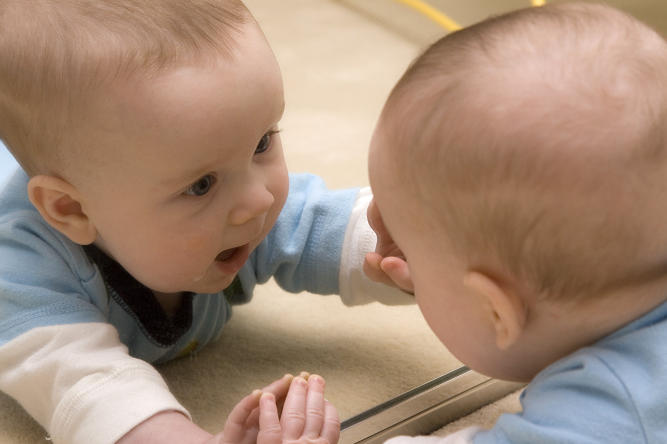
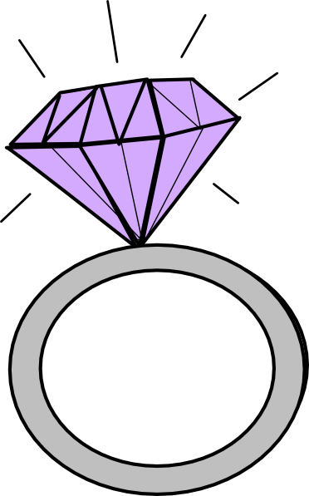
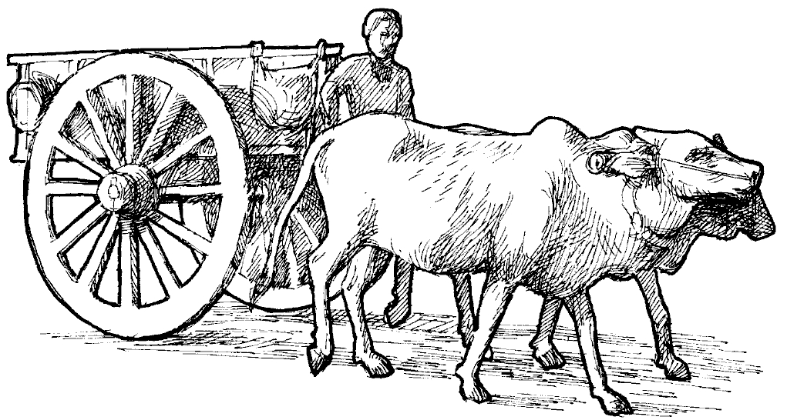
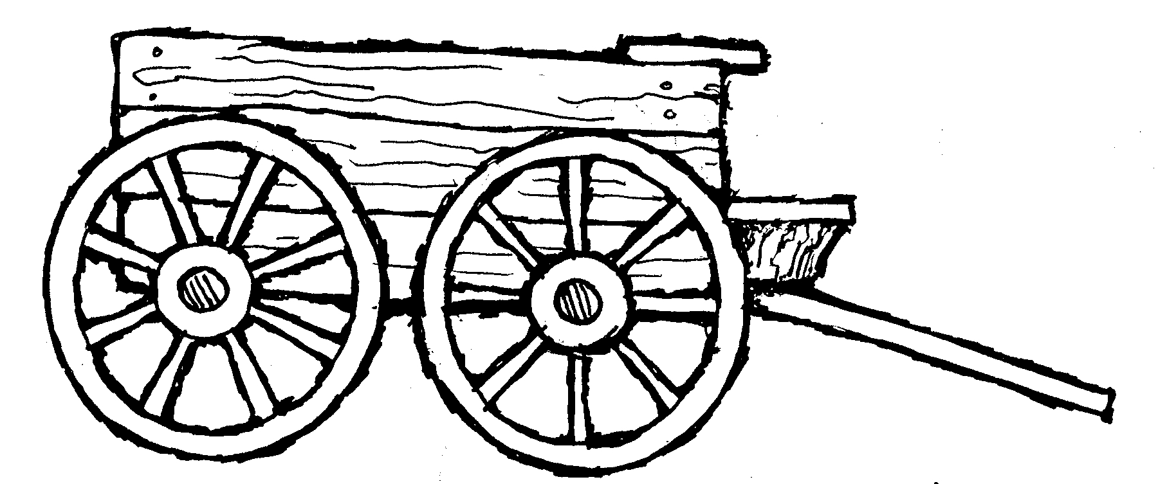
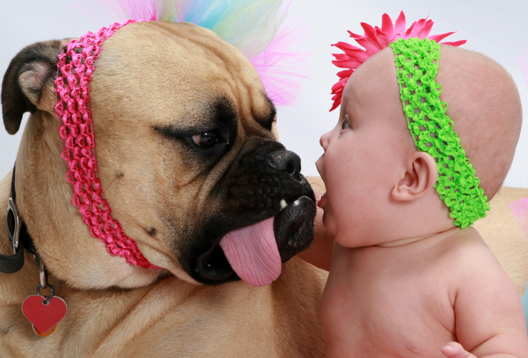
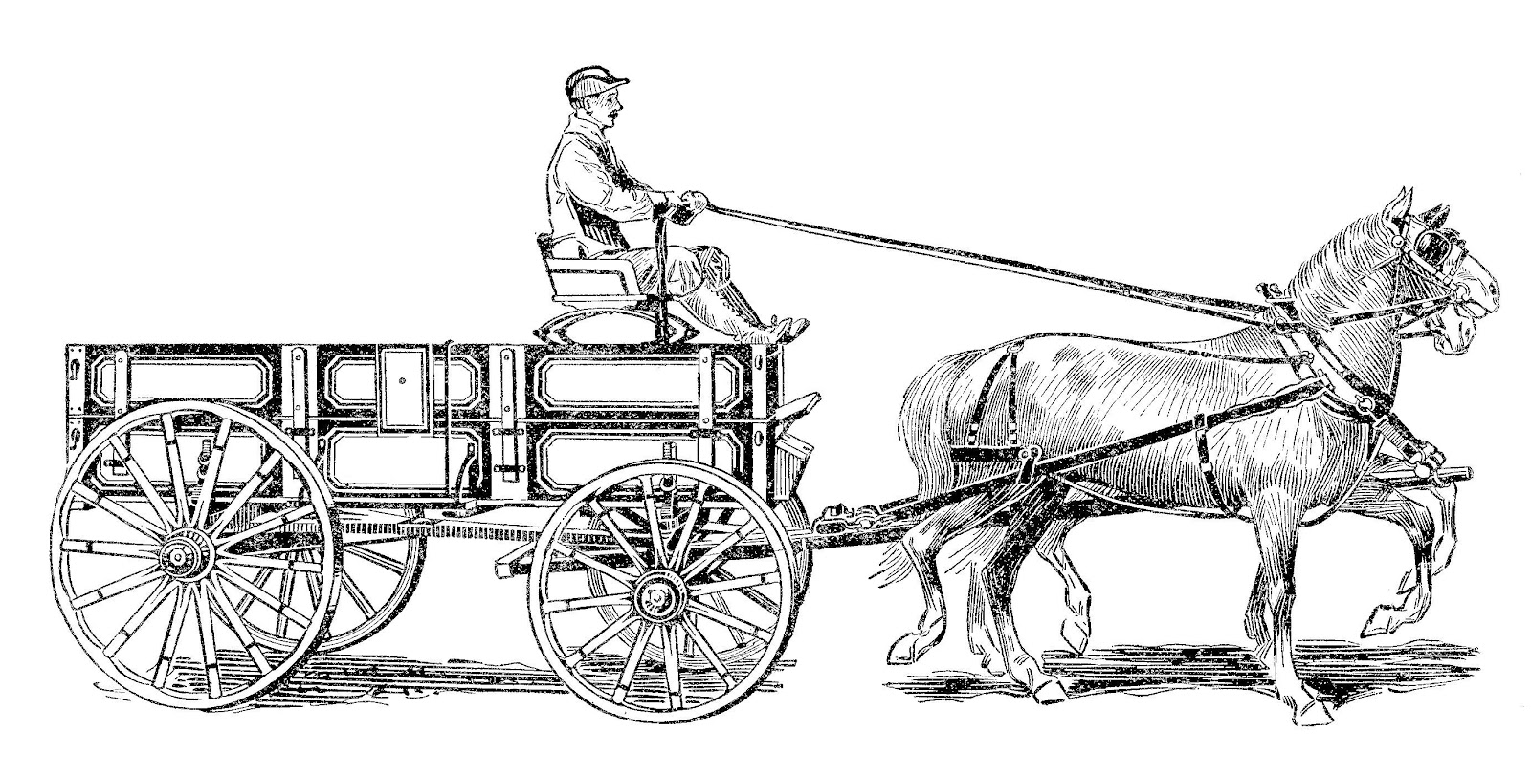
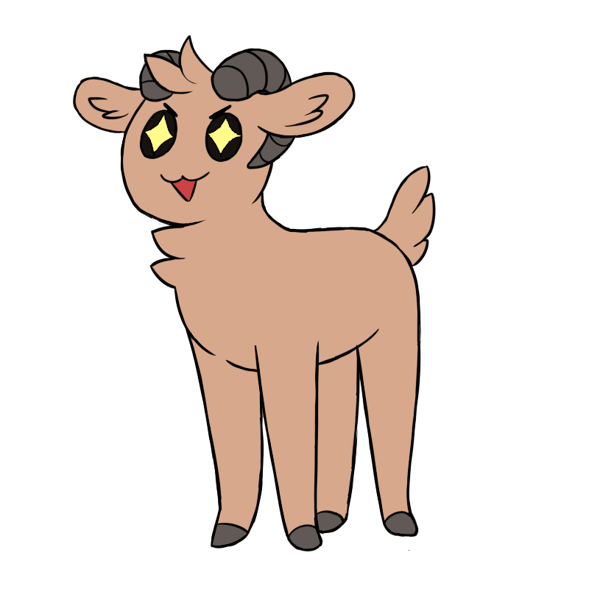
Papa's gonna buy you a looking glass
If that looking glass gets broke
Papa's gonna buy you a mockingbird.
If that cart and bull turn over
If that horse and cart fall down
If that diamond ring turns to brass
Hush little baby, don't say a word
If that billy goat won't pull
Papa's gonna buy you a diamond ring
If that mockingbird won't sing
Papa's gonna buy you a cart and bull
If that dog named Rover won't bark
Papa's gonna buy you a horse and cart
Papa's gonna buy you a billy goat
Papa's gonna buy you a dog named Rover
And if that horse and cart fall down
You'll still be the sweetest little baby in town!

Slide 3
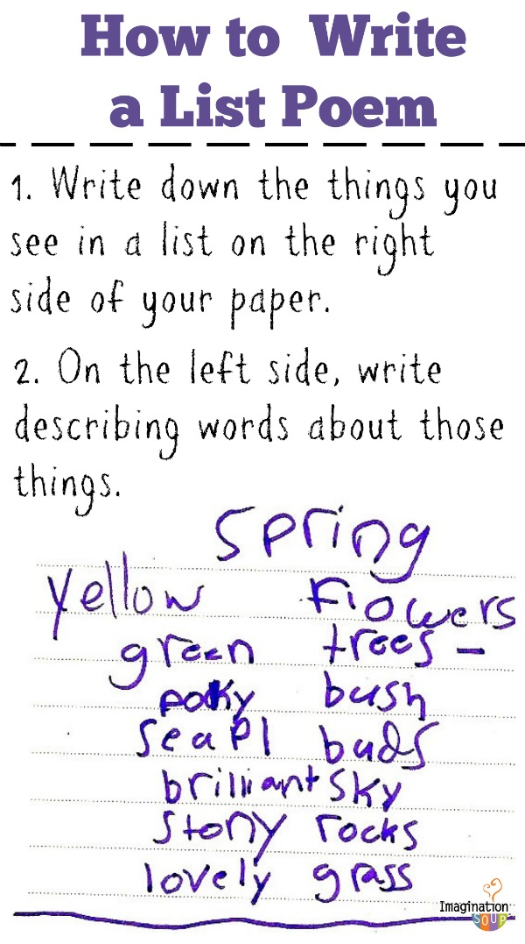
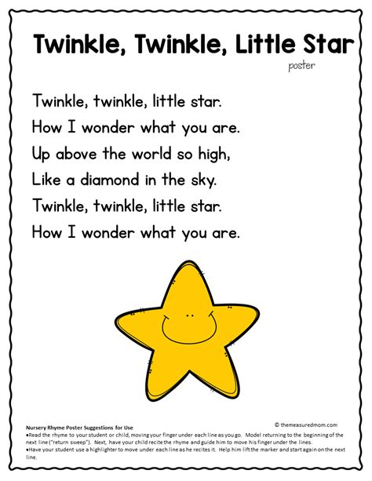
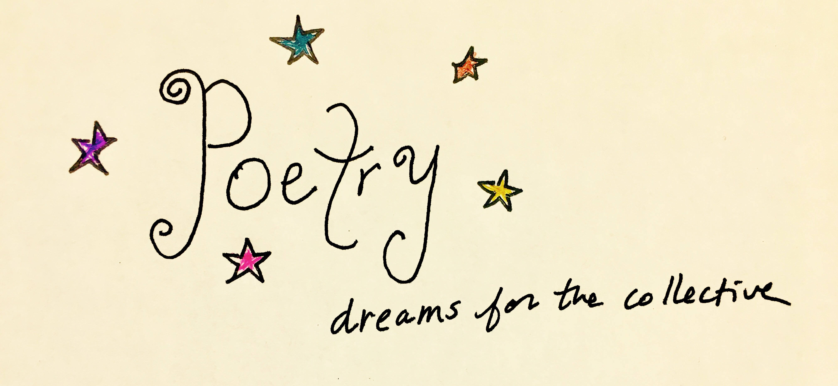
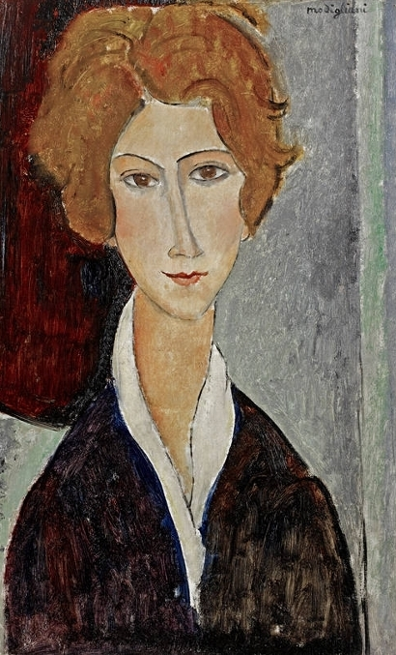
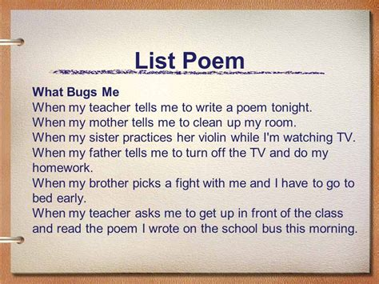
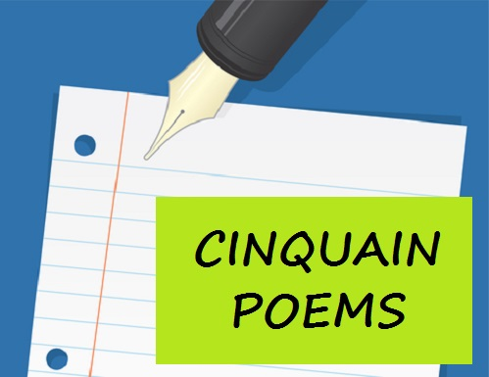
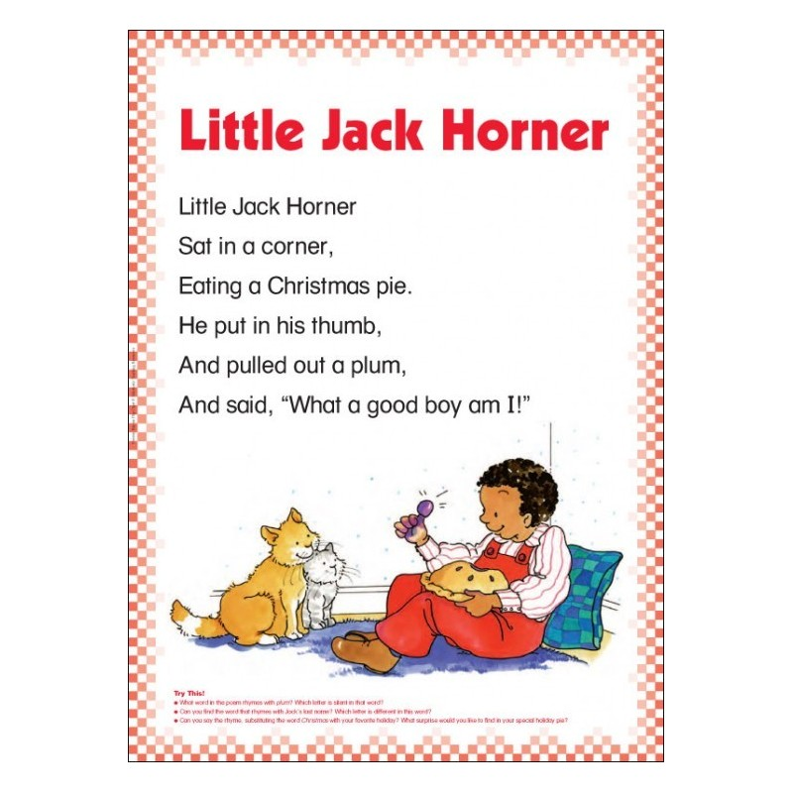
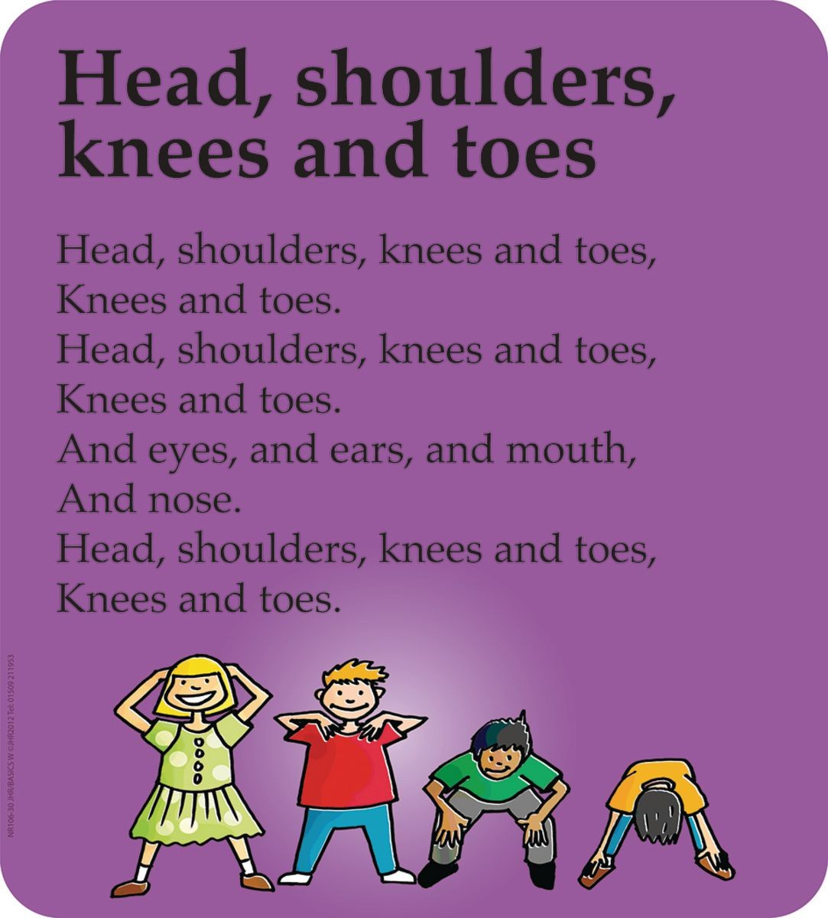
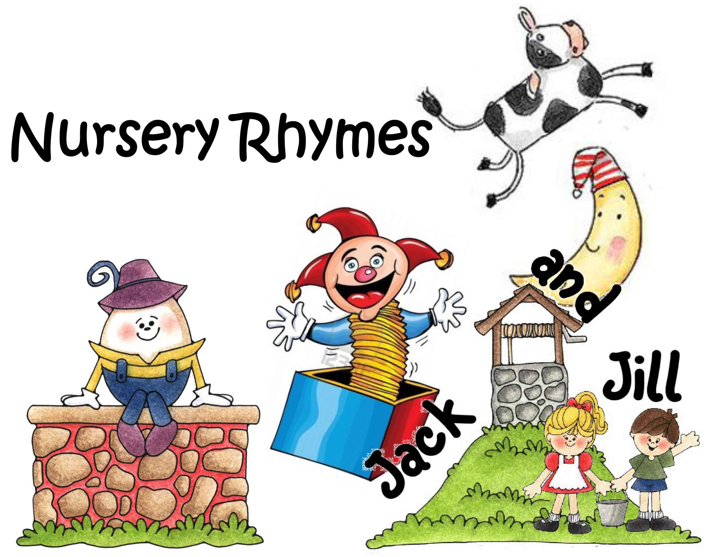
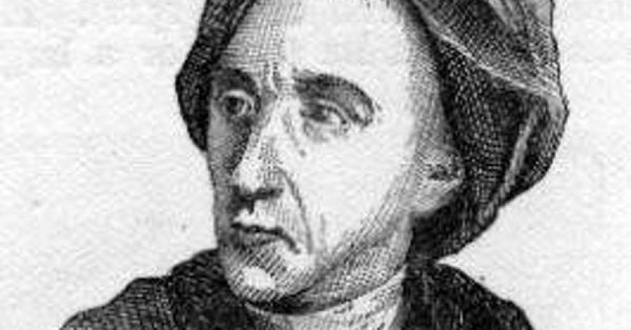
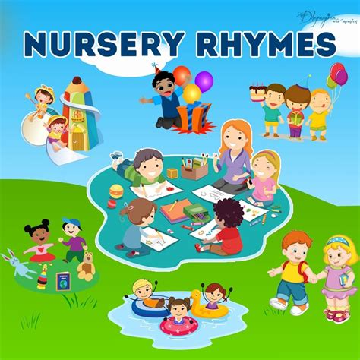
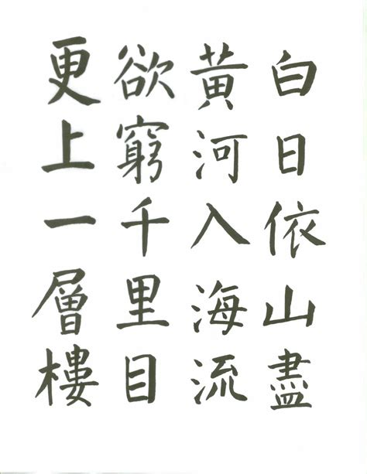
they delight small children because they rhyme,
have strong rhythm and a lot of repetition
Some poems tell a story
or describe something in a way
that will give the reader a strong impression.
By playing with the words in nursery rhymes,
children learn about language.
A lot of Tang poetry
has been translated into English.
The poems may not make sense and even seem contradictory,
but they are easy to learn and recite.
Another simple form of poem that students can easily write is the cinquain
Poets use
many different forms
of poetry to
express themselves.
A Few Simple Forms of English Poems
There are various reasons
why people write poetry.
Some of the first poetry a young child learns in
English is nursery rhymes.
With these, students can convey
a strong picture in just a few words.
Haiku is a Japanese form of poetry
that is made up of 17 syllables.
The language
is concrete
but imaginative,
Others try to
convey
certain emotions.
List poems have a flexible
line length and repeated
phrases which give both
a pattern and a rhythm
to the poem.
a poem made up of
five lines

