Slide 1
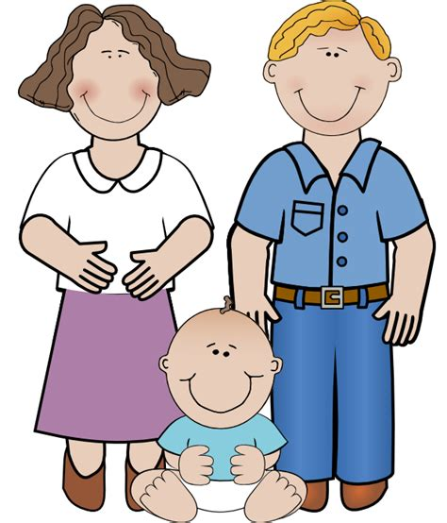
2
PEP M6U2—Poems
Song: Hush, Little Baby
作者：苏明慧
单位：华南师范大学外文学院

Slide 2
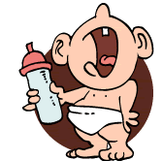
Hush, little baby, don't say a word,
Papa's gonna buy you a mockingbird.

Slide 3
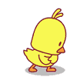
If that mockingbird won't sing,
Papa's gonna buy you a diamond ring.

Slide 4
If that diamond ring turns brass,
Papa's gonna buy you a looking glass.

Slide 5
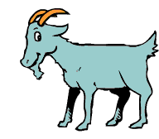
If that looking glass gets broke,
Papa's gonna buy you a billy goat.

Slide 6
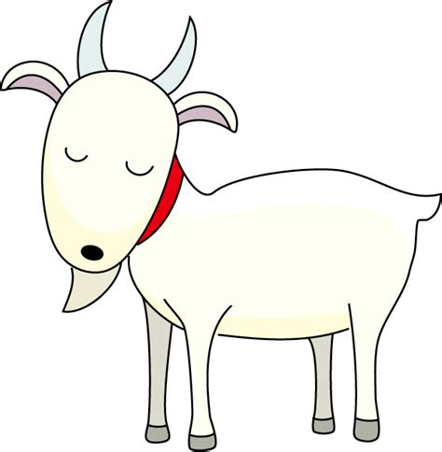
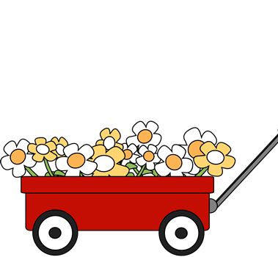
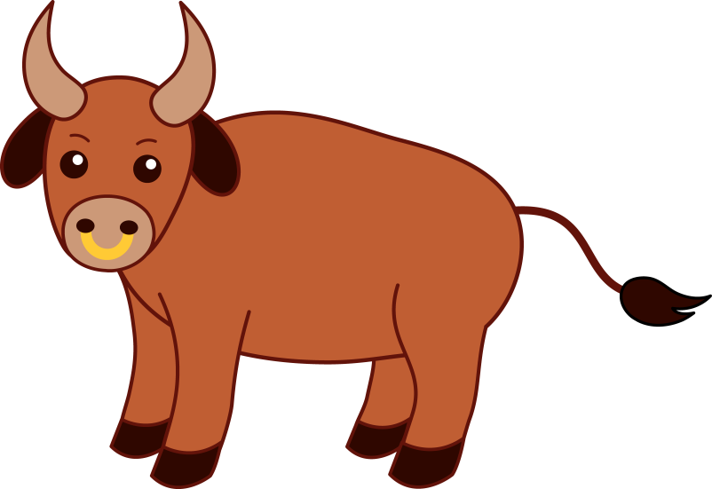
If that billy goat won't pull,
Papa's gonna buy you a cart and bull.

Slide 7
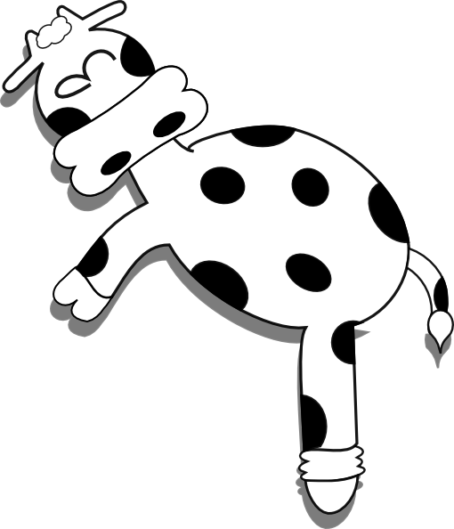
If that cart and bull fall down,
You'll be the sweetest little baby in town.

Slide 8
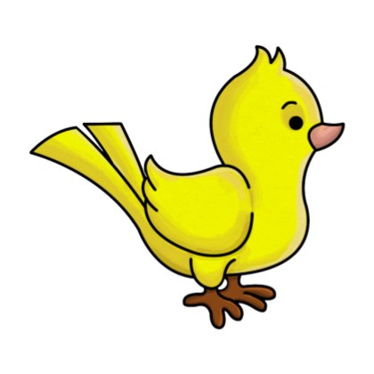
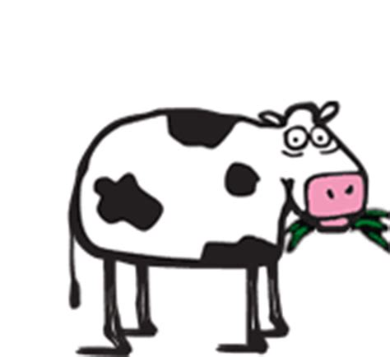
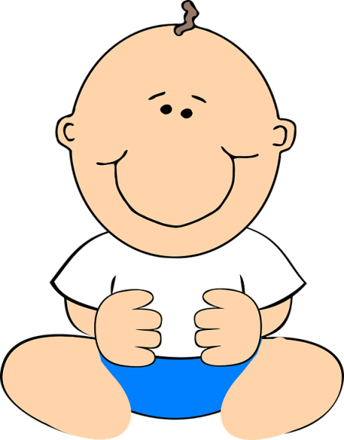
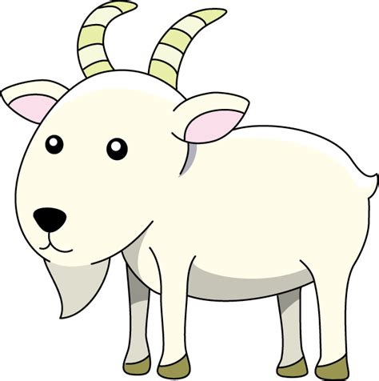

Slide 9
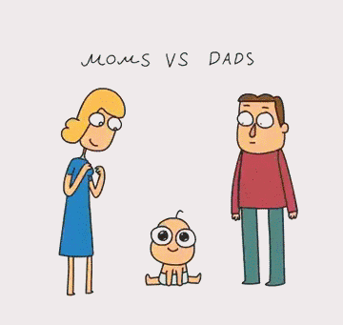

Slide 10
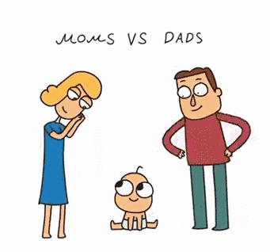

Slide 11
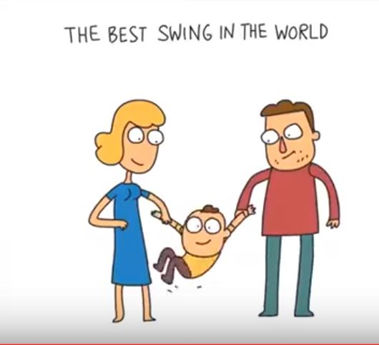

Slide 12
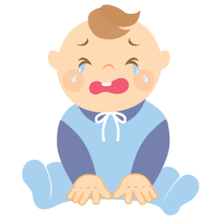
Hush, little baby, don't say a word

Slide 13
Papa's gonna buy you a mockingbird.

Slide 14
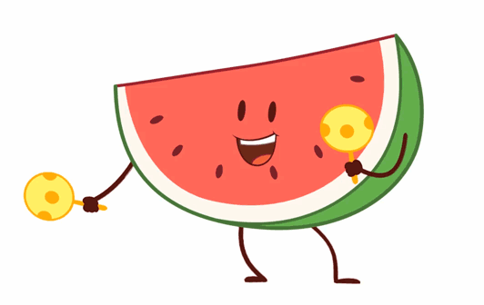
If that mockingbird won't sing,
Papa's gonna buy you a diamond ring.

Slide 15
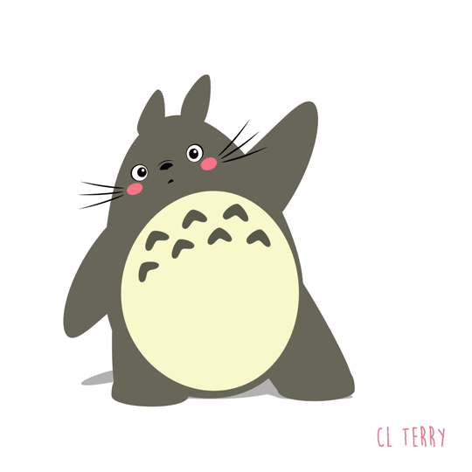
If that diamond ring turns brass,
Papa's gonna buy you a looking glass.

Slide 16
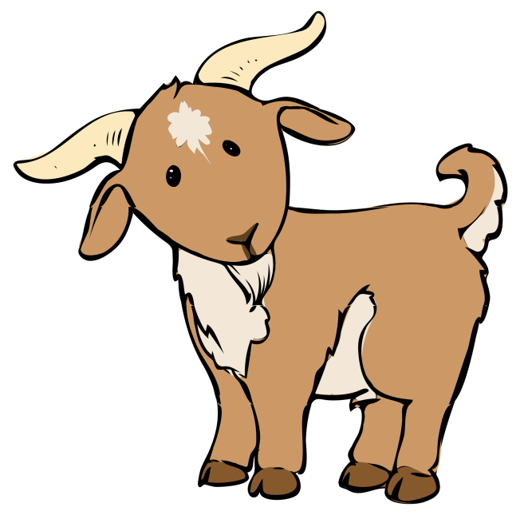
If that looking glass gets broke,
Papa's gonna buy you a billy goat.

Slide 17
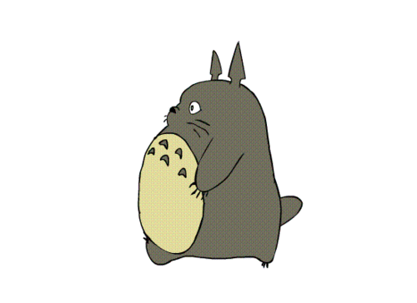
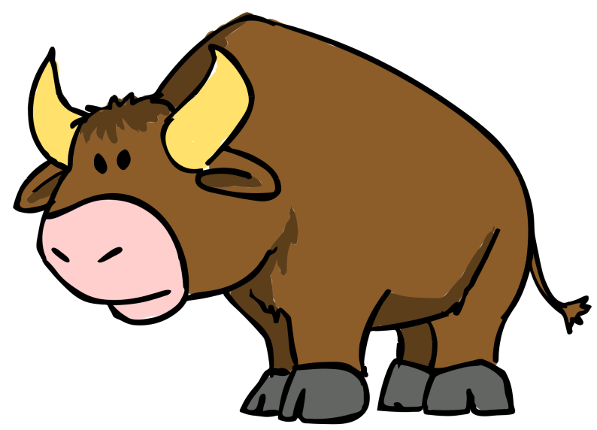
If that billy goat won't pull,
Papa's gonna buy you a cart and bull.

Slide 18
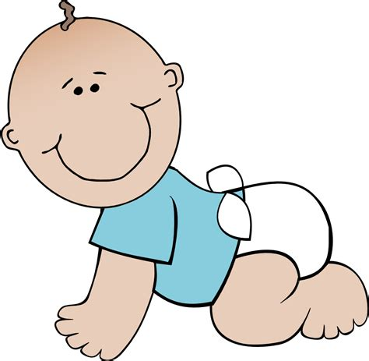
If that cart and bull fall down,
You'll be the sweetest little baby in town.

Slide 19
Thank You

