Slide 1
Keep Healthy
人教版
选修六 Unit 6
A Healthy Life
By
华南师范大学外文学院
李思洁

Slide 2
This song is about Maria
A close friend of mine
Who lost herself in drugs
She told me to wait for her
But guess what...
She never came back
And I'm still waiting
She told me
Wait 'til you hear from me
Monday, Tuesday it won't be
Wednesday, Thursday we will see
If only you can wait baby
Wait 'til you hear from me
Friday use your fantasy
Saturday you got over me
If only you can wait baby

Slide 3
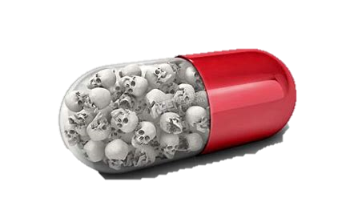
She was called Maria and she really was a friend
I remember when we were walking hand in hand
She was telling me that she understands
All the world and every thrill by taking little pills
So she was trying everything and more
Alcohol and speed, coke and weed and tried to score
Tragedy: she didn't feel much better than before
So she got away here quick to find a better kick

Slide 4
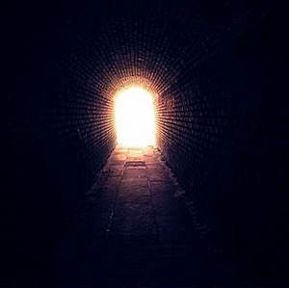
Never let it, wanna find her
Can't forget it to remind her
She's my sister, wanna tell her
How I miss her, she told me

Slide 5
Wait 'til you hear from me
Monday, Tuesday it won't be
Wednesday, Thursday we will see
If only you can wait baby
Wait 'til you hear from me
Friday use your fantasy
Saturday you got over me
If only you can wait baby
Wait, don't call you've got to
Wait 'til you hear from me
Wait, that's all you've got to

