Slide 1
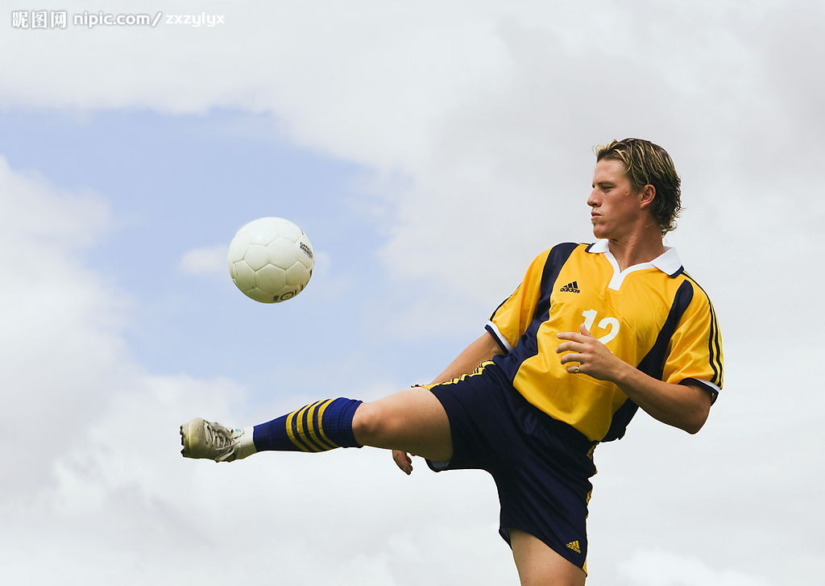
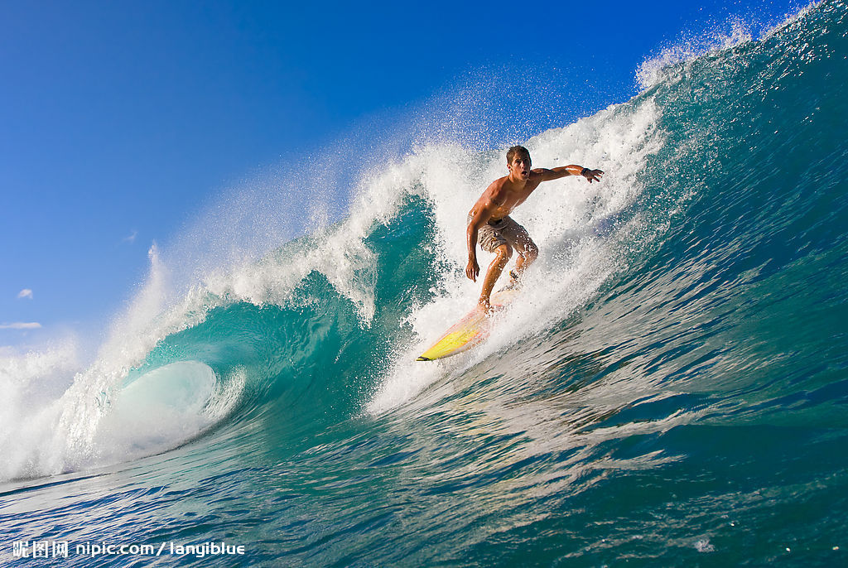
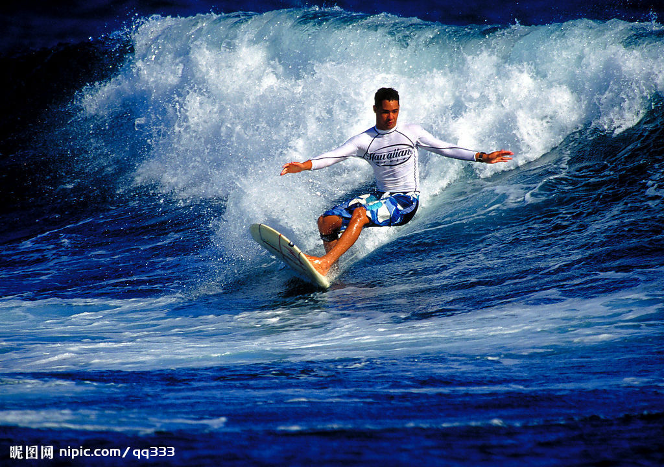
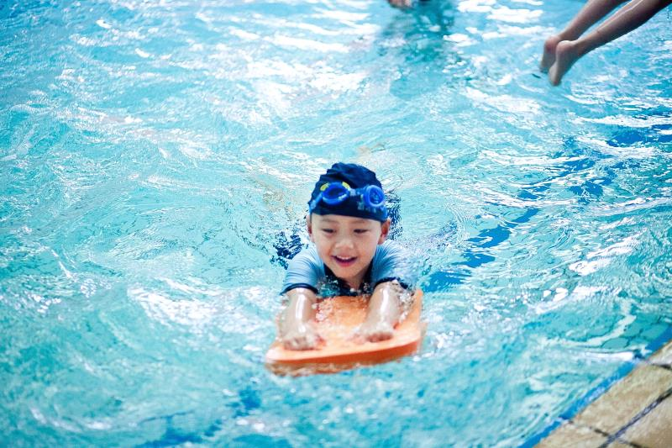
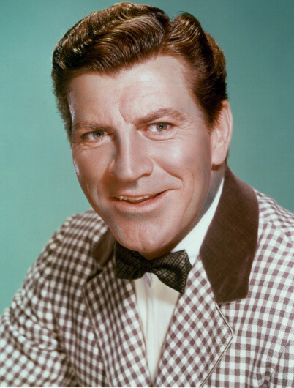
Chicken Fat
Robert Preston
Once more on the rise
Nuts to the flabby guys
Go you chicken fat go away
Touch down every morning ten times
Not just now and then
Give that chicken fat back to the chicken and don't be chicken again
Now then touch your toes with me Ready
Good morning
Hands on hips place
Give that chicken fat back to the chicken
And don't be chicken again
Touch down every morning ten times
Not just now and then
Push up every morning ten times
Push up Starting low
No don't be chicken again
No don't be chicken again
Chicken Fat ---- Robert Preston
Go you chicken fat go

Slide 2
PEP Module 6
Unit 3
A Healthy Life
陆家欣
华南师范大学外文学院

