Slide 1
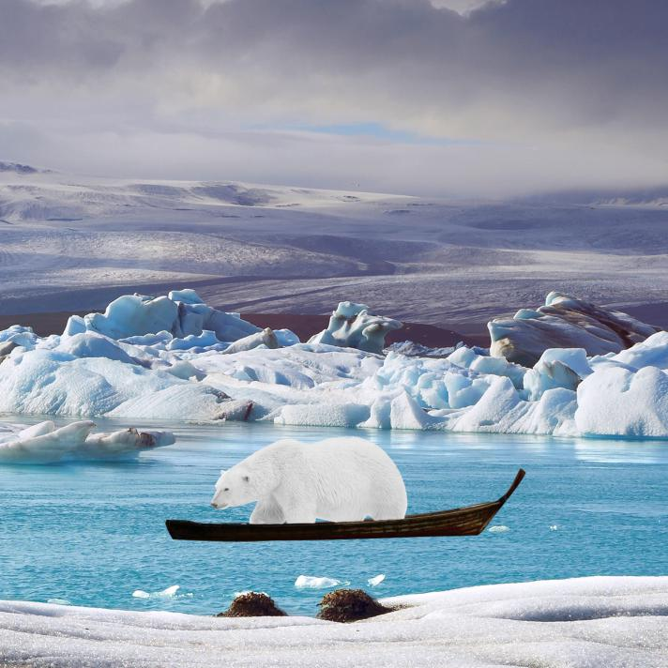
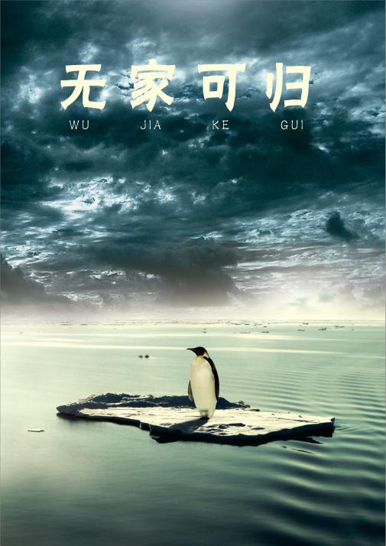
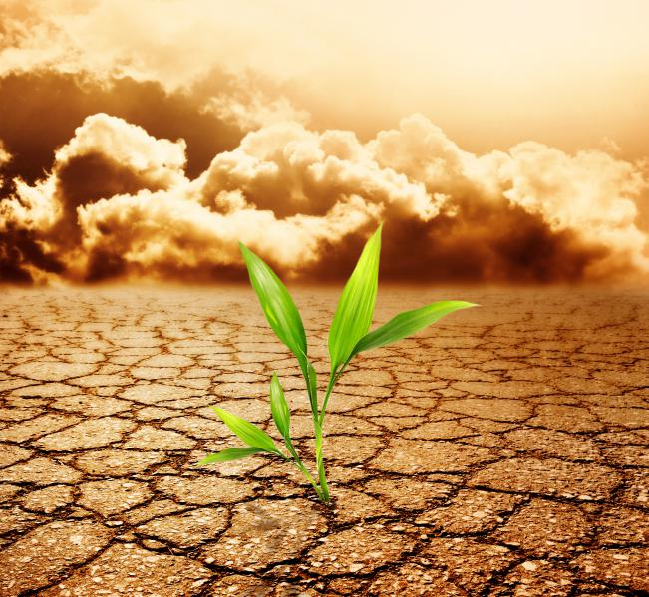
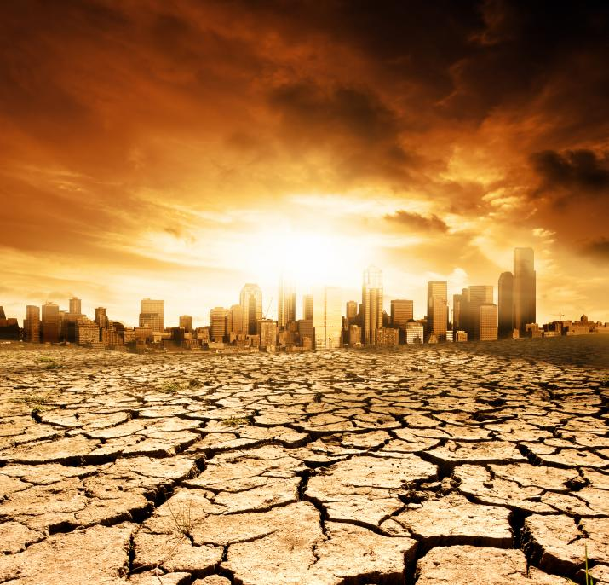
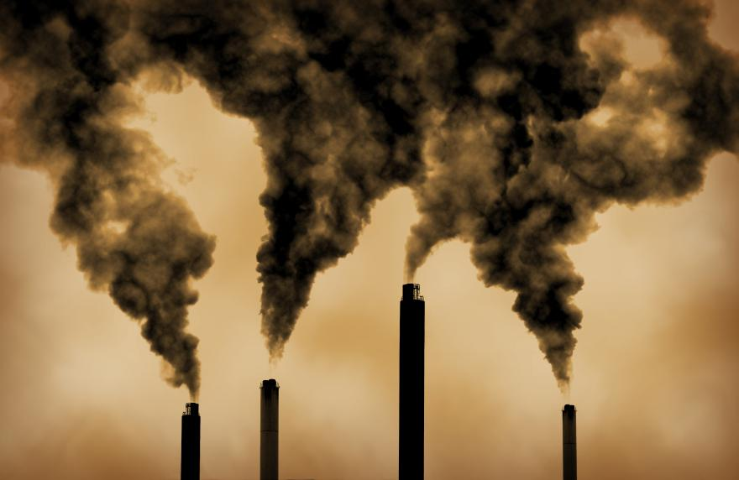
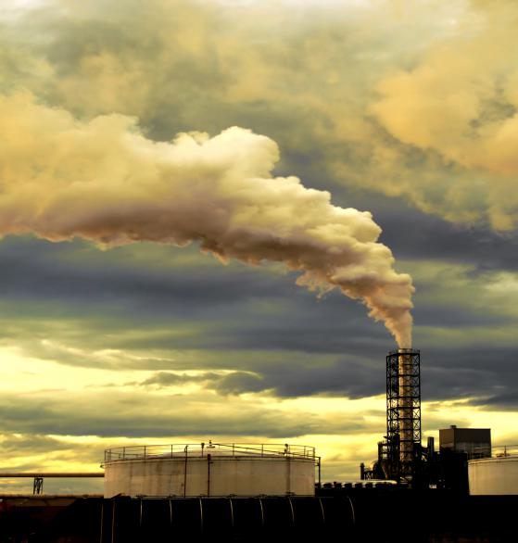
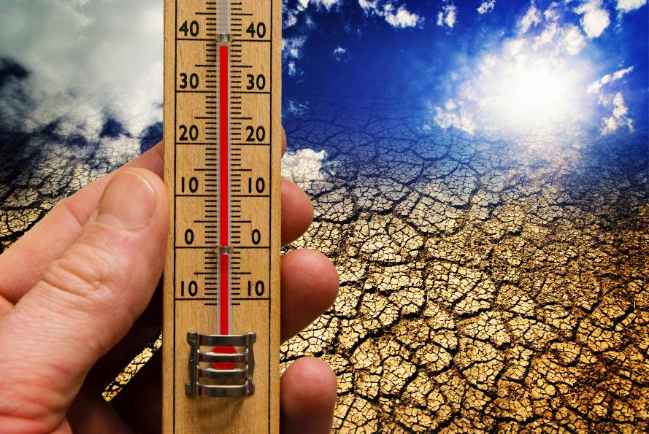
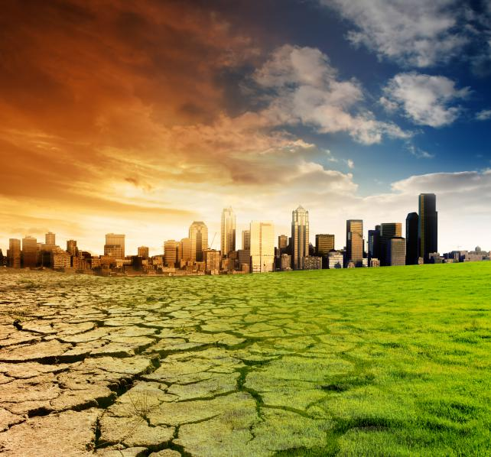
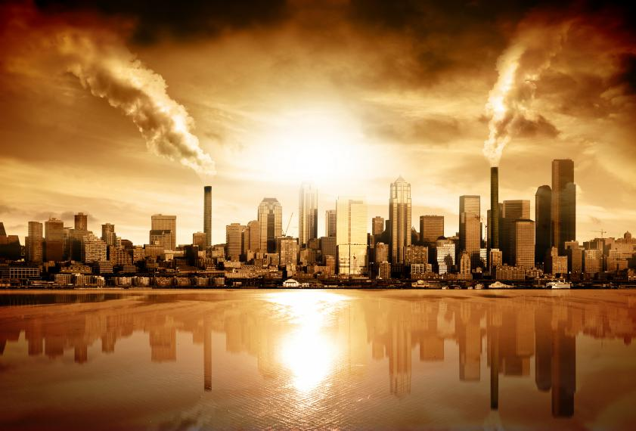
The crying Earth the weeping shores?
Did you ever stop to notice
All the boold we've shed before
What about sunrise
What about all the thing
Module 6 Unit 4:Globle Warming
What about rain
单位：华南师范大学外文学院
作者：林乔乔
版本：the PEP edition of English textbook
That you said was yours and mine
That you said we were to gain...
Did you ever stop to notice
What about all the things
What about killing fields
Is there a time

