Slide 1
Song: Gone With Home
Unit 4 Global warming
（人教版高中英语选修6）
作者：吴佩霞 20150201085
单位：华南师范大学外文学院

Slide 2
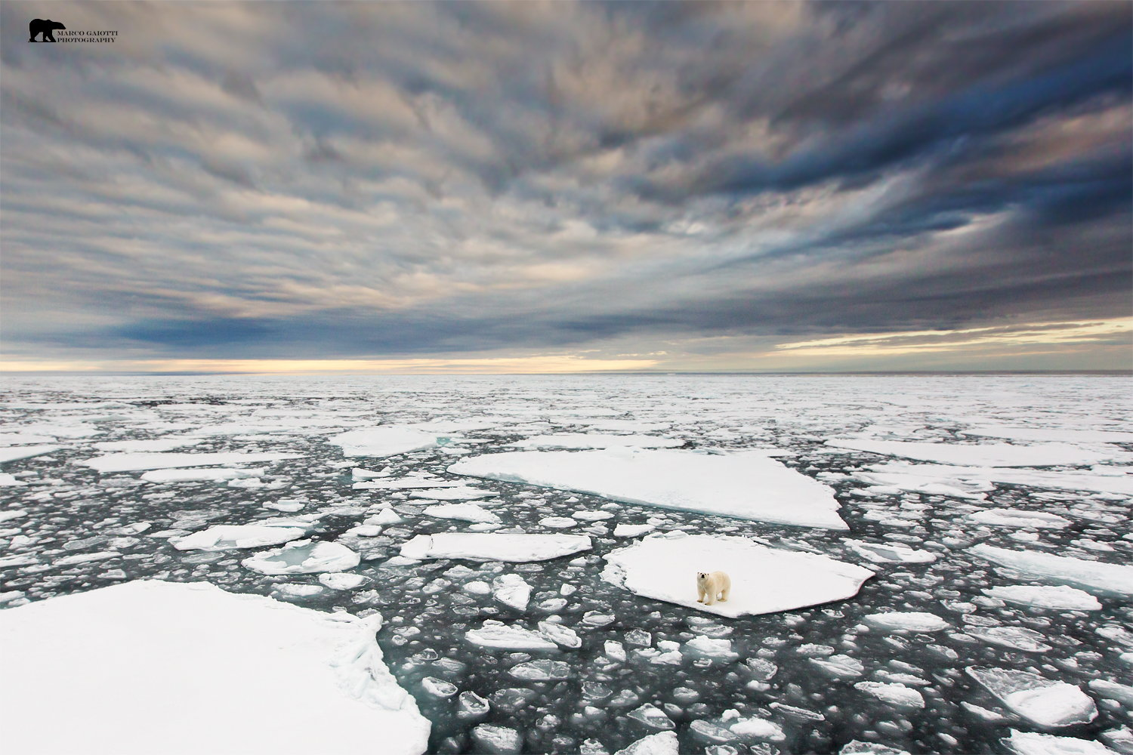
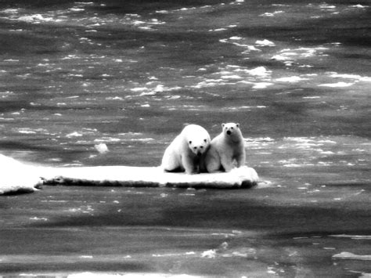
Homeless is my name
Where's the place used to be home
Skip>>

Slide 3
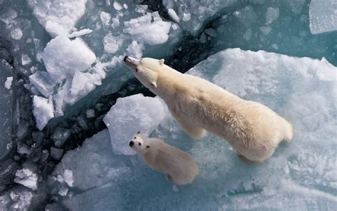
No one knows or no one tells
Could you take a shot at the riddle
Skip>>

Slide 4
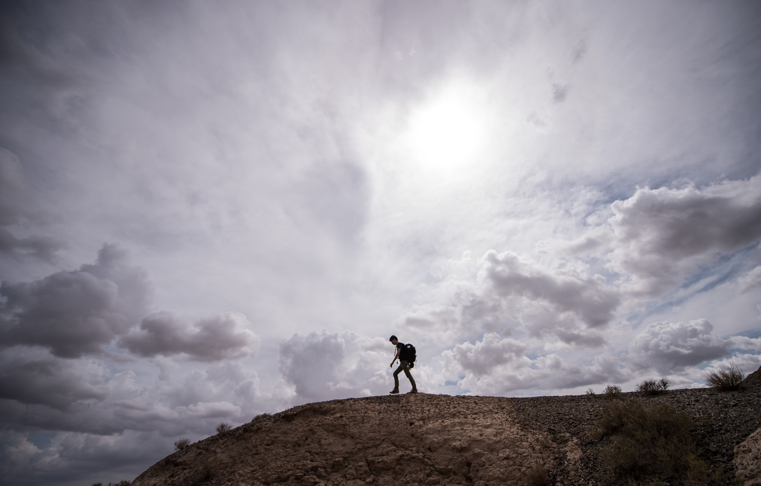
Wandering Life is not I want
Homecoming is only in my dream
Skip>>

Slide 5
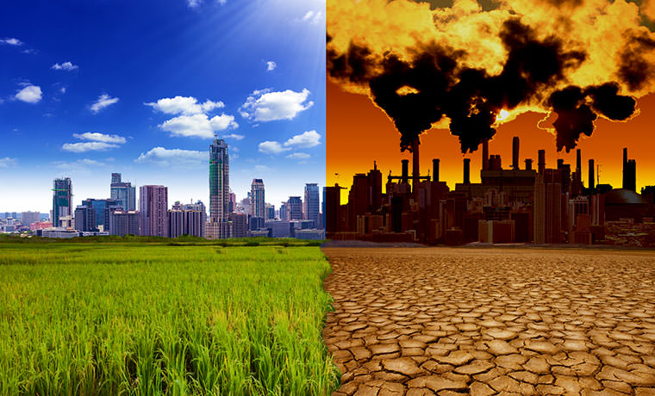
Homesick tortures me day and night
But all the hope gone with home
Skip>>

Slide 6
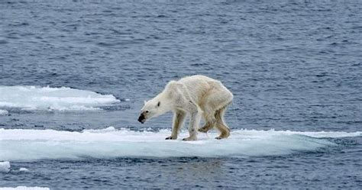
Homeless is not my name
I see the place used to be home
Skip>>

Slide 7
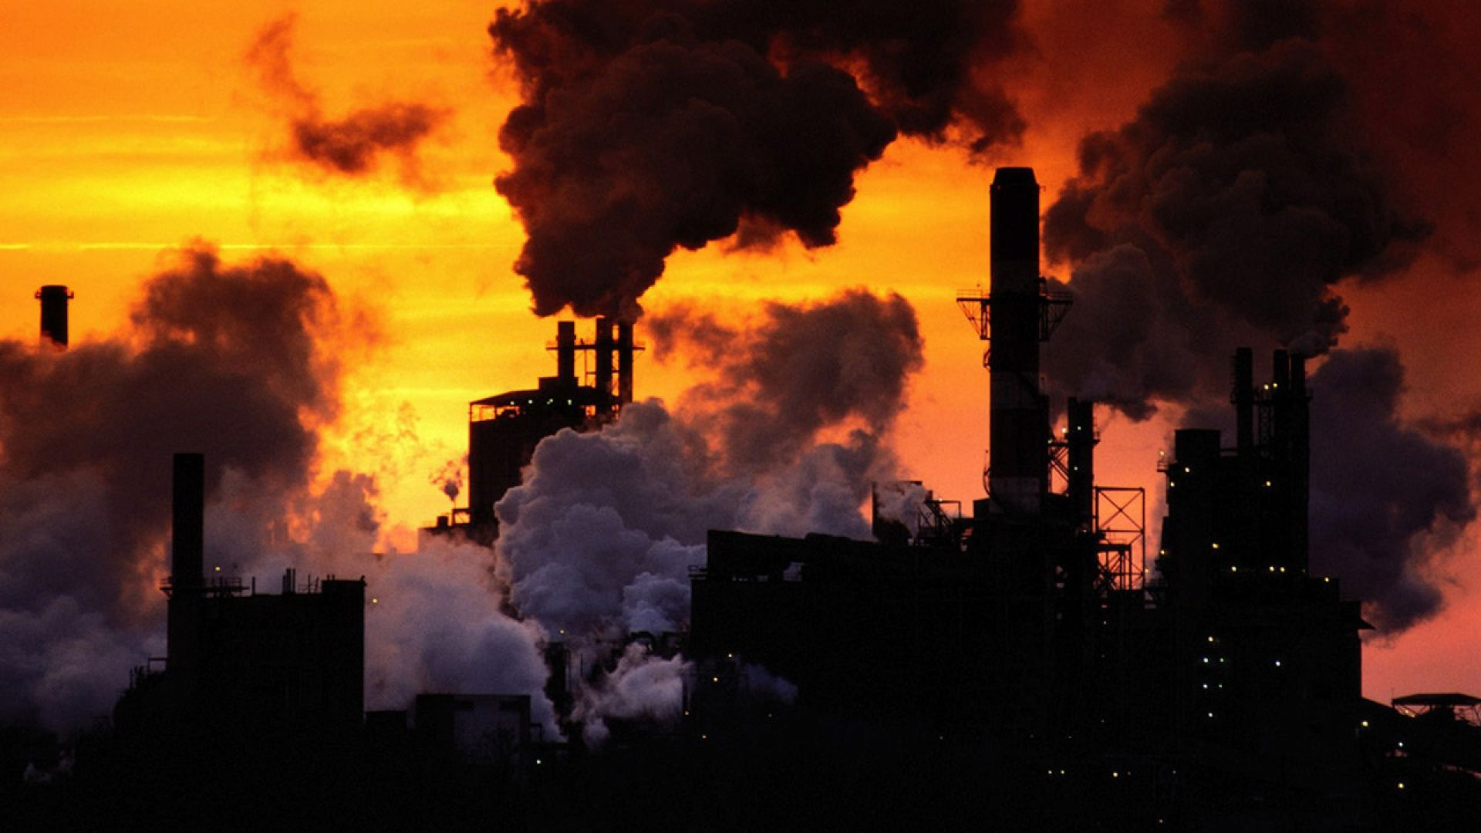
So beautiful and so warm
Destroyed by no one but myself
Skip>>

Slide 8
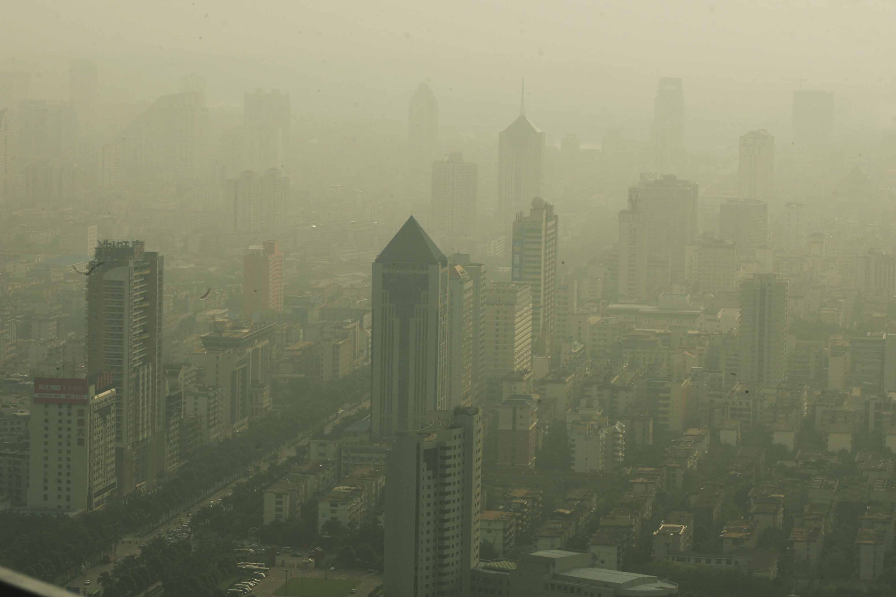
Confession for nothing
The die is cast there's no turning back now
Skip>>

Slide 9
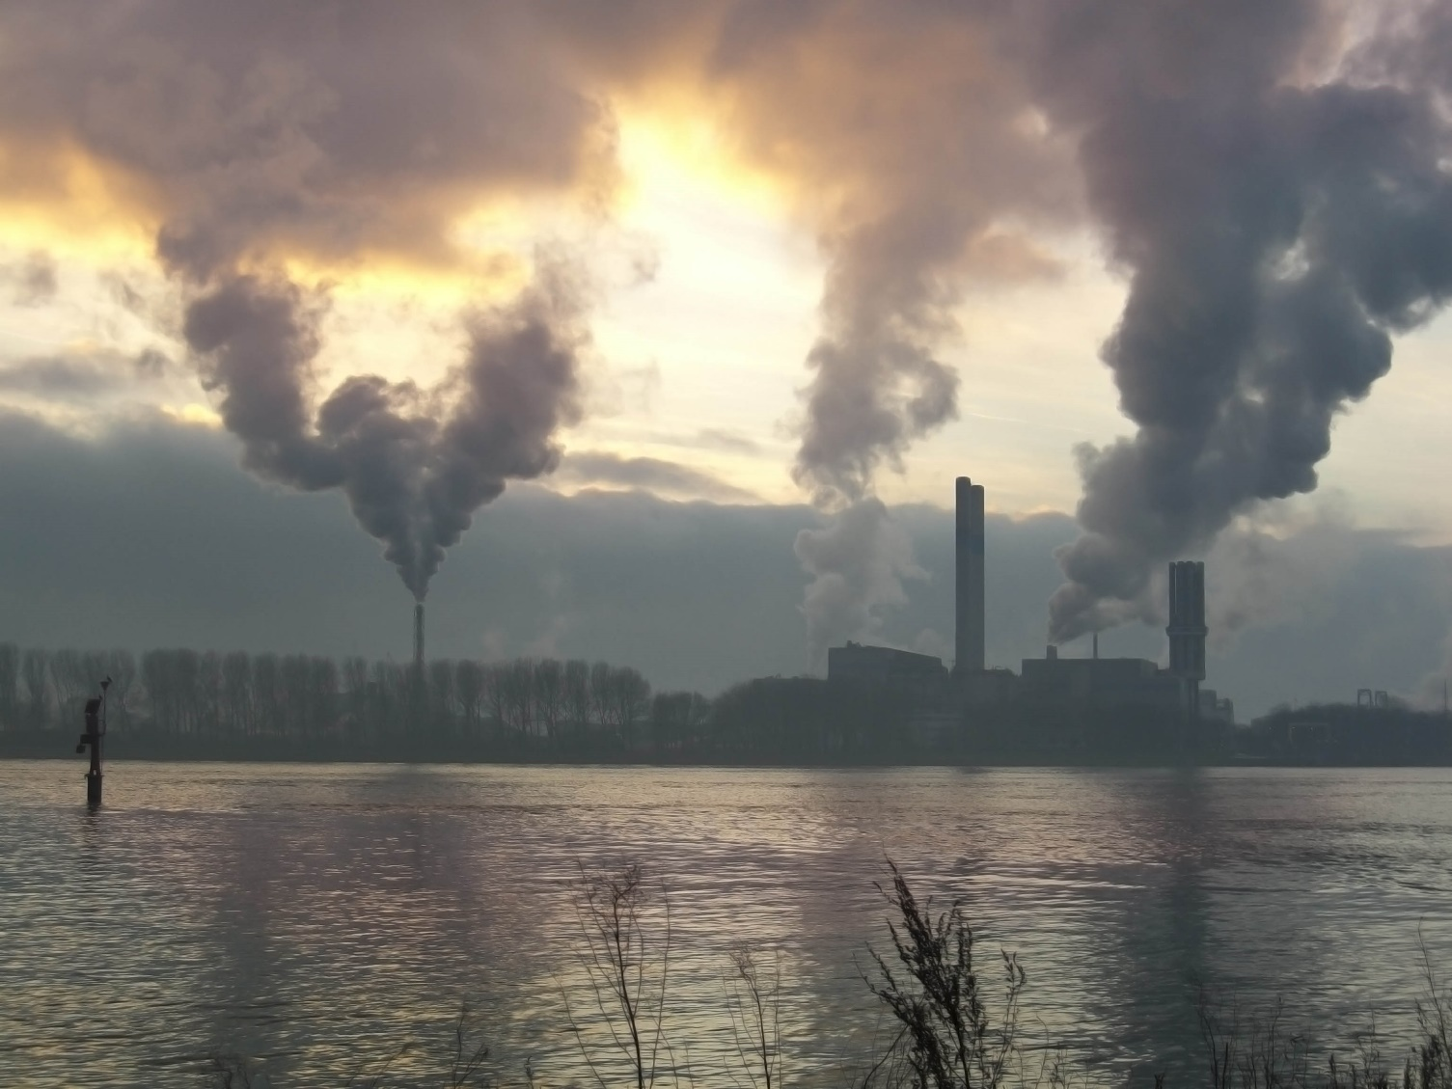
Oh the trial. Nothing I can really depend on
Can I turn the clock back and change everything
Skip>>

Slide 10
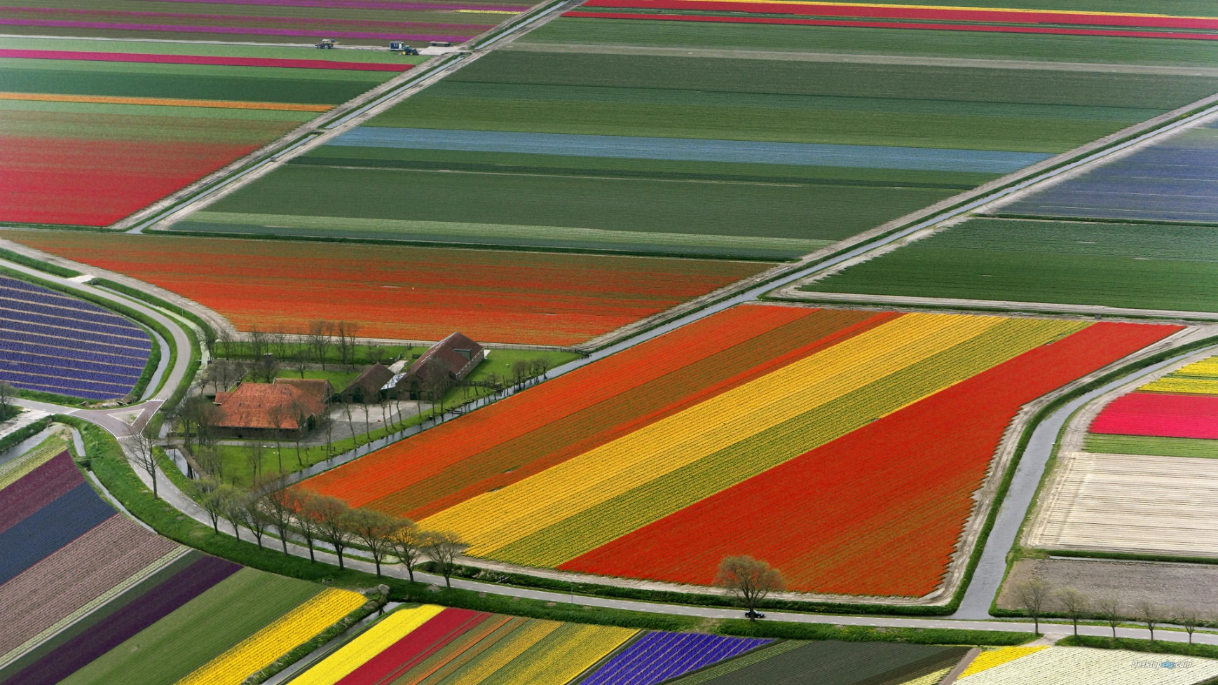
Trees of green
roses of red
Skip>>

Slide 11
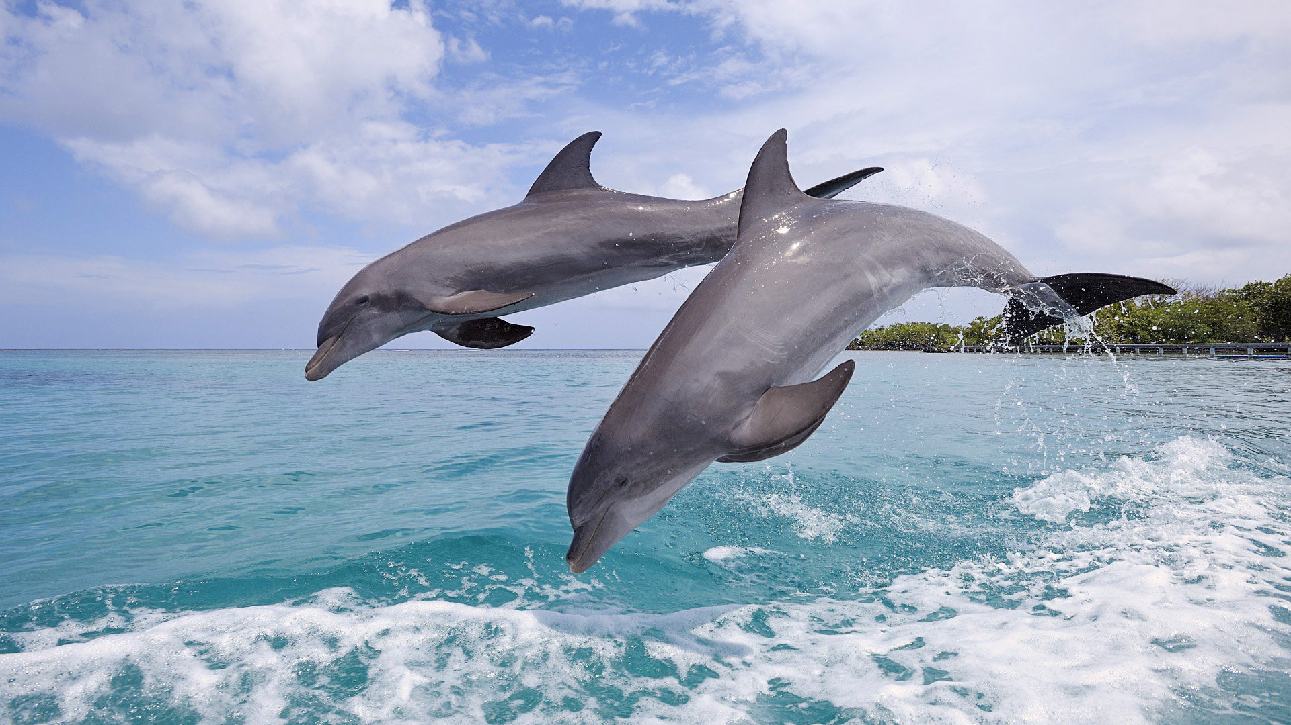
animals like children naive and carefree
Skip>>

Slide 12
skies of blue
clouds of white
Skip>>
and it's right

Slide 13
Don't let all the hope gone with home.
Skip>>

Slide 14
GLOBAL WARMING
GLOBAL WARNING

