Slide 1
A Healthy Life
M6 U3
华南师范大学外文学院
PEP
吴青霞

Slide 2
You're
out of touch
running in
in overtime
running better left behind

Slide 3
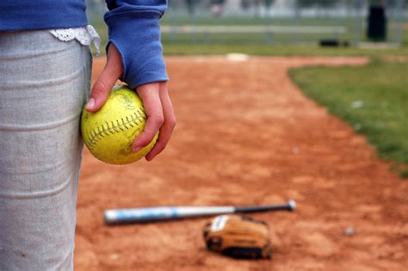
You've dropped the ball to catch it with
And is it all there really is

Slide 4
You're thinking but you're thinking
'Cause you know the best all things in life are
free
And it's all you need

Slide 5
You gotta
live your life
treat you right
give into the great thing appetite
shake it up
hold it down
do all the things that

Slide 6
You gotta
do all the things that
make you

Slide 7
beautiful
on high hopes
evergreen
got big dreams

Slide 8
So let them shine
we'll light it up

Slide 9
'Cause now's the time to find your voice
Wear your heart out on your sleeve

Slide 10
'Cause you know the best all things in life are
free

Slide 11
You gotta
live your life
treat you right
give into the great thing appetite
shake it up
hold it down
do all the things that

Slide 12
MAKE YOU

Slide 13
we won't forget
Live for a night
Live for the memories
we haven't made yet

Slide 14
turn up
the love
fall into it
Live for the memories we haven't made yet
This is our life no regrets

Slide 15
You gotta live your life
You gotta treat you right
You gotta give into the great thing appetite
You gotta shake it up
You gotta hold it down
You gotta do all the things that
MAKE YOU

Slide 16
Let the world be a
that you fill with

