Slide 1
高中英语人教版 M6U5 THE POWER OF NATURE 何祖君 华南师范大学外文学院

Slide 2
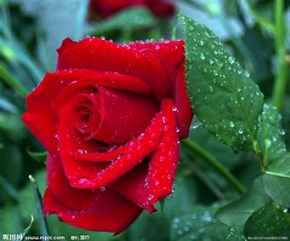
I see trees of green
red roses too
Notes:
00：07

Slide 3
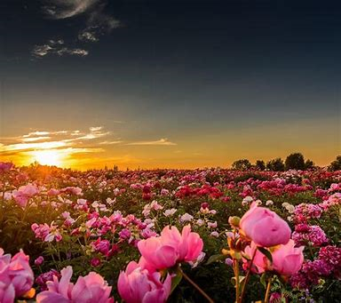
I see them bloom
for me and you
Notes:
00：15

Slide 4
And I think to myself
what a wonderful world
Notes:
00:20

Slide 5
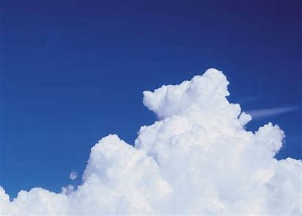
I see skies are blue
and clouds of white
Notes:
00:33

Slide 6
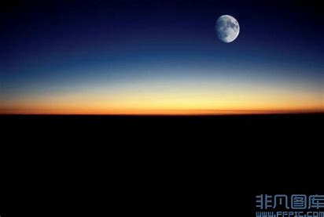
The bright blessed day
and dark sacred night
Notes:
00:41

Slide 7
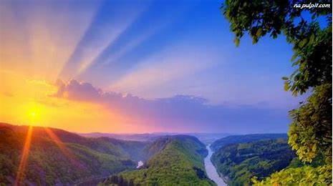
And I think to myself
what a wonderful world
Notes:
00：48

Slide 8
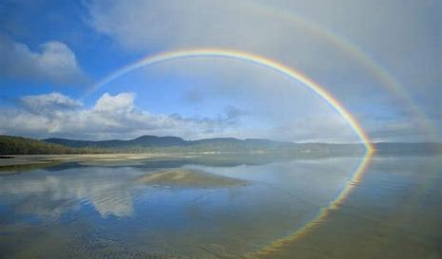
The colors of the rainbow
so pretty in the sky
Notes:
01:01

Slide 9
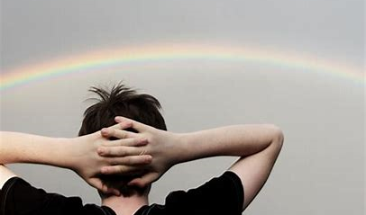
Are also on the faces
of people going by
Notes:
01:08

Slide 10
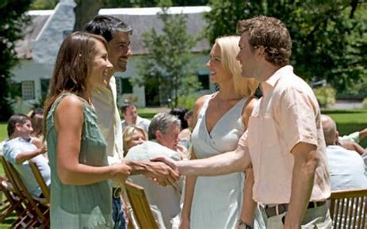
I see friends shaking hands
saying "How do you do?"
Notes:
01:14

Slide 11
They’re really saying
"I love you"
Notes:
01:22

Slide 12
I hear babies crying
I watch them grow
Notes:
01:28

Slide 13
They’ll learn much more
than I'll ever know
Notes:
01:35

Slide 14
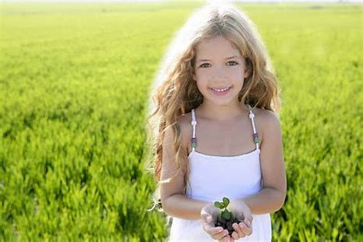
what a wonderful world
And I think to myself
Notes:
01:41

Slide 15
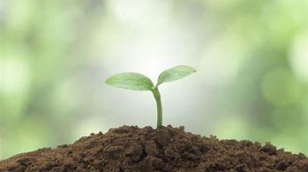
Yes I think to myself
What a wonderful world
Notes:
01:53

