Slide 1
The Power of Nature
人教版高中英语M6U5
作者：刘 茵
单位：华南师范大学外文学院

Slide 3
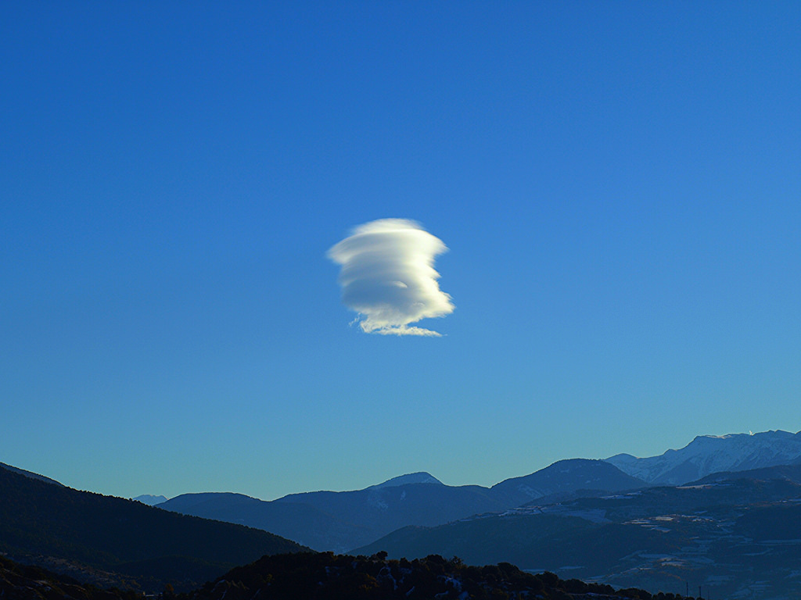
I wandered lonely
as a cloud
That floats on high o'er vales and hills

Slide 4
When all at once I saw a crowd
When all at once I saw a crowd

Slide 5
A host of golden daffodils

Slide 6
Beside the lake, beneath the trees
Fluttering and dancing in the breeze

Slide 7
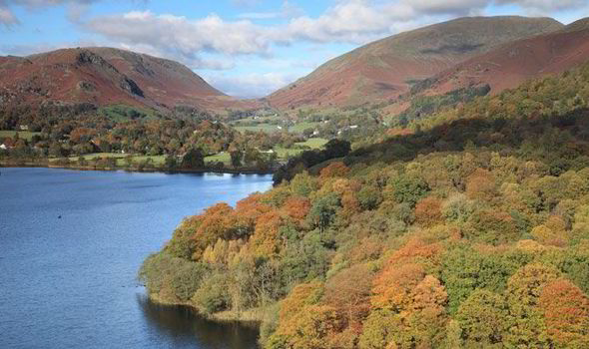
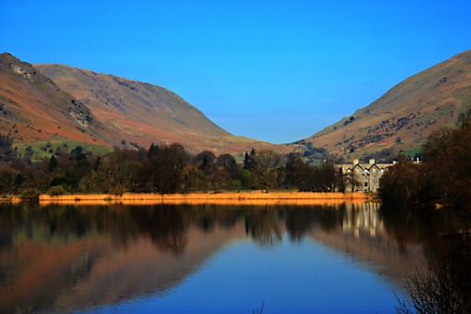

Slide 8
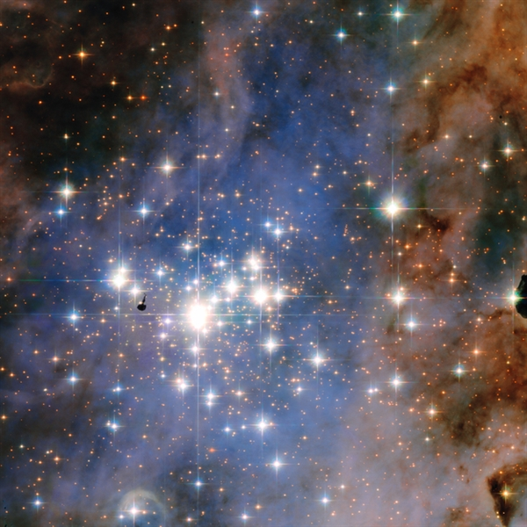
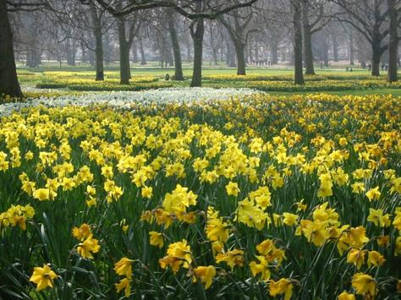
Continuous as the stars that shine
And twinkle on the Milky Way

Slide 9
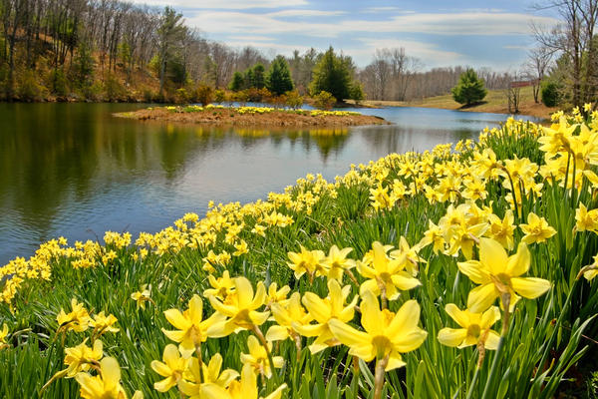
They stretched in never-ending line

Slide 10
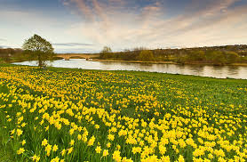
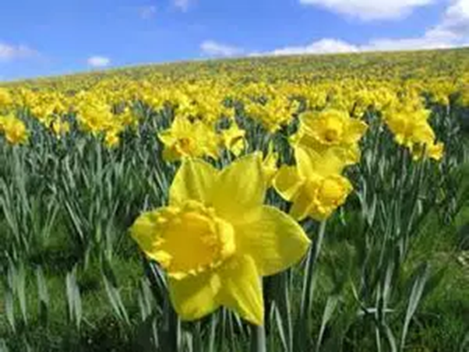
Along the margin of a bay
Ten thousand saw I at a glance
Tossing their heads in sprightly dance

Slide 11
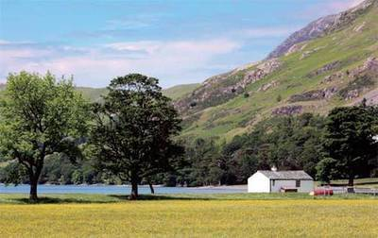
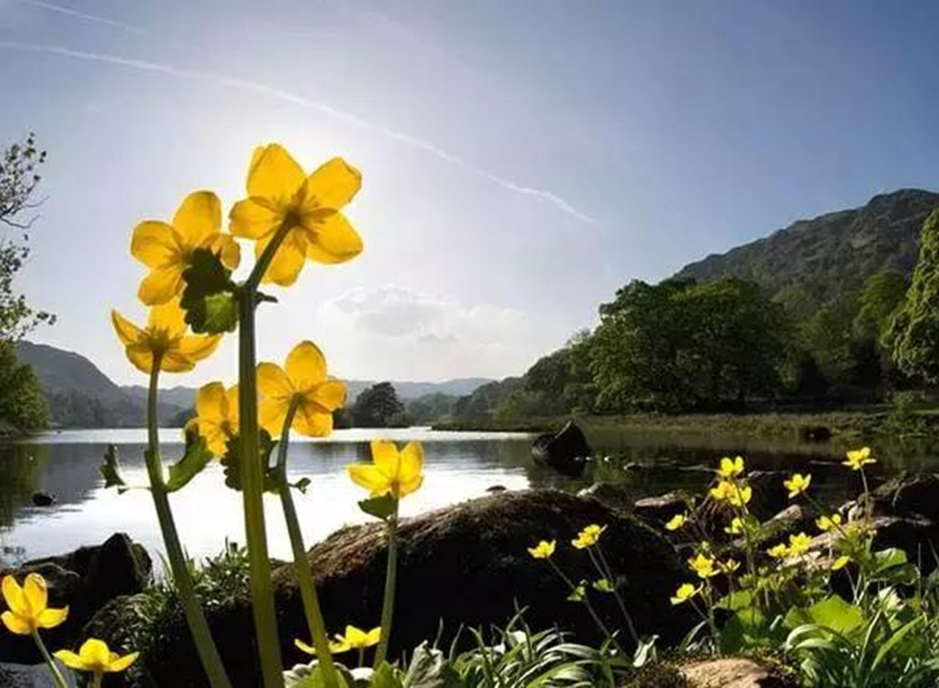
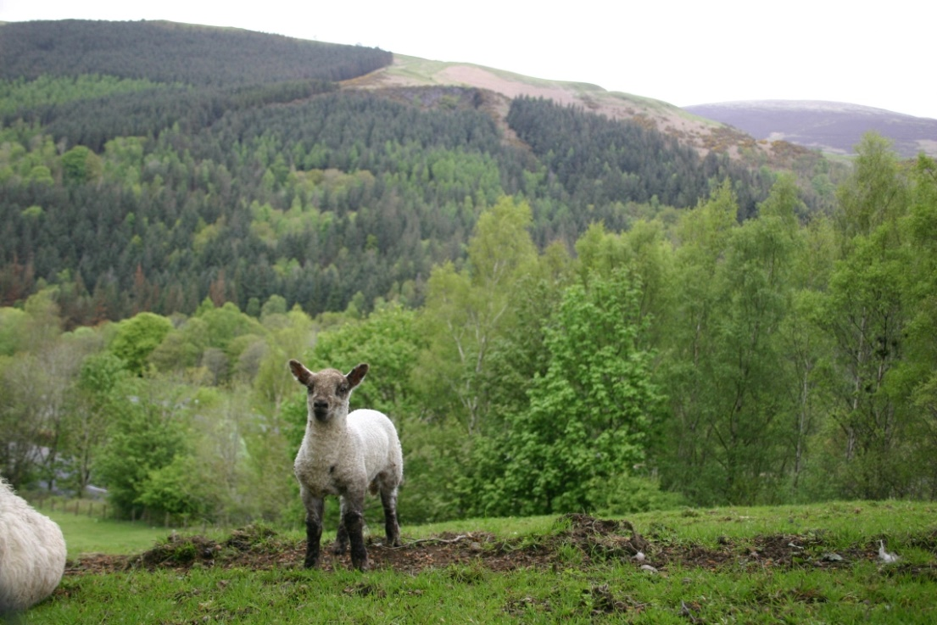

Slide 12
A poet could not but be gay
Out-did the sparkling waves in glee
The waves beside them danced, but they

Slide 14
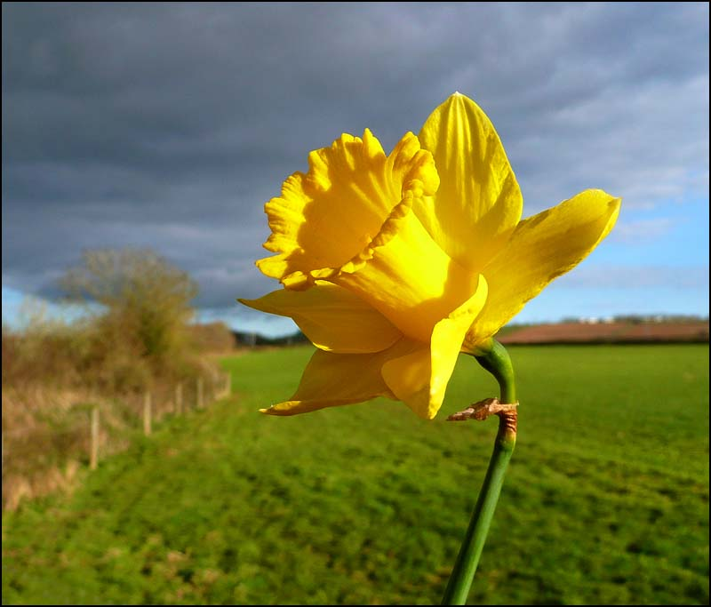
I gazed -and gazed -but little thought
What wealth the show to me had brought

Slide 15
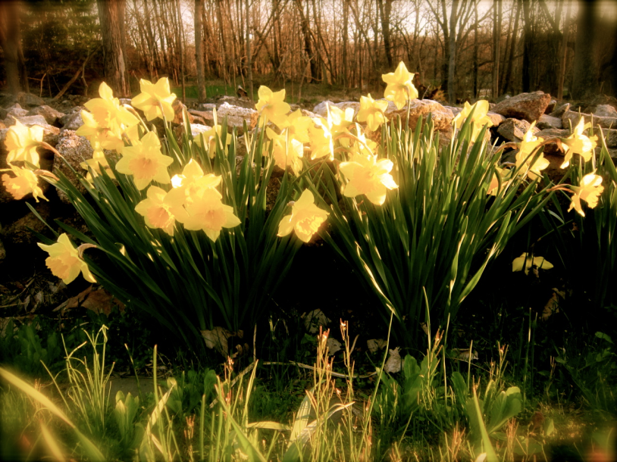
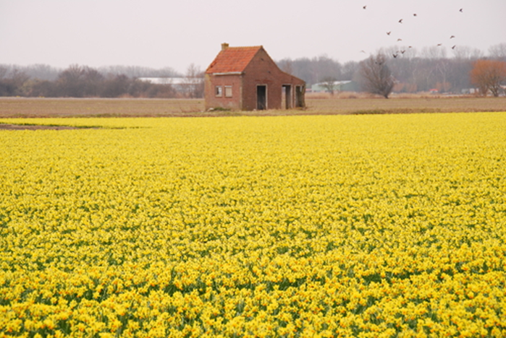

Slide 16
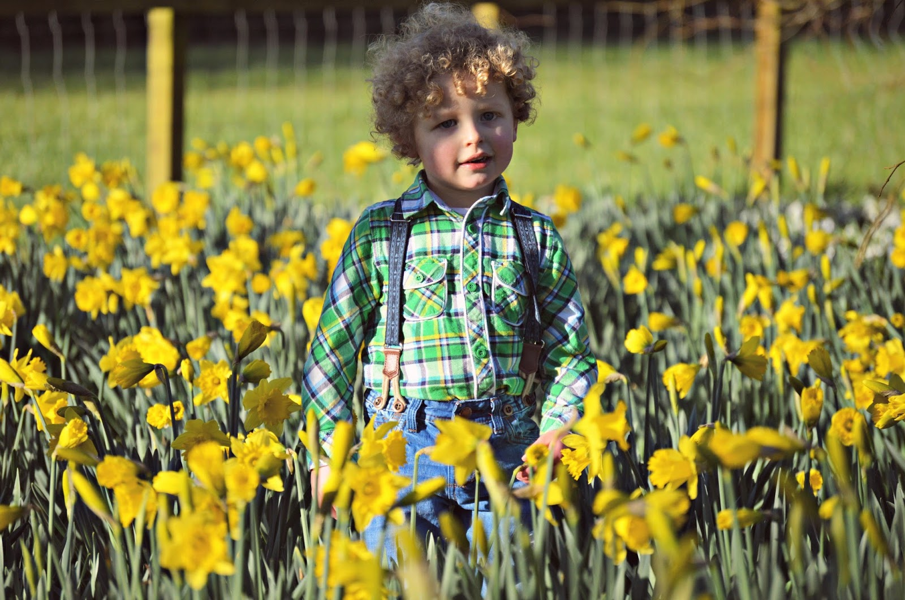

Slide 17
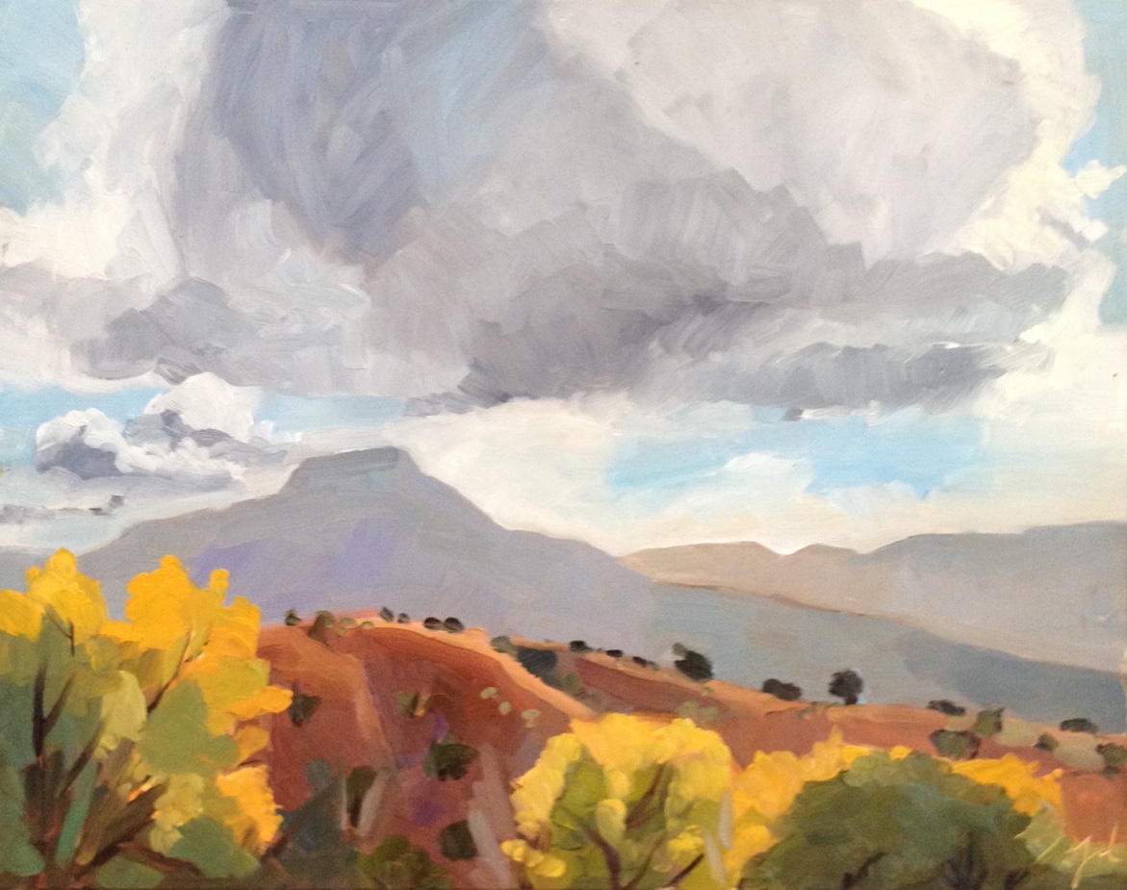
For oft, when on my couch I lie
In vacant or in pensive mood

Slide 18
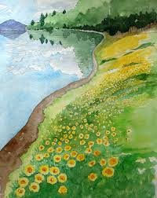
They flash upon that inward eye
Which is the bliss of solitude
And then my heart with pleasure fills
And dances with the daffodils

Slide 19
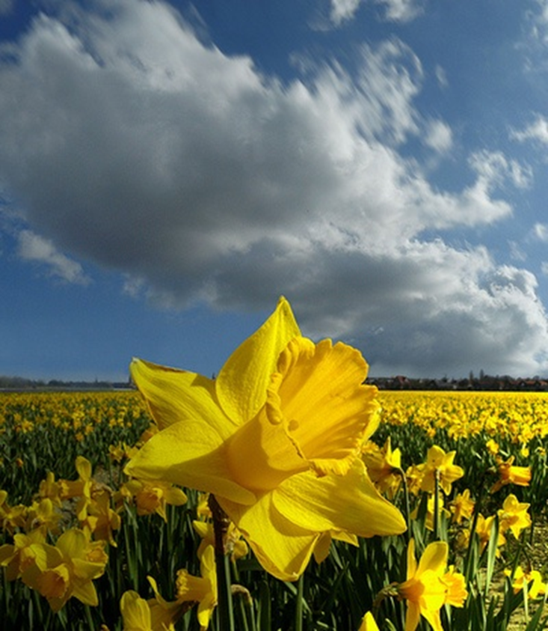
The power of nature never end

