Slide 1
Equally Destructive
人教版高中英语M6U5
The Power of Nature
谢逸凡
华南师范大学外文学院

Slide 2
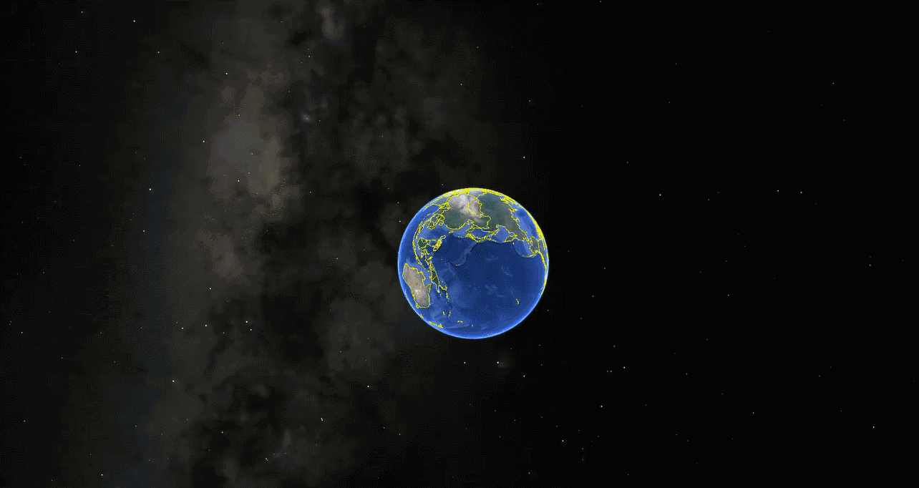

Slide 3
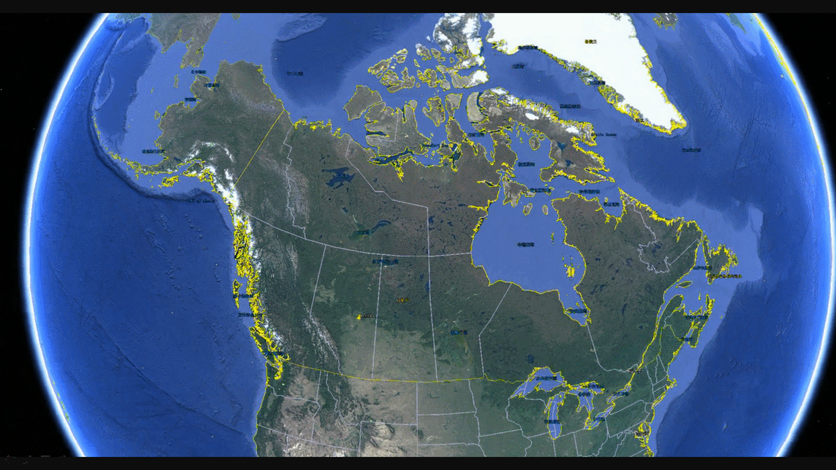

Slide 4
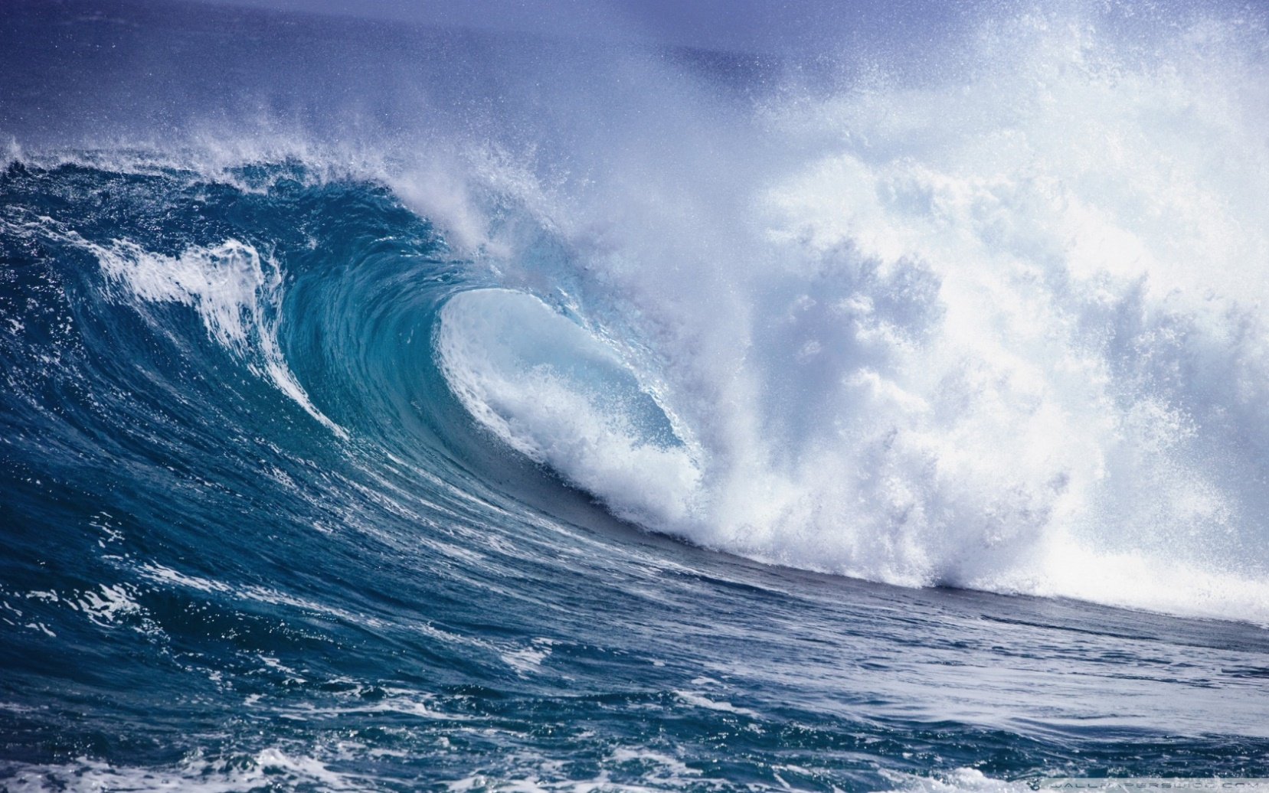
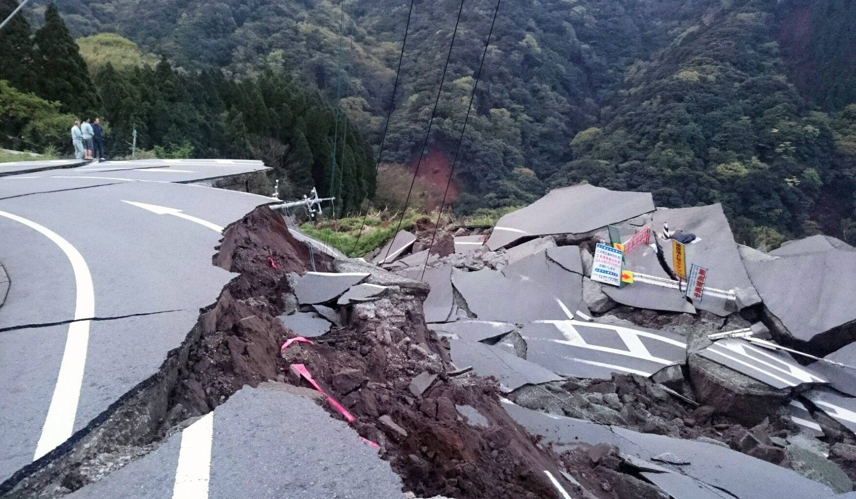
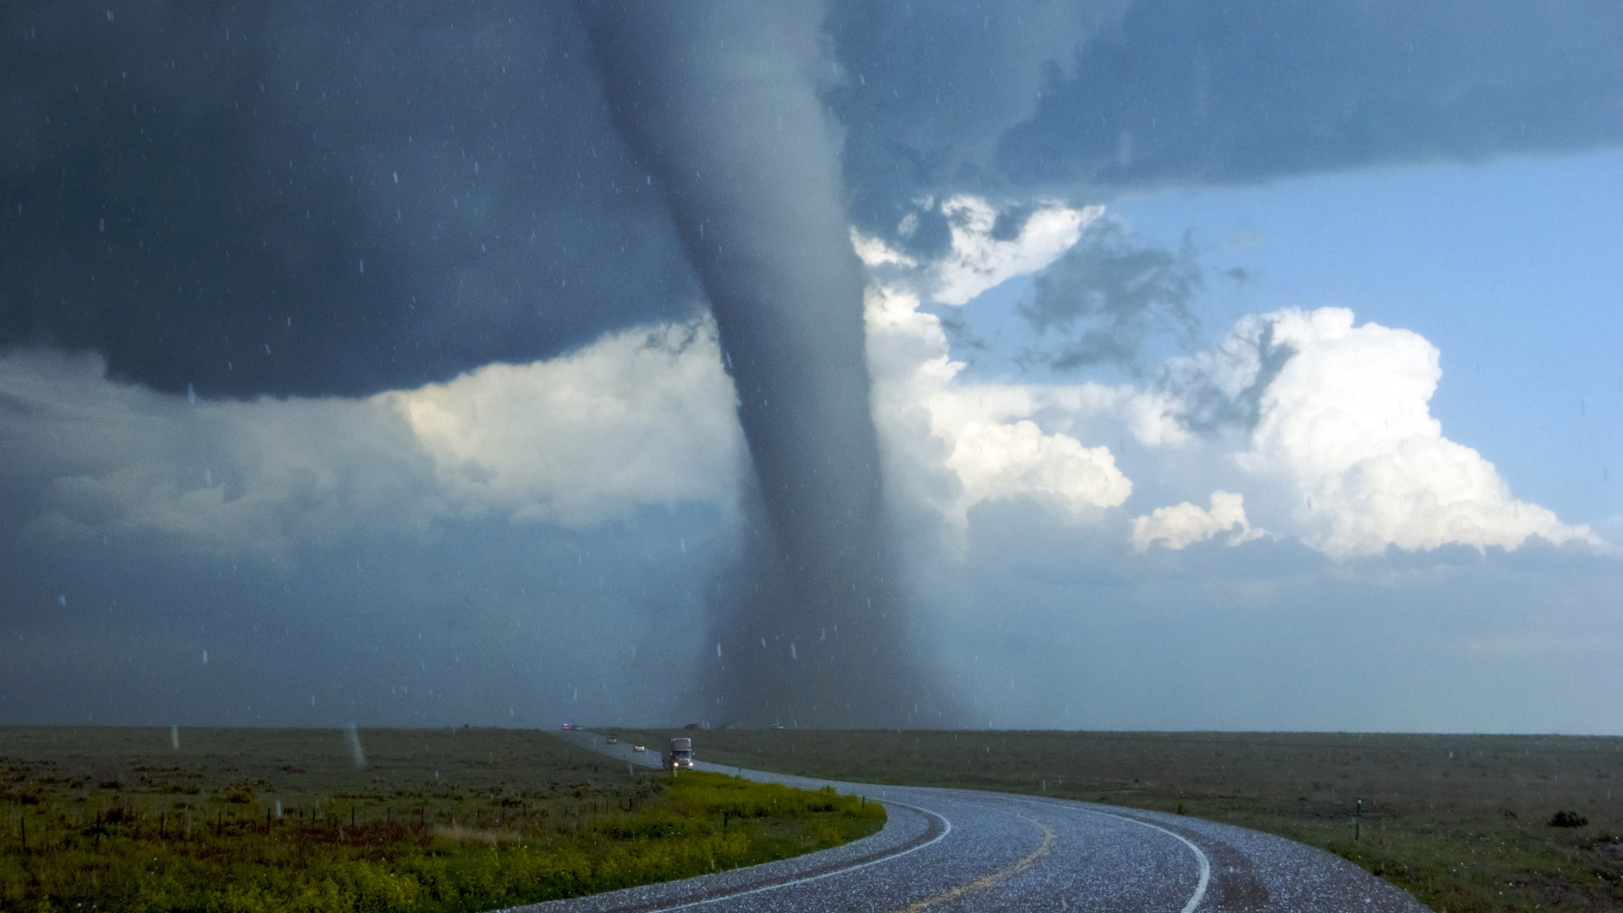
The wind has lost control
Ground is shaking
Waves are breaking

Slide 5
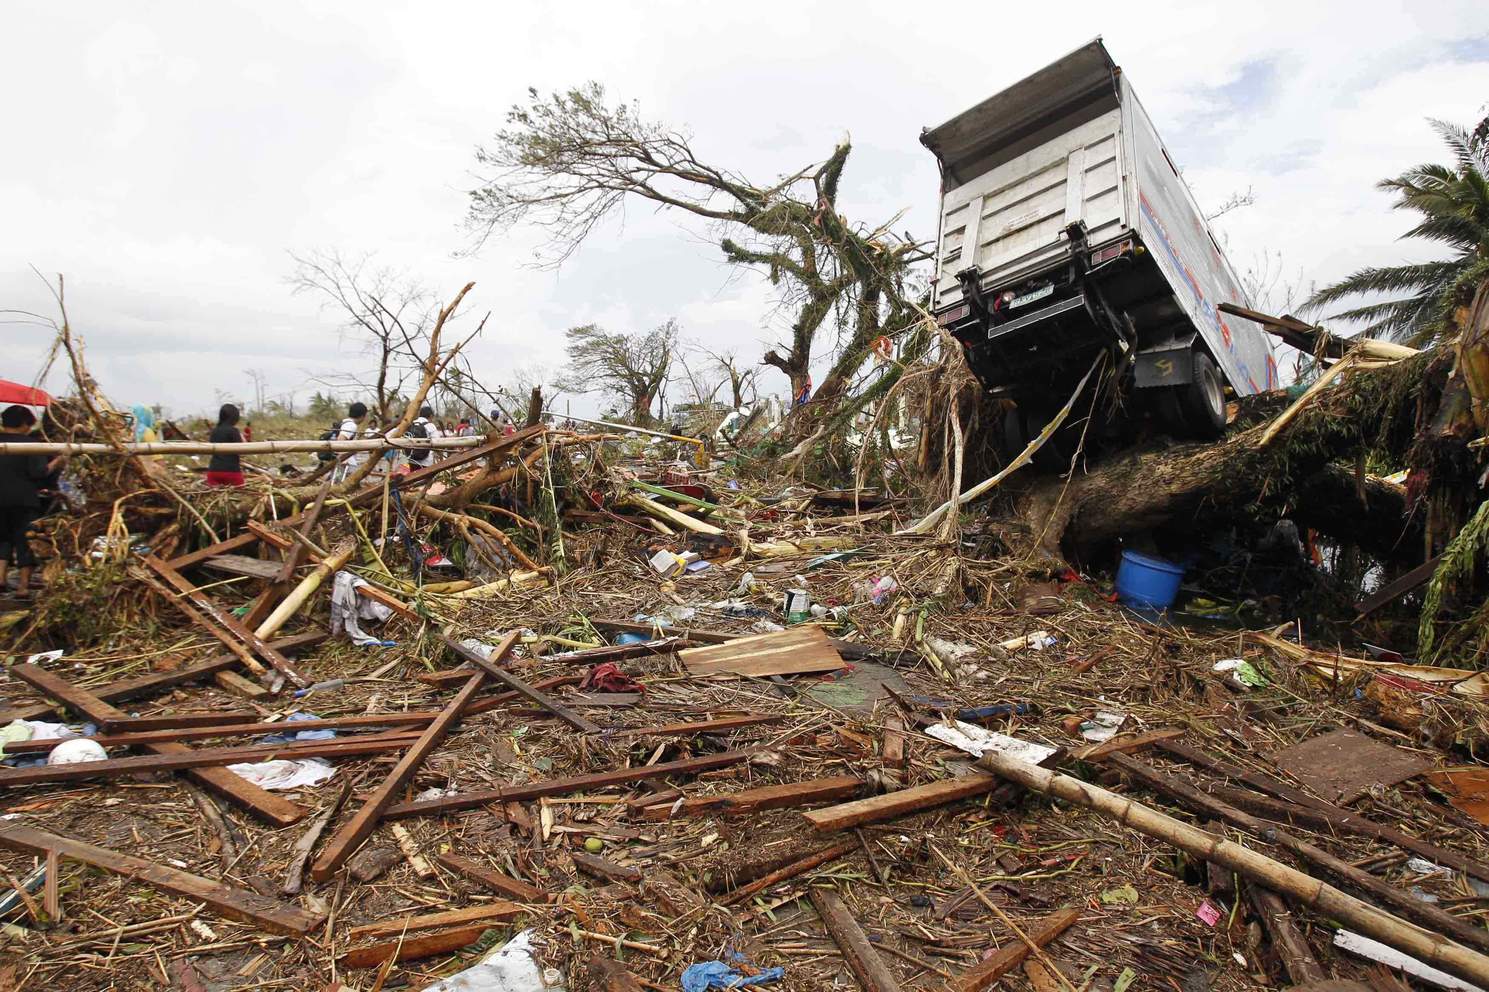
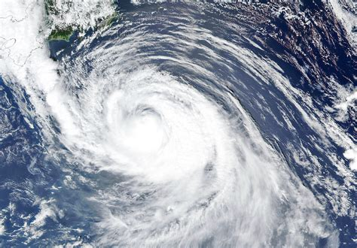
While its lifting force fools gravity
The air is shifting

Slide 6
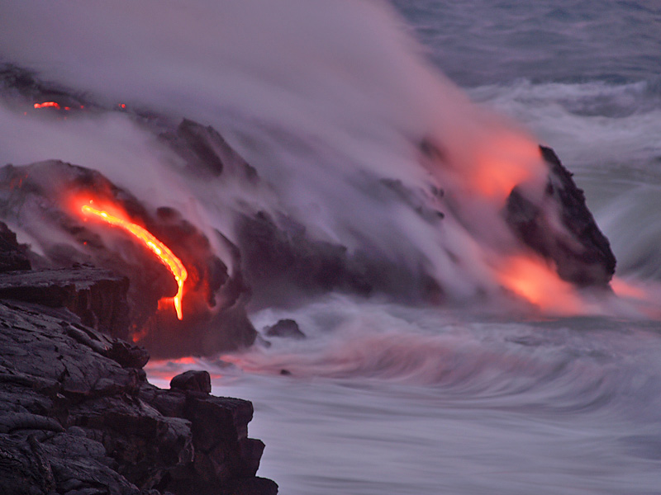
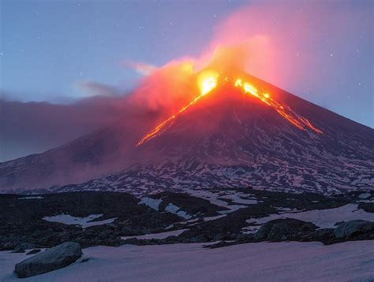
Vast explosion as it bursts the earth
A huge eruption

Slide 7
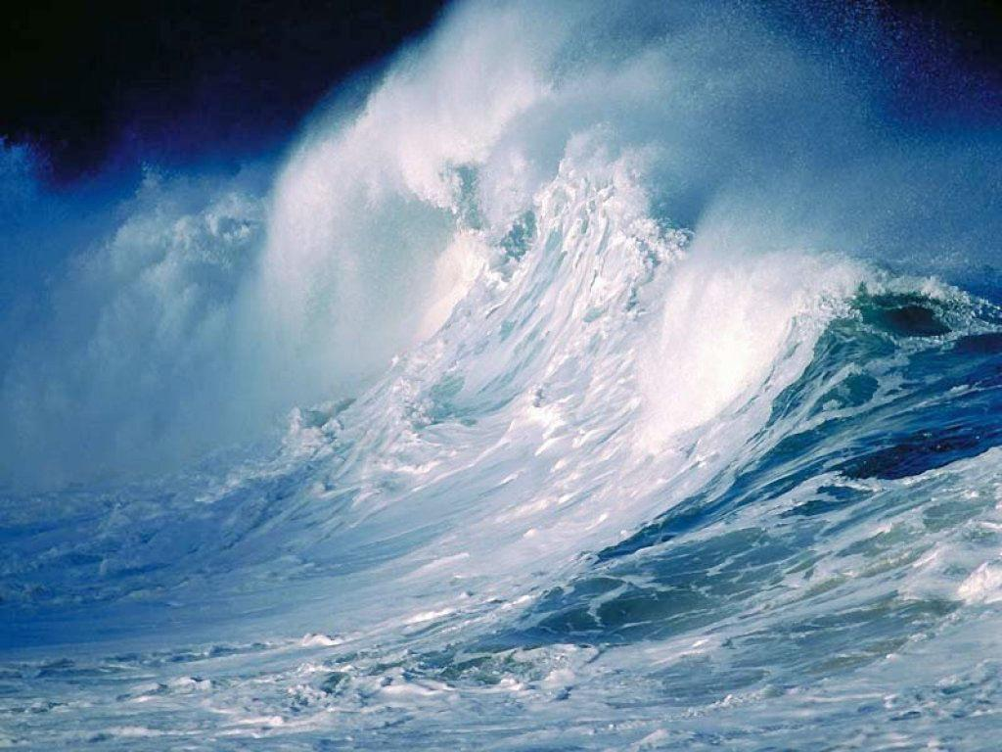
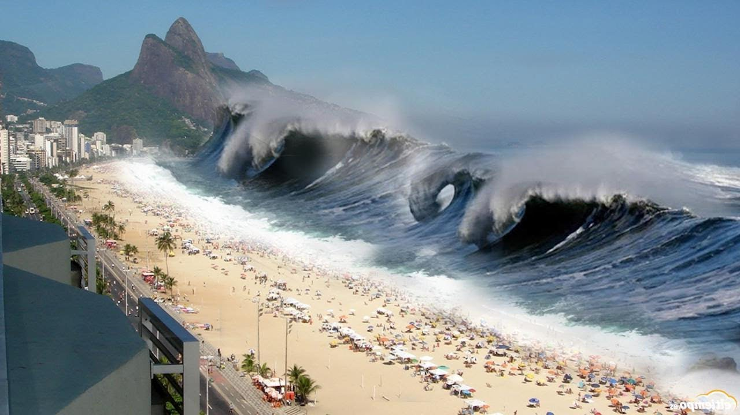
Water’s pounding
Waves are sounding deadly and extreme

Slide 8
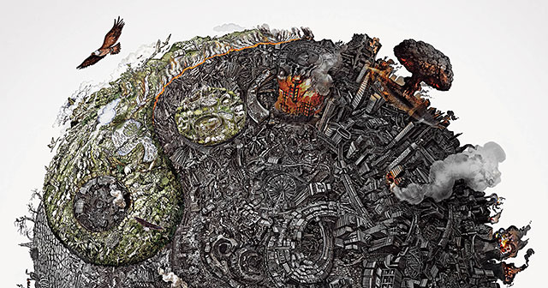
Equally destructive as we are
But we are equally destructive

Slide 9
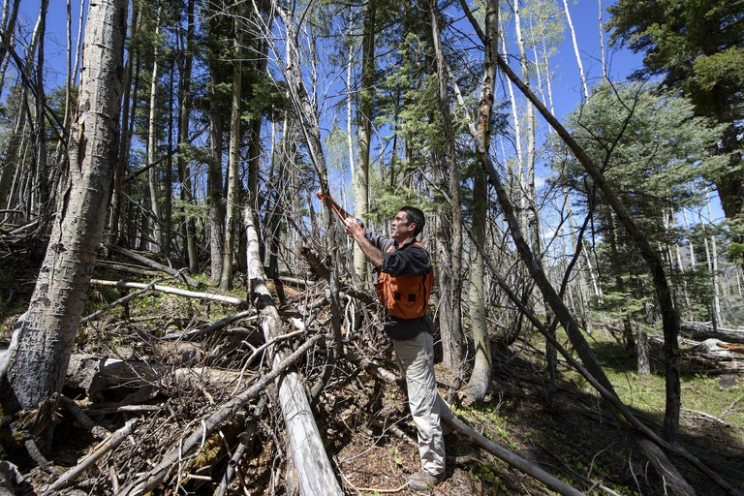
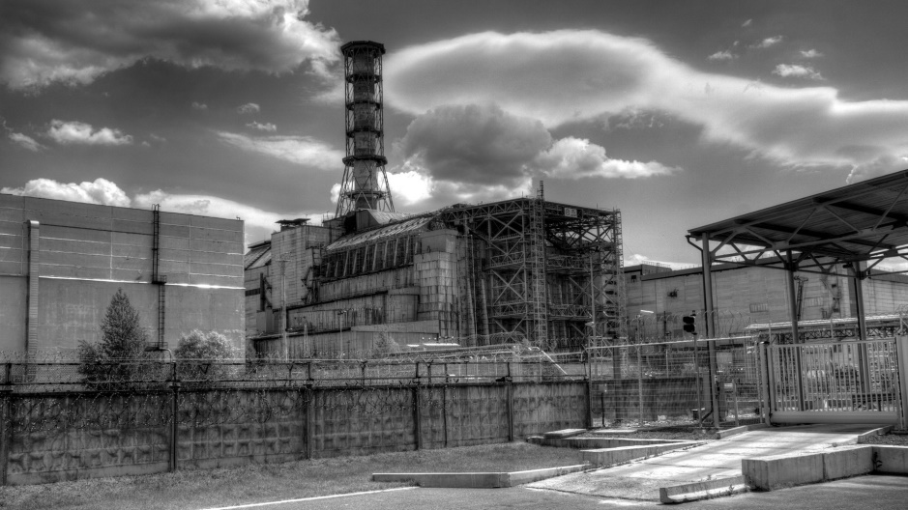
Don’t you think we’ve also gone too far

Slide 10
We are just a part of this machine

Slide 11
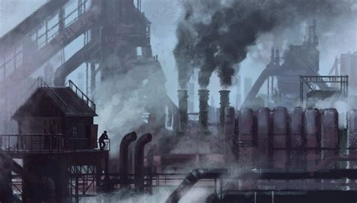
And its endless stream

