Slide 1
PEP M7U1：Living Well
Song: Dream It Possible
Singer: Delacey
作者：古纯
单位：华南师范大学

Slide 2
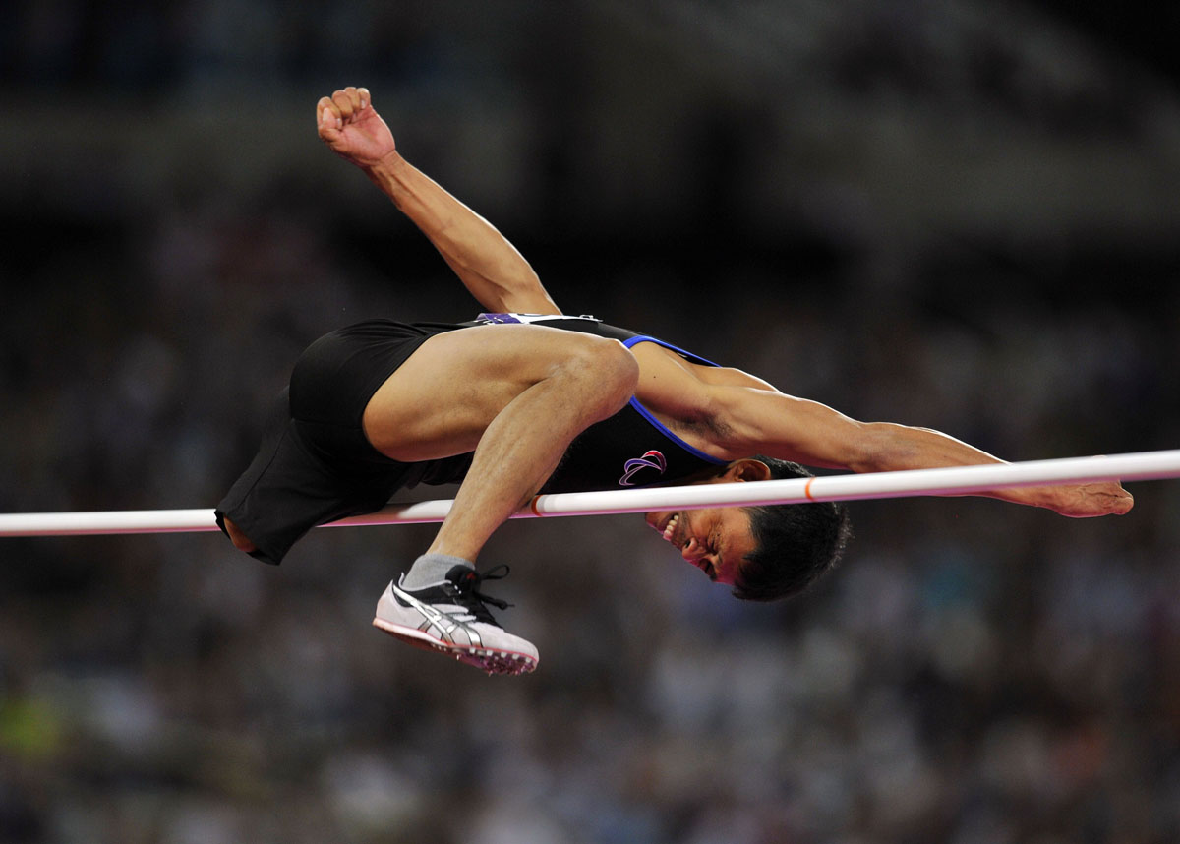
I will run
I will soar
I will climb
I'm undefeated

Slide 3
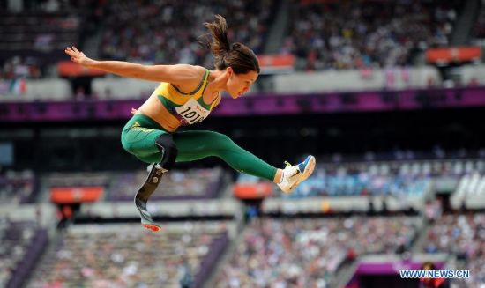
Jumping out of my skin pull the chord
Yeah I believe it

Slide 4
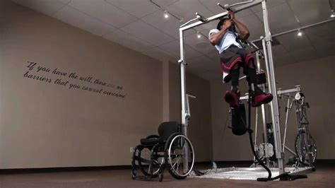
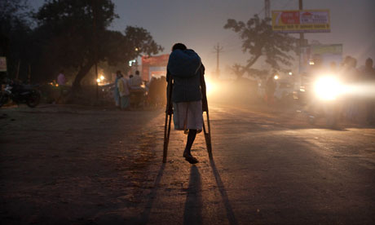
The past, is everything we learn
we were don't make us who we are
It's not until you fall that you fly
So I'll dream
until I make it real
and all I see is stars

Slide 5
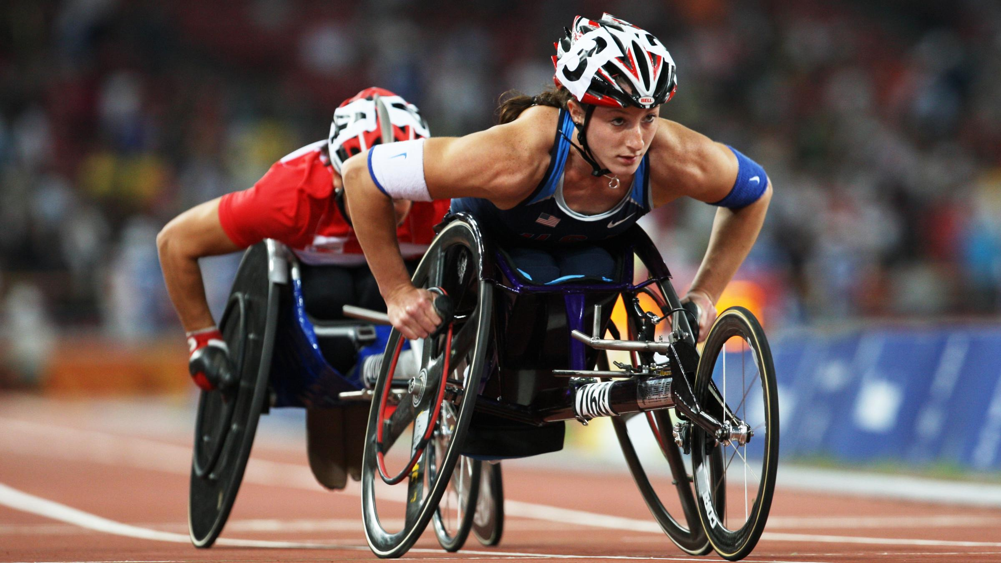
When your dreams come alive you're unstoppable

Slide 6
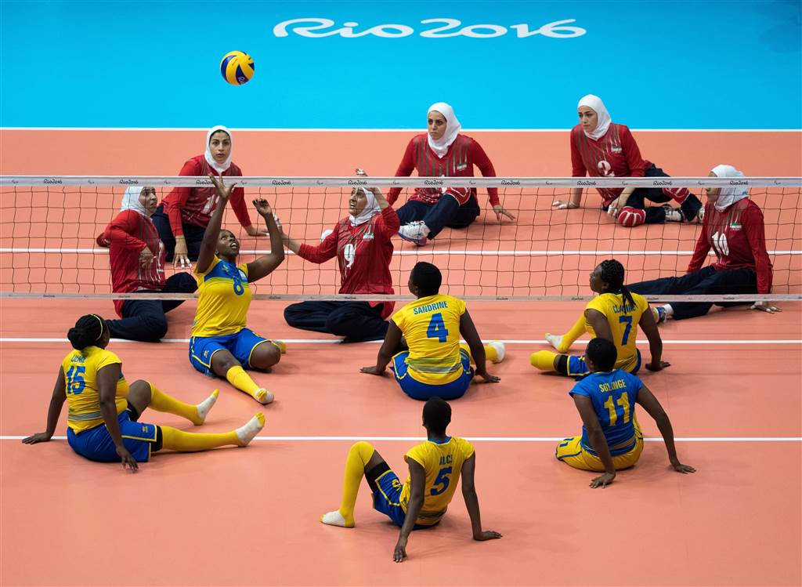
Take a shot
find the beautiful
chase the sun

Slide 7
It Possible
And we'll dream it possible
We will glow in the dark turning dust to gold
And we'll dream it possible

Slide 8
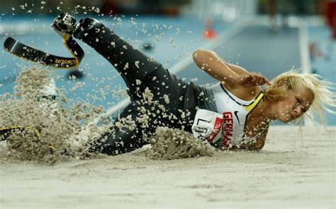
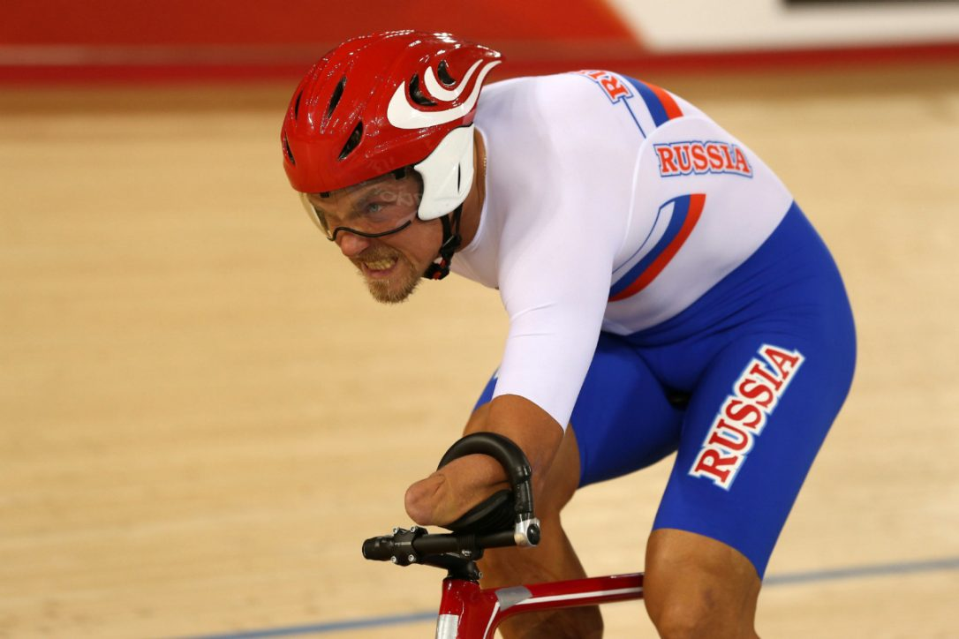
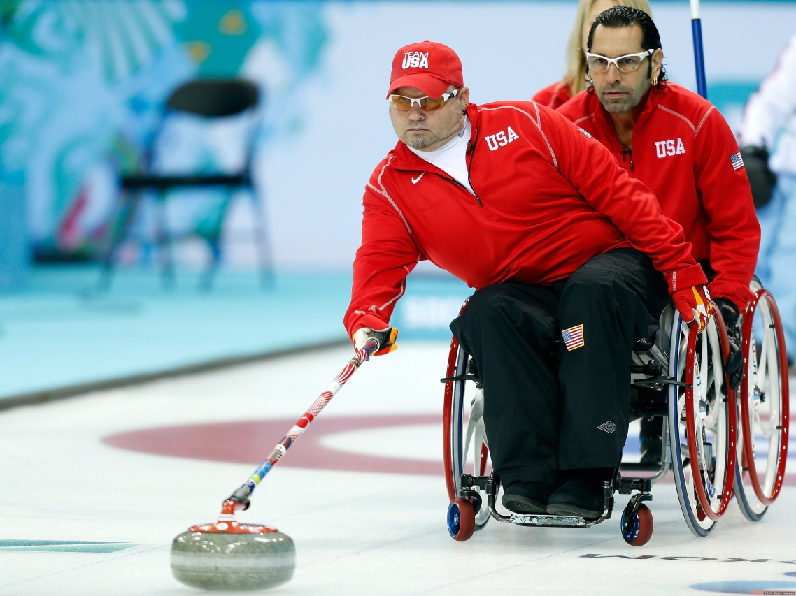
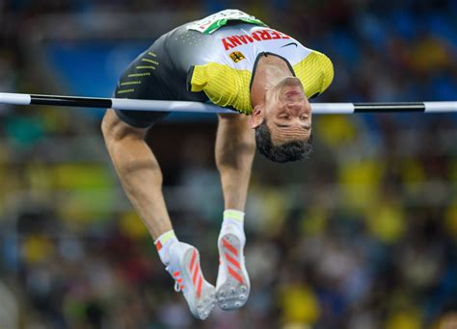
Until I'm breaking until I'm breaking
I will chase
I will reach
I will fly

Slide 9
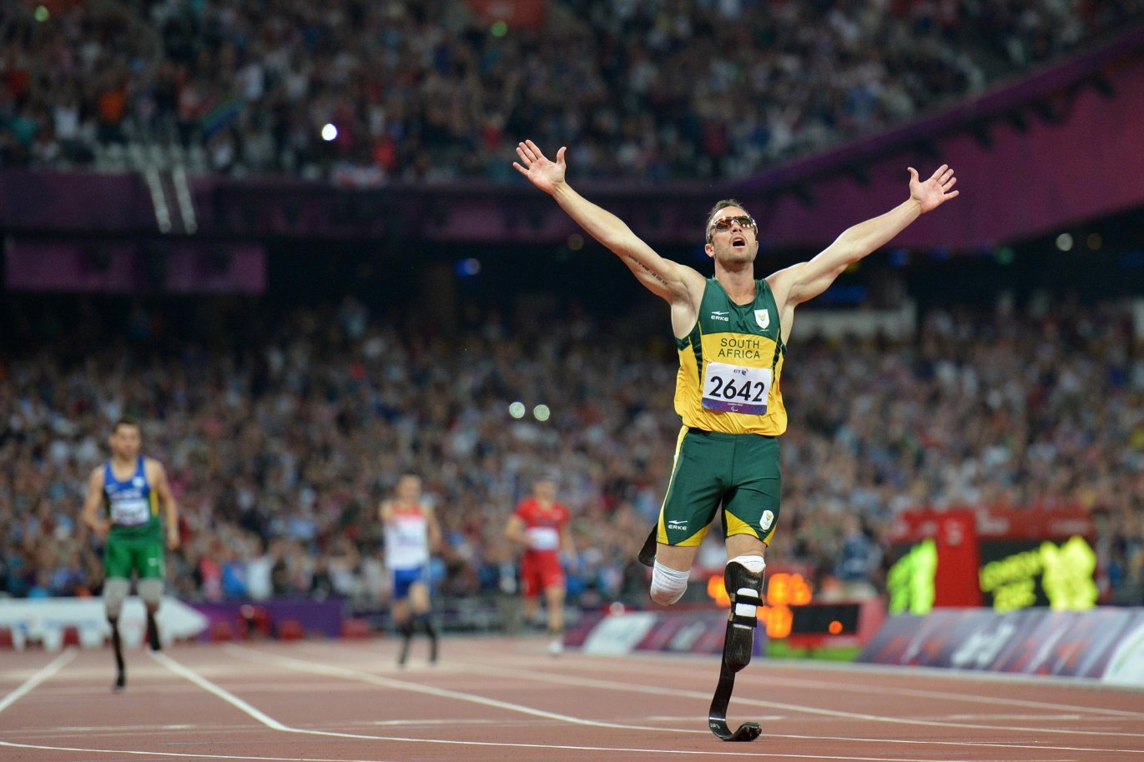
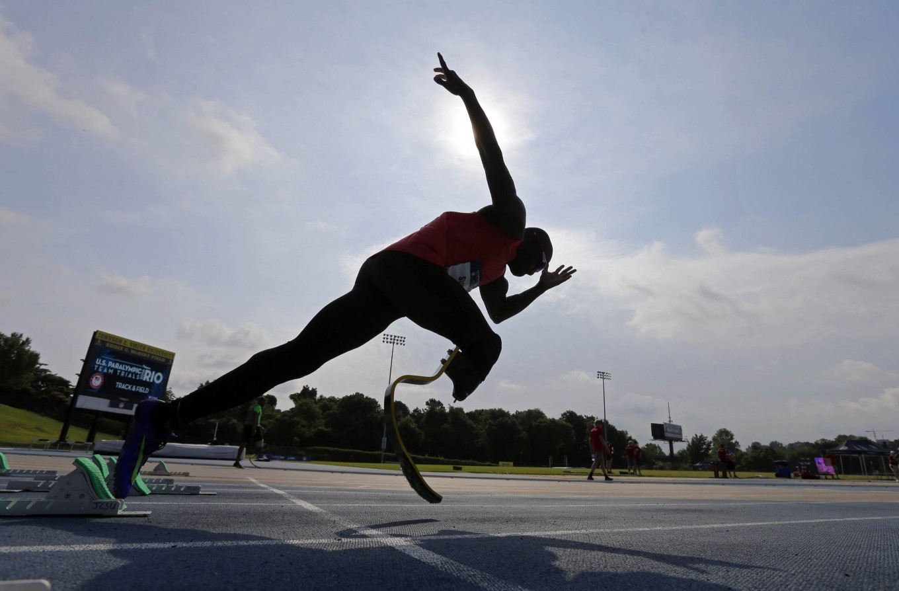
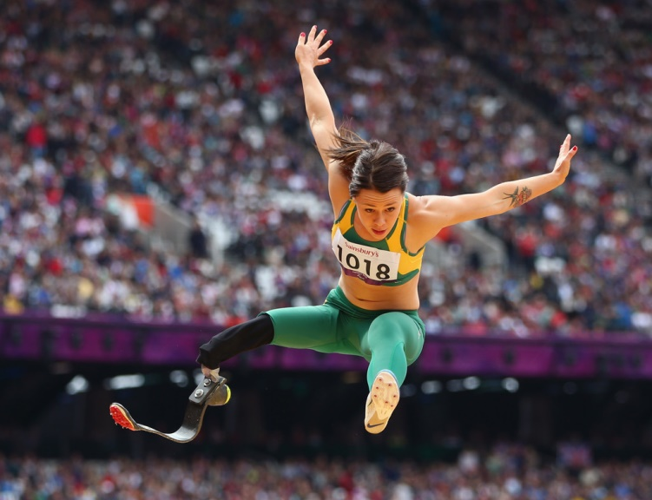
Out of my cage like a bird in the night
In into something big better than before
I know I'm changing I know I'm changing

Slide 10
It's not until you fall that you fly
And if it takes
takes a thousand lives
Then it's worth fighting for

Slide 11
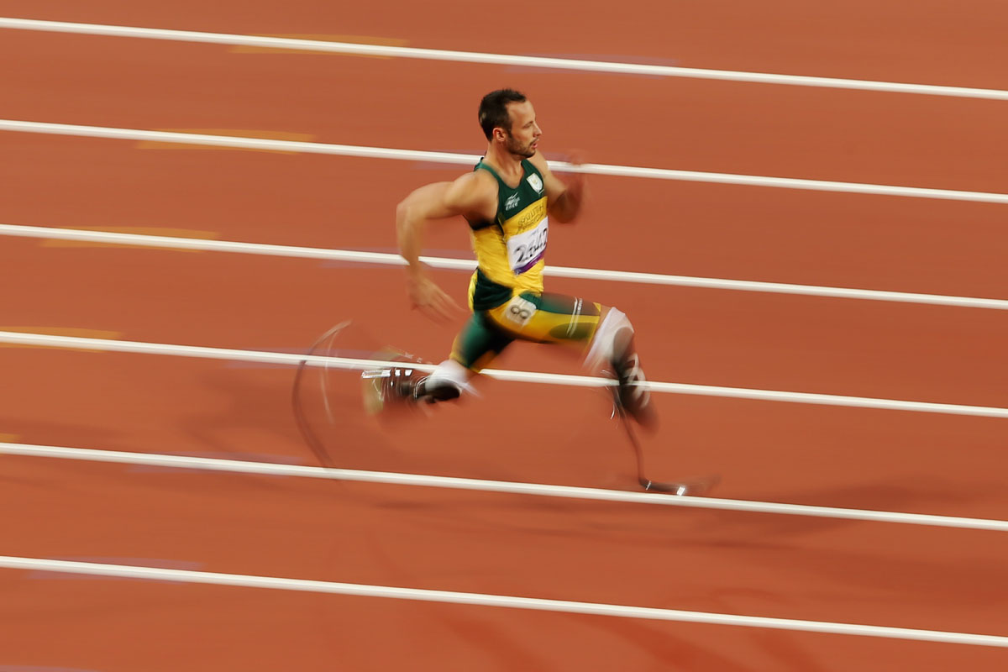
When your dreams come alive you're unstoppable

Slide 12
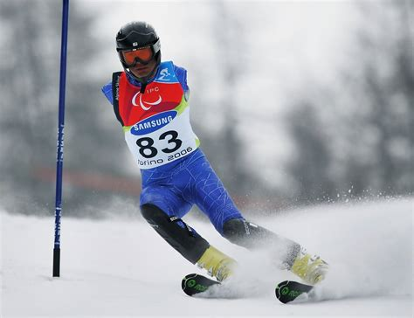
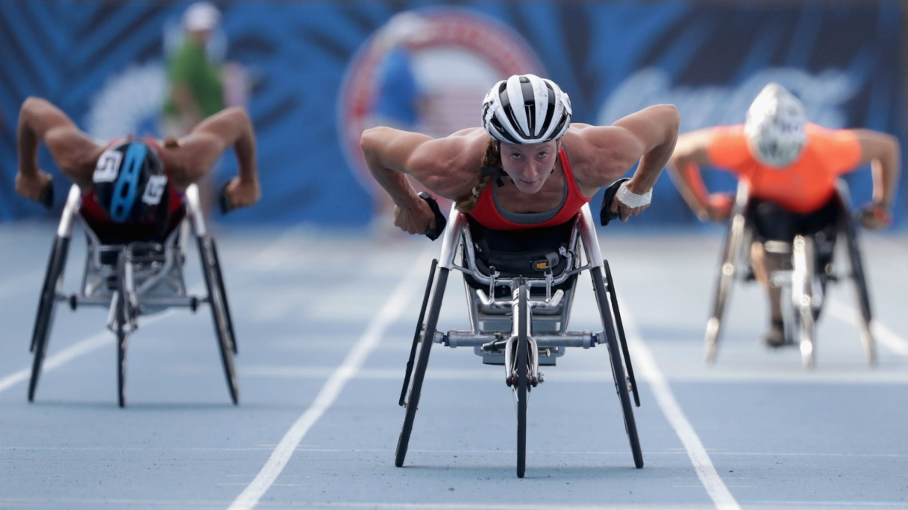
Take a shot
find the beautiful
chase the sun

Slide 13
It Possible
And we'll dream it possible
We will glow in the dark turning dust to gold

Slide 14
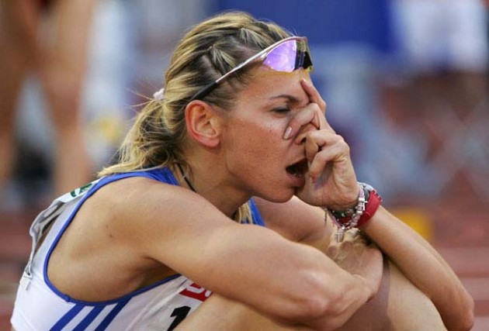
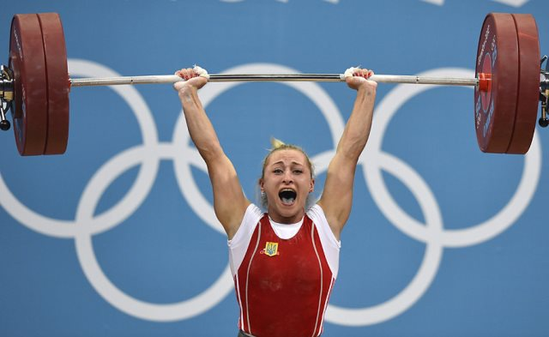
From the bottom to the top
We're sparking wild fire's

Slide 15
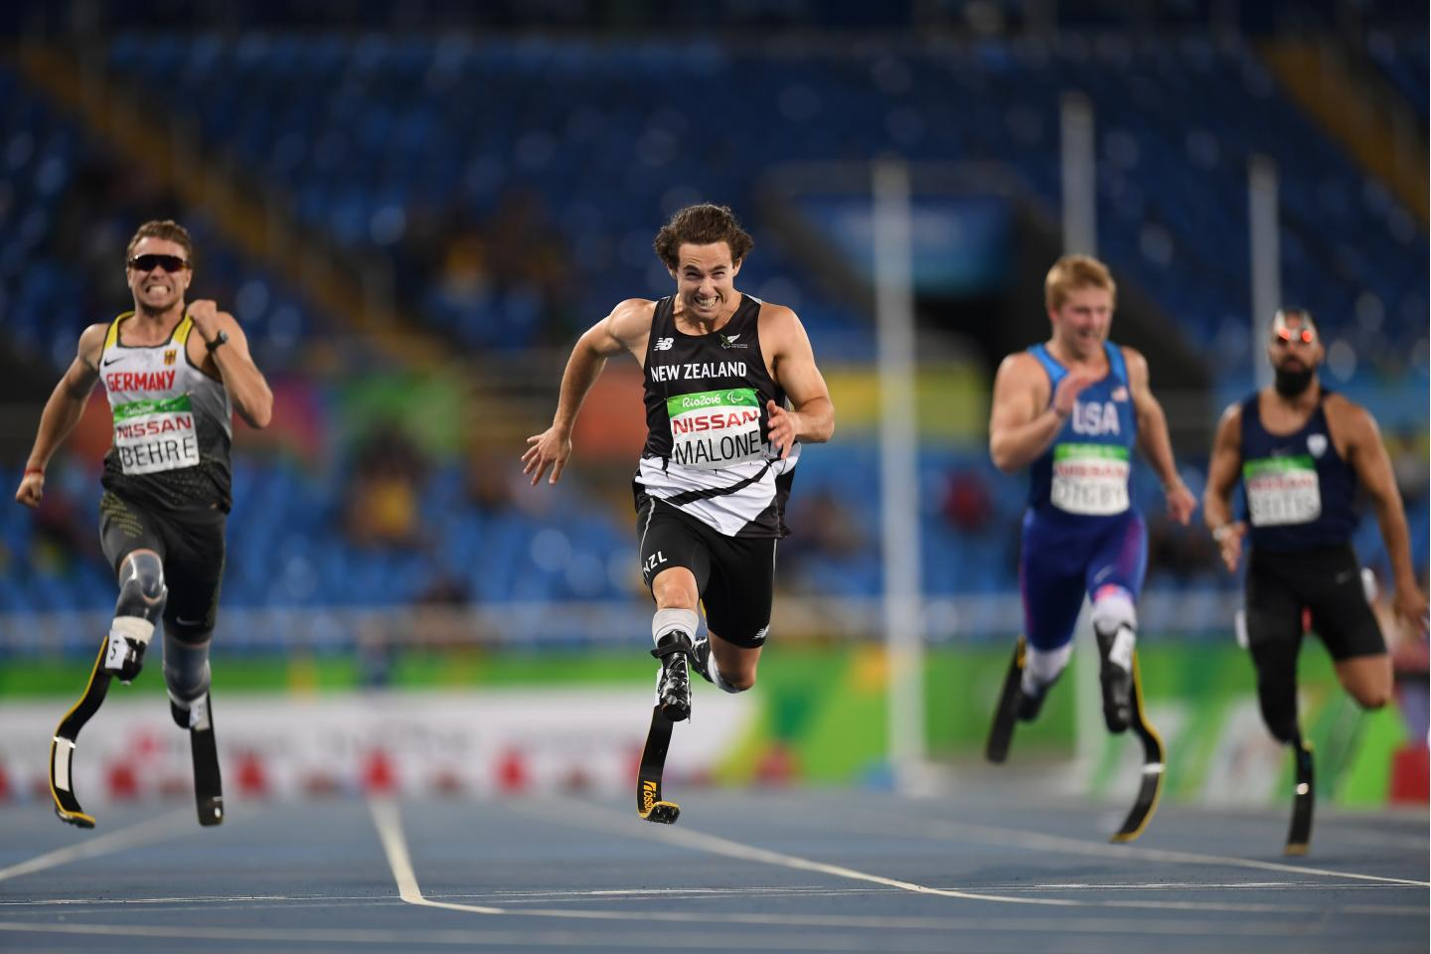
Never quit and never stop
The rest of our lives

Slide 16
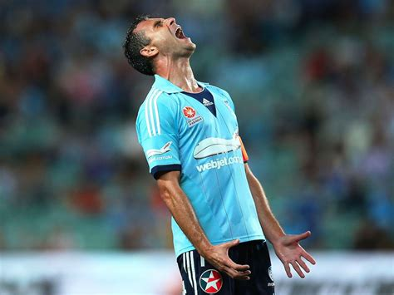
From the bottom to the top
We're sparking wild fire's

Slide 17
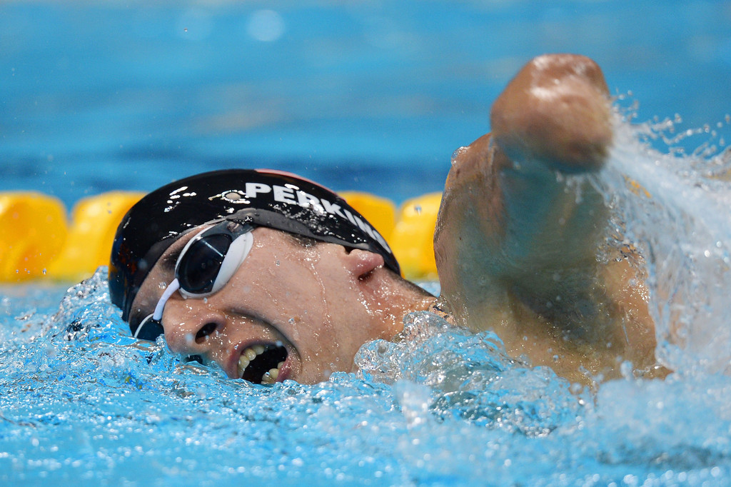
Never quit and never stop
It's not until you fall that you fly

Slide 18
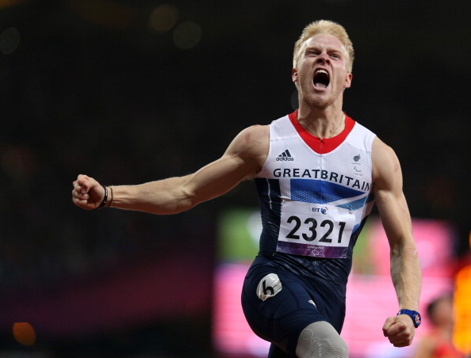
When your dreams come alive you're unstoppable

Slide 19
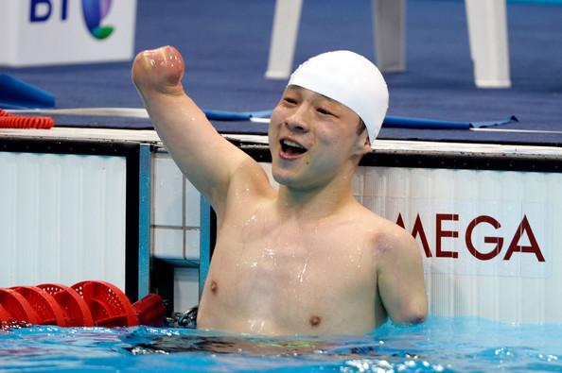
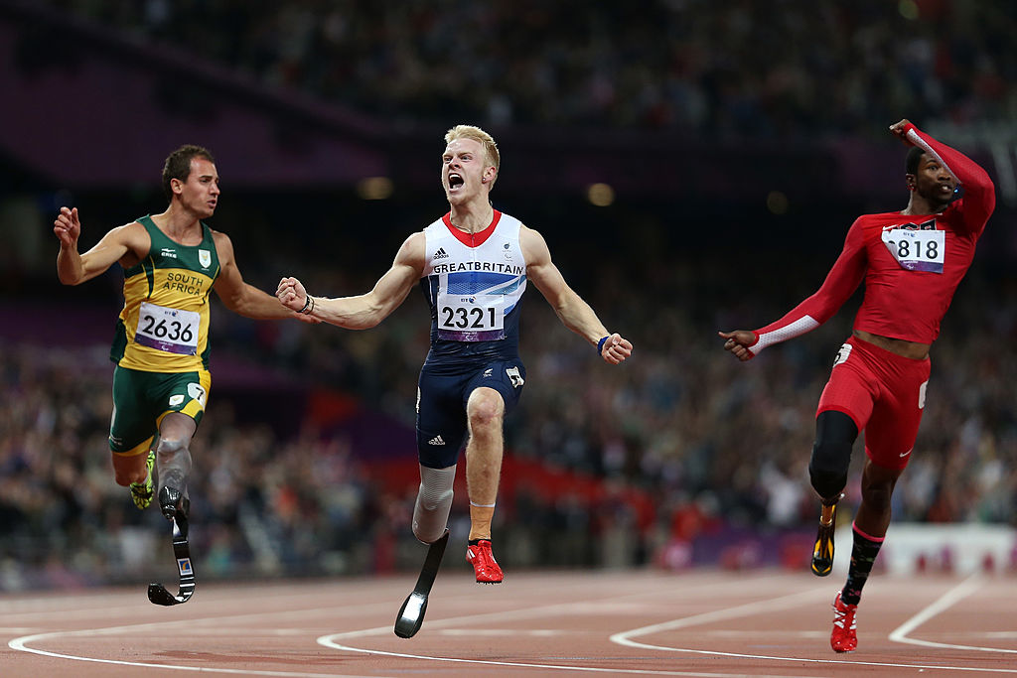
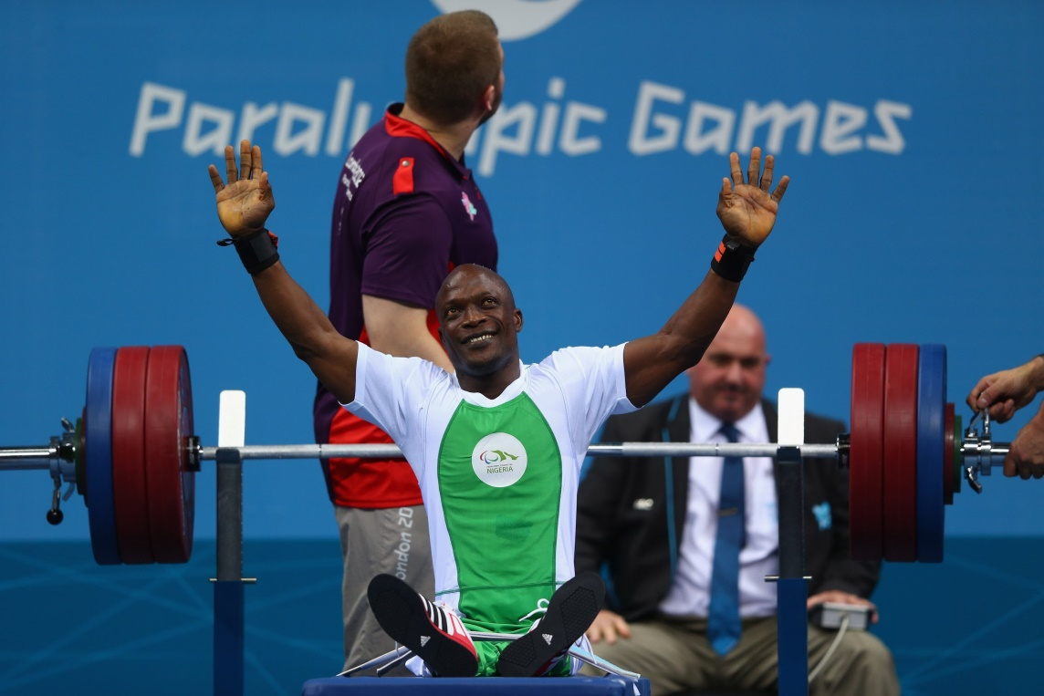
Take a shot
find the beautiful
chase the sun

Slide 20
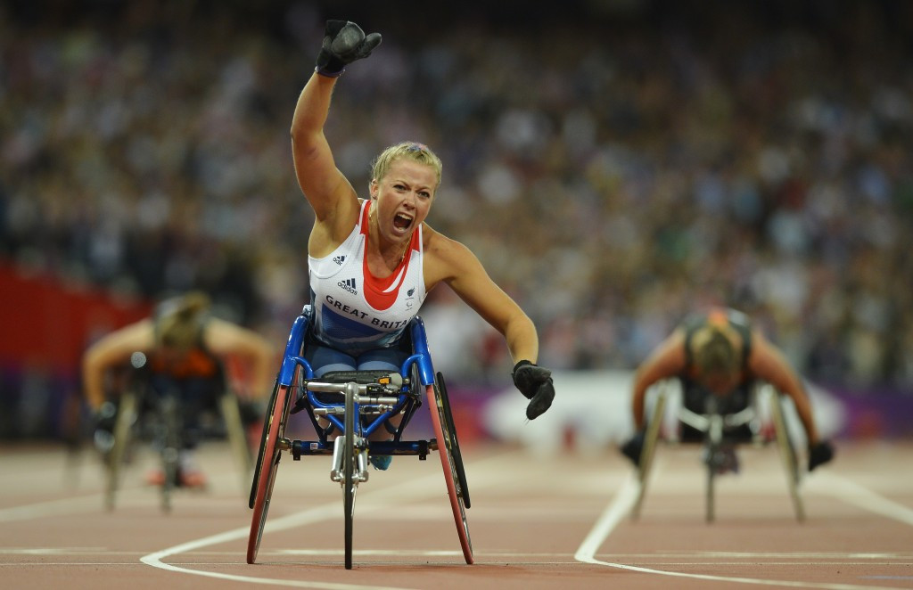
We will glow in the dark turning dust to gold
And we'll dream it possible

Slide 21
It Possible
And we'll dream it possible

