Slide 1
PEP M7U1: Living well
Song: Hero-Mariah Carey
作 者：徐映娴
单 位：华南师范大学外文学院

Slide 3
There's a hero
If you look inside your heart

Slide 4
You don't have to be afraid of what you are

Slide 5
There's an answer
If you reach into your soul

Slide 6
And the sorrow that you know
will melt away

Slide 7
And then a hero comes along
With the strength to carry on

Slide 8
And you cast your fears aside
And you know you can survive

Slide 9
So when you feel like hope is gone

Slide 10
Look inside you and be strong

Slide 11
And you'll finally see the truth
that a hero lies in you

Slide 12
It's a long road
when you face the world alone

Slide 13
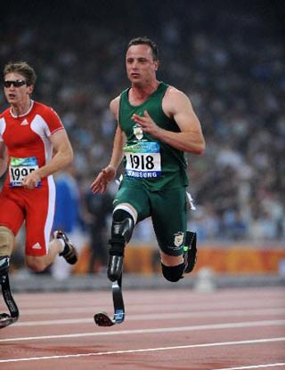
No one reaches out a hand for you to hold

Slide 14
You can find love
If you search within yourself

Slide 15
And the emptiness you
felt will disappear

Slide 16
And then a hero comes along
With the strength to carry on

Slide 17
And you cast your fears aside
And you know you can survive

Slide 18
So when you feel like
hope is gone

Slide 19
Look inside you and be strong

Slide 20
And you'll finally see the truth
That a hero lies in you

Slide 21
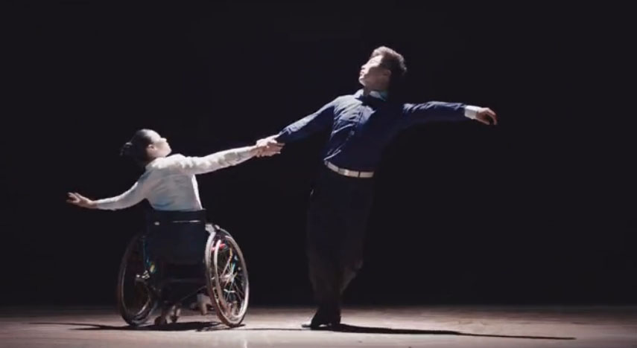
Lord knows
Dreams are hard to follow

Slide 22
But don't let anyone tear them away

Slide 23
Hold on
There will be tomorrow

Slide 24
In time, you'll find the way

Slide 25
And then a hero comes along
With the strength to carry on

Slide 26
And you cast your fears aside
And you know you can survive

Slide 27
So when you feel like hope is gone

Slide 28
Look inside you and be strong

Slide 29
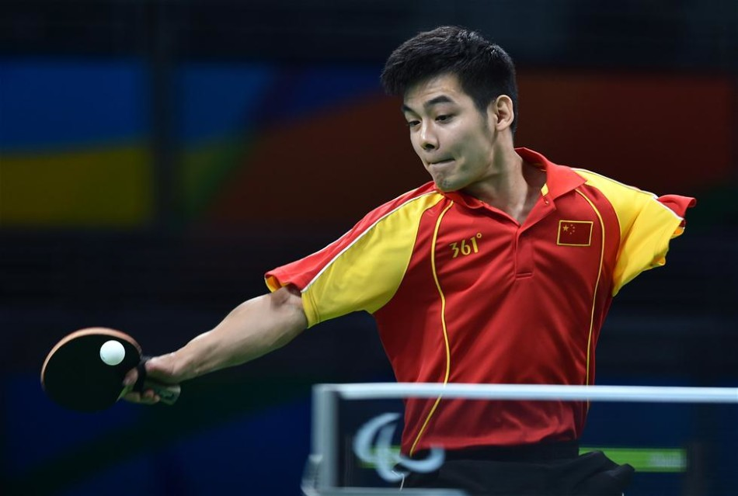
And you'll finally see the truth
That a hero lies in you

Slide 30
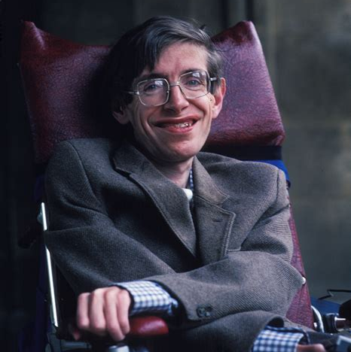
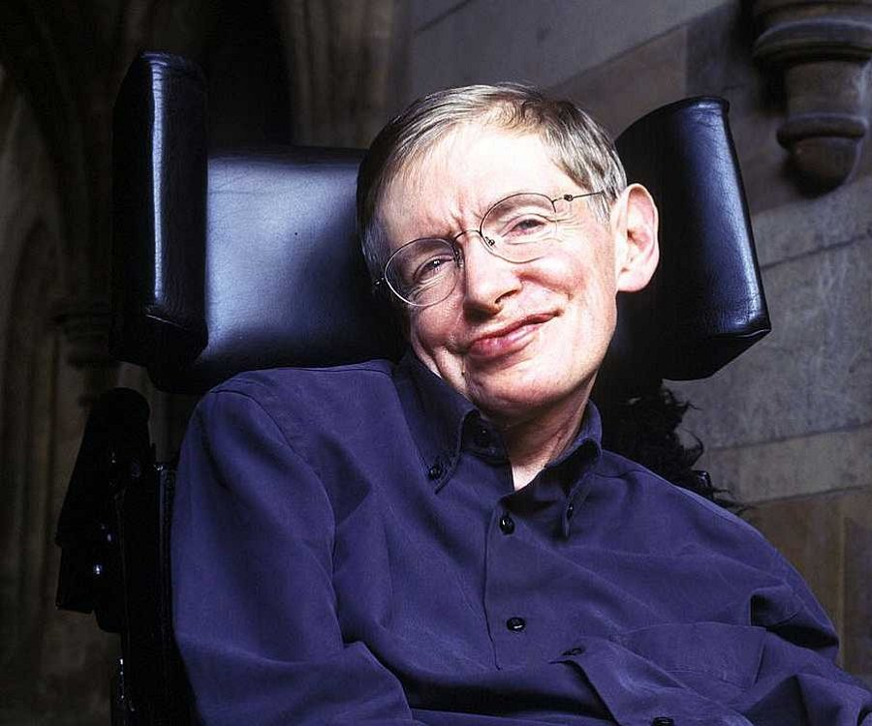
That a hero lies in you

Slide 31
That a hero lies in you

Slide 32
Thank you

