Slide 1
人教版必修7 Unit 3 Under the sea
华南师范大学外文学院
李静怡 20150201135

Slide 2
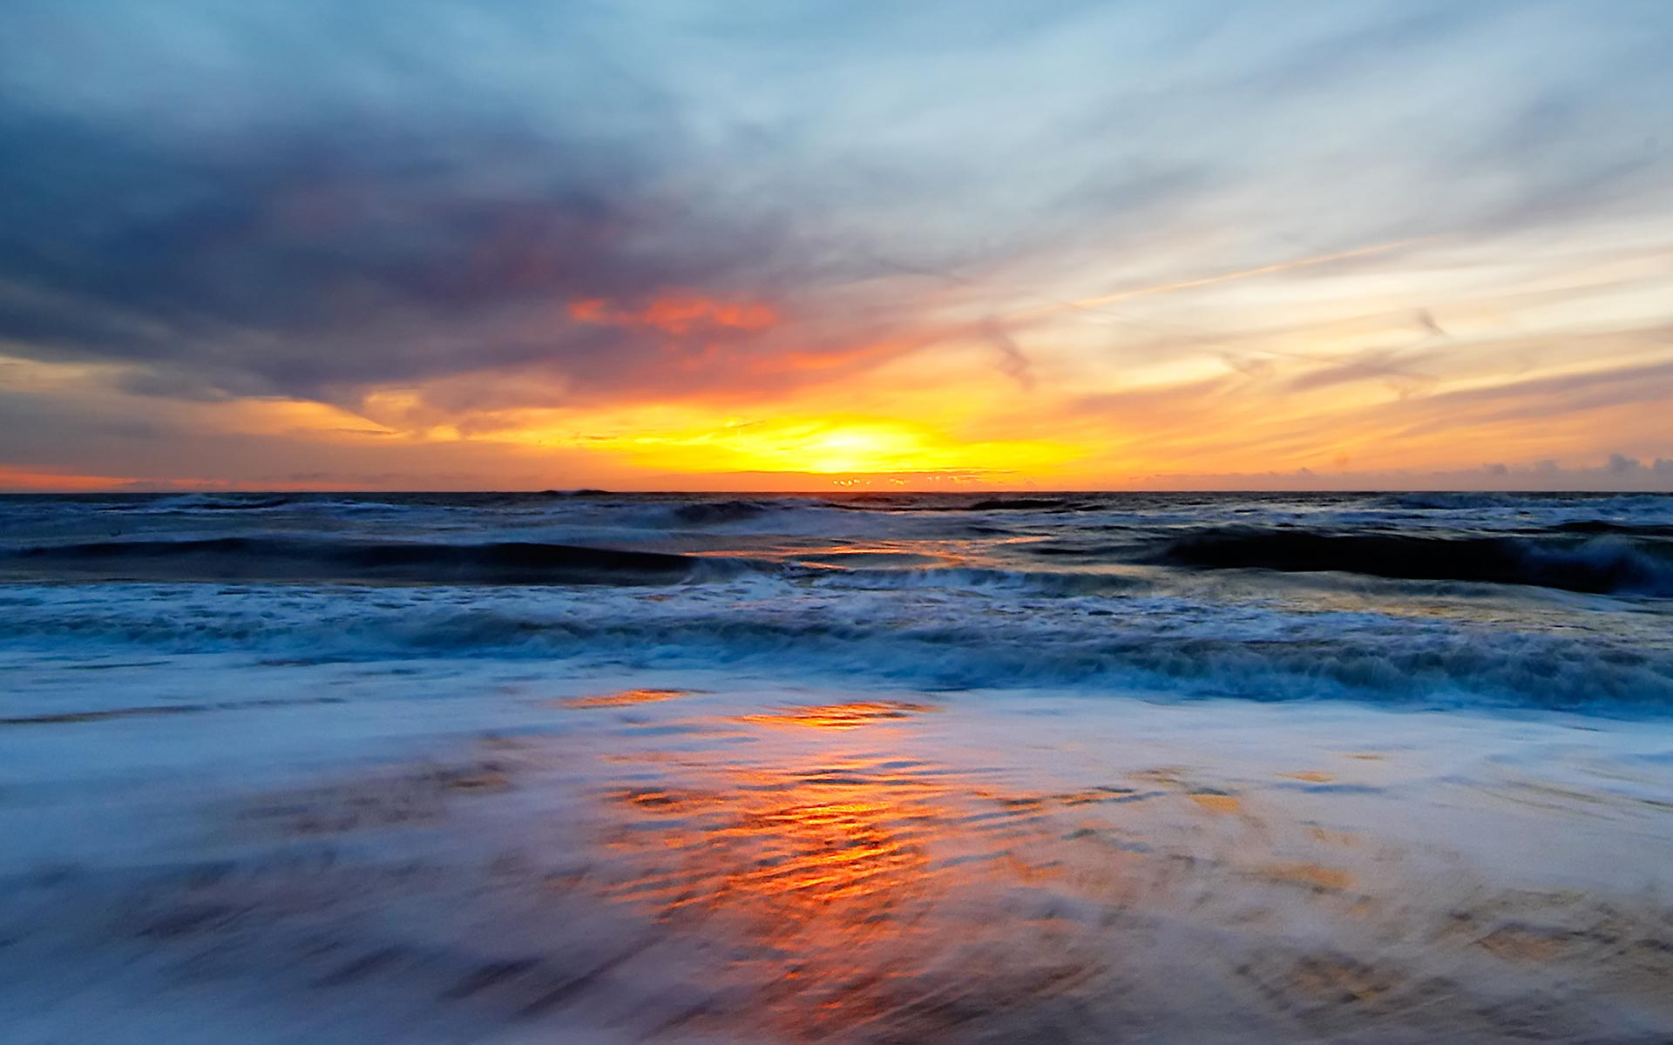
The song of nature
Skip
Look into me

Slide 3
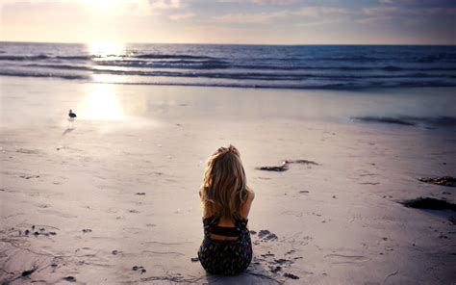
All she wanted was to go to the sea
Skip

Slide 4
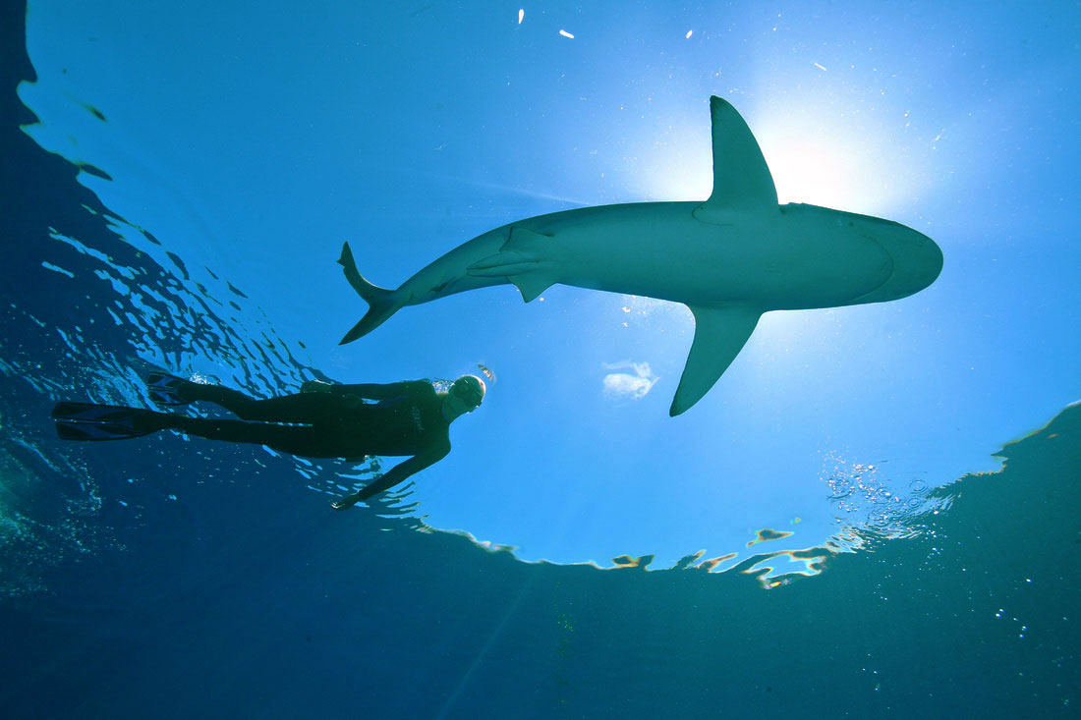
Don't worry mine
Cause I'm not afraid,
I'm not afraid
Skip

Slide 5
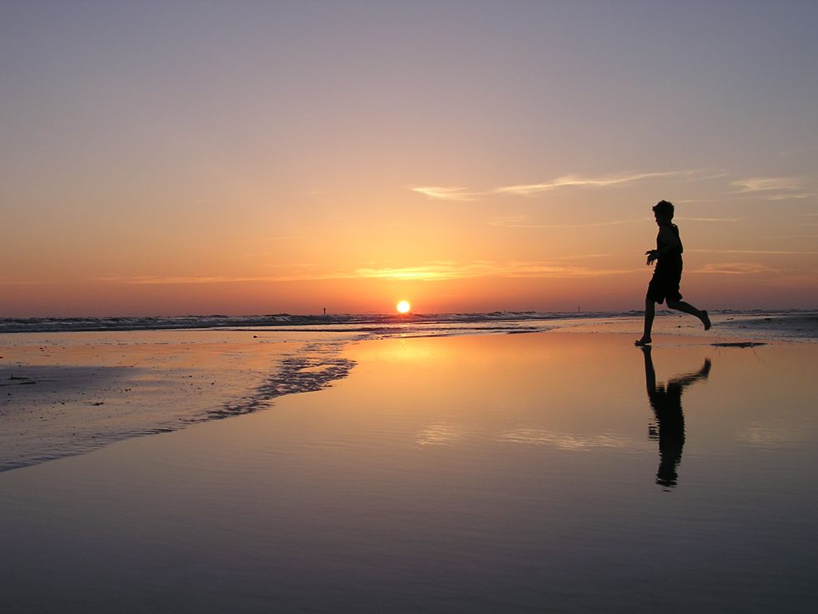
Don't worry mine Cause I'm on my way
Skip
I'm on my way to the ocean
T o the ocean

Slide 6
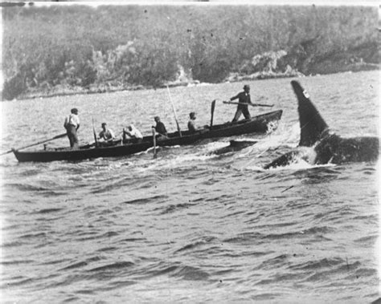
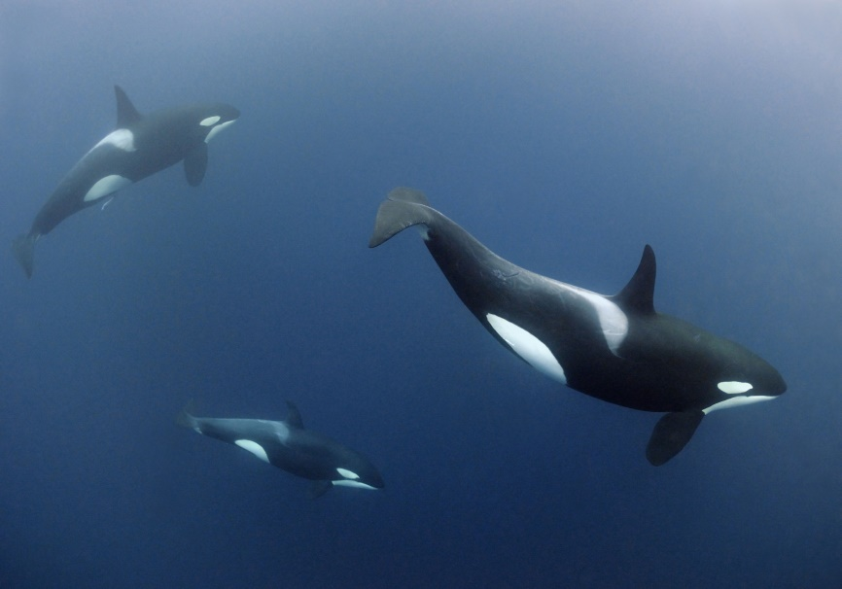
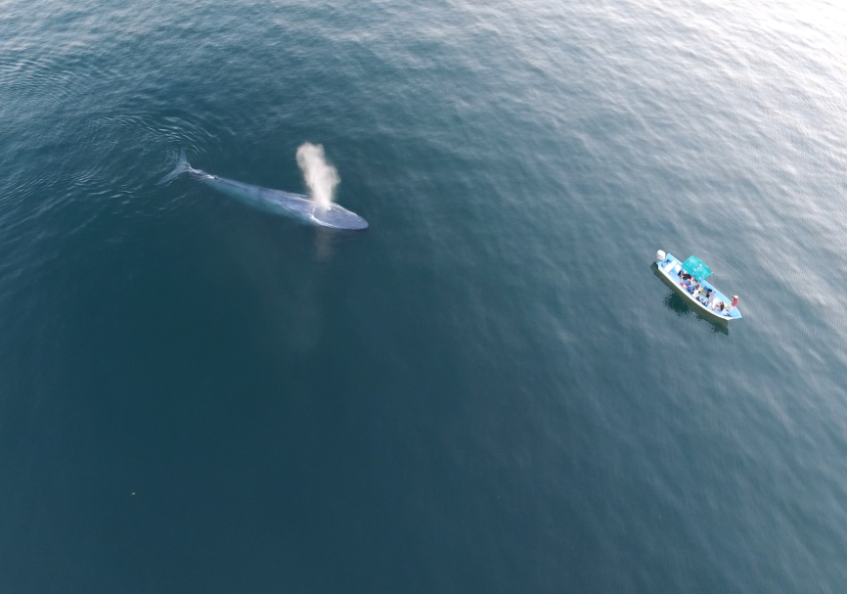
Skip

Slide 7
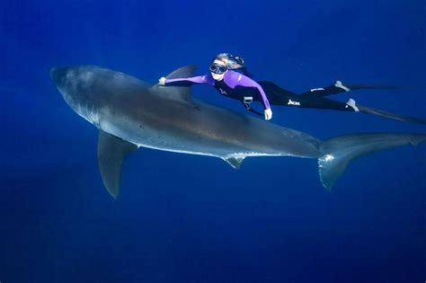
Wish I told you I loved you more Maybe I was lost before
So do if the actions only go
While the sound make me cold
Skip

Slide 8
Swear that I will play my mourn Doesn't matter if we're rich or poor
Skip

Slide 9
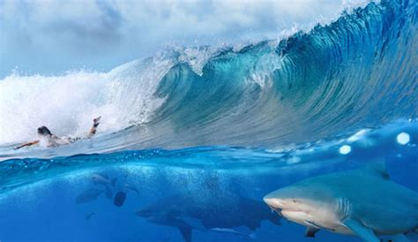
Find another way to live, to die
Even though there is no reason why
Skip

Slide 10
Don't worry mine Cause I'm not afraid, I'm not afraid
Skip

Slide 11
Don't worry mine Cause I'm on my way
I'm on my way to the ocean

Slide 12
To the ocean, to the ocean, to the ocean To the ocean…
Skip

Slide 13
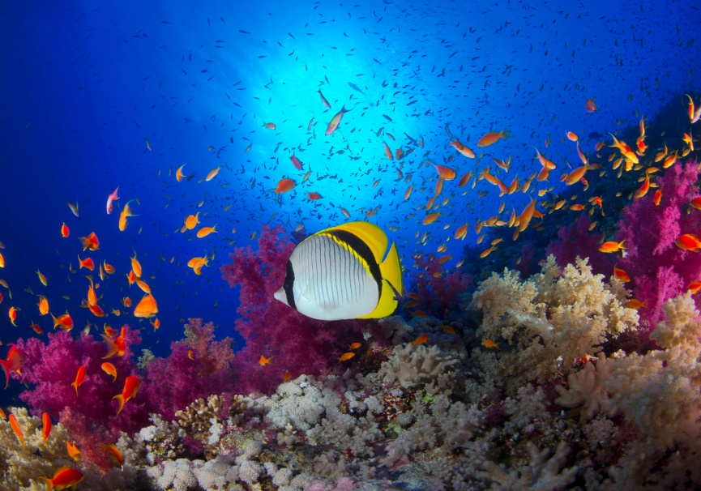
I'm on my way to the ocean
Skip

Slide 14
To the ocean
Skip

