Slide 1
The Sharing Song
作者：李婷
单位：华南师范大学外文学院

Slide 2


PEP M7U4: Sharing
Song: The Sharing Song
Singer: Jack Johnson

Slide 3
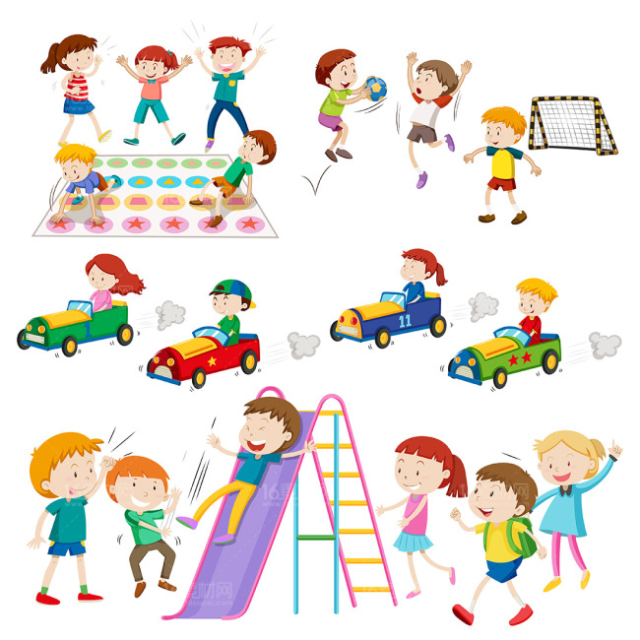

It's always more fun to share with everyone

Slide 4
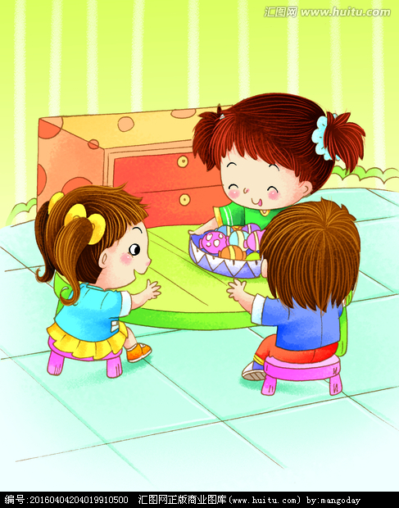
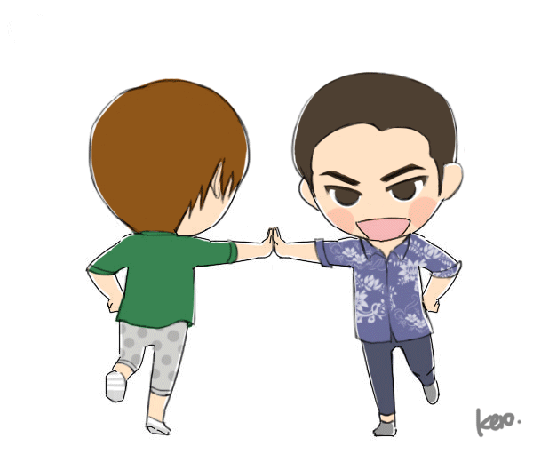

It's always more fun
to share with everyone

Slide 5


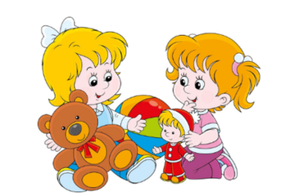
If you have two,
give one to your friend

Slide 6
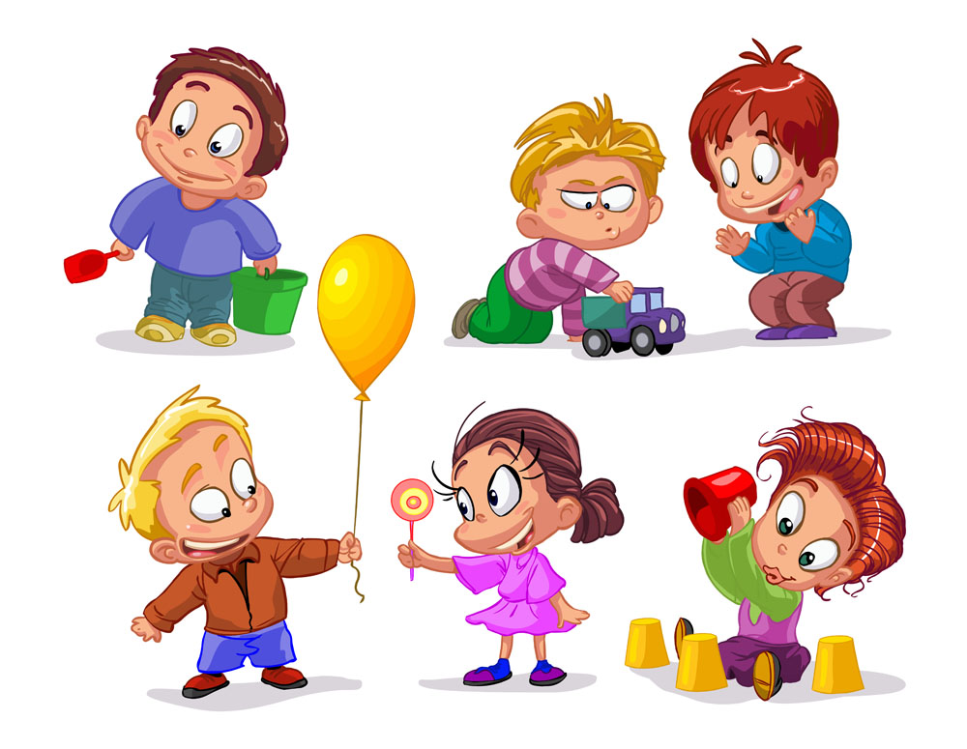

If you have three, give one to your friend and me

Slide 7

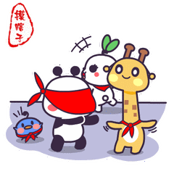
It's always more fun to share with everyone

Slide 8
It's always more fun to share with everyone

Slide 9



If you have one,here is something you can learn

Slide 10


You can still share just by taking turns

Slide 11

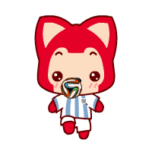

If you've got a ball,
bounce it to the gang

Slide 12



If there is a new kid, invite him out to hang

Slide 13
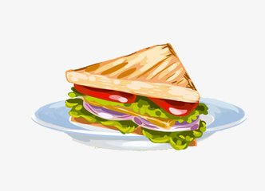

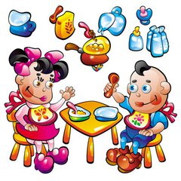
If you've got one,
sandwich
cut that thing in half

Slide 14


If you know a secret joke, tell it and share a laugh

Slide 15



If you‘ve got one ,give one to your friend
drum stick

Slide 16


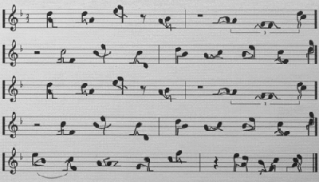
Make one beautiful rhythm, share a beat that never ends

Slide 17



If you're feeling lonely,
share time with your mom

Slide 18
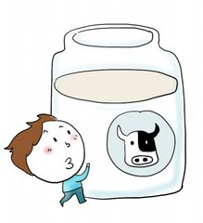


Share some milk and cookies,

Slide 19
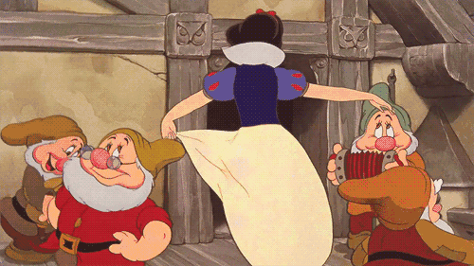

and sing the sharing song

Slide 20
It's always more fun
to share with everyone

Slide 21
It's always more fun to share with everyone

Slide 22
It's always more fun to share with everyone

Slide 23

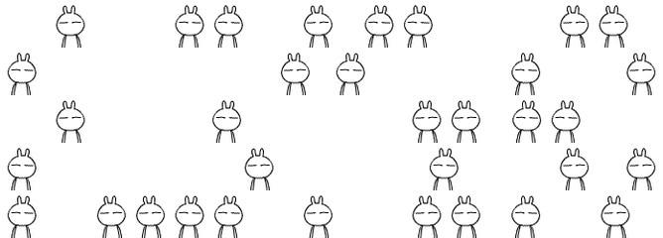
It's always more fun to share with everyone

Slide 24
Thank you

