Slide 1
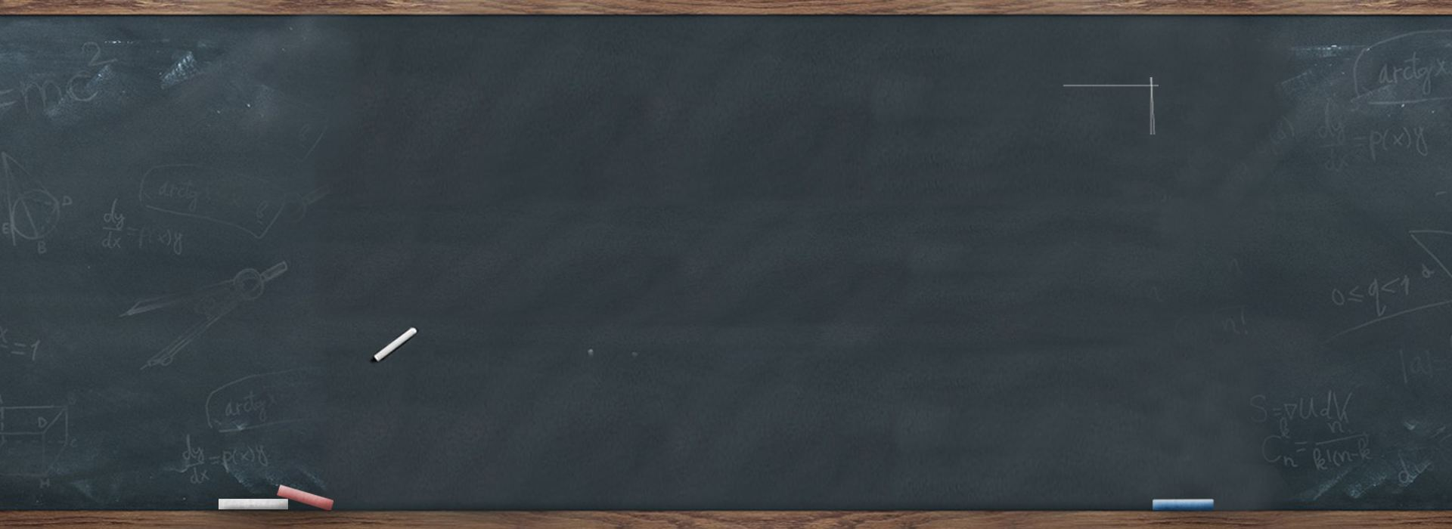


Unit 4
Sharing
人教版选修七
作者：王婷婷
单位：华南师范外文学院

Slide 2
It's always more fun
To share with everyone

Slide 3

It's always more fun
To share with everyone

Slide 4

If you have two
Give one to your friend

Slide 5
If you have three
Give one to your friend and me

Slide 6




It's always more fun
To share with everyone

Slide 7
It's always more fun
To share with everyone

Slide 8
If you've got one
Here is something you can learn
You can still share
Just by taking turns

Slide 9
If you've got a ball
Bounce it to the gang
If there is a new kid
Invite him out to hang

Slide 10


If you've got one sandwich
Cut that thing in half
If you know a secret joke
Tell it and share a laugh

Slide 11

If you've got one drumsticks
Give one to your friend
Make one beautiful rhythm
Share a beat that never ends

Slide 12


And if you're feeling lonely
Share time with your mom
Share some milk and cookies
And sing the sharing song

Slide 13

It's always more fun
To share with everyone

Slide 14
It's always more fun
To share with everyone

Slide 15
It's always more fun
To share with everyone
sharing

Slide 16

Thanks

