Slide 1


PEP M7U4 sharing
Sheira &
Loli's
Dittydoodle Works
That’s how we share
单位：华南师范大学外文学院
姓名：辛泽婷
Singer
Music

Slide 2


I have a cookie
And That's how we share
That's how we share
And I give you half

Slide 3



You tell a joke
And it makes me laugh
And that's how we share
That's how we share

Slide 4

When you share
You’ll be fair
“HHHHHH
HHHHHH”
It’s me not you you're thinking of
When you share
You mean to care
It means you are growing up

Slide 5

I take a trip
And then you come along
And that's how we share
That's how we share

Slide 6


You teach me a dance
And that's how we share
I teach you a song
That's how we share
friendship：

Slide 7


When you share
You’ll be fair
It’s me not you you're thinking of
When you share
You mean to care
It means you are growing up

Slide 8


I have a secret
I tell it to you
And that's how we share
That's how we share

Slide 9


We ride a bicycle
we use it for tour
And that's how we share

Slide 10

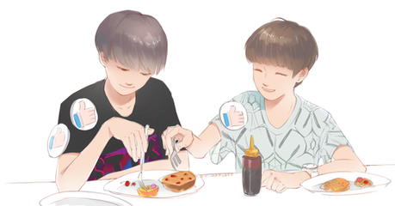
When you share
You’ll be fair
It’s me not you you're thinking of
When you share
You mean to care
It means you are growing up

Slide 11


I give to you
And you give to me
That's how we share
I play with you
And you play with me

Slide 12


I take of you
And you take of me

Slide 13

Thank you
PPT模板下载：www.1ppt.com/moban/ 行业PPT模板：www.1ppt.com/hangye/
节日PPT模板：www.1ppt.com/jieri/ PPT素材下载：www.1ppt.com/sucai/
PPT背景图片：www.1ppt.com/beijing/ PPT图表下载：www.1ppt.com/tubiao/
优秀PPT下载：www.1ppt.com/xiazai/ PPT教程： www.1ppt.com/powerpoint/
Word教程： www.1ppt.com/word/ Excel教程：www.1ppt.com/excel/
资料下载：www.1ppt.com/ziliao/ PPT课件下载：www.1ppt.com/kejian/
范文下载：www.1ppt.com/fanwen/ 试卷下载：www.1ppt.com/shiti/
教案下载：www.1ppt.com/jiaoan/

