Slide 1
Unit 5 Travelling abroad
必修7 人教版
黄梓晴
华南师范大学

Slide 2
Travelling abroad

Slide 3
On the road again

Slide 4
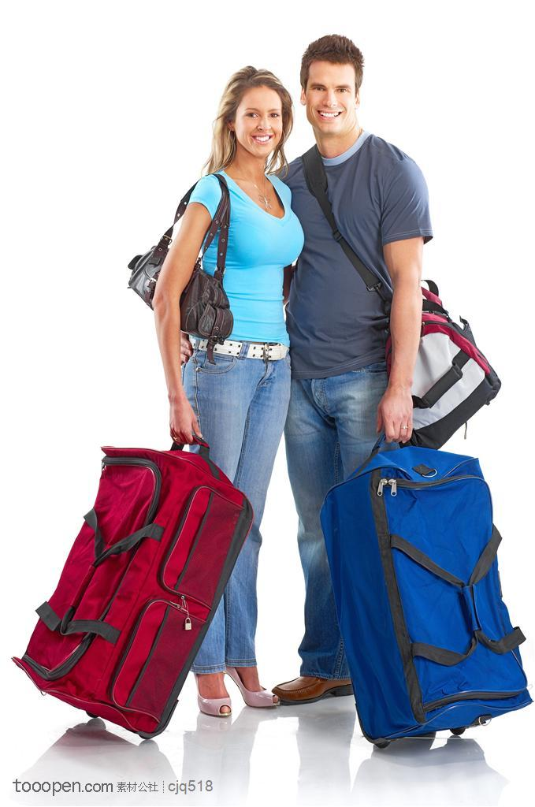
Just can't wait to get on the road again
Notes:
6-10

Slide 5
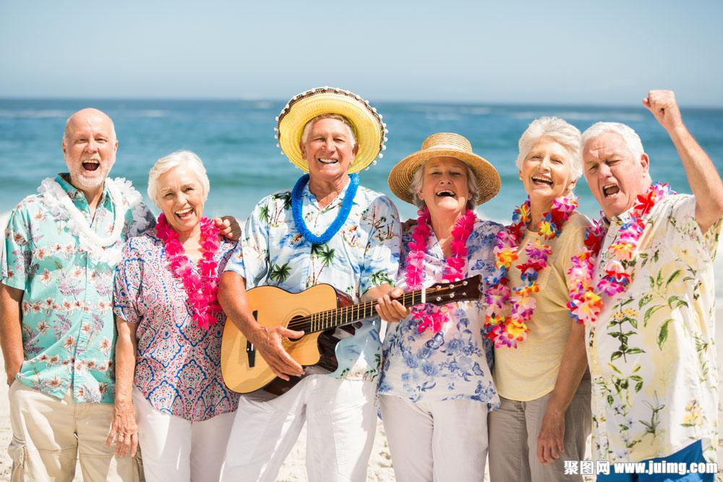
The life I love is making music with my friends
And I can't wait to get on the road again
Notes:
10-13 13-17

Slide 6
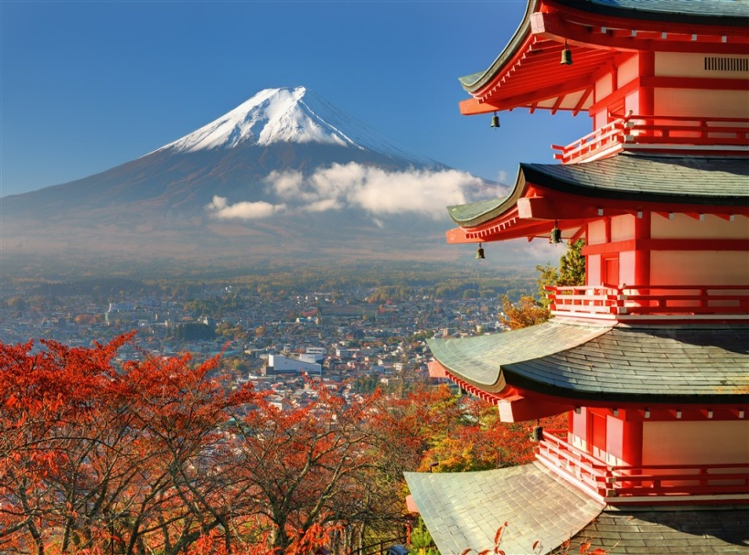
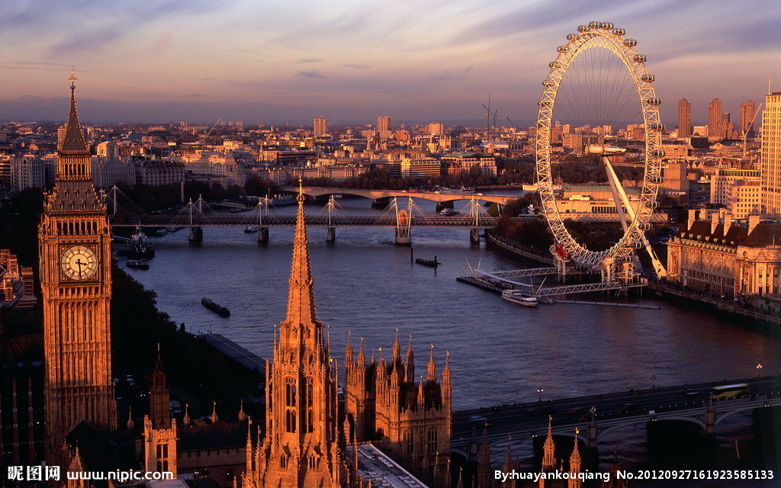
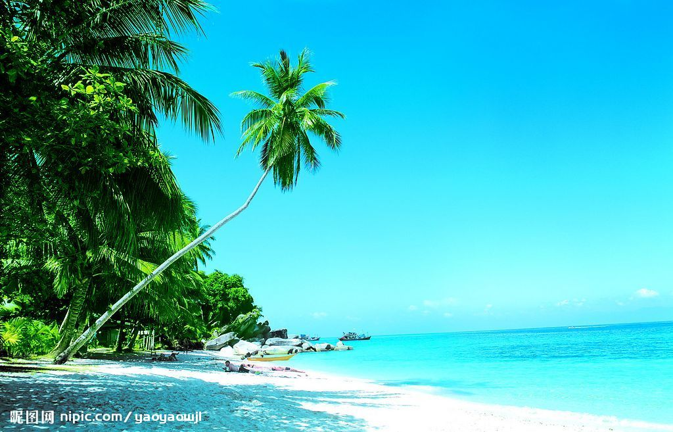
Goin' places that I've never been
On the road again
Notes:
18-21 21-25

Slide 7
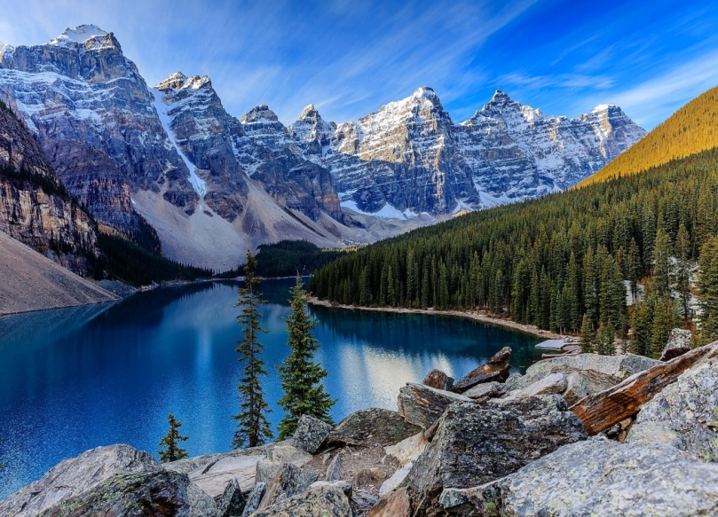
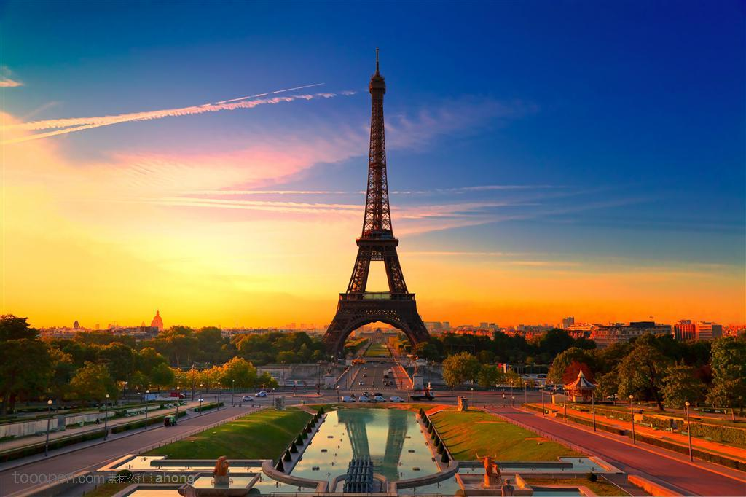
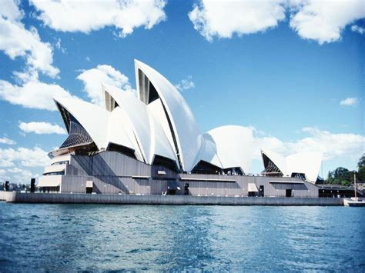
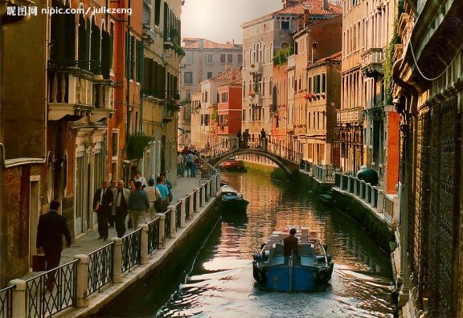
Seein' things that I may never see again
Notes:
25-29

Slide 8
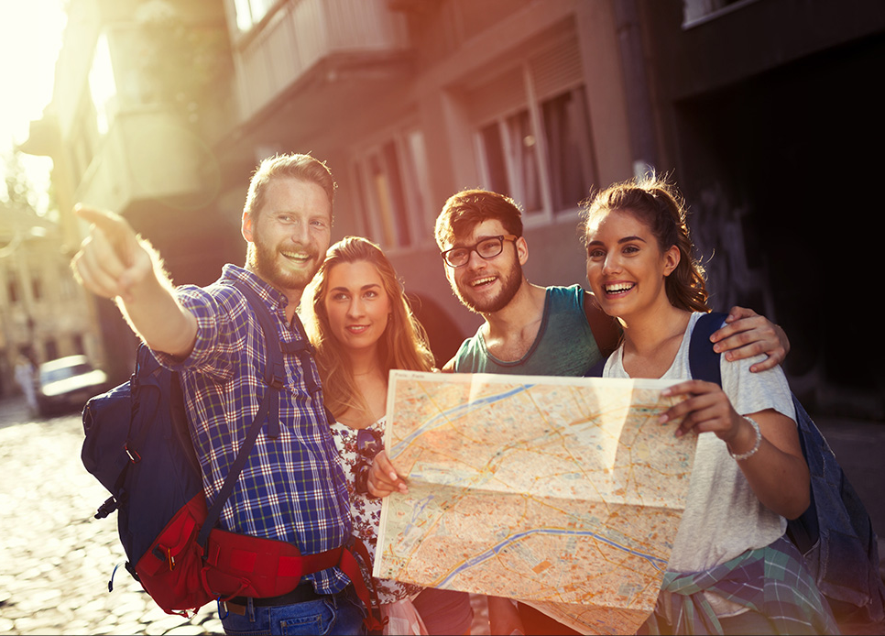
And I can't wait to get on the road again
Notes:
29-32

Slide 9
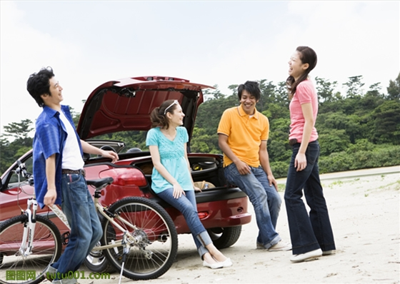
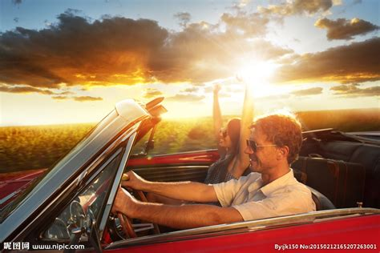
Like a band of gypsies we go down the highway
On the road again
Notes:
32-35 35-39

Slide 10
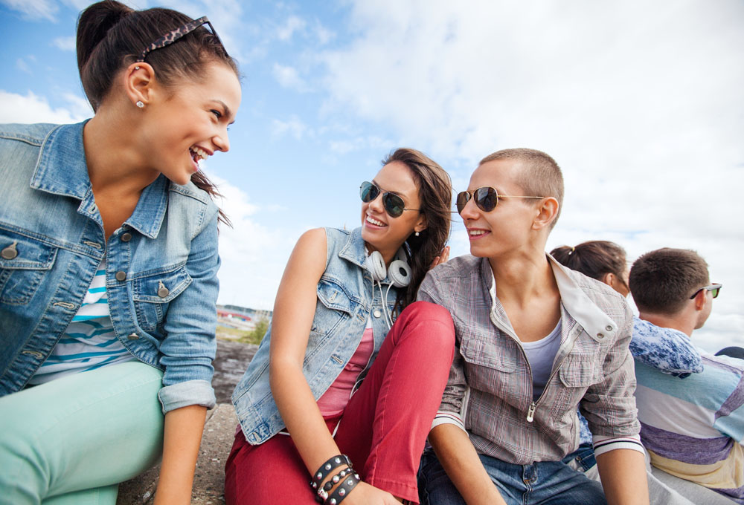
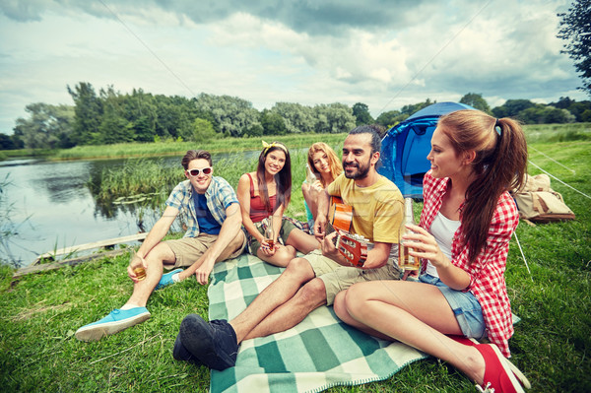
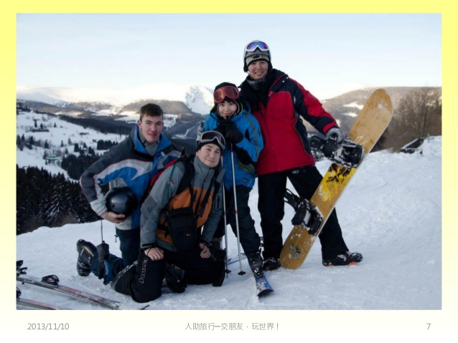
We're the best of friends
Notes:
39-42

Slide 11
Insisting that the world keep turning our way
Notes:
42-46

Slide 12
Just can't wait to get on the road again
And our way, is on the road again
Notes:
46-50 50-55

Slide 13
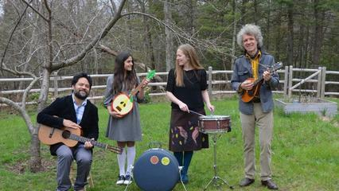
The life I love is making music with my friend
Notes:
55-59

Slide 14
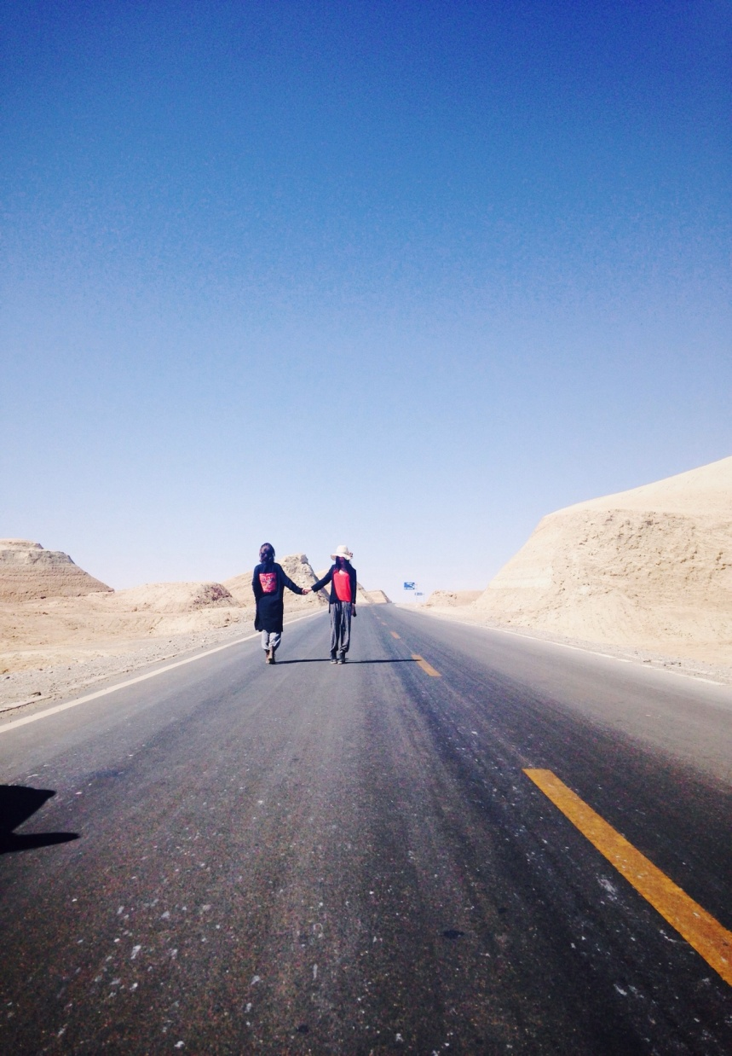
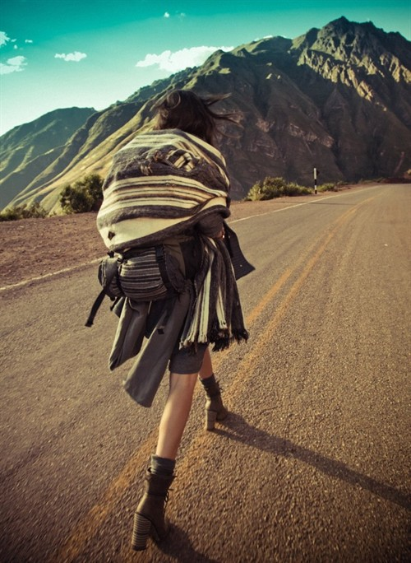
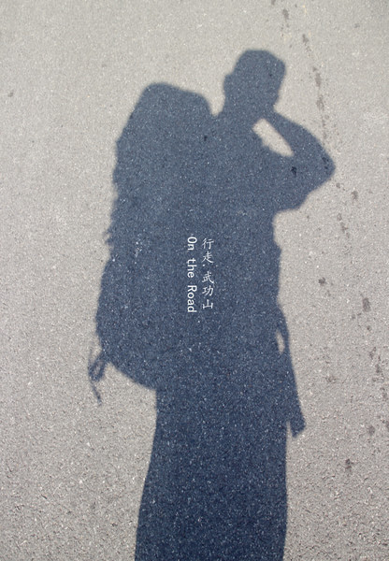
And I can't wait to get on the
road again
Notes:
50-64

