Slide 1
人教版 高中英语选修7 Unit 5 Travelling abroad
王泽玲
歌曲名:The World At Large
华南师范大学外文学院

Slide 2
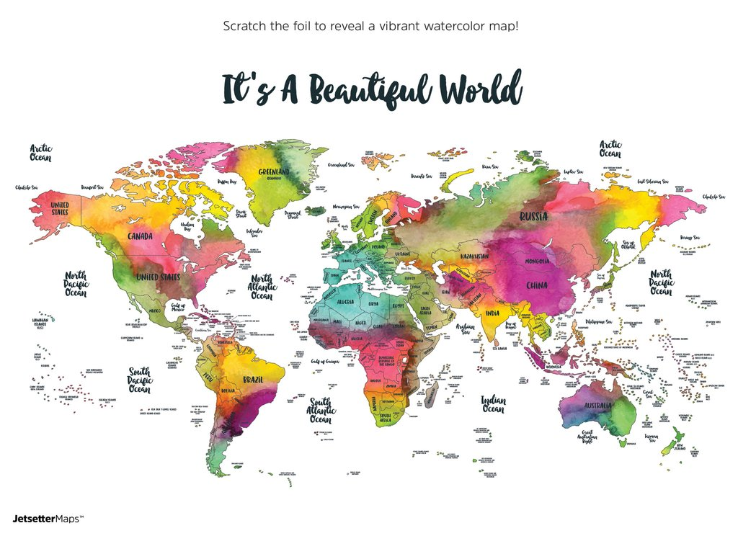
Ice-age heat wave, can't complain.

Slide 3
If the world's at large, why should
I remain?

Slide 4
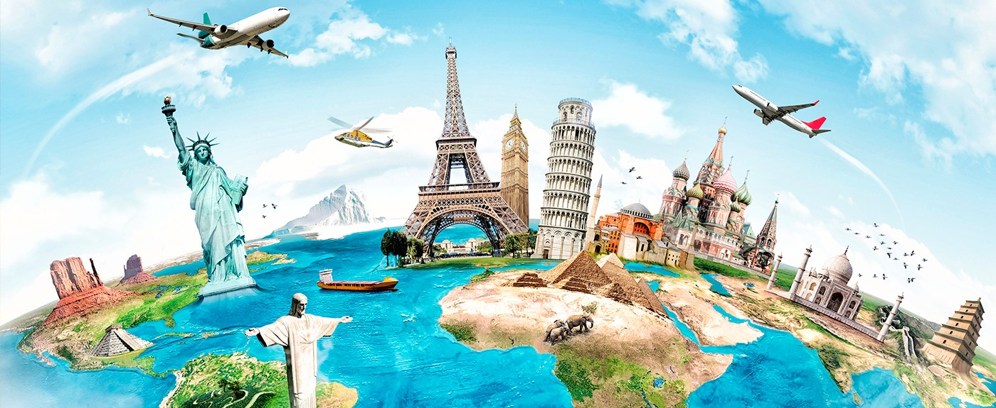
Walked away to another plan.

Slide 5
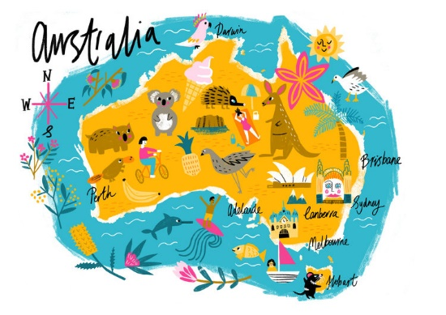
Gonna find another place, maybe one
I can stand.

Slide 6
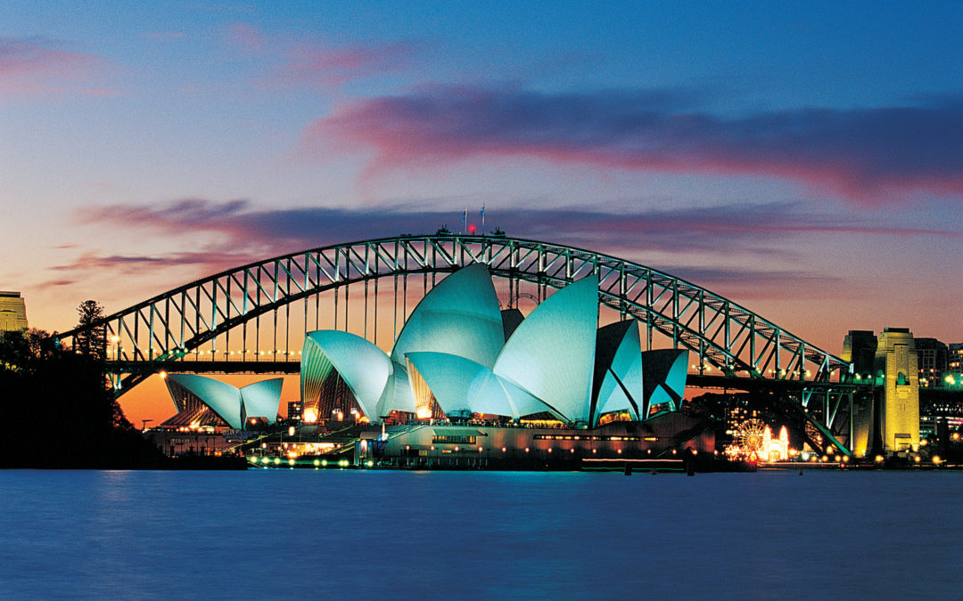
I move on to another day,

Slide 7
To a whole new town
with a whole new way.

Slide 8
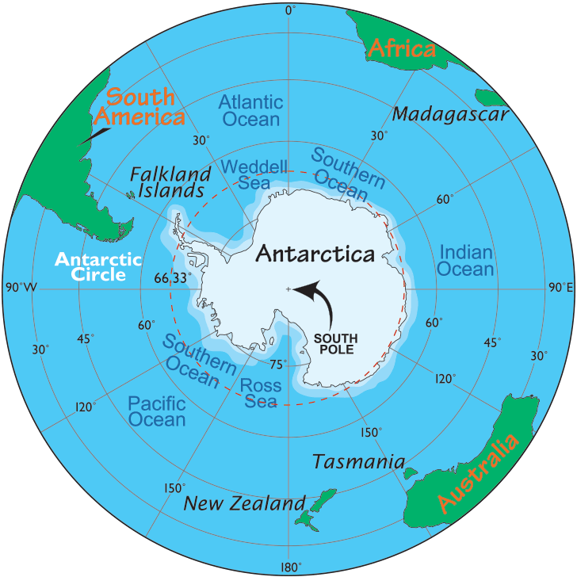
Went to the porch to have a thought.

Slide 9
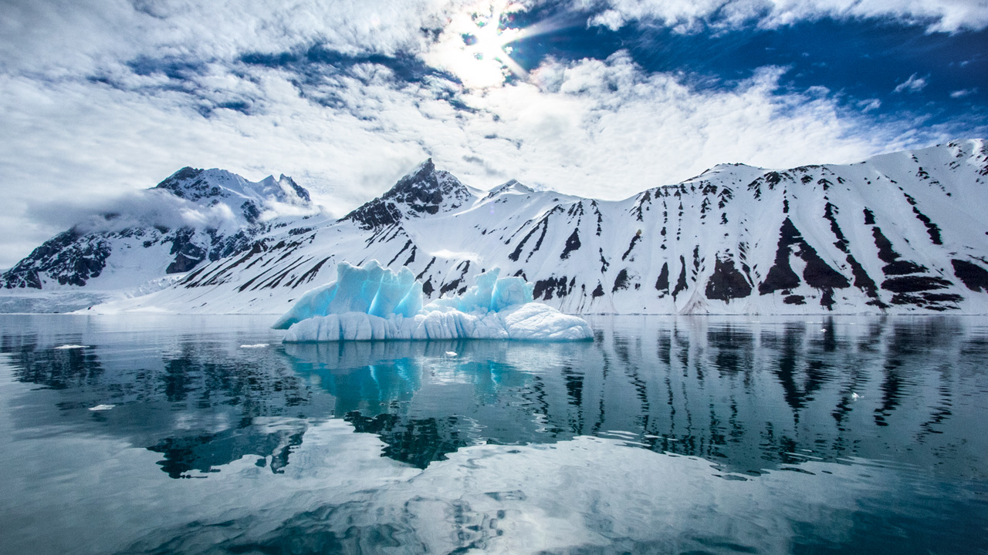
Got to the door and again, I couldn't stop.

Slide 10
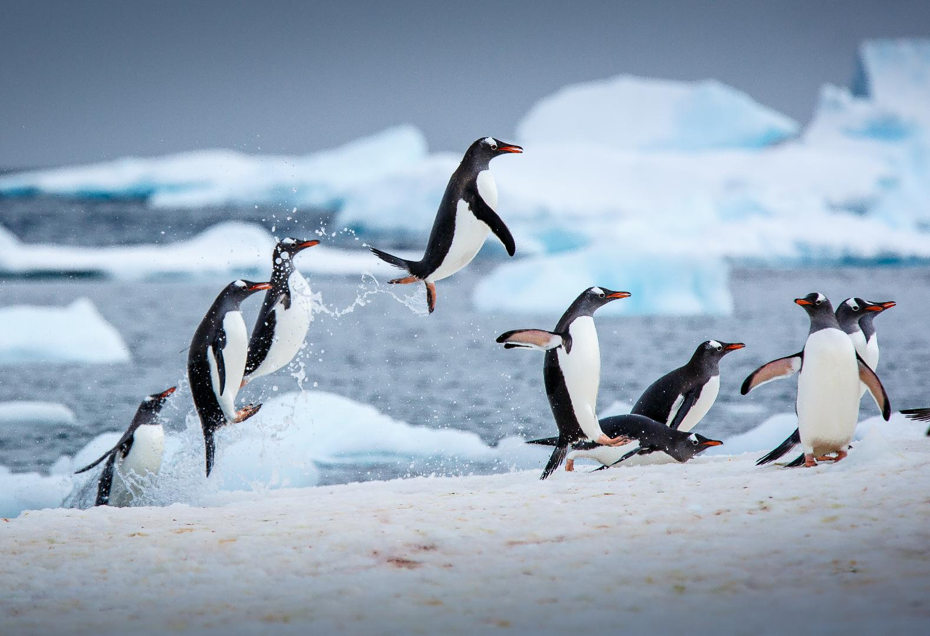
You don't know where and you don't know when.

Slide 11
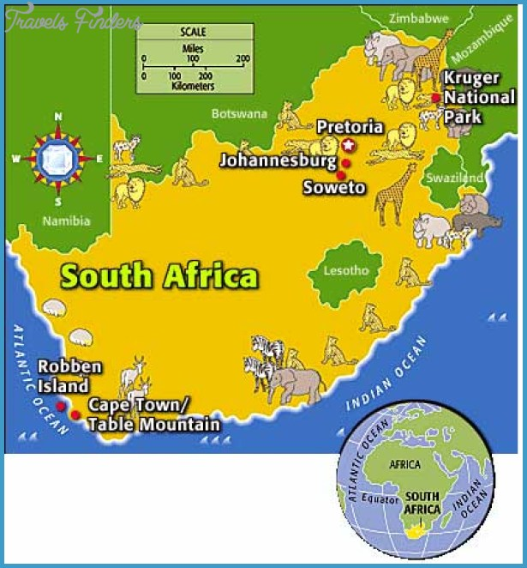
But you still got your words and you got your friends.

Slide 12
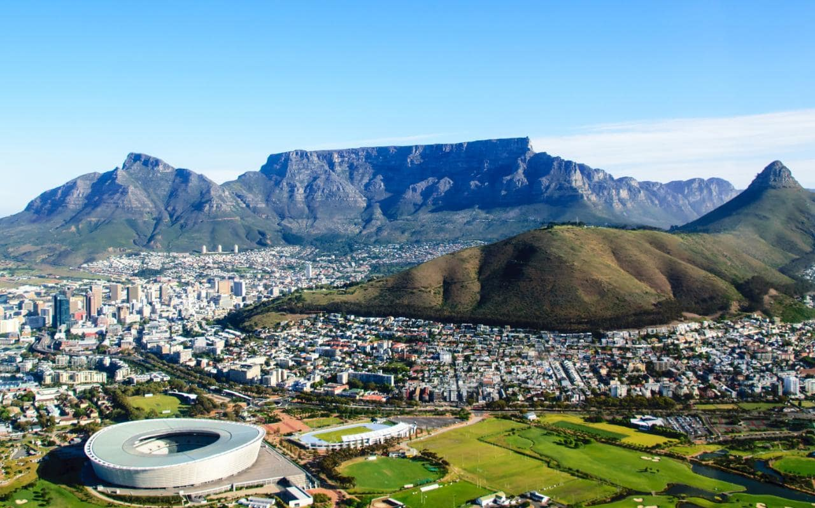
Walk along to another day.

Slide 13
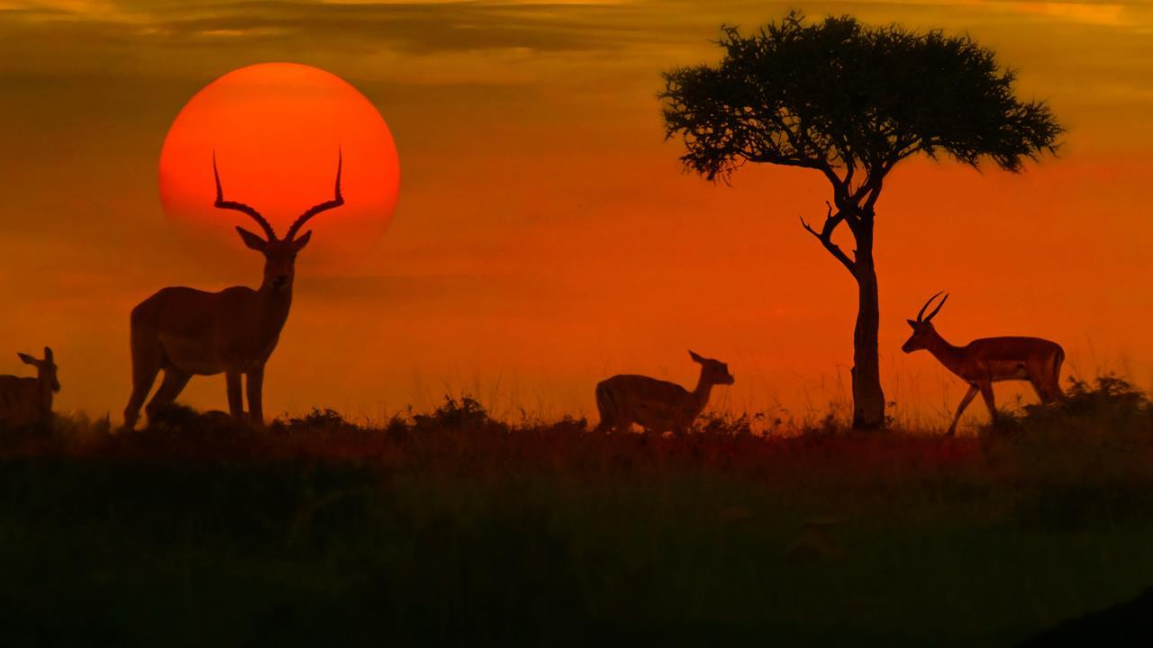
Work a little harder, work another way.

Slide 14
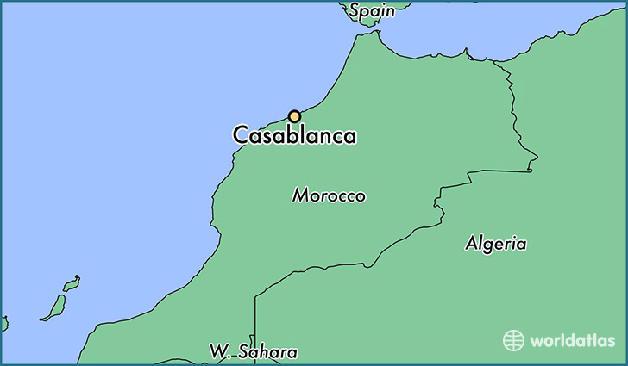
Well uh-uh baby I ain't got no plan.

Slide 15
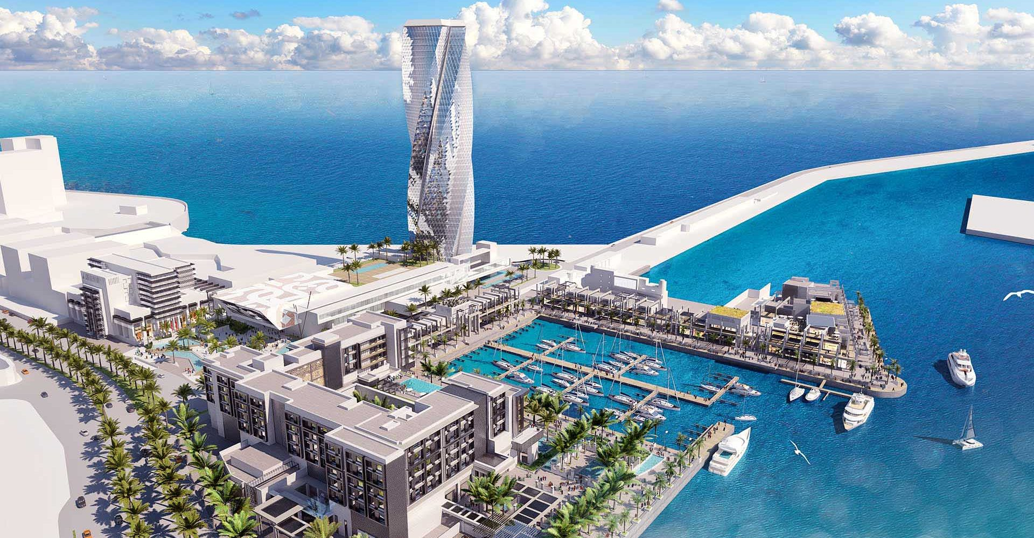
We'll float on maybe would you understand?

Slide 16
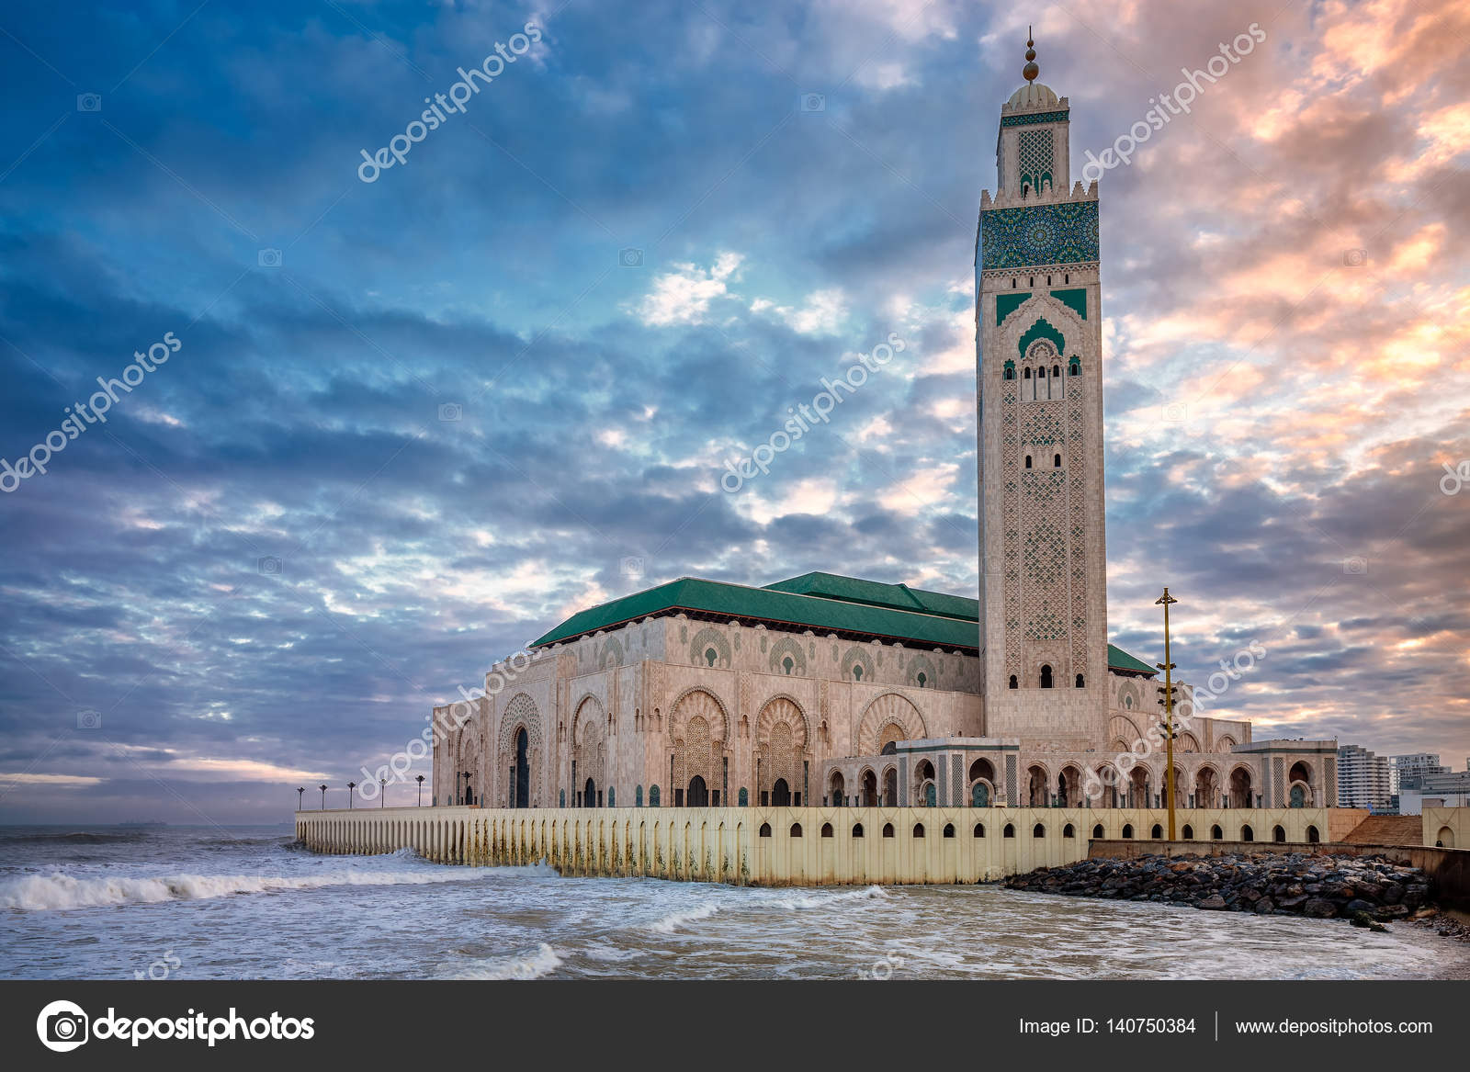
Gonna float on maybe would you understand?

Slide 17
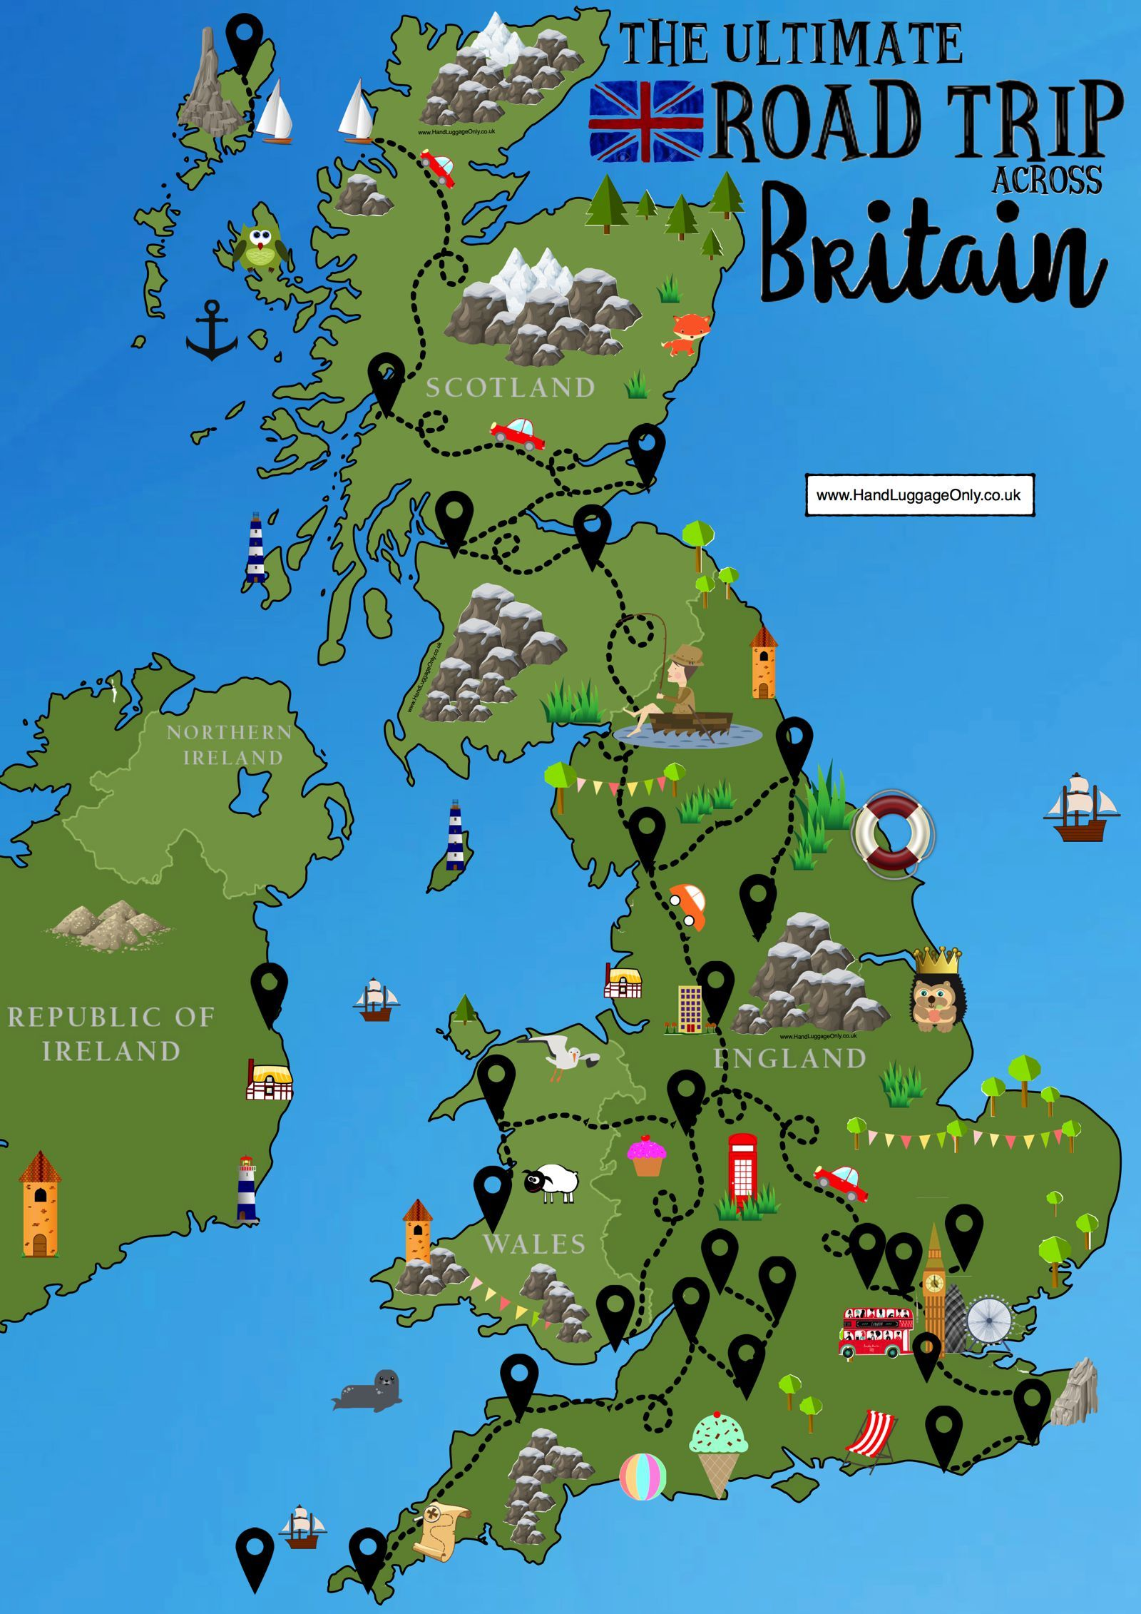
Well float on maybe would you understand?

Slide 18
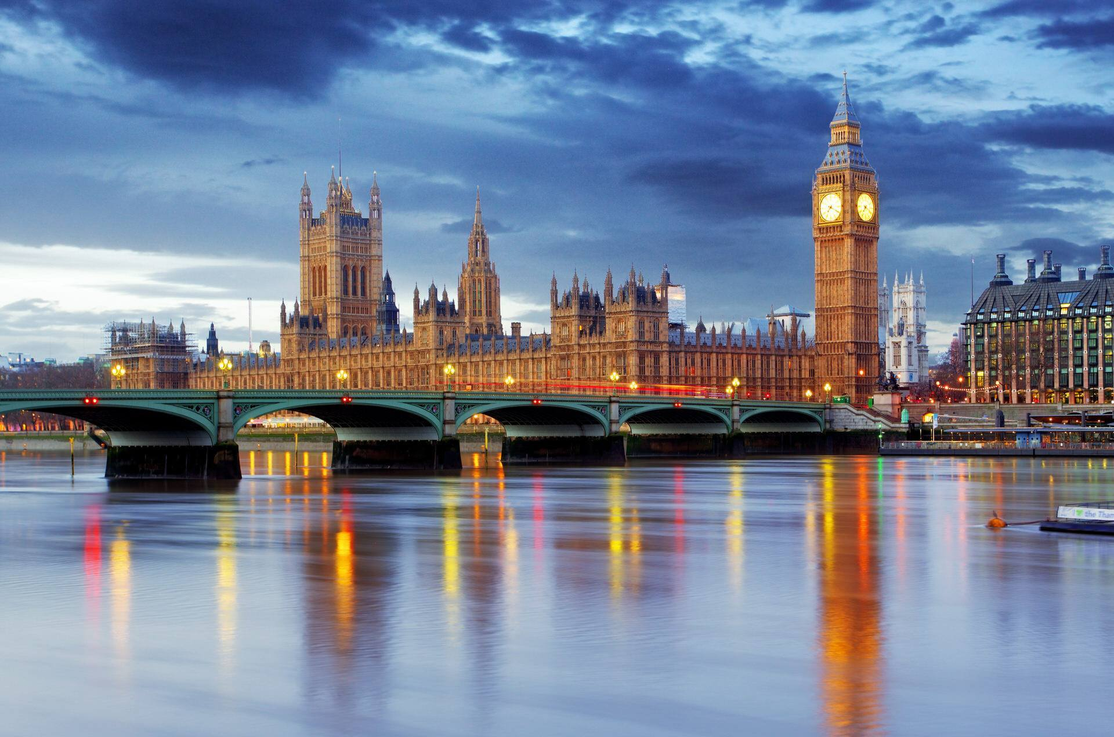
The days get shorter and the nights get cold.

Slide 19
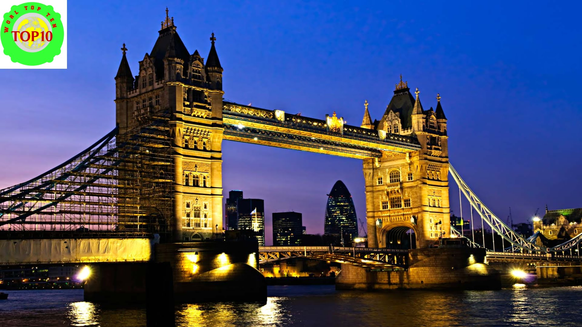
I like the autumn but this place is getting old.

Slide 20
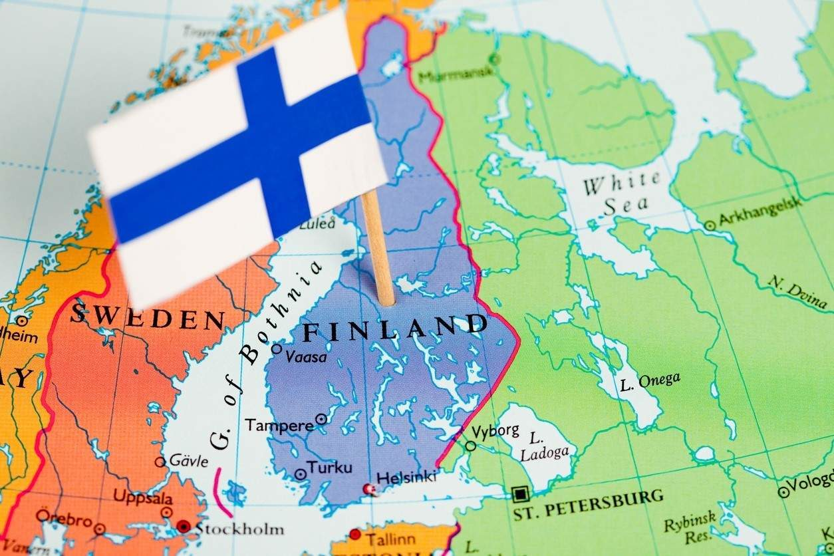
I pack up my belongings and I head for the coast.

Slide 21
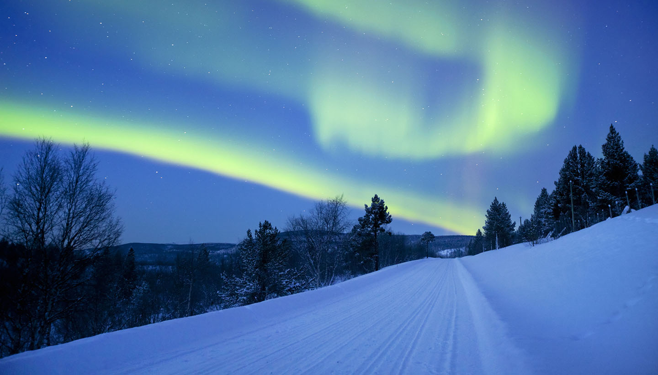
It might not be a lot but I feel like I'm making the most.

Slide 22
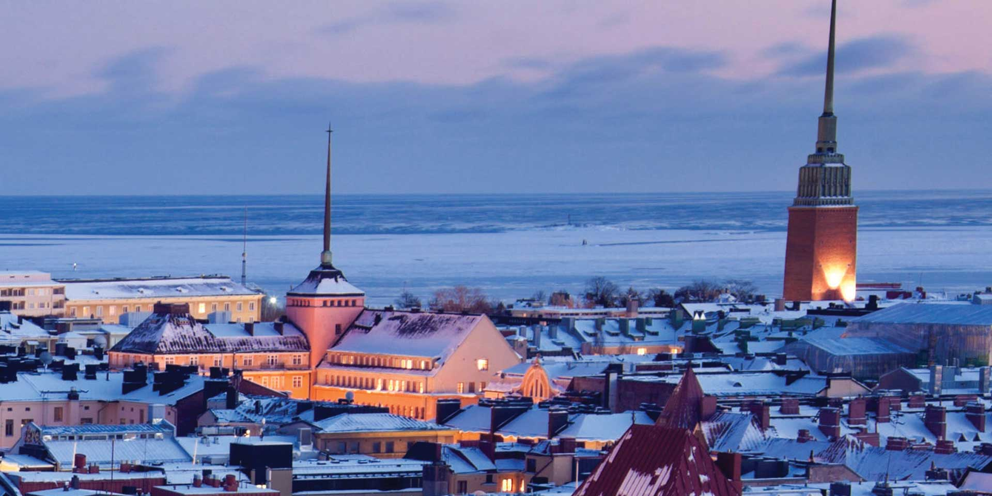
The days get longer and the nights smell green.

Slide 23
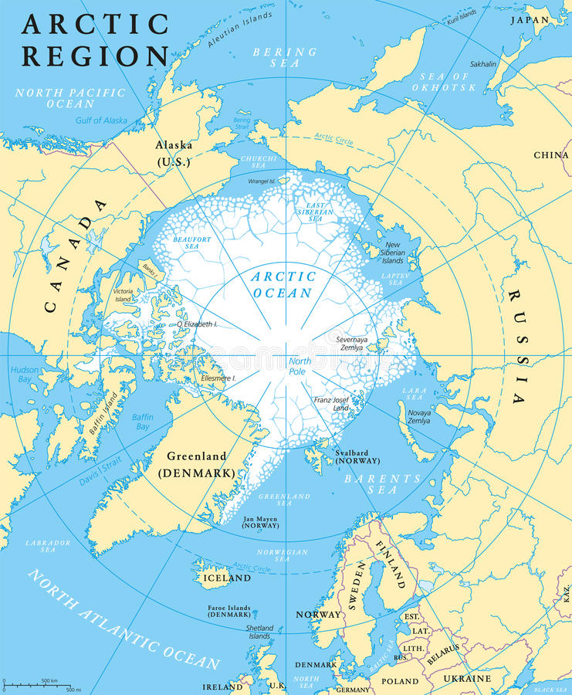
I guess it's not surprising but it's spring and I should leave.

Slide 24
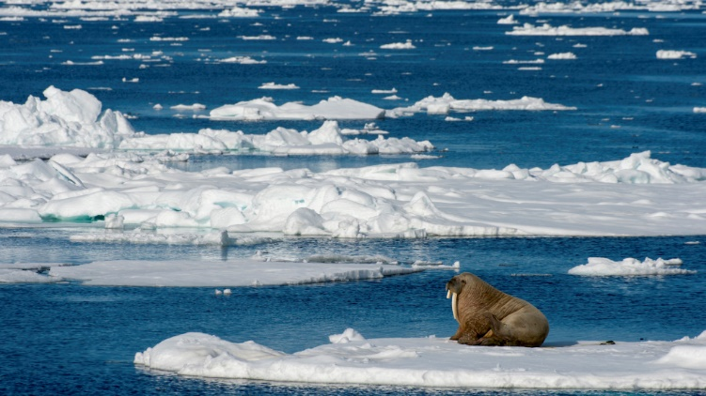
I like songs about drifters - books about the same.

Slide 25
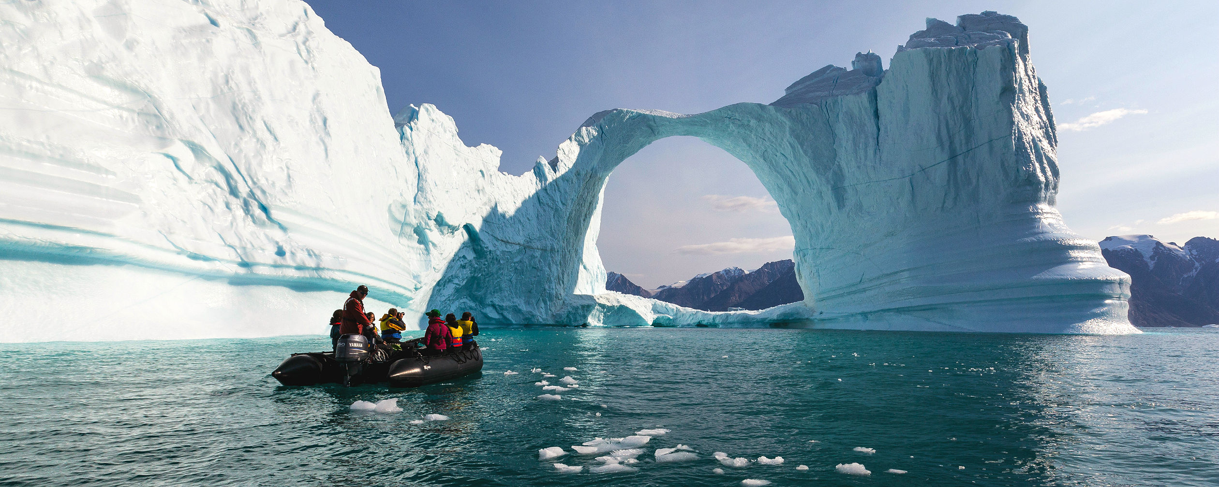
They both seem to make me feel a little less insane.

Slide 26
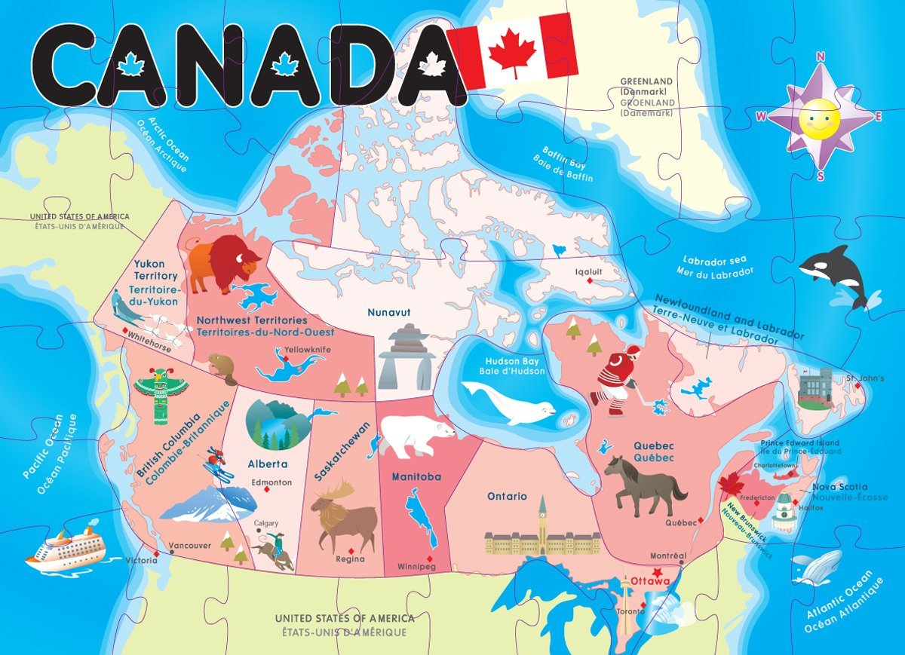
Walked on off to another spot.

Slide 27
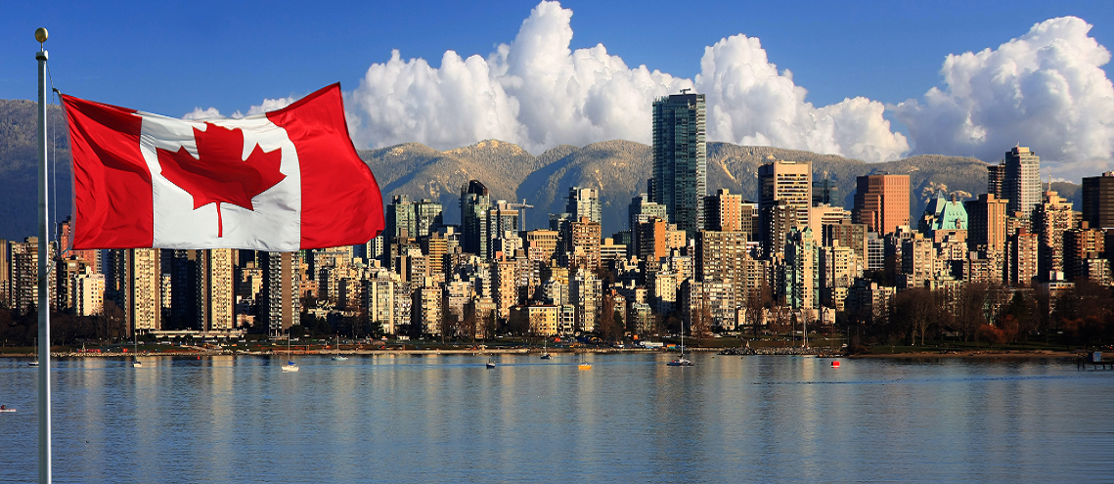
I still haven't gotten anywhere that I want.

Slide 28
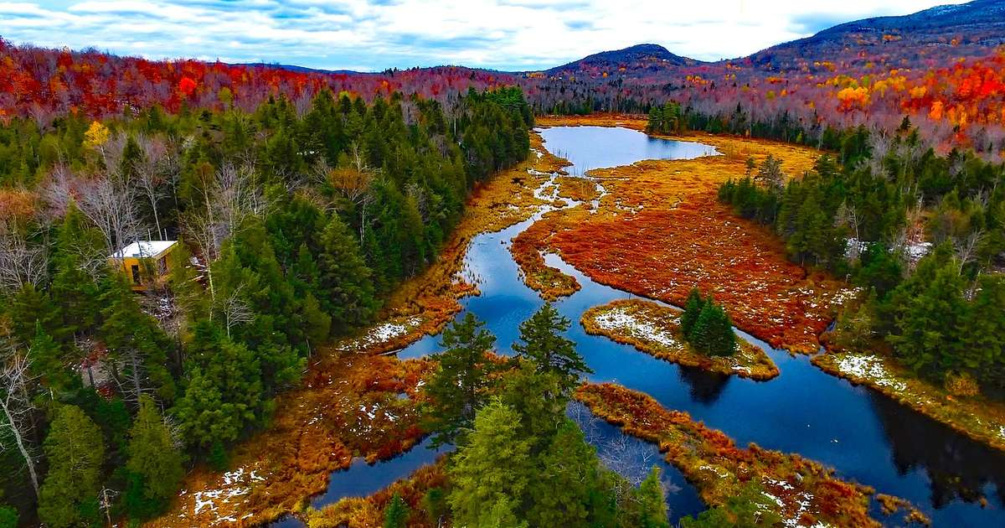
Did I want love? Did I need to know?

Slide 29
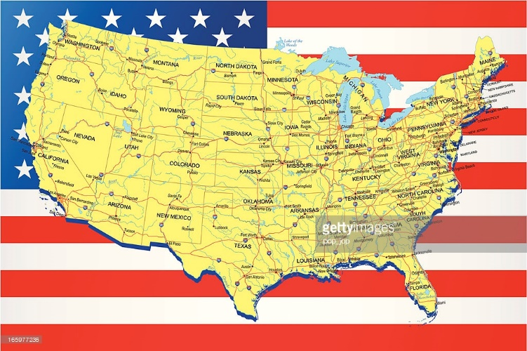
Why does it always feel like I'm caught in an undertow?

Slide 30
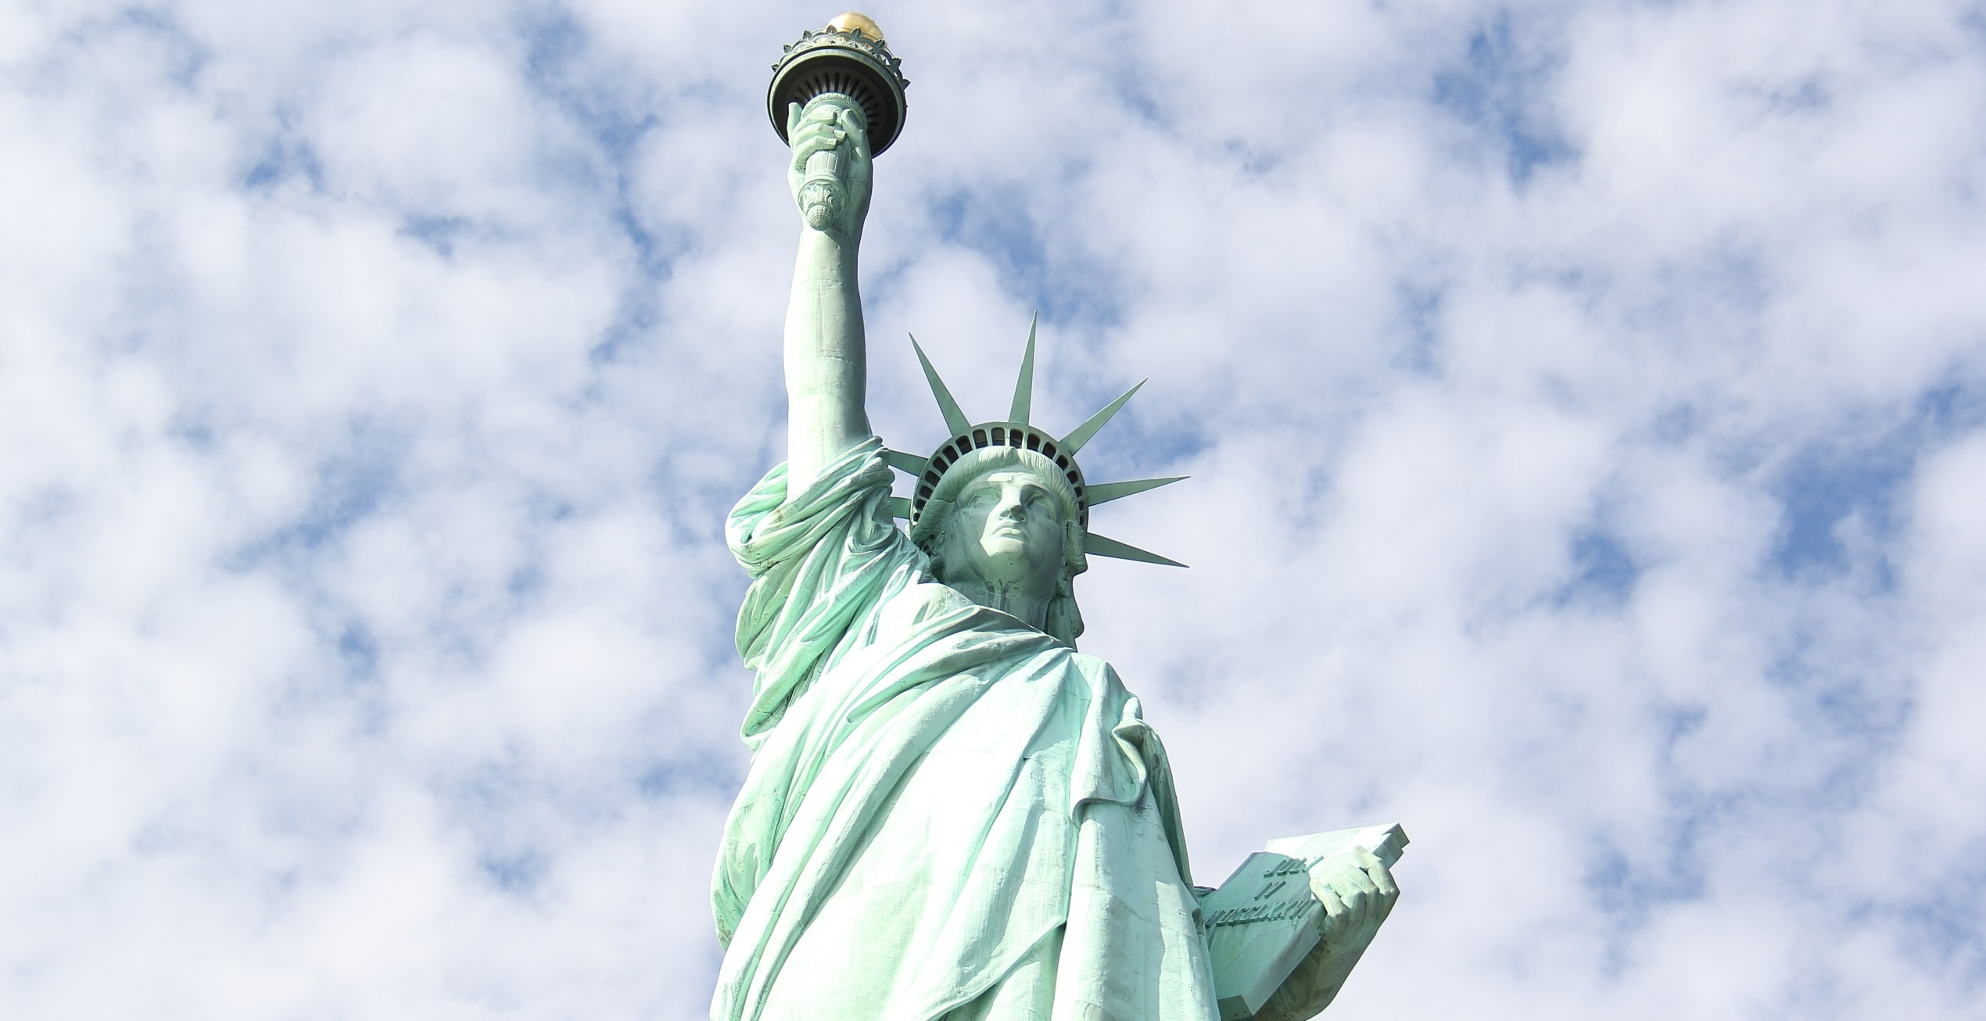
The moths beat themselves to death against the lights.

Slide 31
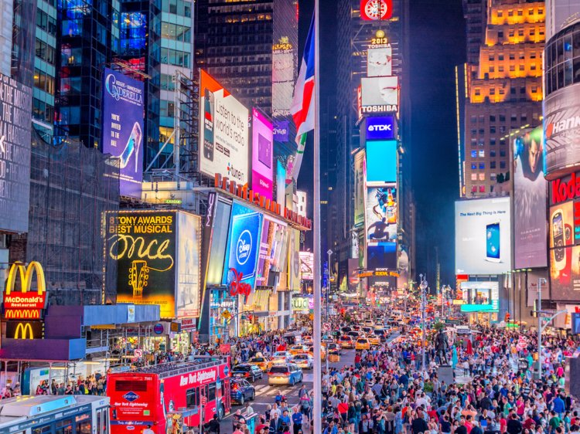
Adding their breeze to the summer nights.

Slide 32
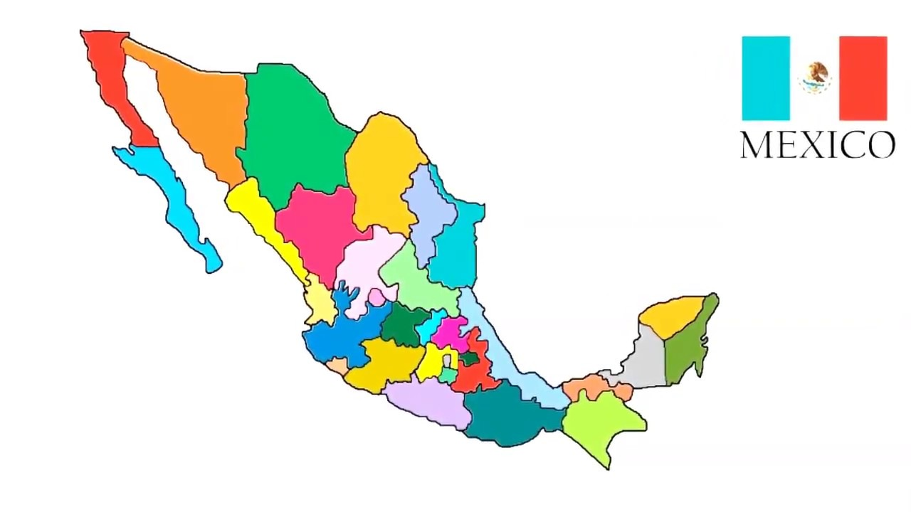
Outside, water like air was great.

Slide 33
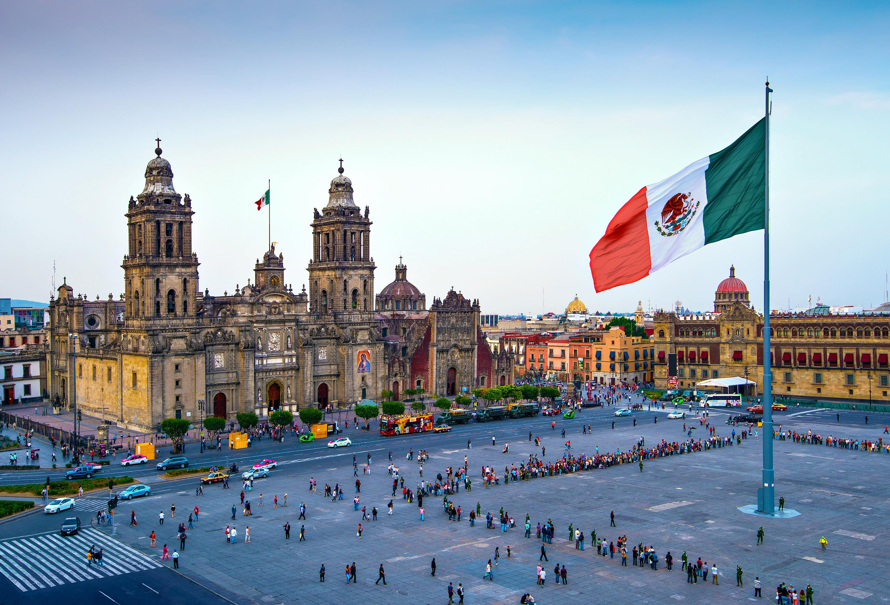
I didn't know what I had that day.

Slide 34
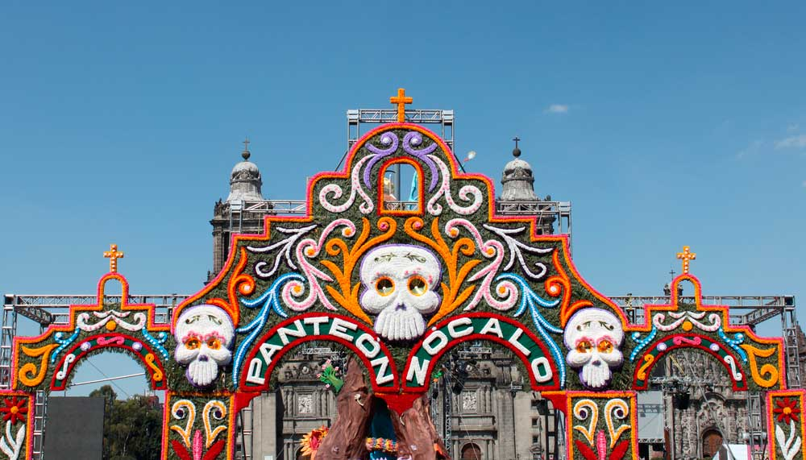
Walk a little farther to another plan.

Slide 35
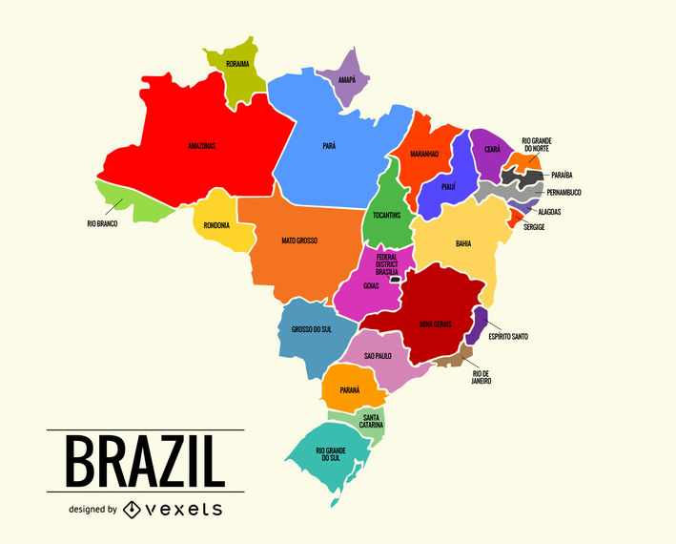
You said that you did, but you didn't understand.

Slide 36
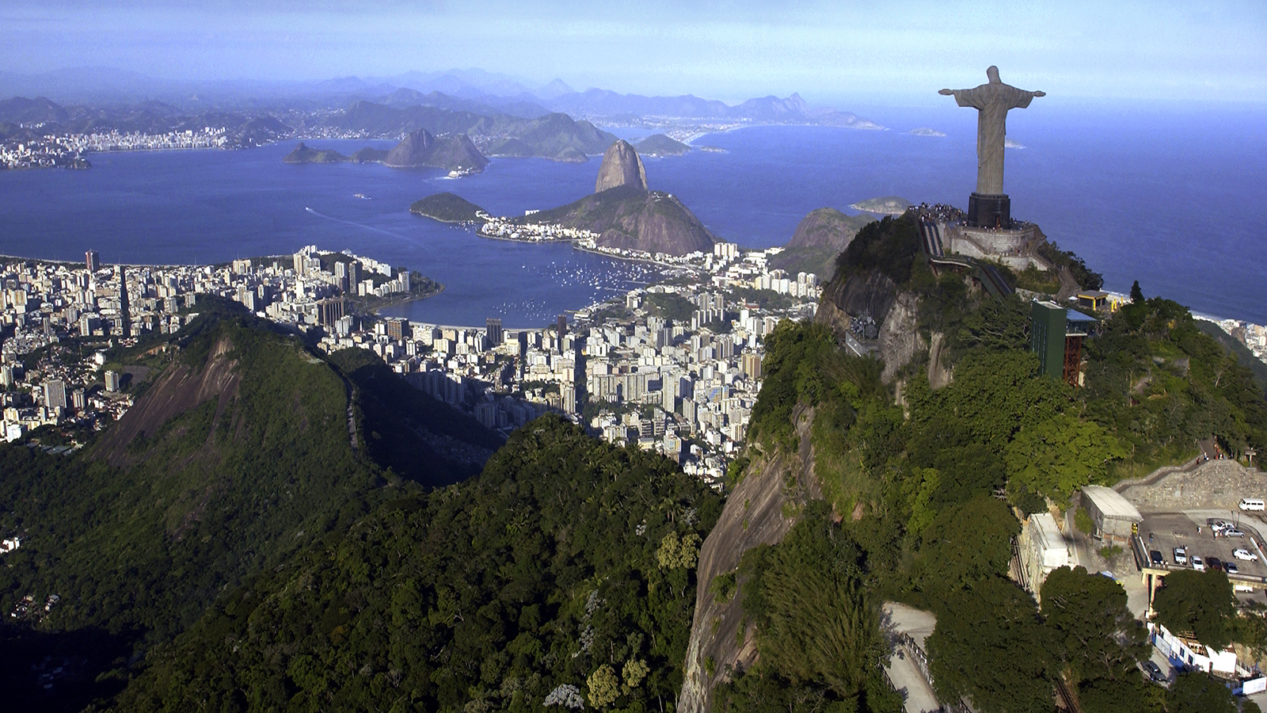
I know that starting over is not what life's about.

Slide 37
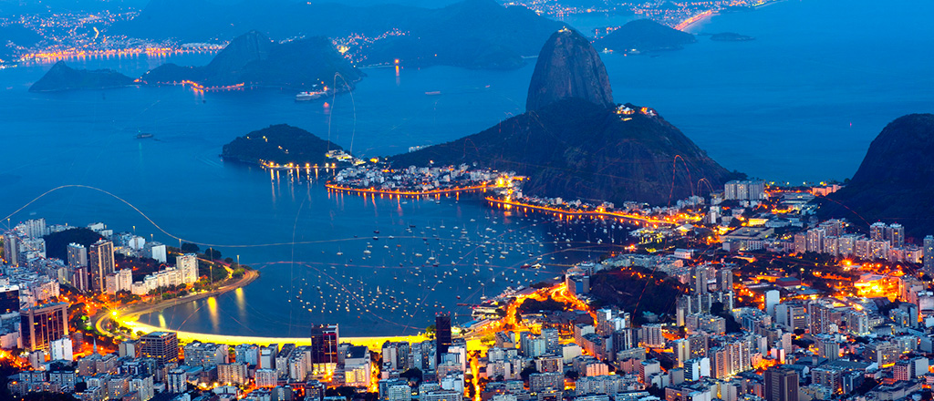
But my thoughts were so loud I couldn't hear my mouth.

Slide 38
My thoughts were so loud I couldn't hear my mouth.

Slide 39
My thoughts were so loud.

Slide 40
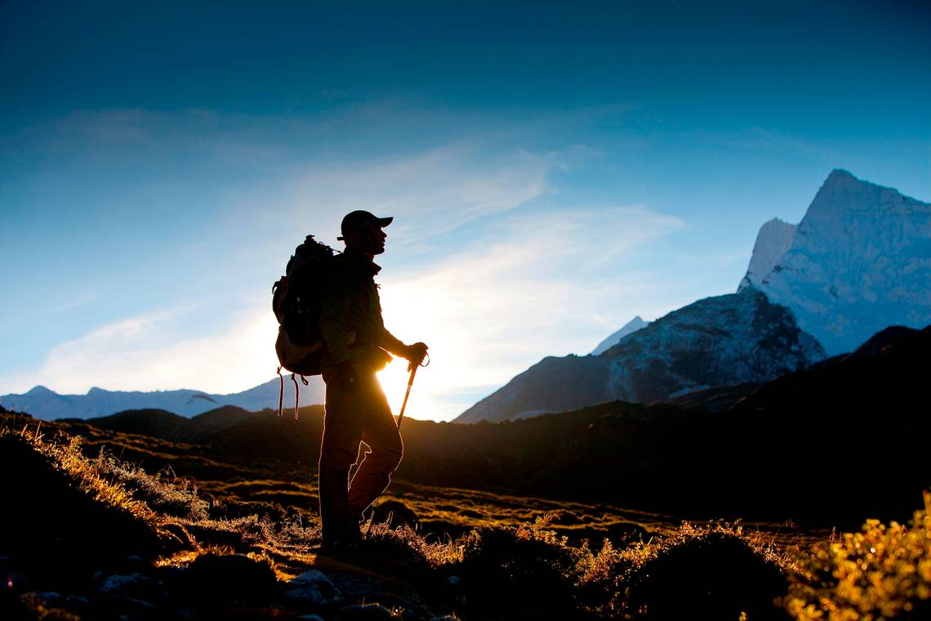

Slide 43
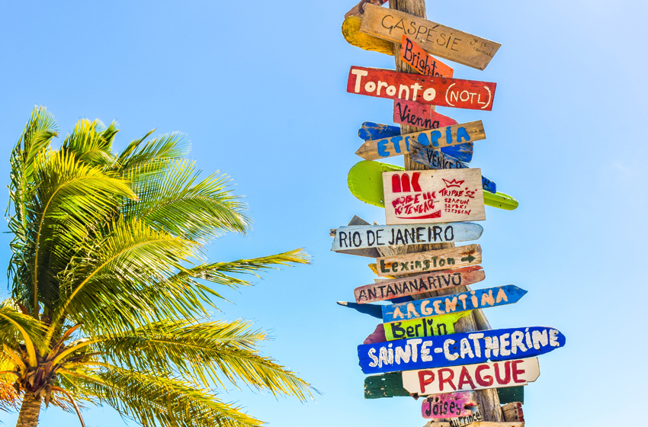

Slide 47
