Slide 1
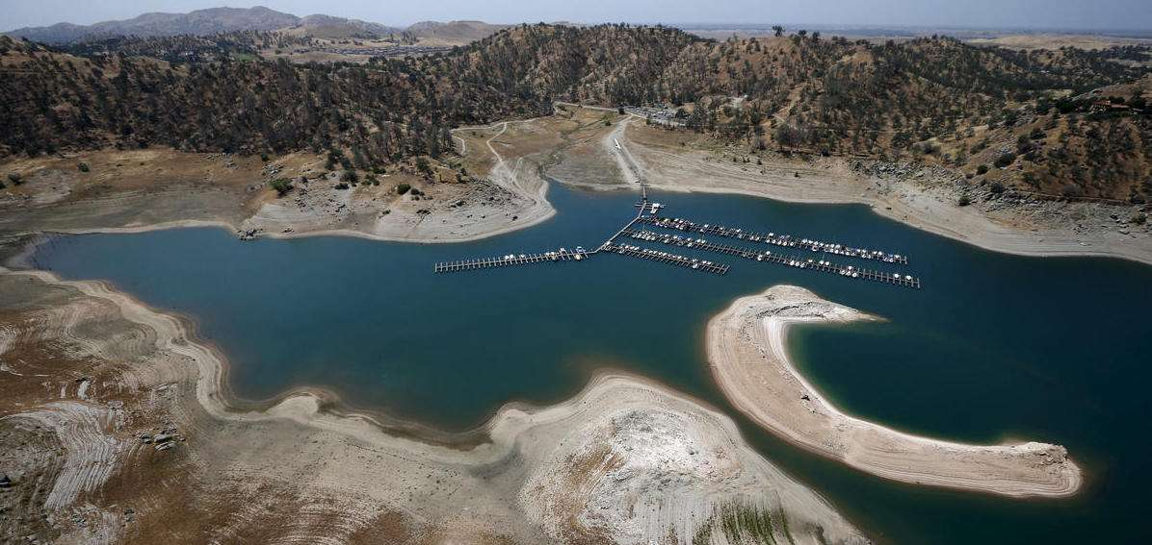
California Dreaming
教材版本：高中英语人教版M8
单元主题：Unit 1 A Land of Diversity
课文主题：California
钟莉莎  华南师范大学外文学院

Slide 2
California Dreaming

Slide 3
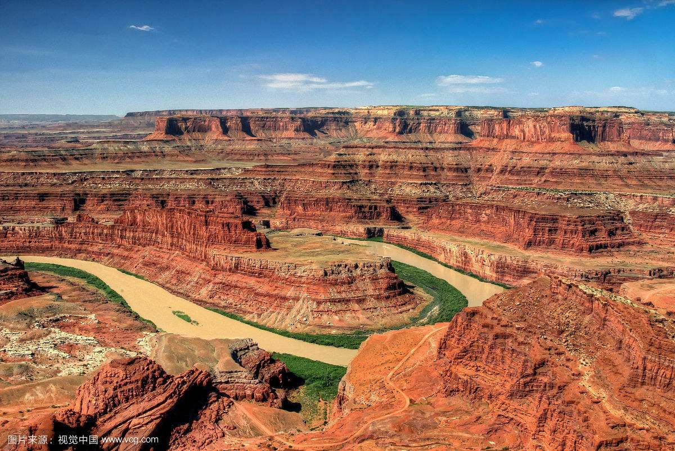
All the leaves are
brown
sky
And the
is grey

Slide 4
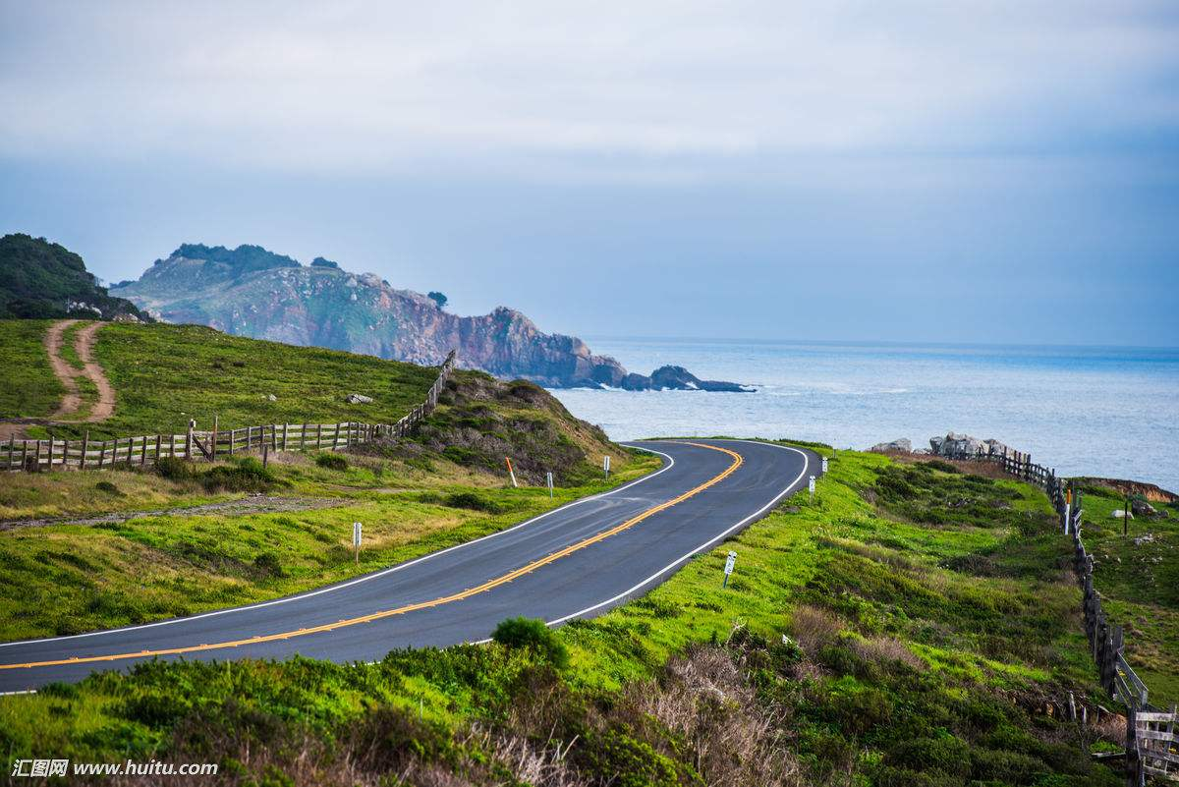
sky
And the
I've been for a walk
on a winter’s day
is grey

Slide 5
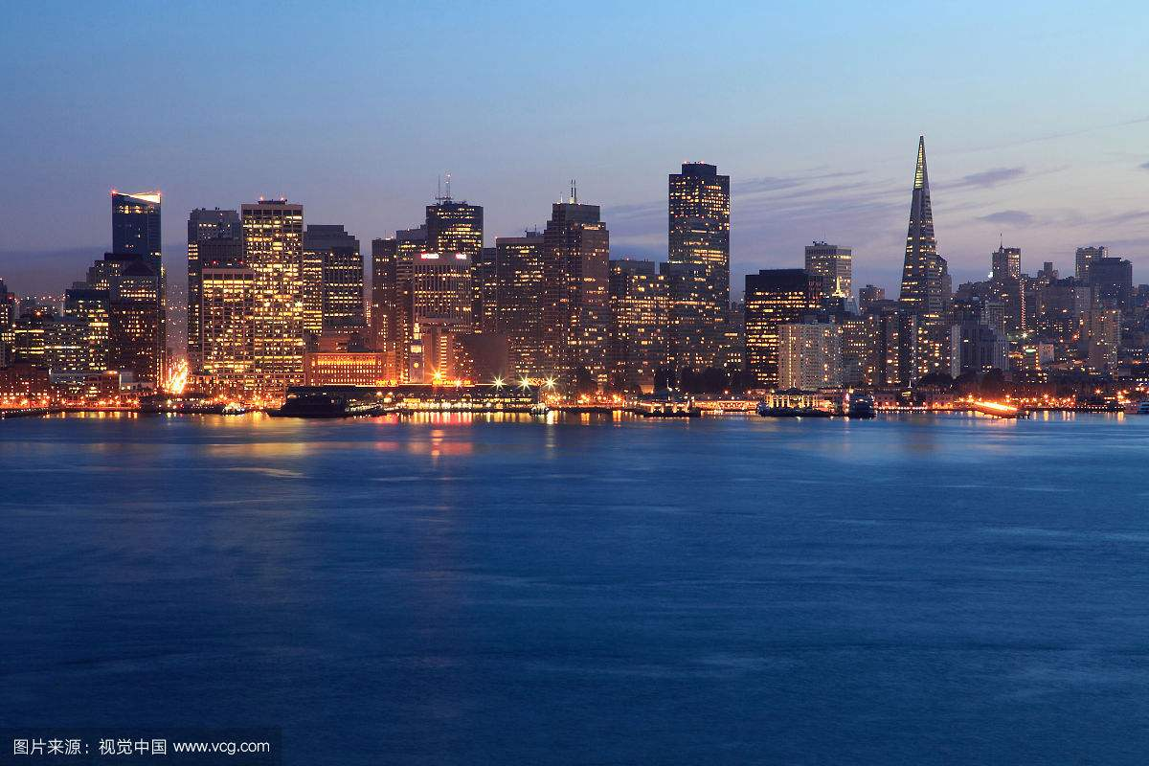
I'd be safe and warm
If I was in L A

Slide 6
California dreaming
I'd be safe and warm
If I was in L A

Slide 7
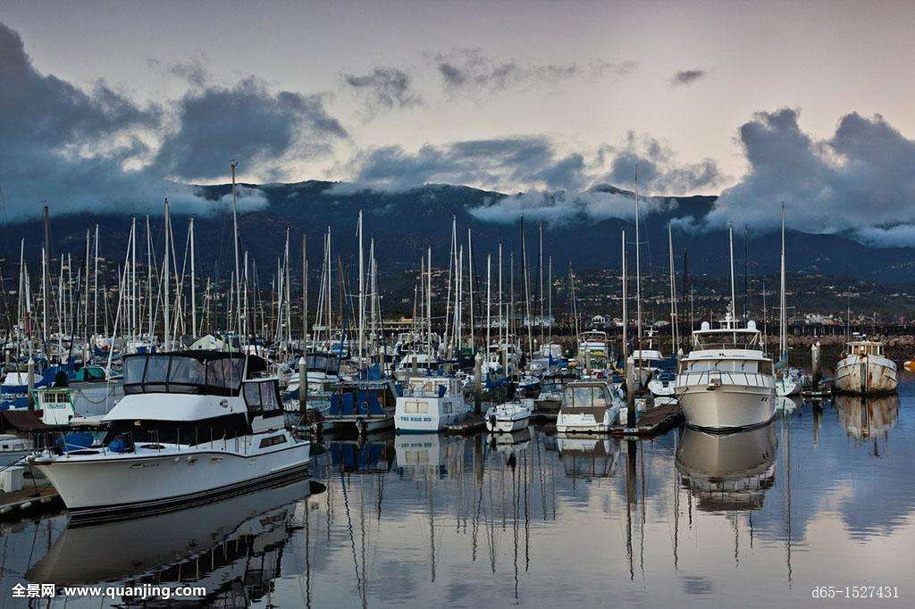
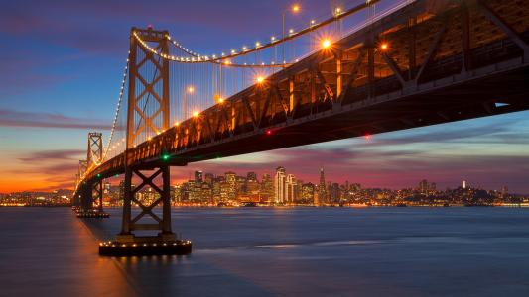
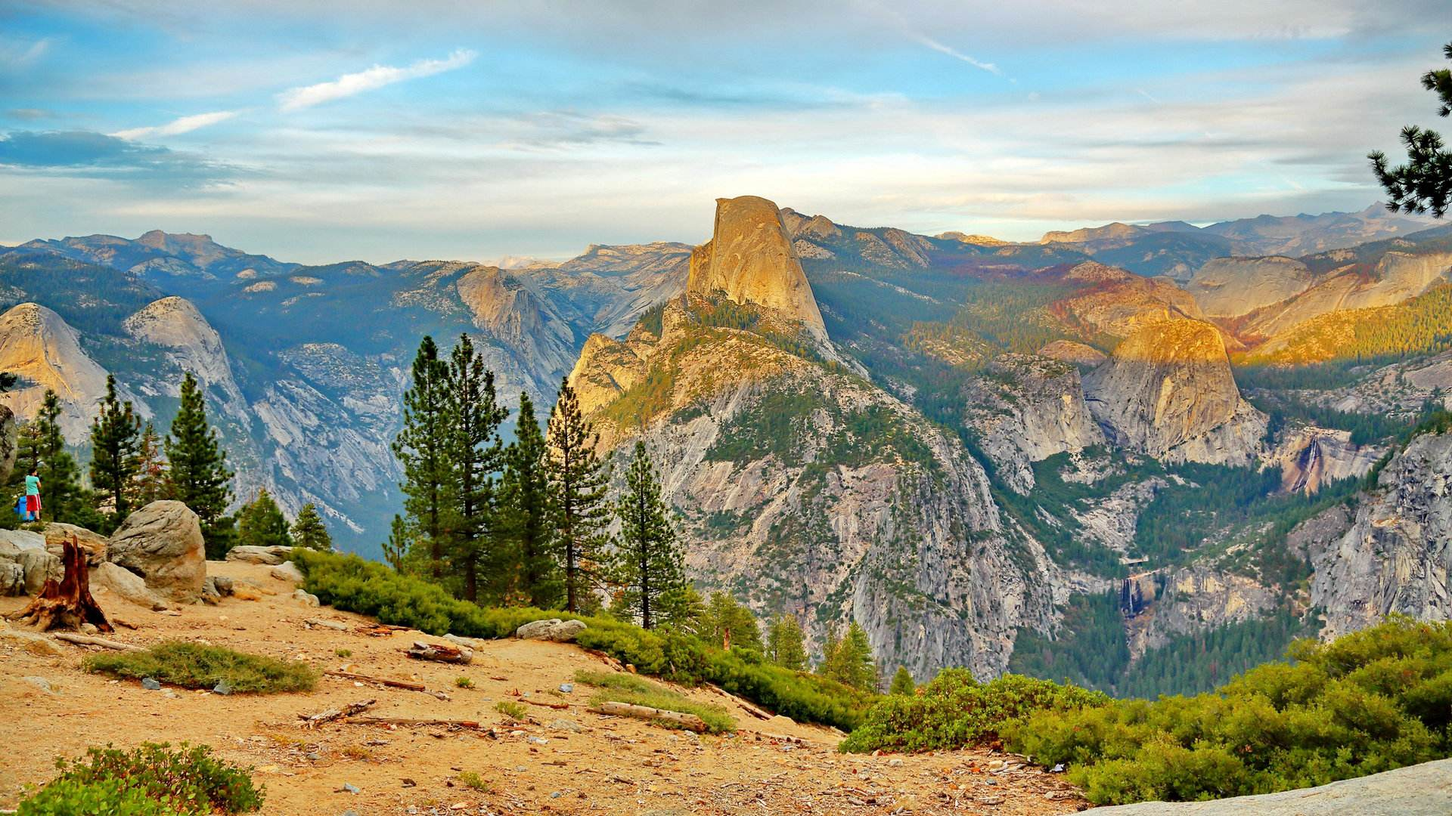
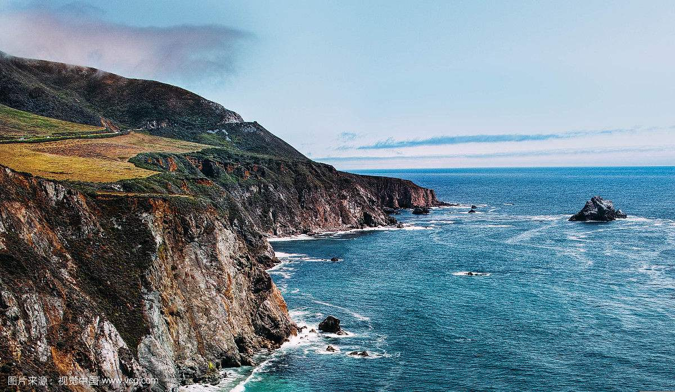
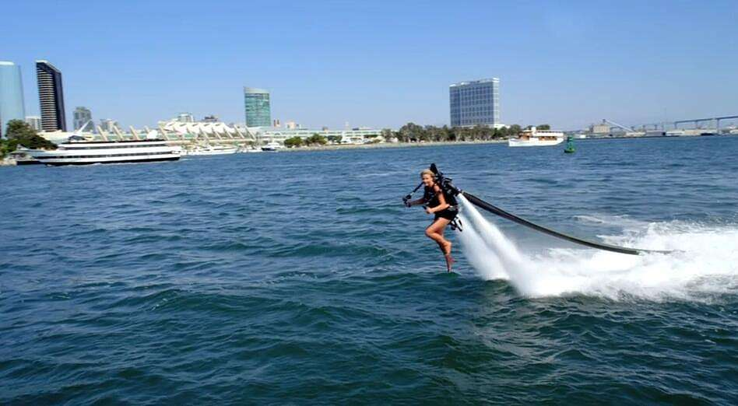
On such a winter's day

Slide 8
On such a winter's day
Stopped into a church
I passed along the way

Slide 9
Well I got down on my knees

Slide 10
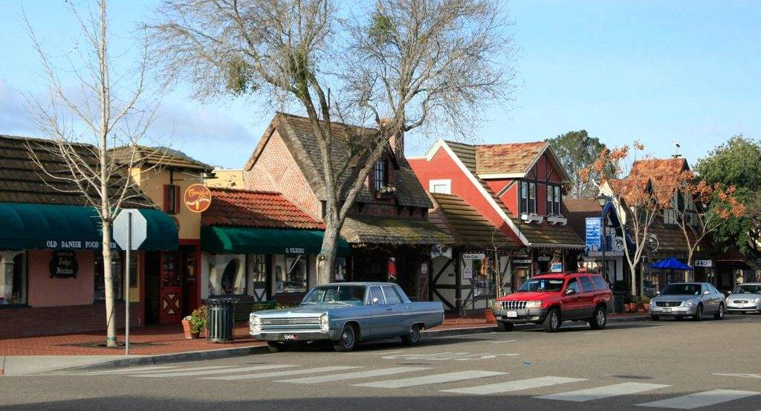
And I pretend to pray

Slide 11
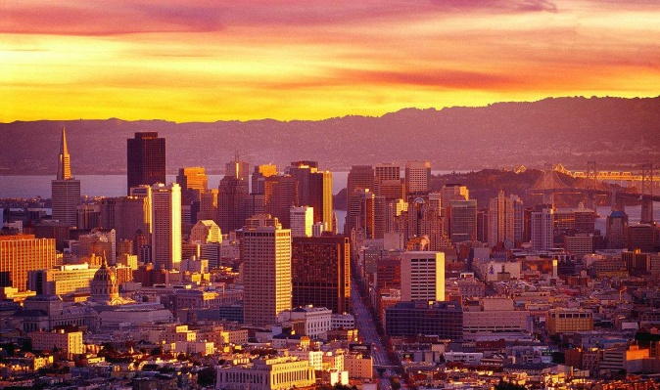
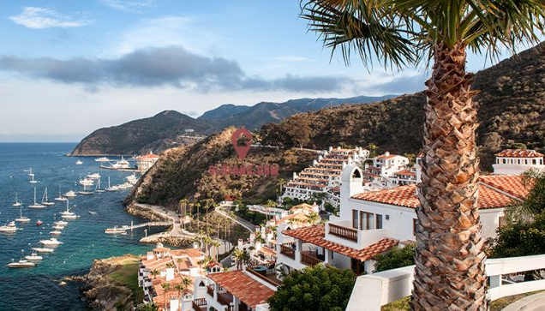
You know the preacher likes the god
He knows I'm gonna stay
California dreaming
On such a winter's day
The End
California Dreaming

