Slide 1
PEP M8U3: Inventors and inventions
Song: Amazing Inventors
作者：林钊泓
华南师范大学外文学院

Slide 2
We are inventors
amazing inventors

Slide 3
Our inventions can go slow or really fast.

Slide 4
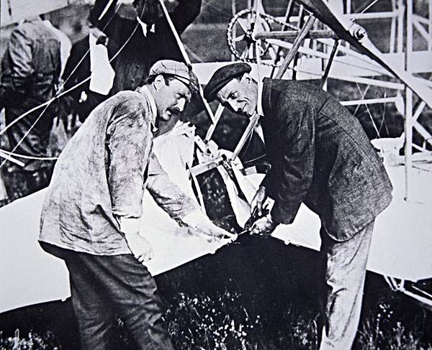
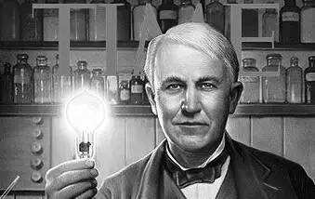
They are inventors
amazing inventors

Slide 5
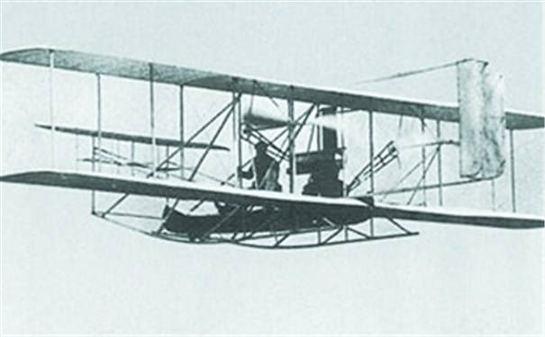
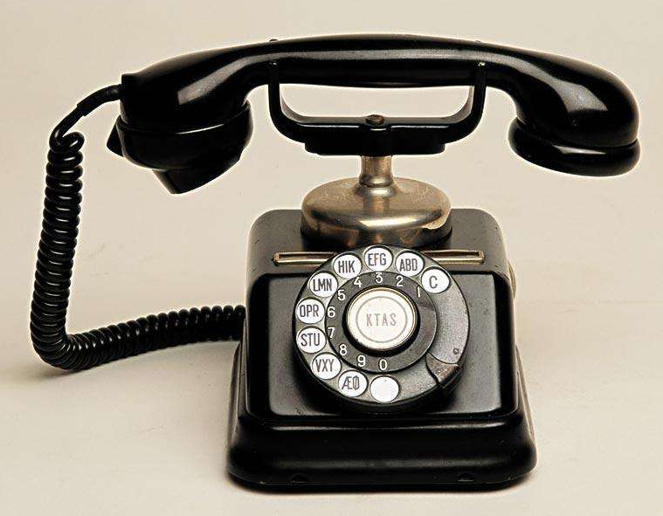
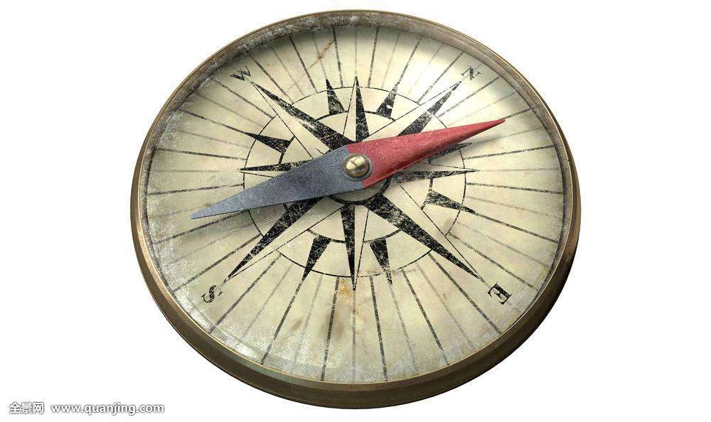
And here are some inventions from the past.

Slide 6
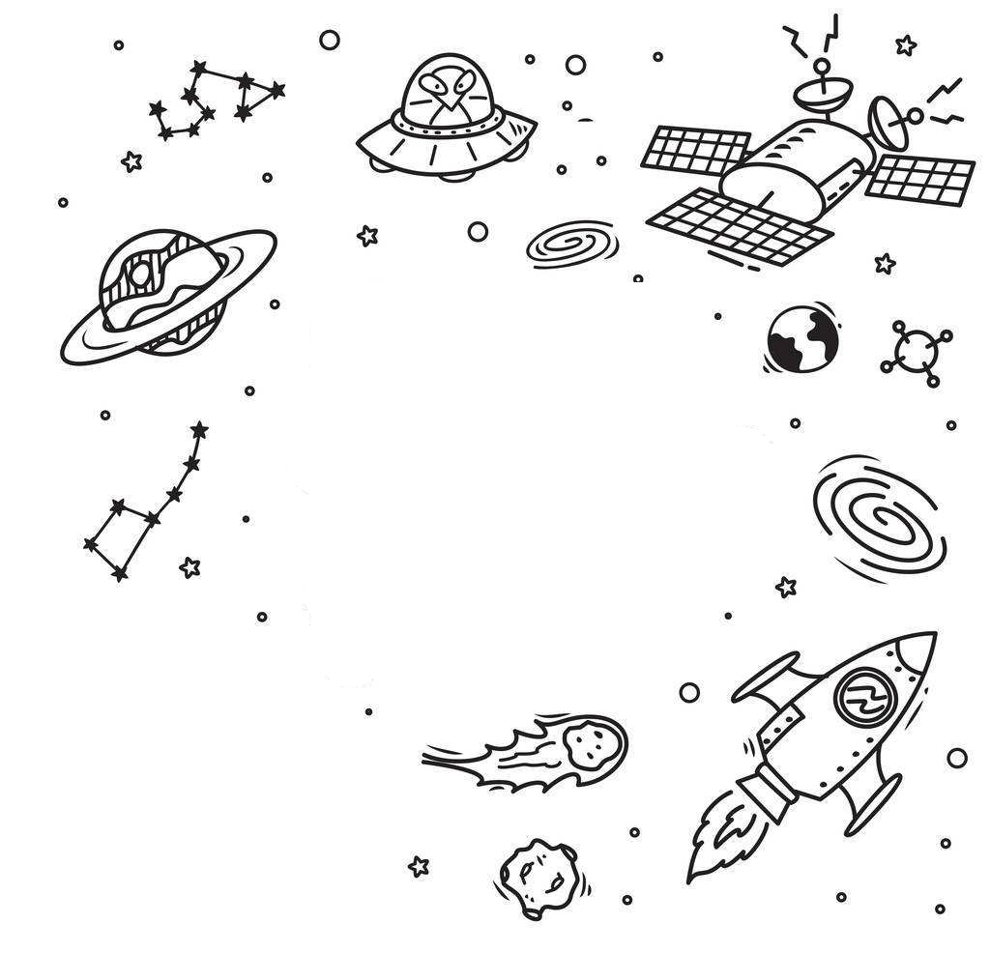
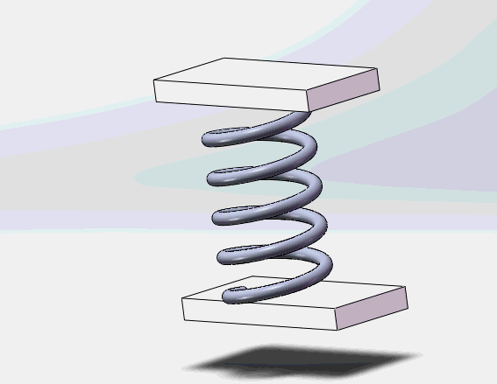
We invented the amazing spring-o-case
to blast us into outer space.

Slide 7
Our flipper sack made history
It took us through the deep blue sea

Slide 8
We are inventors
amazing inventors

Slide 9
Our inventions can go slow or really fast.

Slide 10
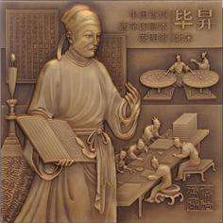
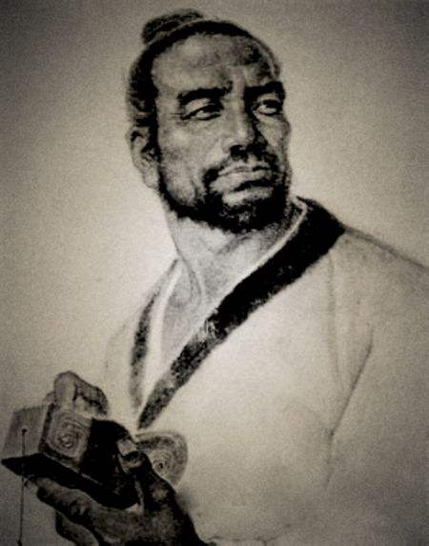
They are inventors
amazing inventors

Slide 11
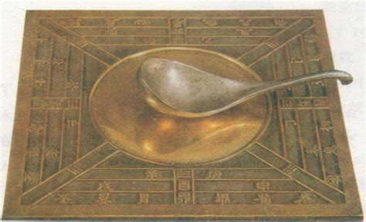
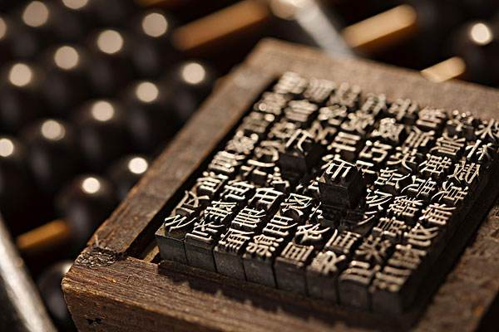
And here are some inventions from the past.

Slide 12
We are inventors
amazing inventors

Slide 13
Making great inventions since our birth

Slide 14
They are inventors
amazing inventors

Slide 15
Now let’s journey to the center of the earth

Slide 16
Thank you.

