Slide 1
PEP M8U4: Pygmalion
MV：Without you
制作人: 陈珊珊
单位：华南师范大学外文学院

Slide 2
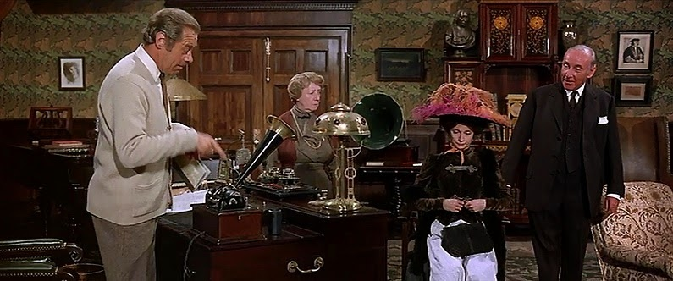
What a fool I was, what a dominated fool,
to think that you were the earth and the sky.

Slide 3
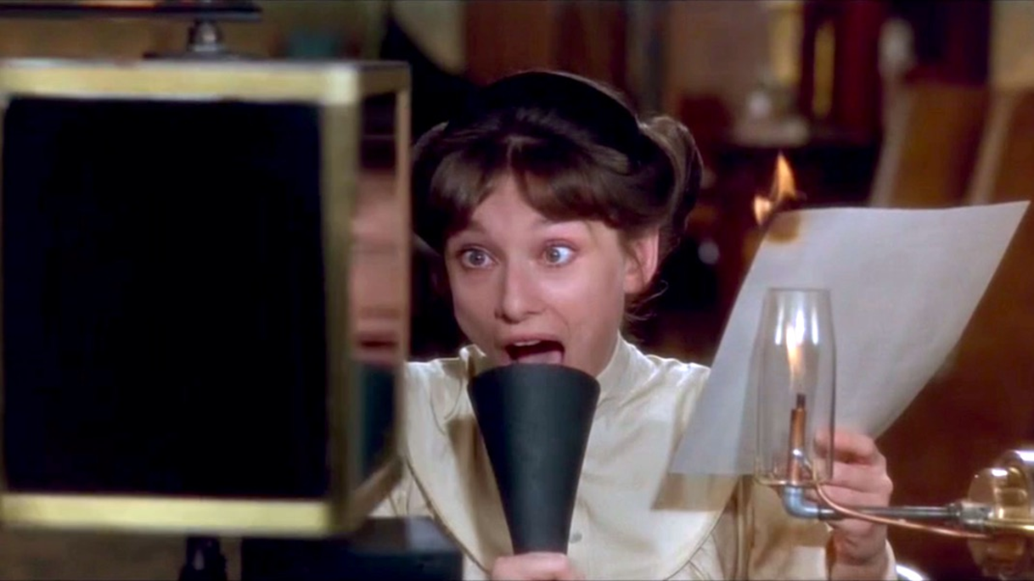
What a fool I was.
What an addlepated fool.

Slide 4
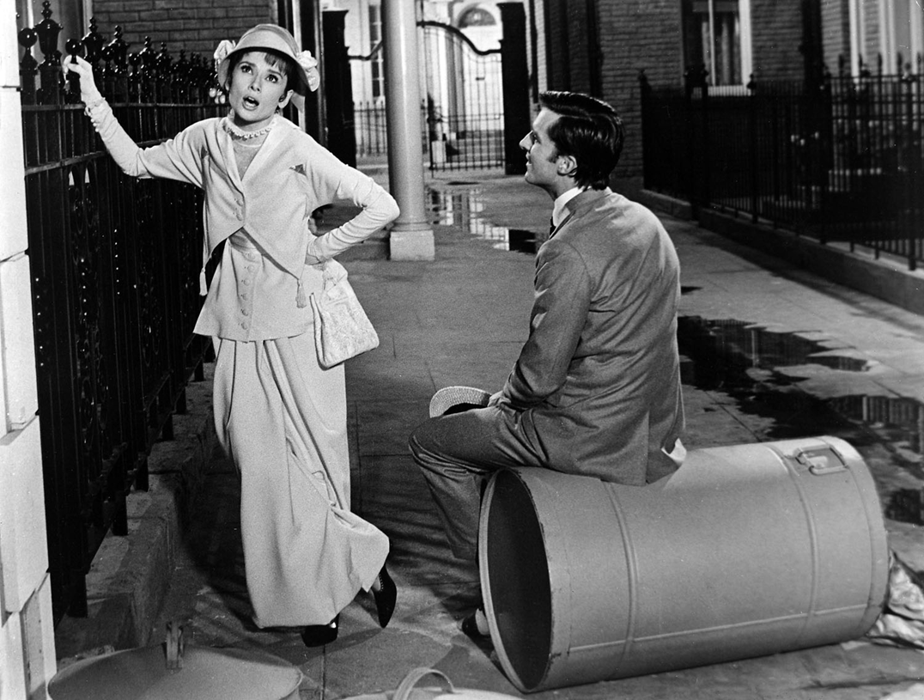
What a mutton-headed dolt was I!

Slide 5
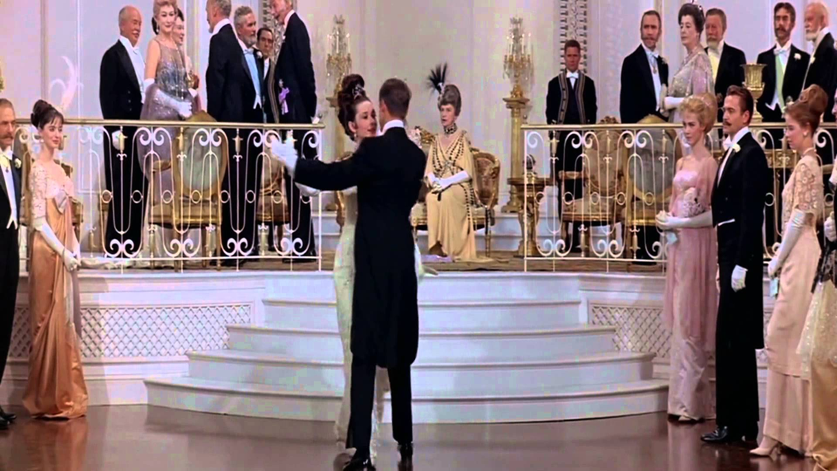
No, my reverberated friend,
you are not the beginning and the end.

Slide 6
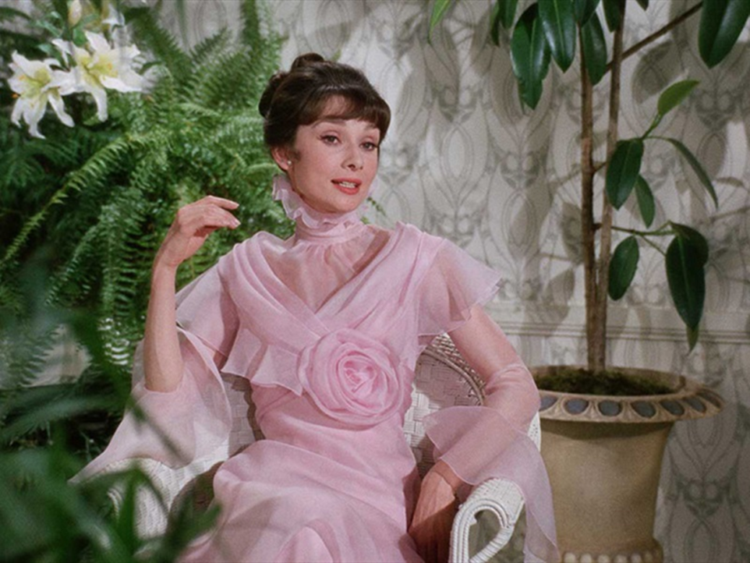
There'll be spring every year without you.
England still will be here without you.

Slide 7
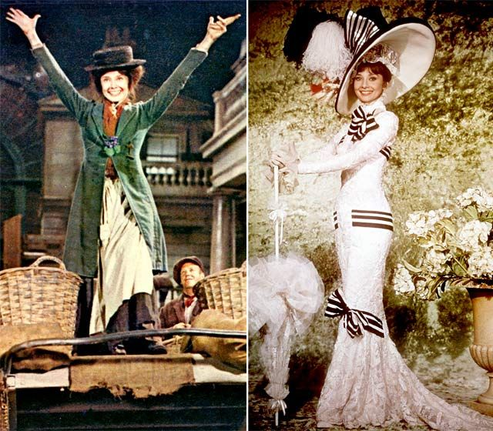
There'll be fruit on the tree. And a shore by the sea.
There'll be crumpets and tea without you.

Slide 8
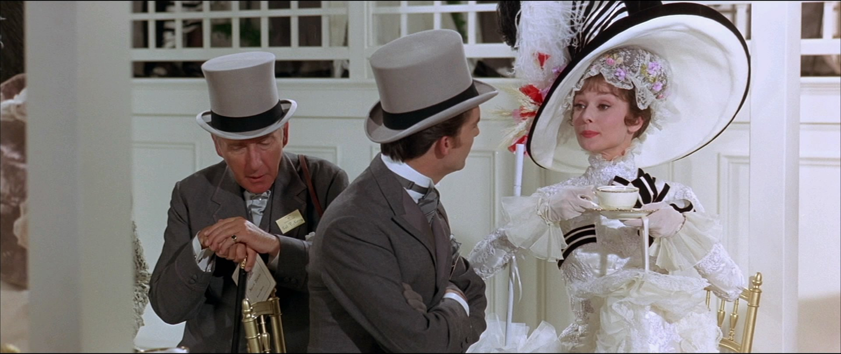
Art and music will thrive without you.
Somehow Keats will survive without you.

Slide 9
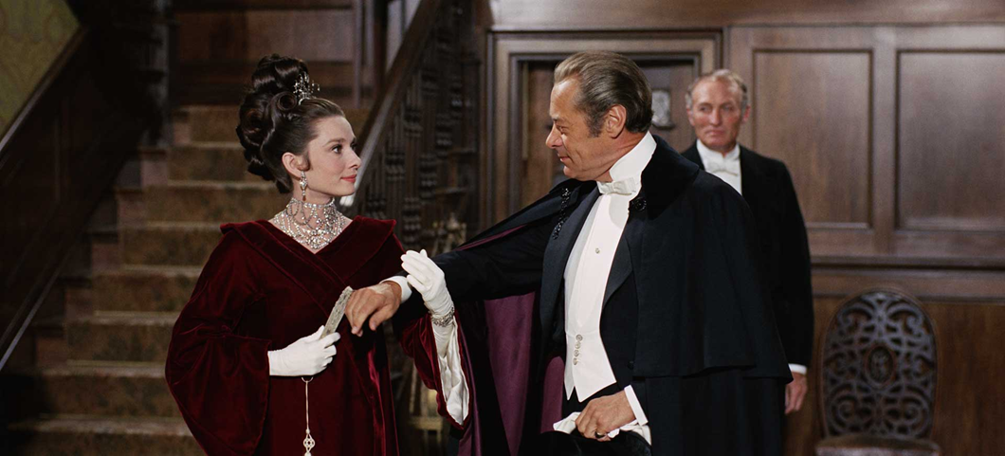
And there still will be rain on that plain down in Spain,
even that will remain without you.
I can do without you.

Slide 10
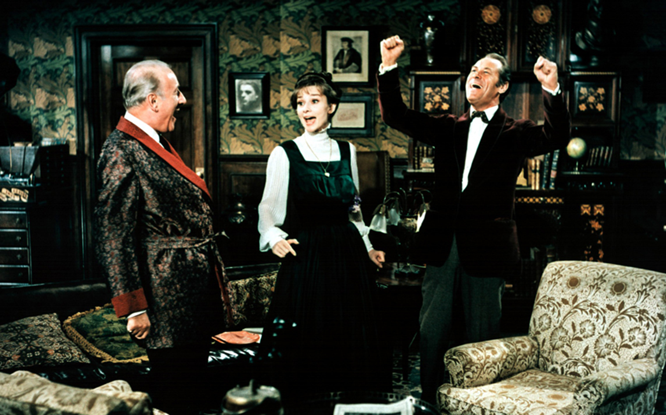
You, dear friend, who taught so well,
You can go to Hartford, Hereford and Hampshire.

Slide 11
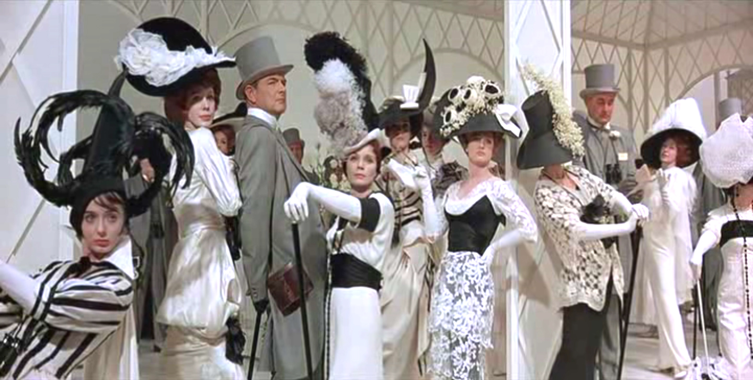
They can still rule the land without you.
Windsor Castle will stand without you.

Slide 12
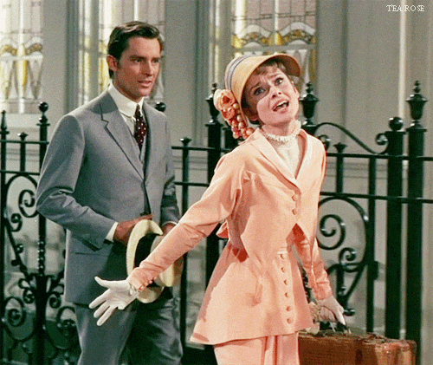
And without much ado we can all muddle
through without you.

Slide 13
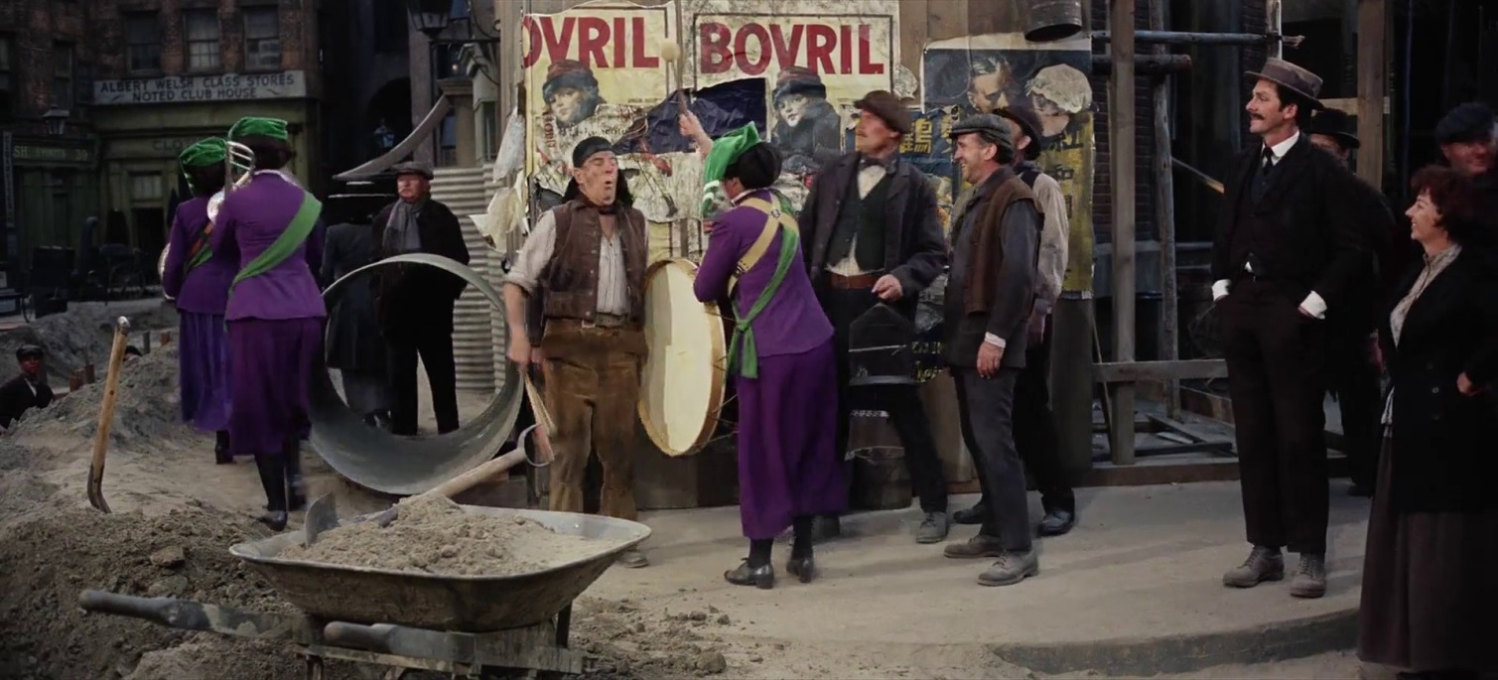
Without your pulling it, the tide comes in
without your twirling it the Earth can spin

Slide 14
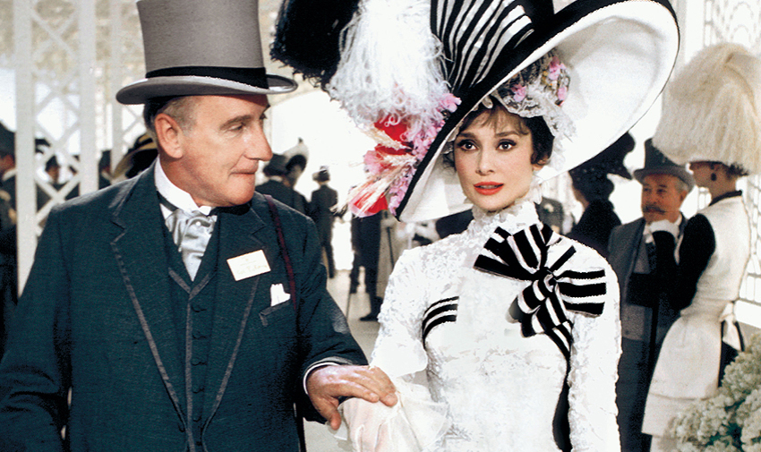
Without your pushing them, the clouds roll by.

Slide 15
If they can do without you, ducky, so can I

Slide 16
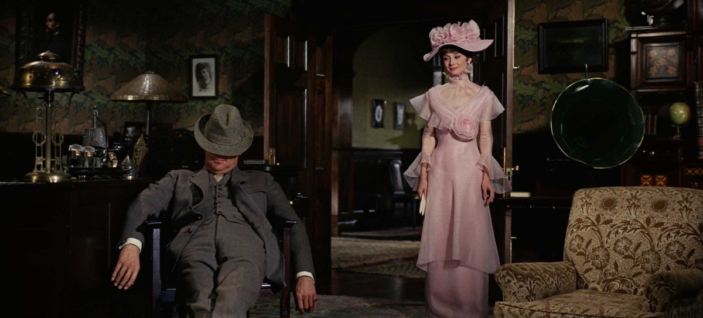
I shall not feel alone without you
I can stand on my own without you

Slide 17
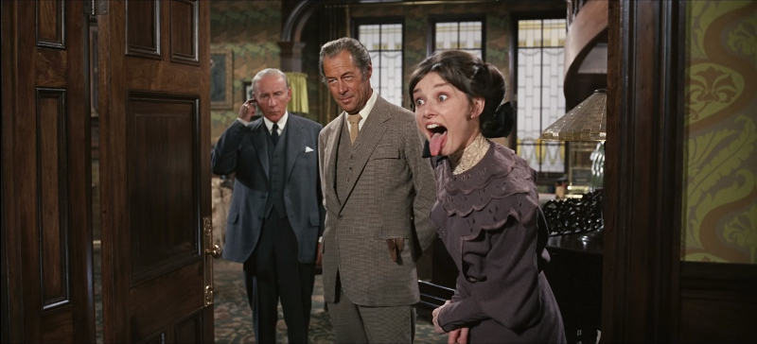
So go back in your shell
I can do bloody well
Without you……

Slide 18
---The End

