Slide 1
PEP M8U4: Pygmalion
Song: The rain in Spain
Singer: Rex Harrison, Julie Andrews
作者：陈晓婷
单位：华南师范大学外文学院

Slide 2
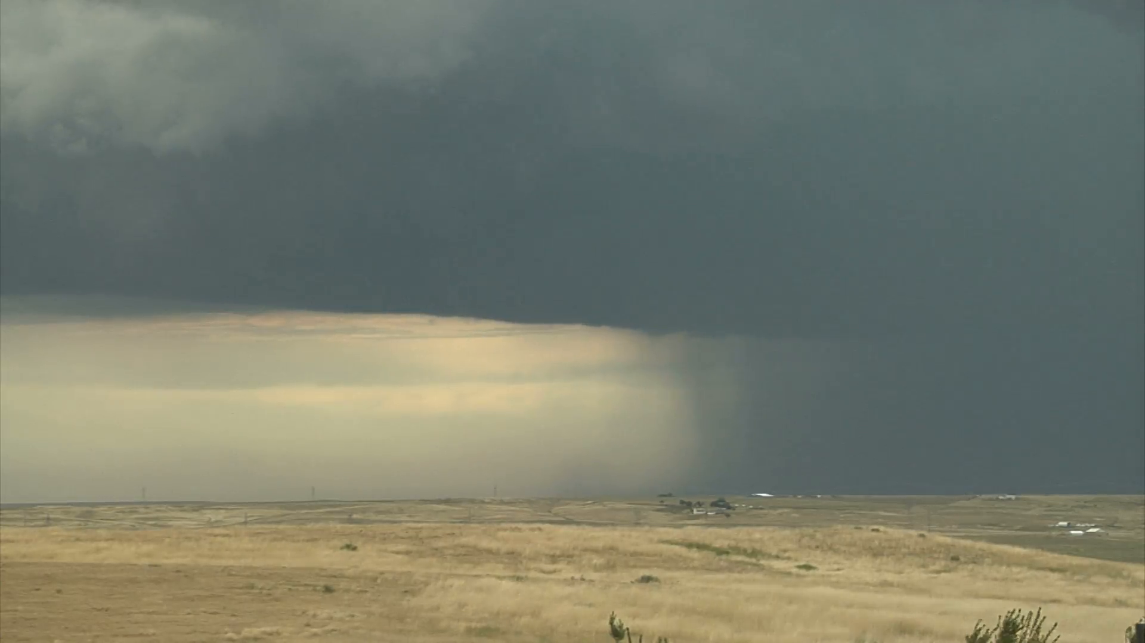
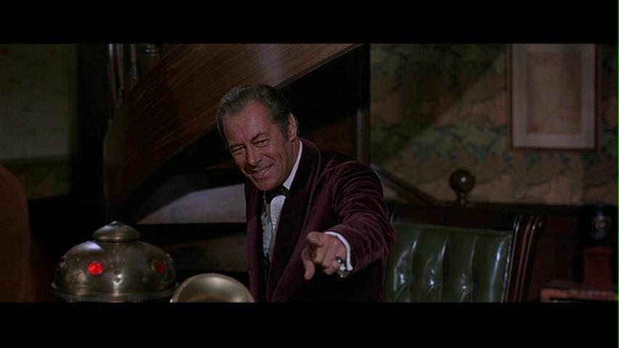
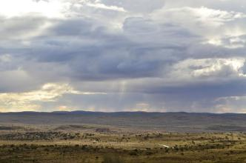
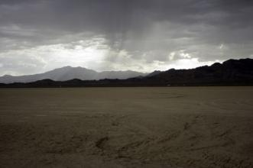
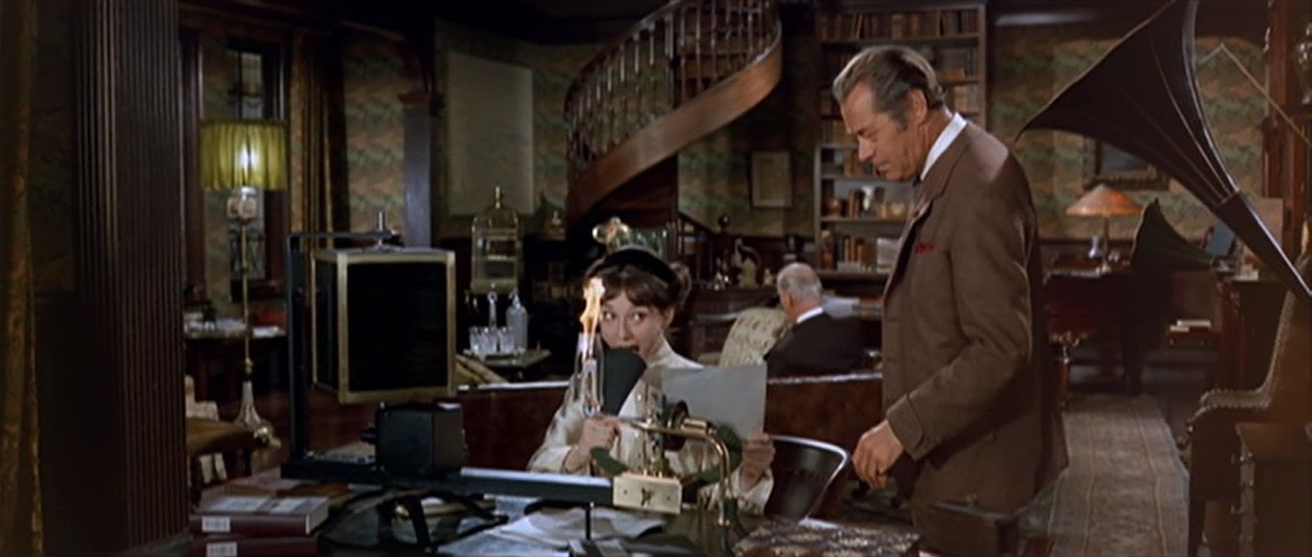
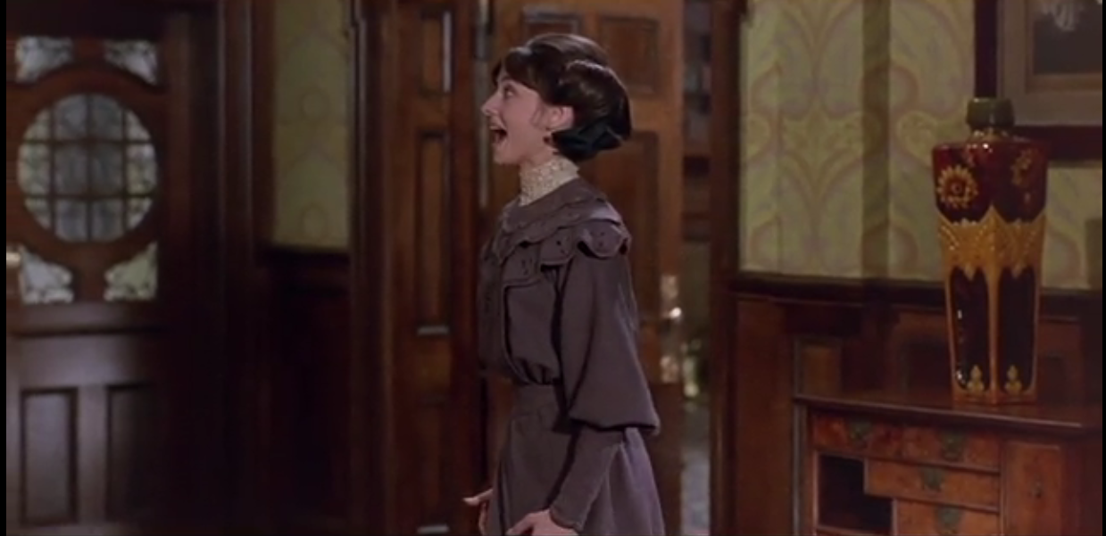
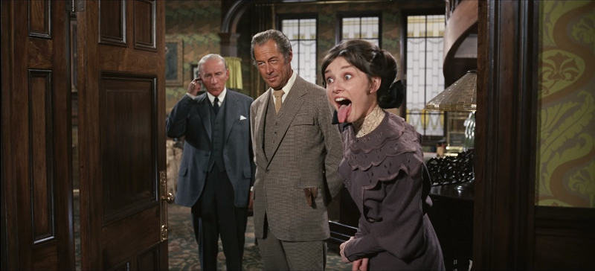
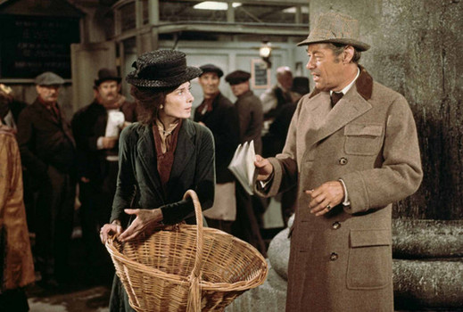
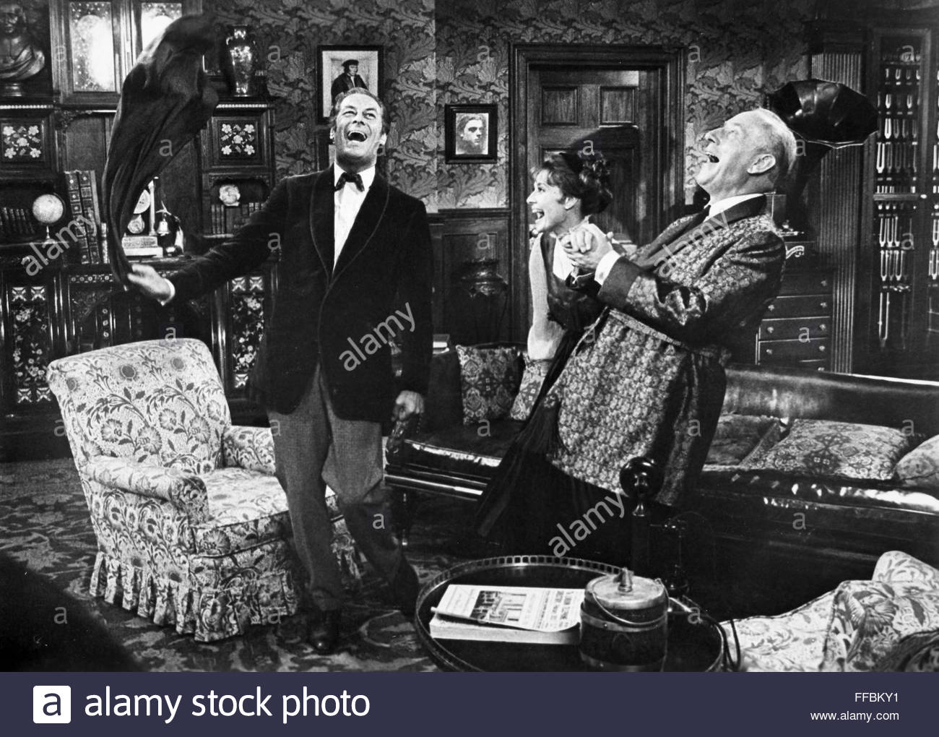
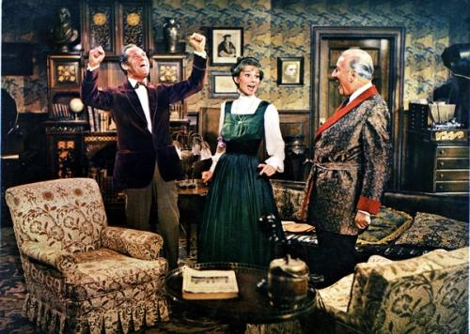
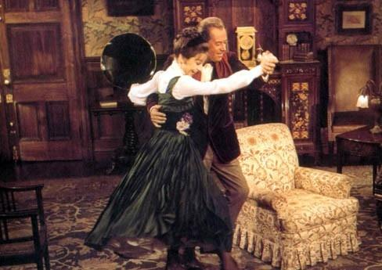
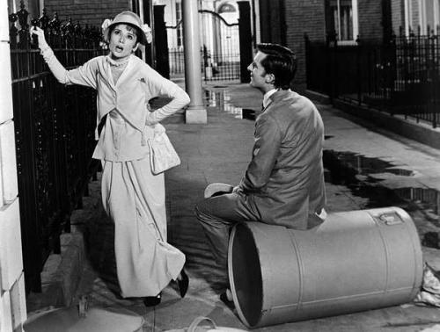
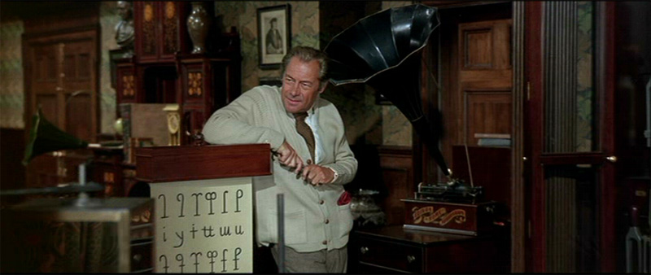
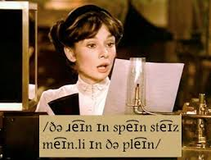
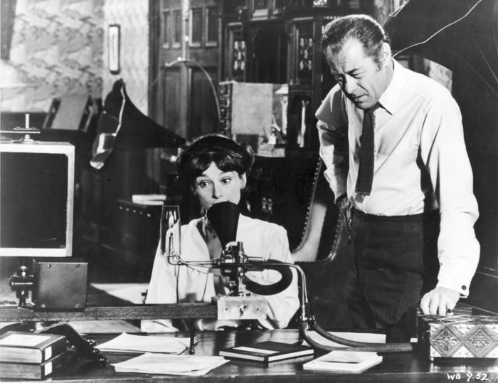
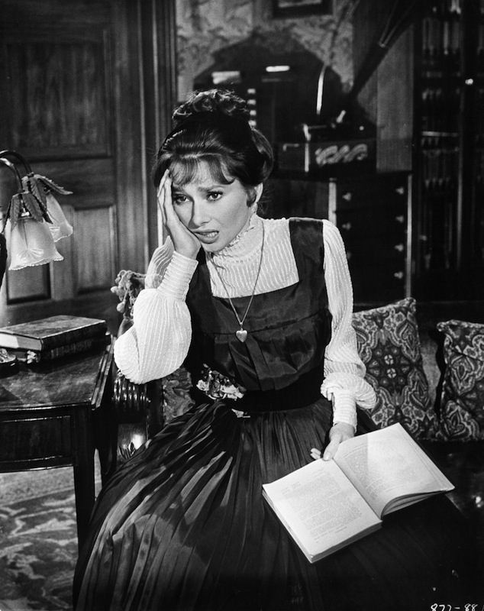
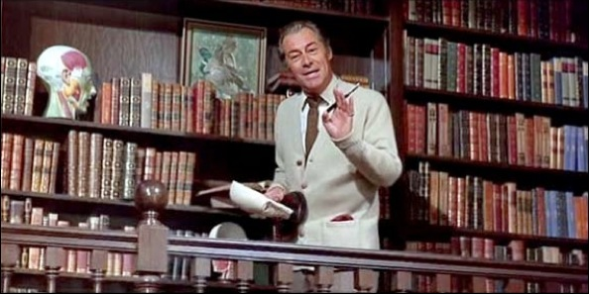
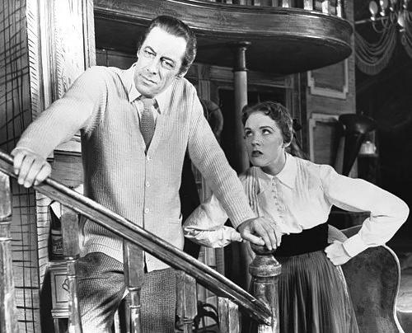
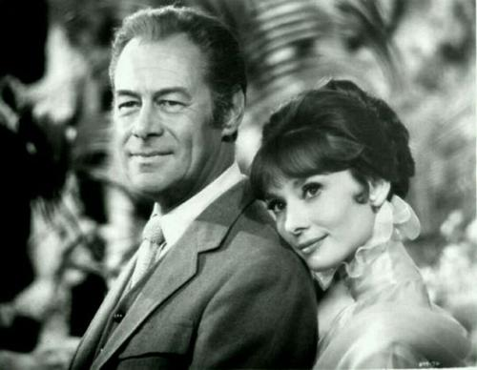
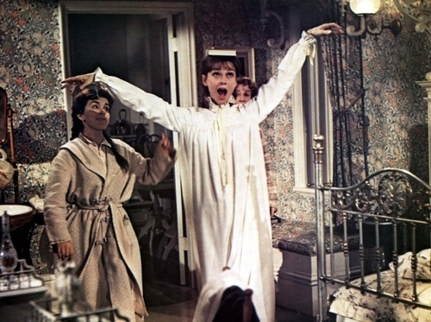
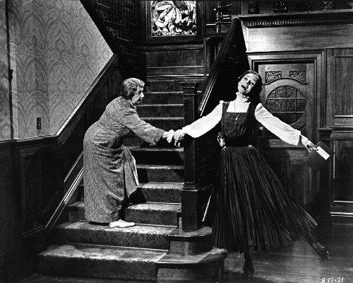
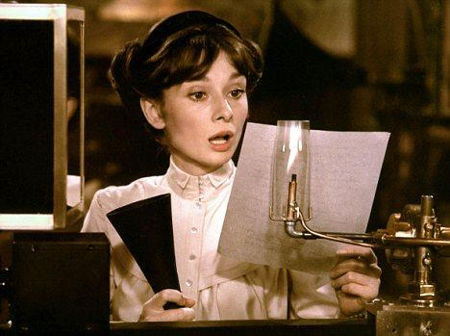
Professor Higgins
The rain in Spain stays mainly in the plain
O not ow
The rain in Spain stays mainly in the plain
In Spain
in Spain
On the plain on the plain
In Spain in Spain
In Hertford Hereford
and Hampshire
In our brain
On the plain on the plain
Hurricanes hardly happen
Pounding pounding
Don't say rine say rain
Quit professor higgins
Quit professor higgins
A not I
O not ow
Again
How kind of you to let me come
Hear our plea
Or payday we will quit
The rain in Spain stays mainly in the plain
The rain in Spain stays mainly in the plain
By George she's got it, by George she's got it
Now once again where does it rain
The rain in Spain stays mainly in the plain
And where's that blasted plain
Now once again where does it rain
A not I
And where's that soggy plain
I think she's got it I think she's got it

