Slide 1
Rain in Spain
教材版本：人教版高中Module 8
课文名称：Unit 4 Pygmalion
作 者：2015级英语师范4班宋嘉嘉
单 位：华南师范大学外文学院

Slide 2
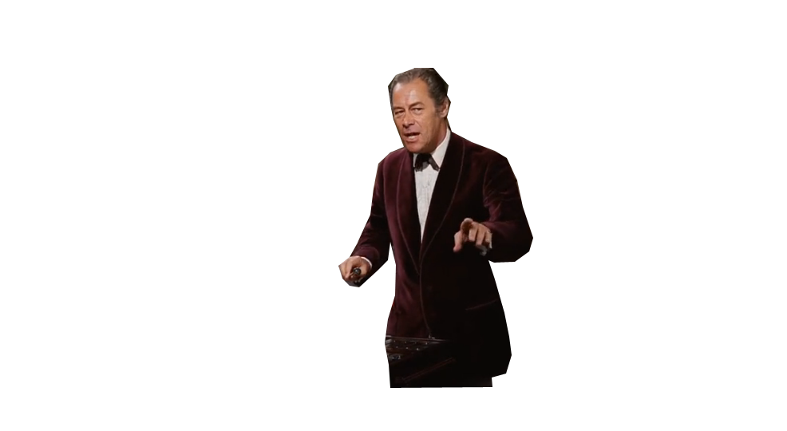
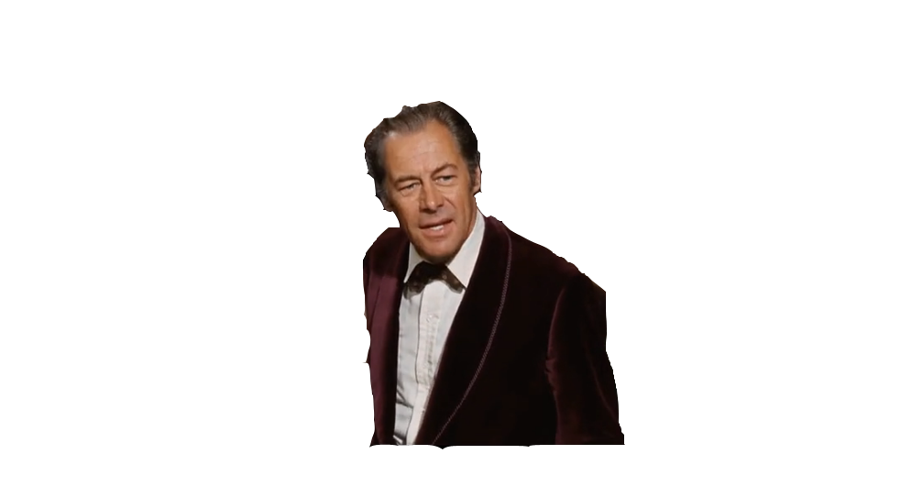
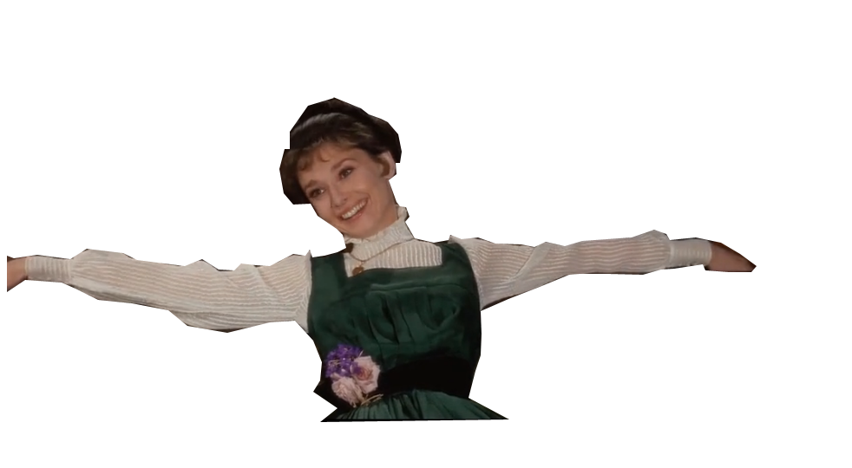
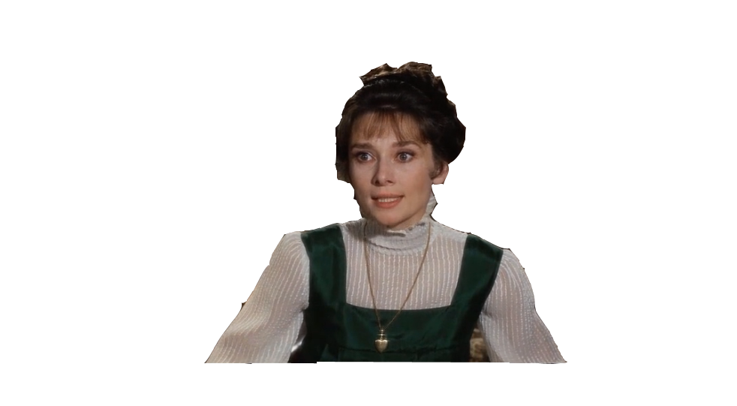
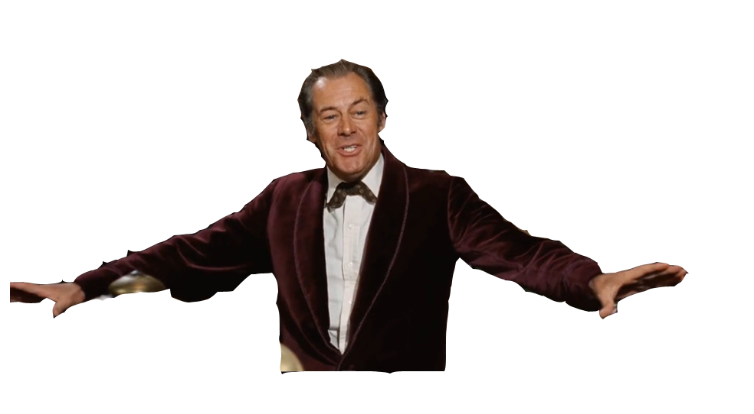
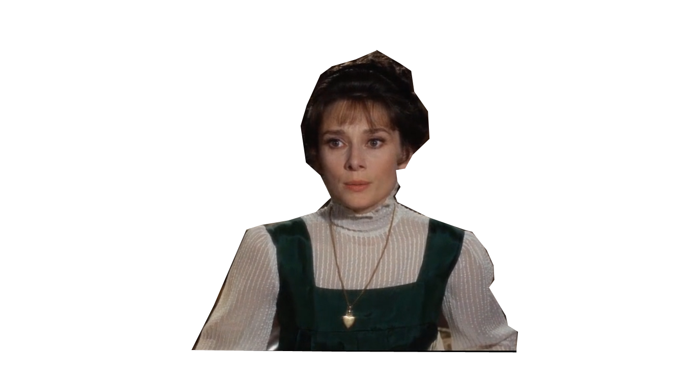
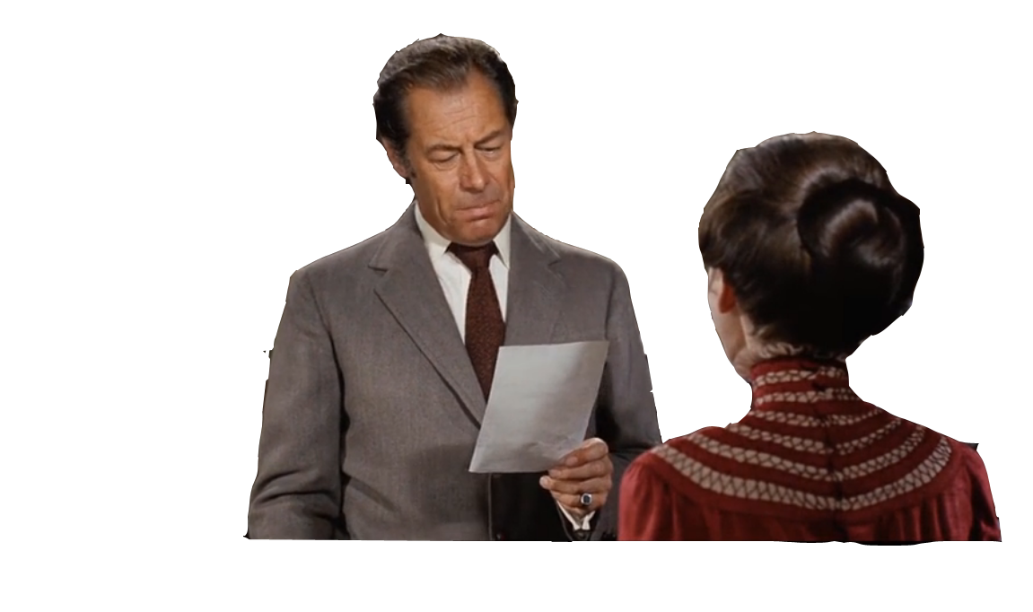
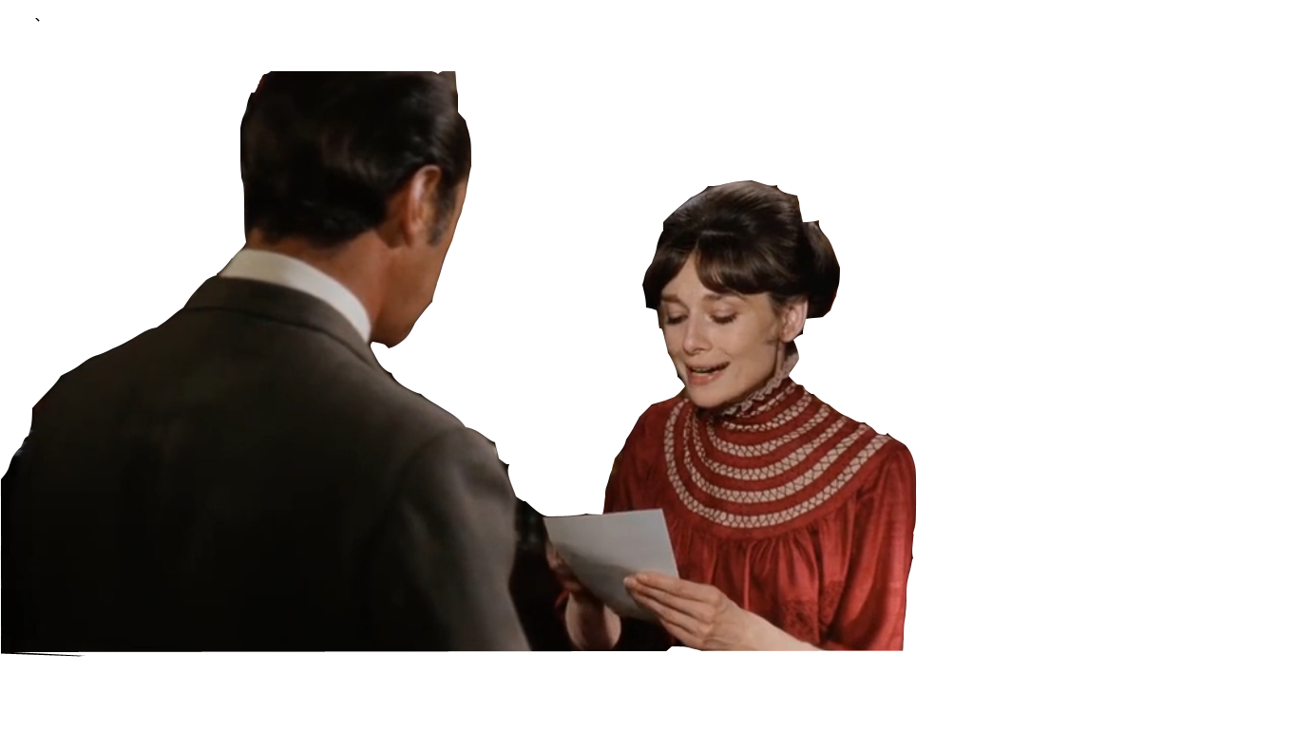
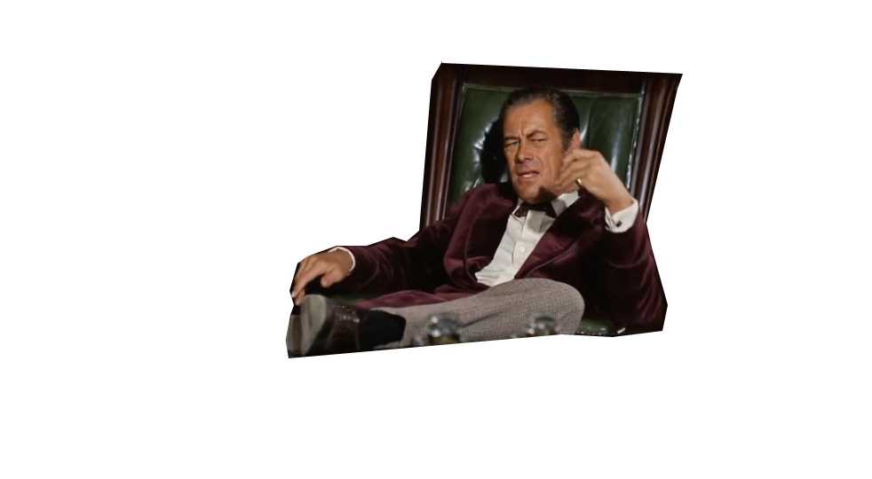
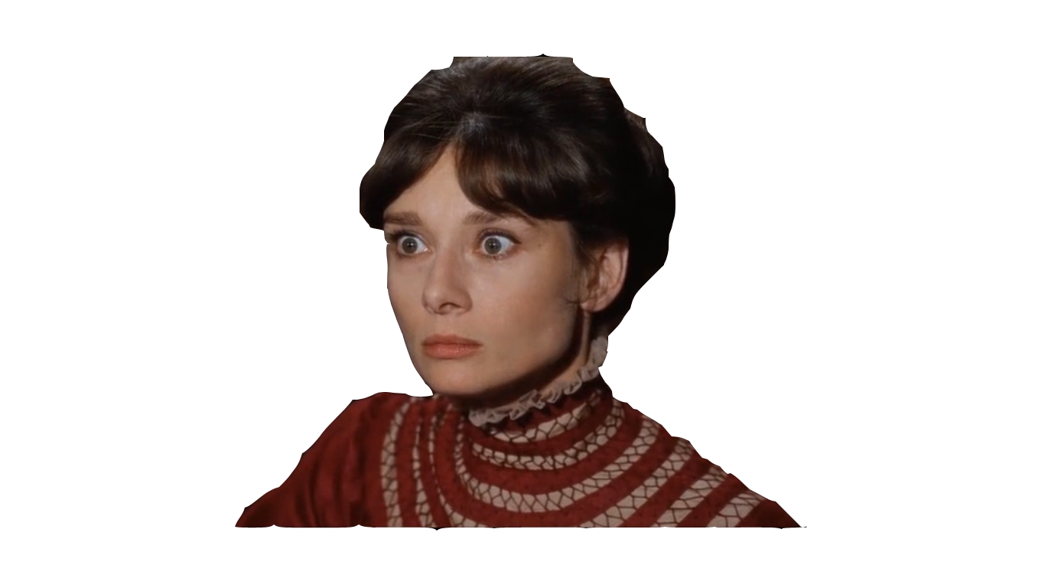
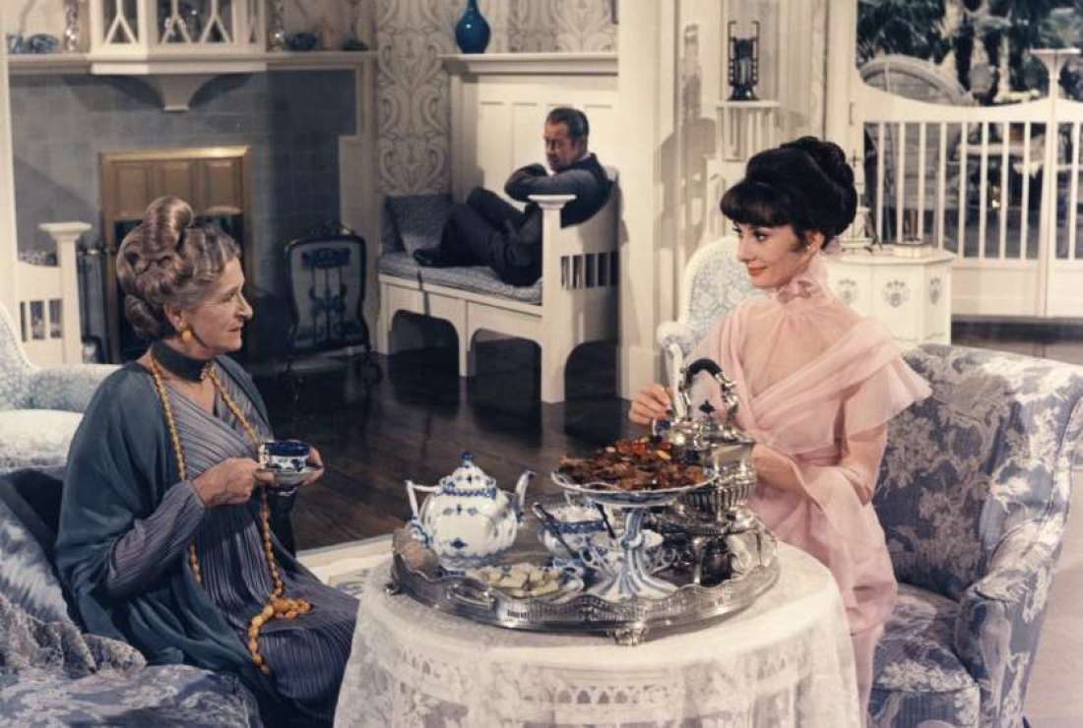
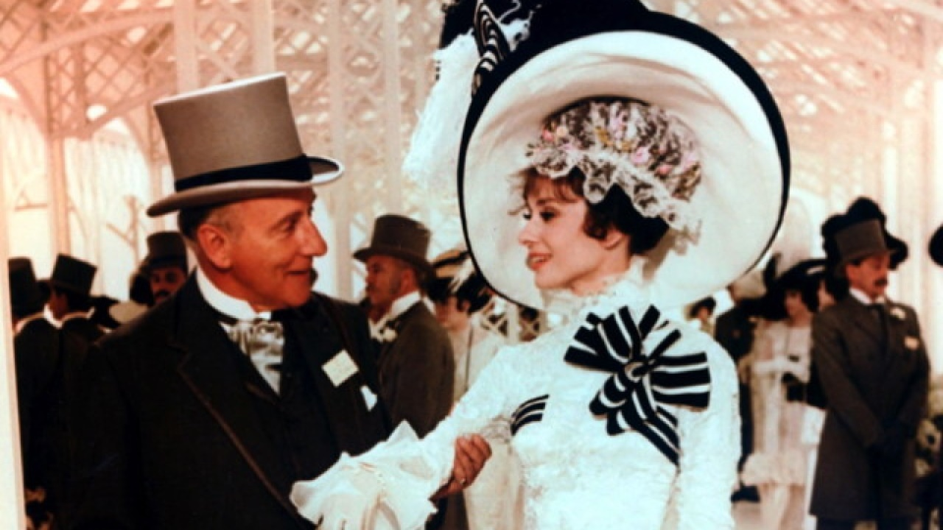
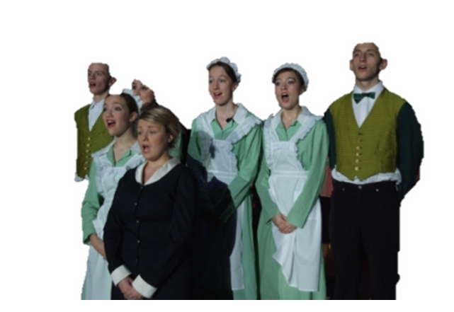
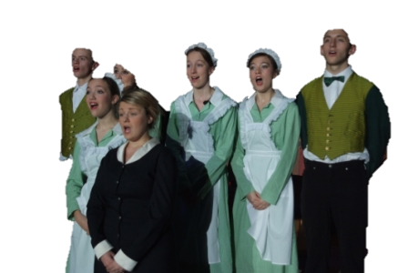
Now once again, where does it rain?
On the plain! On the plain!
The rain in Spain stays mainly in the plain!
In Spain! In Spain!
The rain in Spain stays mainly in the plain!
And where's that soggy plain?
In Hartford, Hereford, and Hampshire...?
The rain in Spain stays mainly in the plain!
Don't say "Rine," say "Rain"
Ay not I, O not Ow,
The rain in Spain stays mainly in the plain!
Again.
And where's that blasted plain?
In Spain! In Spain!
Hurricanes hardly happen.
How kind of you to let me come!
Now, once again where does it rain?
By George, she's got it!
By George, she's got it!
Hear our plea or payday we will quit,
Professor Higgins!
I think she’s got it! I think she’s got it!
On the plain! On the plain!
Pounding pounding in our brain
Quit, Professor Higgins!
Ay not I, O not Ow

