Slide 1
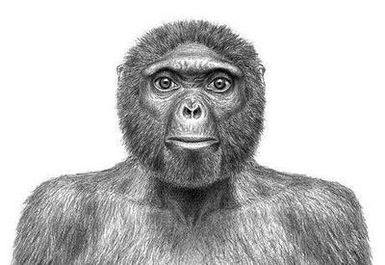
人教版M8U5 meeting your ancestors
庄千红
华南师范大学外文学院
Notes:
特殊字体：禹卫书法行书简体，汉仪南宫体简
1

Slide 2
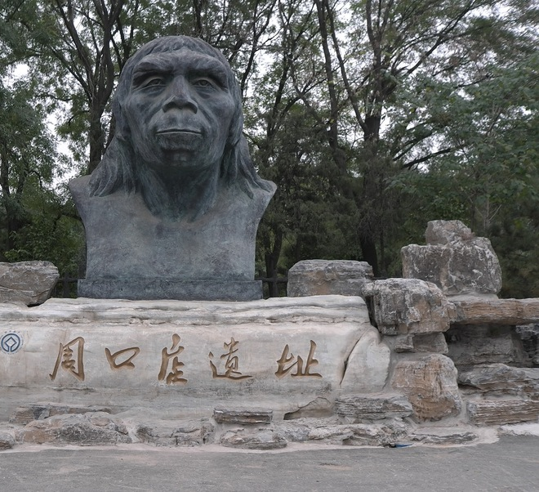
Hands
down

Slide 3
see straight

Slide 4
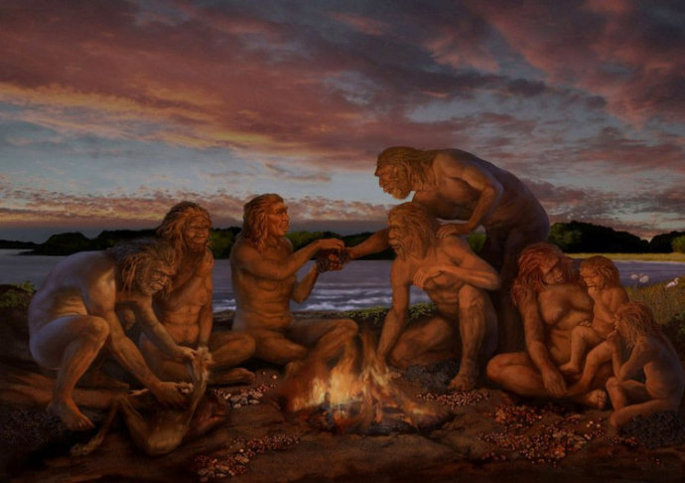
be faithful till the end

Slide 5
We circle like the moon

Slide 6
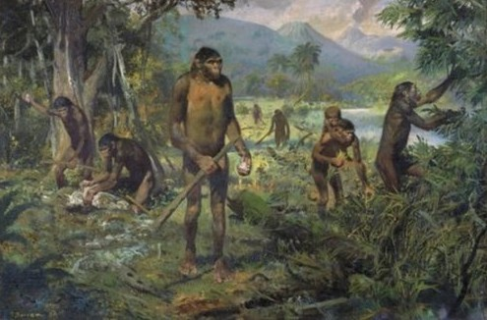
one day we’ll all come down to dust it’s clear

Slide 7
And in the end I’ve always felt

Slide 8
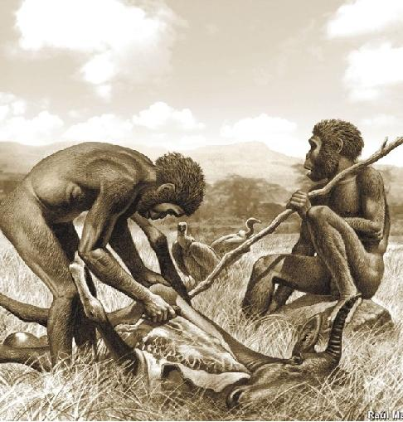
The ancestors will come back when we leave

Slide 9
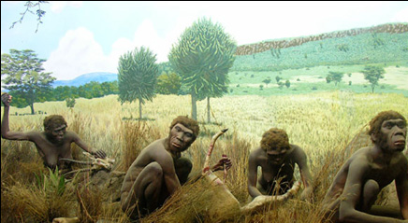
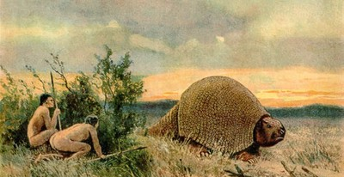
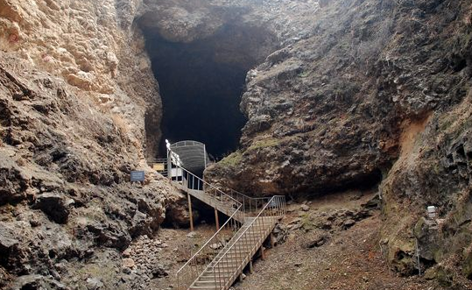
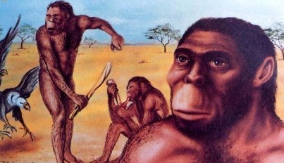

Slide 10
The ancestors will come back when we leave

Slide 11
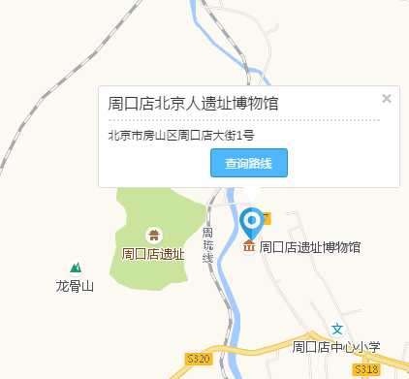

Slide 12
I know a girl from an island She stands apart from the e crowd Sometimes the world seems against you The journey may leave a scar But scars can heal and reveal just Where you are The people you love will change you The things you have learned will guide you And nothing on earth can silence The quiet voice still inside you And when that voice starts to whisper Moana far Moana listen Do you know who you are Who am II am a girl who loves my island I'm the girl who loves the sea It calls me I am the daughter of the village chief We are descended from voyagers Who found their way across the world They call me I've delivered us to where we are I have journeyed farther I am everything I've learned and more Still it calls me And the call come so isn't out there at all It's inside me It's like the tide Always falling and rising I will carry you here in my heart You'll remind me That come what may I know the way I am Moana

Slide 13
