Slide 1
Paperback Writer
主题：Writers
作者：顾芷婷
单位：华南师范大学外文学院

Slide 3
Dear Sir or Madam, will you read my book?

Slide 4
It took me years to write, will you take a look?

Slide 5
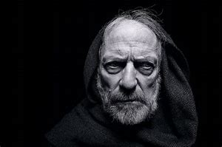
Based on a novel by a man named Lear

Slide 6
And I need a job, so I want to be a
paperback writer

Slide 7
It’s the dirty story of a dirty man

Slide 8
And his clinging wife doesn't understand

Slide 9
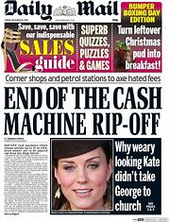
His son is working for the Daily Mail

Slide 10
It's a steady job but he wants to be a paperback writer

Slide 11
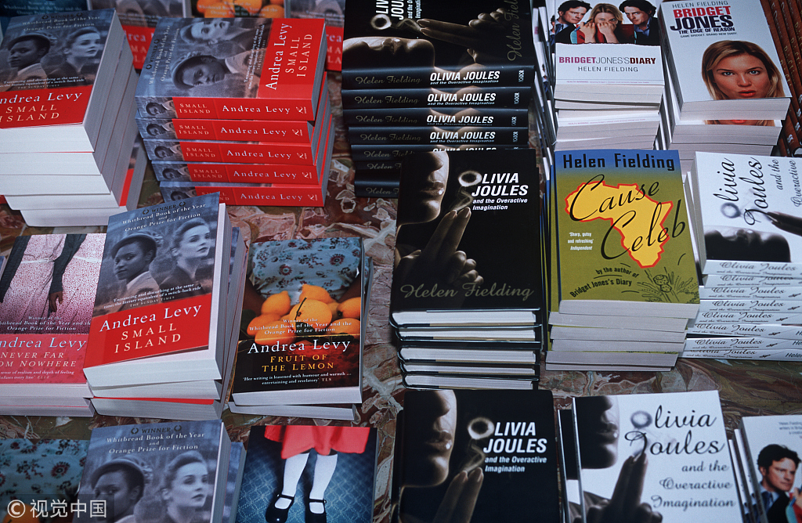
Paperback writer

Slide 12
Paperback writer

Slide 13
It’s a thousand pages, give or take a few

Slide 14
I'll be writing more in a week or two

Slide 15
I can make it longer if you like the style

Slide 16
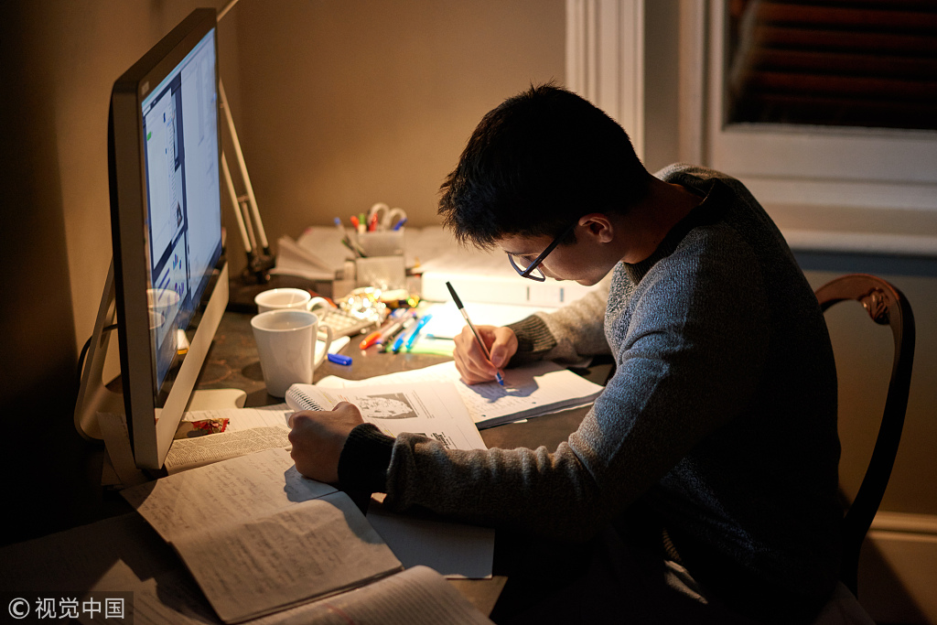
I can change it round and I want to be a
paperback writer

Slide 17
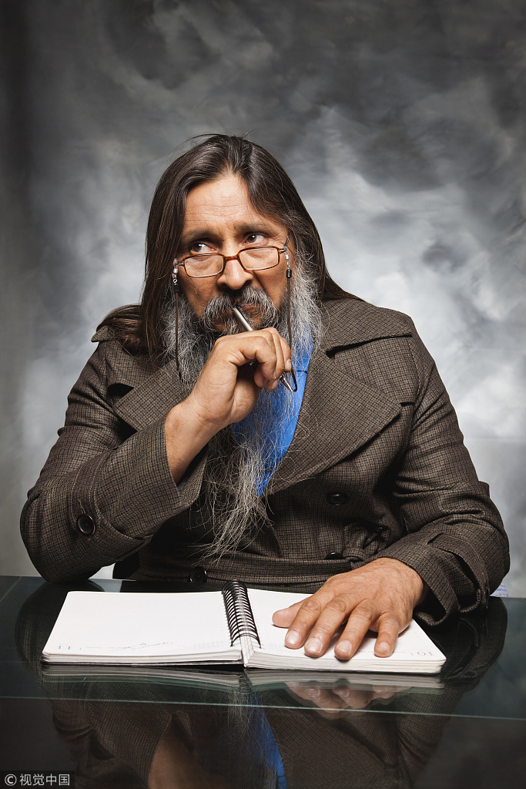
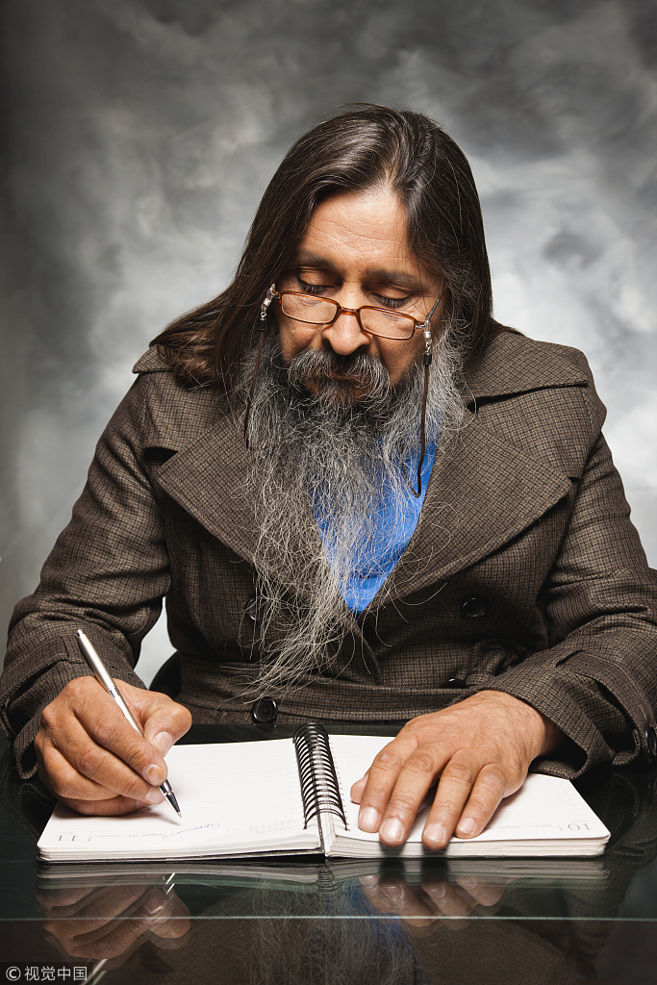
Paperback writer

Slide 18
If you really like it you can have the rights

Slide 19
It could make a million for you overnight

Slide 20
If you must return it, you can send it here

Slide 21
But I need a break
and I want to be a paperback writer

Slide 22
Paperback writer

Slide 23
Paperback writer

Slide 24
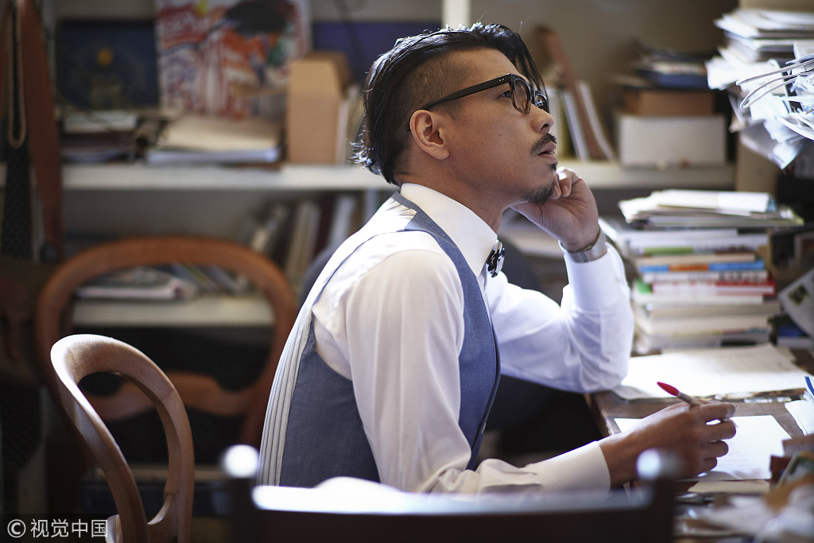

Slide 25
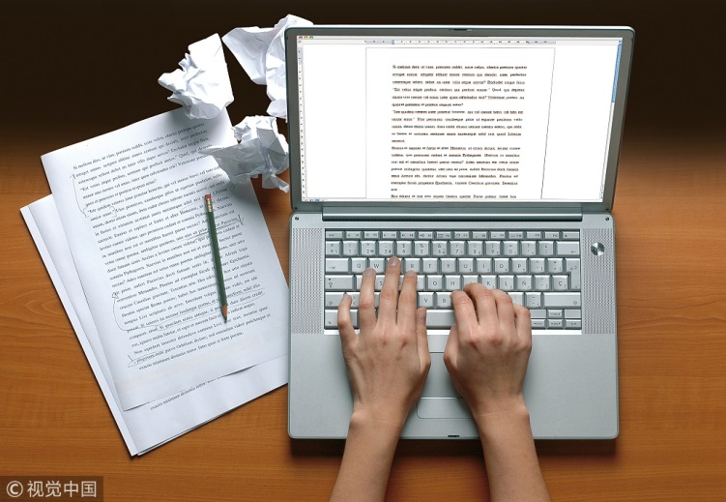
Paperback writer

Slide 26
Paperback writer

Slide 27
Paperback writer

Slide 28
Thank
you
for
Watching!

