Slide 1
STORIES
周洁羽
华南师范大学外文学院

Slide 2
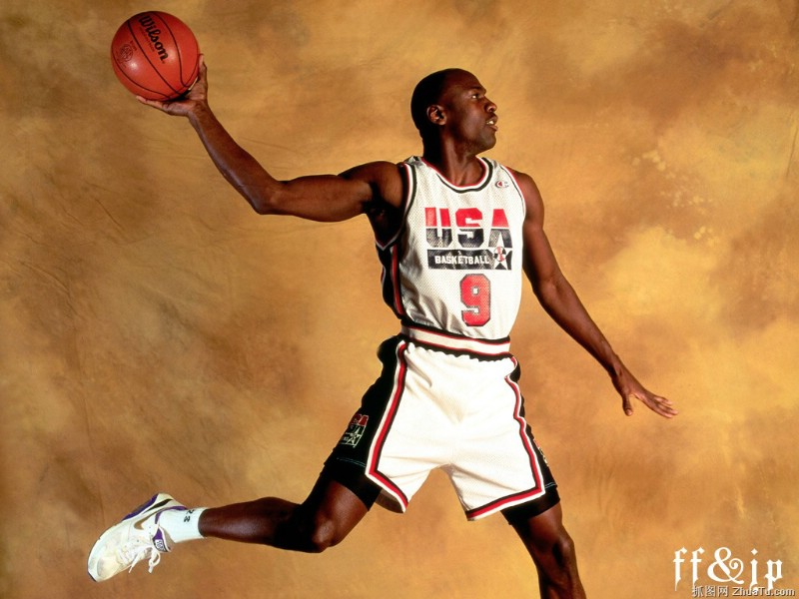
HERO
- Mariah Carey

Slide 3
Hmm~There's a hero

Slide 4
If you look inside your heart

Slide 5
You don't have to be afraid

Slide 6
Of what you are

Slide 7
There's an answer

Slide 8
If you reach into your soul

Slide 9
And the sorrow that you know

Slide 10
Will melt away

Slide 11
And then a hero comes along

Slide 12
With the strength to carry on

Slide 13
And you cast your fears aside

Slide 14
And you know you can survive

Slide 15
So when you feel like hope is gone

Slide 16
Look inside you and be strong

Slide 17
And you'll finally see the truth

Slide 18
That a hero lies in you

Slide 19
It's a long road

Slide 20
When you face the world alone

Slide 21
No one reaches out a hand

Slide 22
For you to hold

Slide 23
You can find love

Slide 24
If you search within yourself

Slide 25
And the emptiness you felt will disappear

Slide 26
And then a hero comes along

Slide 27
With the strength to carry on

Slide 28
And you cast your fears aside

Slide 29
And you know you can survive

Slide 30
So when you feel like hope is gone

Slide 31
Look inside you and be strong

Slide 32
And you'll finally see the truth

Slide 33
That a hero lies in you

Slide 34
Lord knows......

Slide 35
Dreams are hard to follow

Slide 36
But don't let anyone

Slide 37
Tear them away

Slide 38
hold on

Slide 39
There will be tomorrow

Slide 40
In time you'll find the away

Slide 41
And then a hero comes along

Slide 42
With the strength to carry on

Slide 43
And you cast your fears aside

Slide 44
And you know you can survive

Slide 45
So when you feel like hope is gone

Slide 46
Look inside you and be strong

Slide 47
And you'll finally see the truth

Slide 48
That a hero lies in you

Slide 49
That a hero lies in you

Slide 50
That a hero lies in you

Slide 51
感谢聆听！

