Slide 1
主题：数字与数据
音乐：Mathematics
作者：罗铃侣
单位：华南师范大学外文学院

Slide 2
Mathematics
is a difficult thing

Slide 3
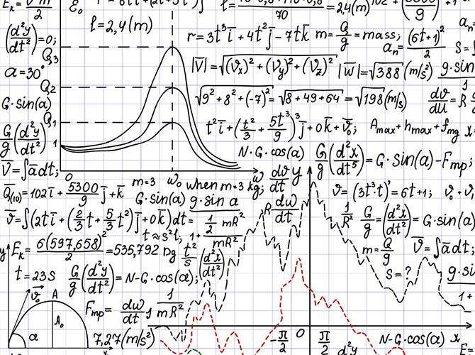
I never understood what was the missing link

Slide 4
And by the time I calculated the correct solution

Slide 5
The question
had escaped me
and so did the conclusion

Slide 6
So tell me
everything must always equal two

Slide 7
Or nothing else is true

Slide 8
And I'll believe you

Slide 9
Cos your X is equal to my Y
=
X
Y

Slide 10
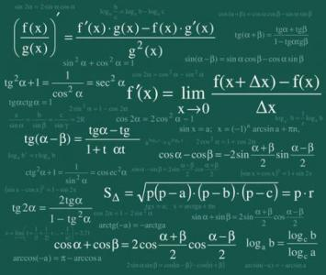
But equations pass me by

Slide 11
So will you take
just a little of my mind
and subtract it from my soul

Slide 12
Add a fraction of your half
and you'll see it makes me whole

Slide 13
Multiply it by the times that we've never been apart

Slide 14
You'll see nothing can divide just a heart plus a heart

Slide 15
A little of my mind
Take it from my soul

Slide 16
A fraction of your half
See it makes me whole

Slide 17
Never be apart
And multiply the times
Cos nothing can divide a heart plus a heart

Slide 18
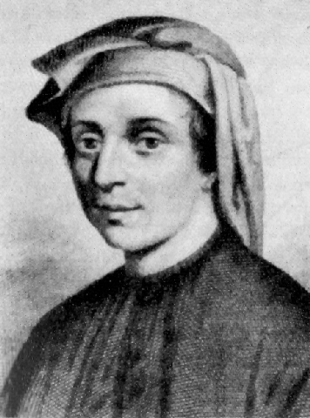
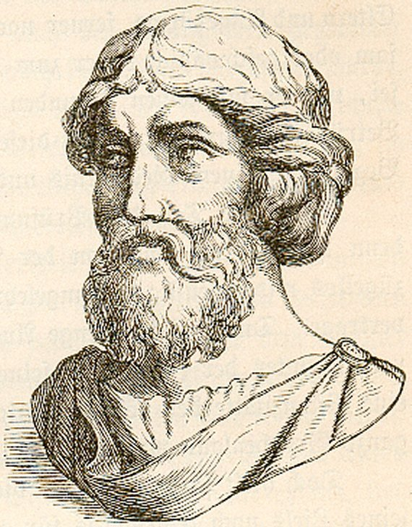
Don't know my Fibonacci or Pythagoras

Slide 19
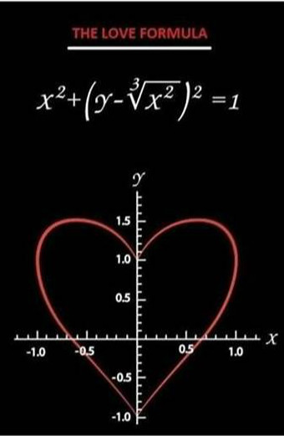
But the only formula I know will work for us
is that

Slide 20
When we're together in the sum of our parts

Slide 21
It's far greater than what we added up to at the start

Slide 22
So tell me everything must always equal
two

Slide 23
Or nothing else is true

Slide 24
And I'll believe you

Slide 25
Cos your X is equal to my Y

Slide 26
But equations pass me by

Slide 27
So will you take just a little of my mind and subtract it from my soul

Slide 28
Add a fraction of your half and you'll see it makes me whole

Slide 29
Multiply it by the times
that we've never been apart

Slide 30
You'll see nothing can divide just a heart plus a heart

Slide 31
A little of my mind
Take it from my soul

Slide 32
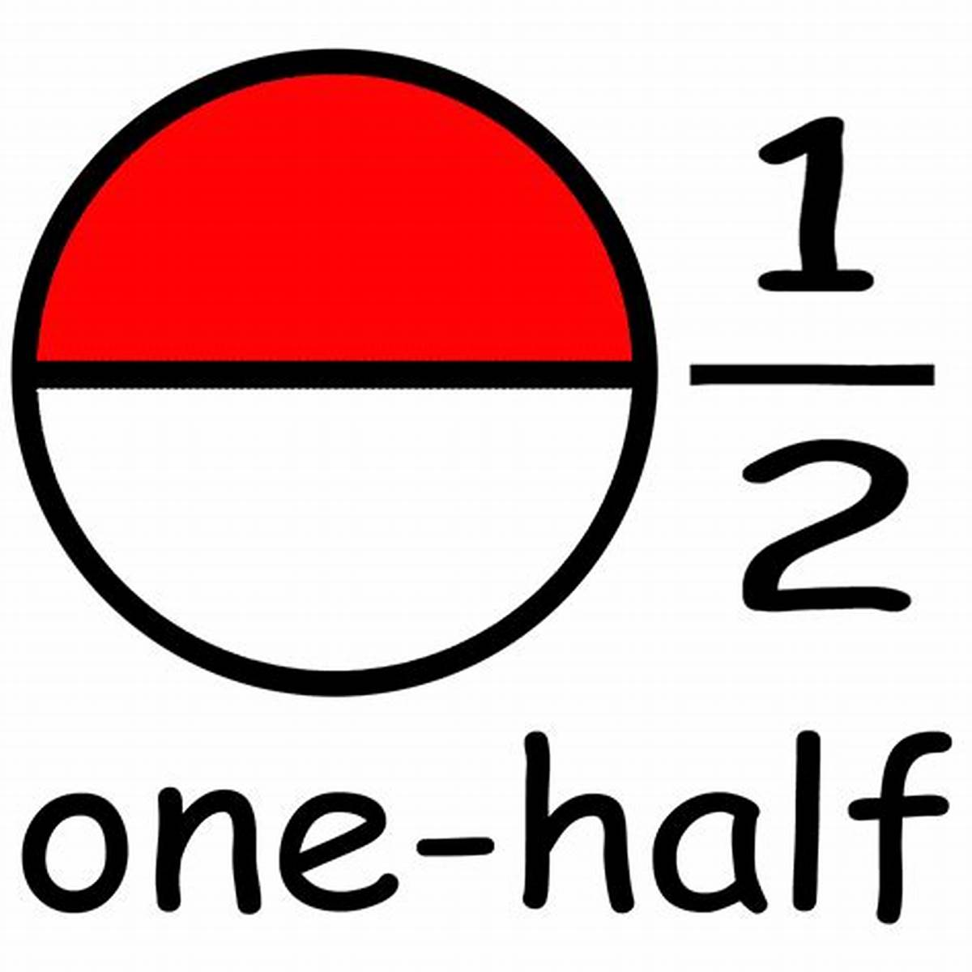
A fraction of your half
See it makes me whole

Slide 33
And multiply the times
Never be apart

Slide 34
Cos nothing can divide a heart plus a heart

