Slide 1

上海外语教育出版社 八年级上册
U10-Evironment
Population
Song: Growth
Singer: Godknott
作者：尹思婷
单位：华南师范大学外文学院

Slide 2




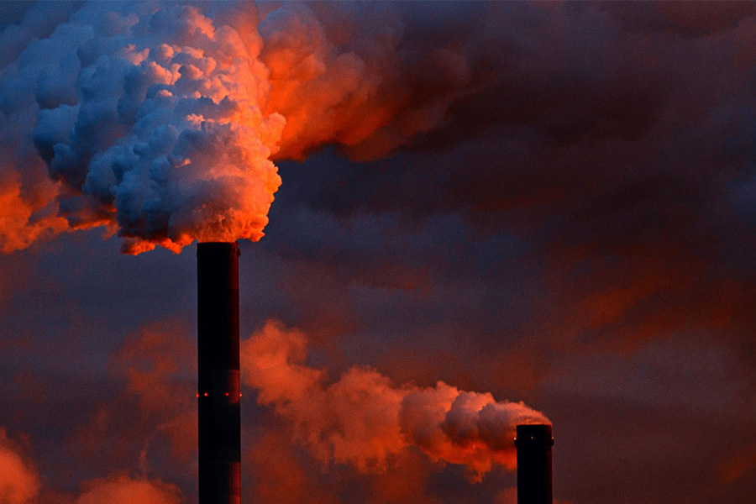








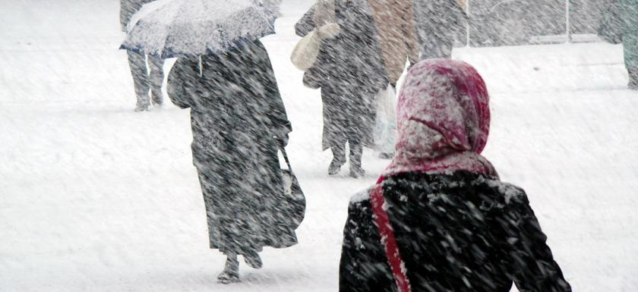

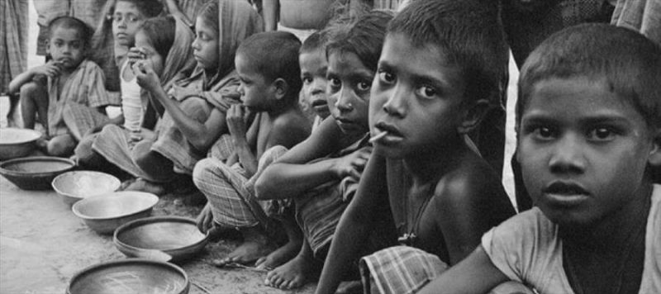


In the snow
And the poor just keep on blooming
Tempers are a fumin
In the sun
blooming
And the people grow
grow
The streets are getting crowdy
crowdy
The people grow
That the way you go,
And the sky is getting clowdy
clowdy
the people go
The rich keep on consuming
consuming

Slide 3

Everywhere you go,
the people go

Slide 4

And the people grow

Slide 5

Until there
ain’t no more

Slide 6

Everywhere you go,
the people go
The people grow

Slide 7
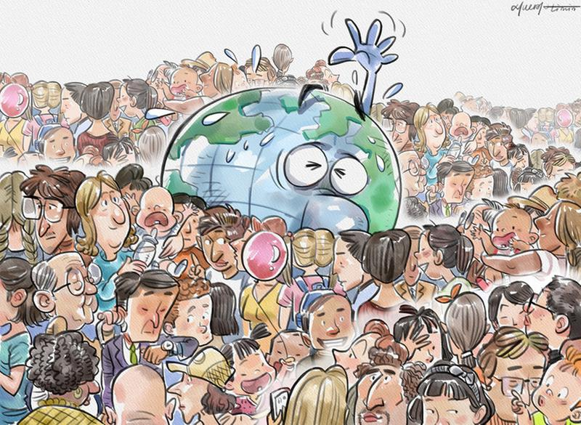

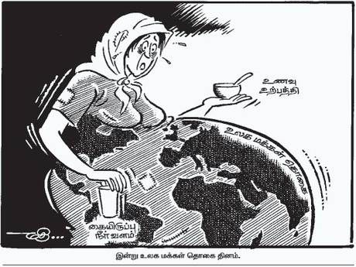

Slide 8
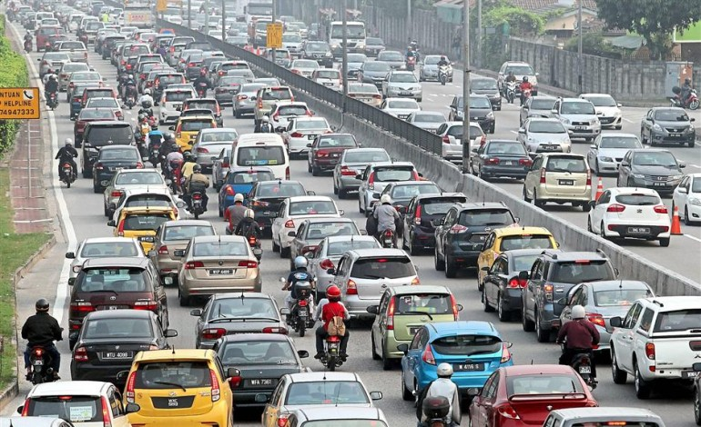
Cars keeping going faster

Slide 9
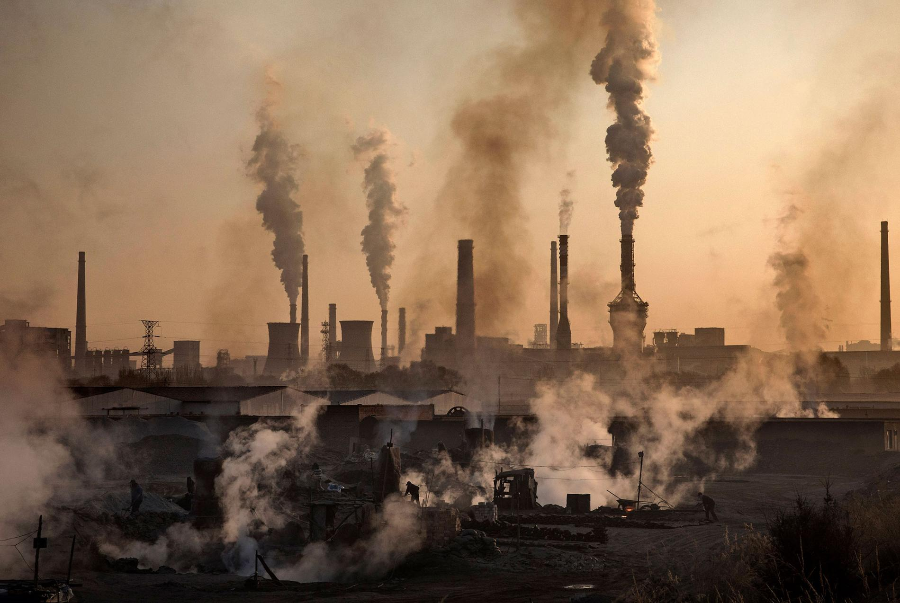
The air is a disaster
disaster

Slide 10

Man is still the master

Slide 11

And the people grow

Slide 12

We’ve got fetus in the tube

Slide 13

And the drug to fill the womb

Slide 14

‘till there ain’t
no room

Slide 15
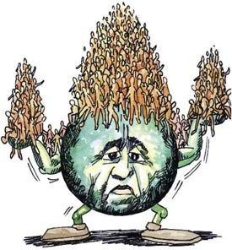
The people grow

Slide 16
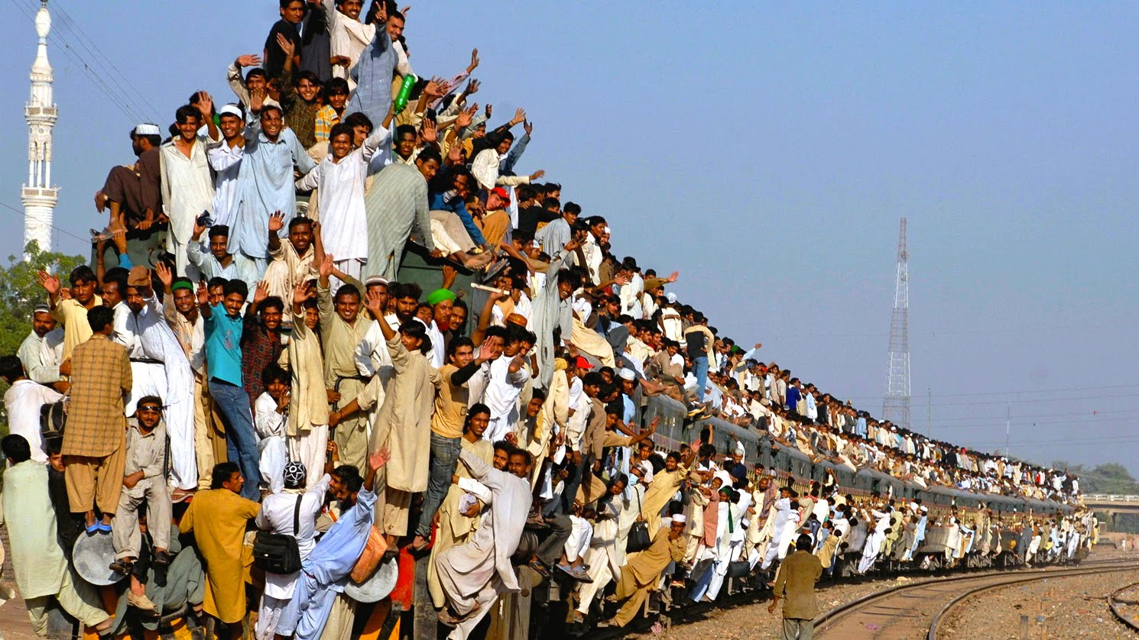
And the people grow
grow

Slide 17

In the sun

Slide 18
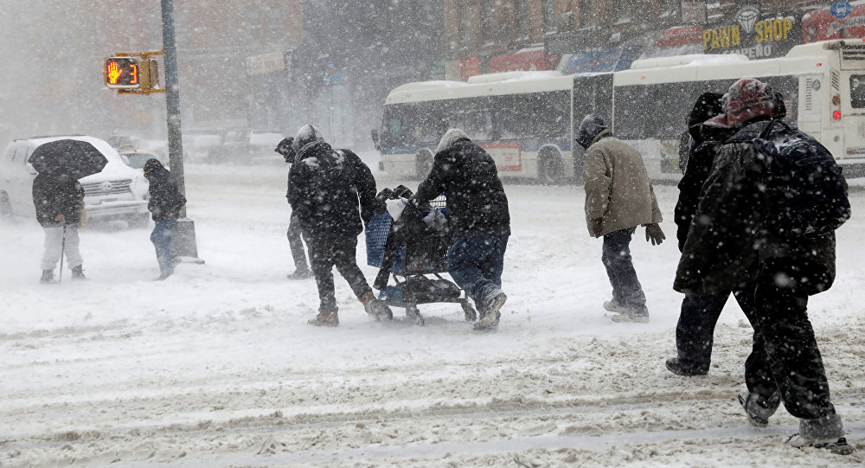
In the snow

Slide 19

Everywhere you go,
the people go

Slide 20

And the people grow

Slide 21

Until there
ain’t no more

Slide 22

Everywhere you go,
the people go
And the people grow

Slide 23




Slide 24

The towns keep growing taller
taller

Slide 25

The line keeps
getting smaller
smaller

Slide 26

We get nothing for a dollar
nothing

Slide 27

The people grow

Slide 28


Not your money ain’t worth much
Keep on spitting it up

Slide 29

Times are getting rough
rough

Slide 30
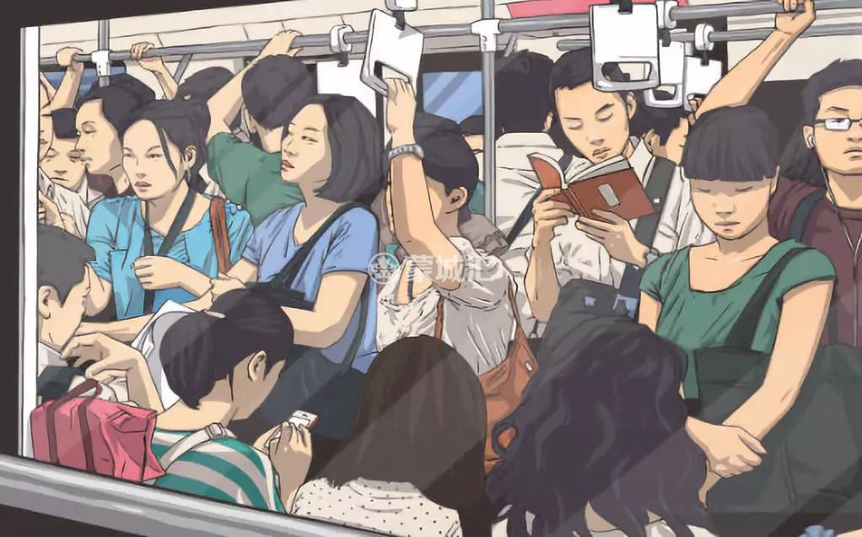
The people grow
The people grow

Slide 31

And the people grow
grow

Slide 32

In the sun

Slide 33
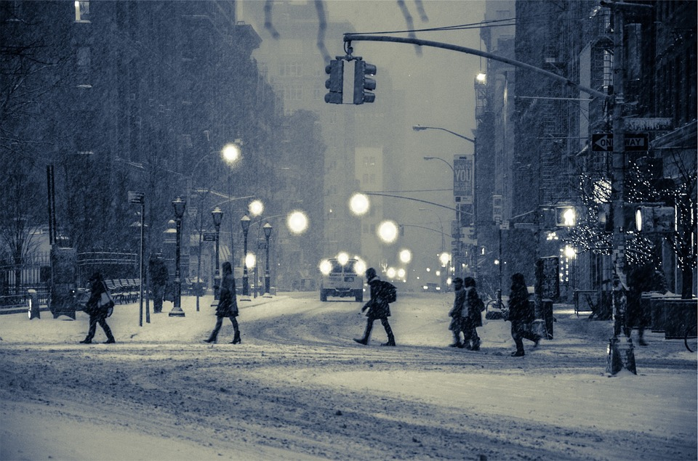
In the snow

Slide 34

Everywhere you go,
the people go

Slide 35

And the people grow

Slide 36

Until there
ain’t no more

Slide 37

Everywhere you go,
the people go
The people grow

Slide 38




