Slide 1


Love in the Future
人教版 九年级 Unit 13：
We're trying to save the earth!
作者：黄钰妍
单位: 华南师范大学外文学院

Slide 2
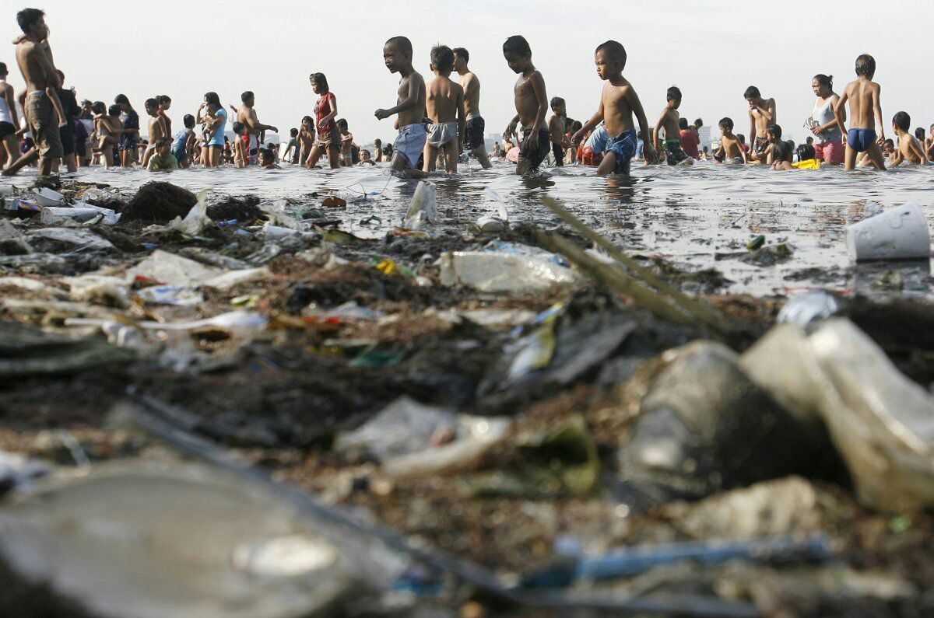
I cannot bathe you in a river
gone black
black

Slide 3
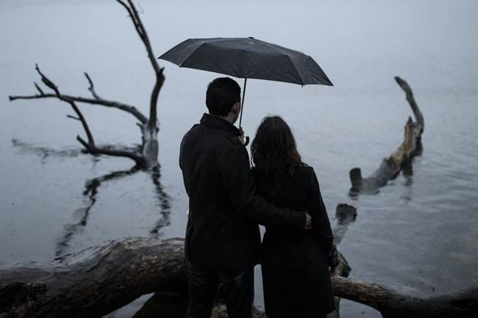
I cannot hold you in a poison rain

Slide 4
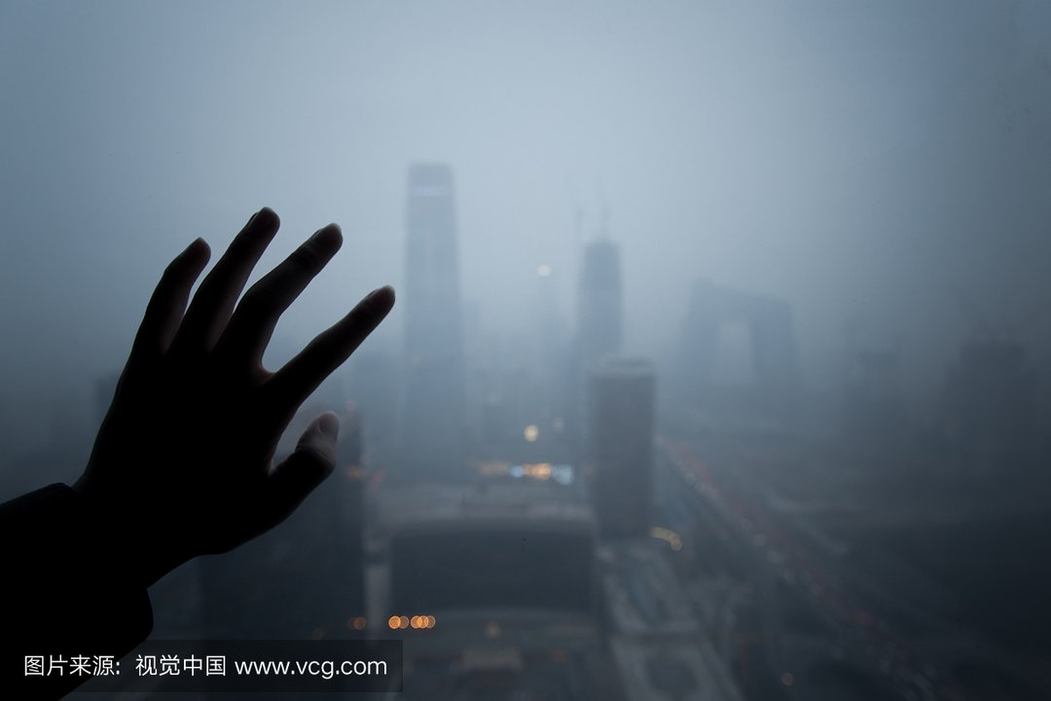
If I can't see you
through the air
that we breathe

Slide 5
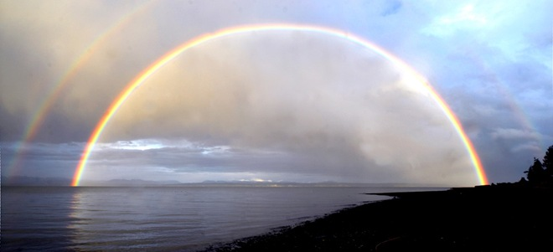

What will in the future be?

Slide 6
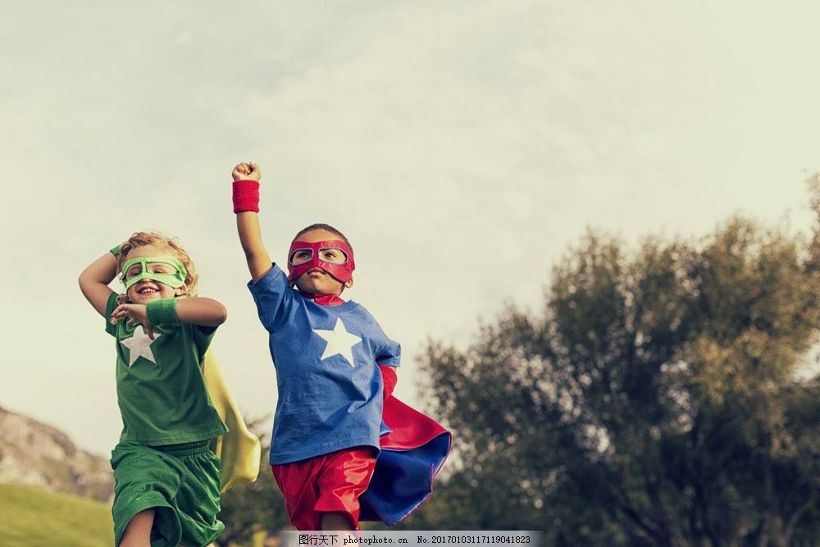
I wanna watch my children laugh as they run

Slide 7
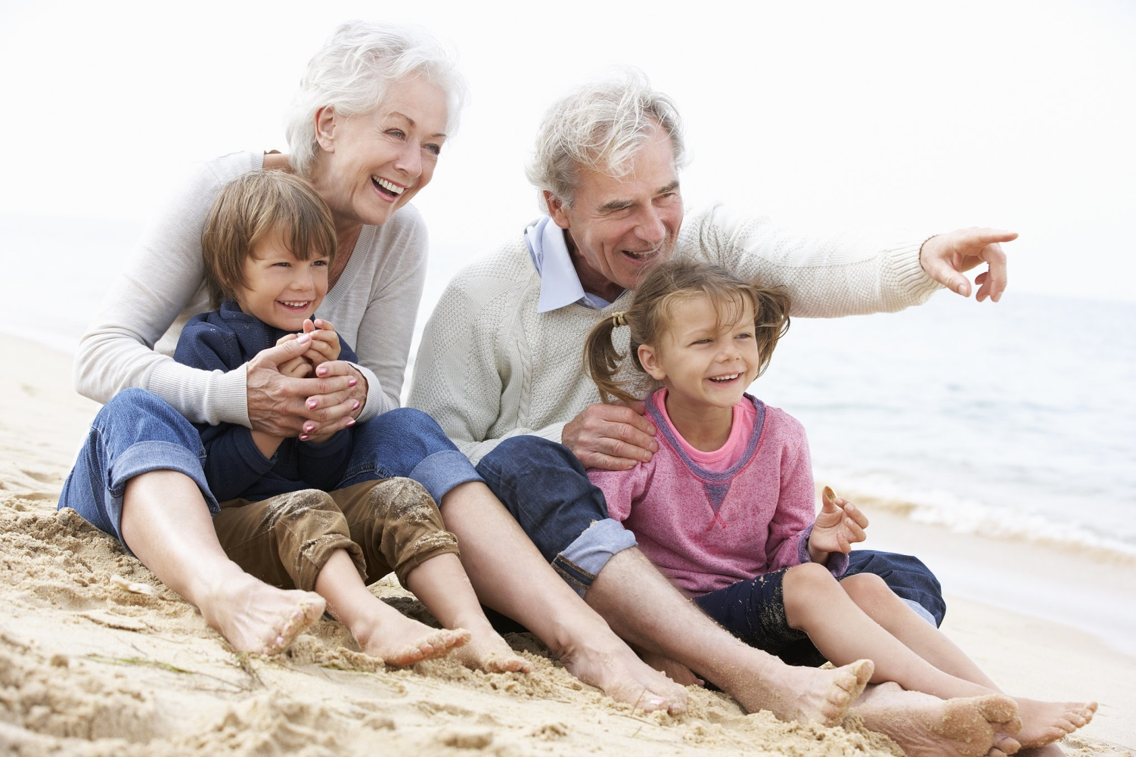
I wanna hold their children on my knee
And tell them stories of a vanishing sun
Of how it used to be

Slide 8

In my lover's life I want to share
I want to see the world now through her eyes

Slide 9

And about everything she sees I care

Slide 10

The time has come to rise

Slide 11
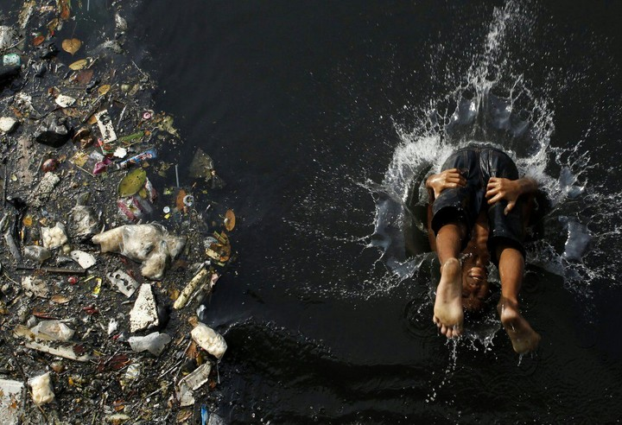
I cannot bathe you in a river gone black

Slide 12
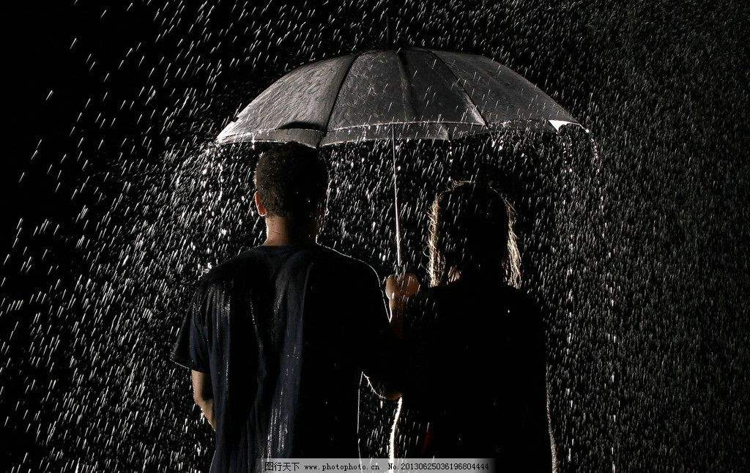
I cannot hold you in a poison rain

Slide 13
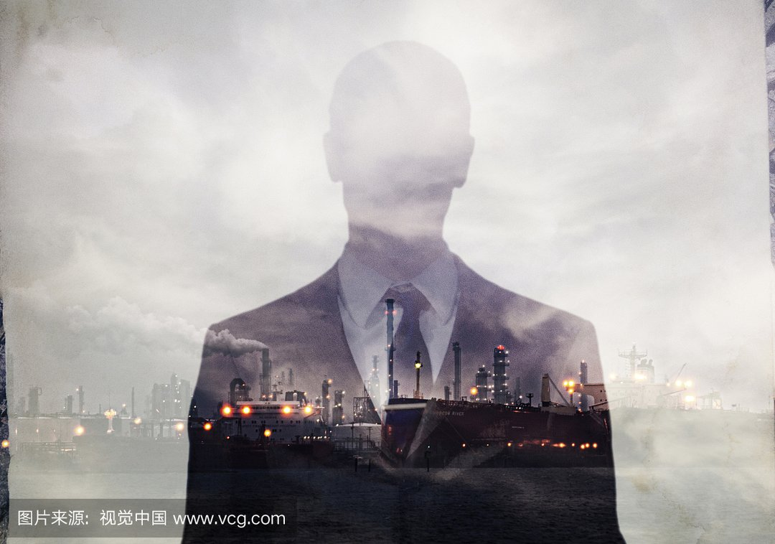
If I can't see you through the air that we breathe
What will love in the future be

Slide 14
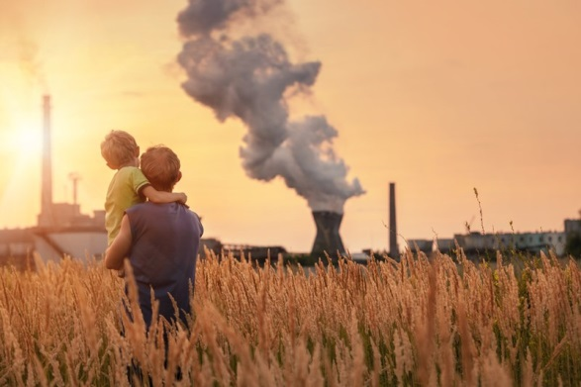
Is there love in the future for you and for me
Will we make it a different story

Slide 15
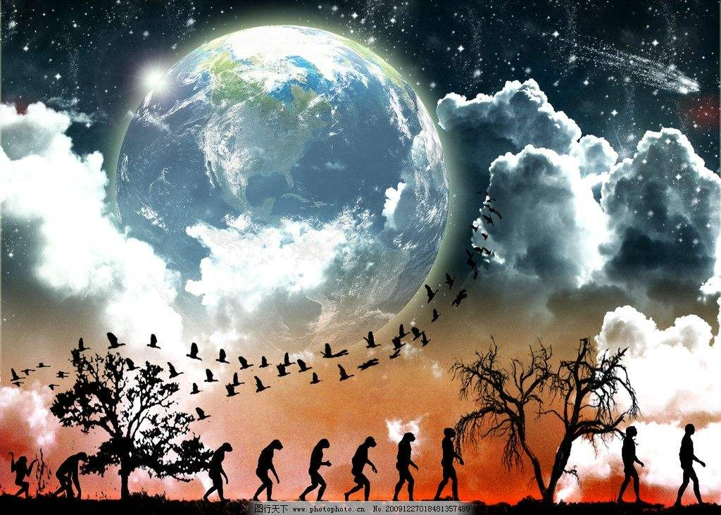
We're looking for answers in outer space
When will we discover the earth is a sacred place

Slide 16
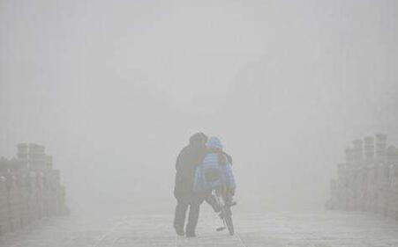
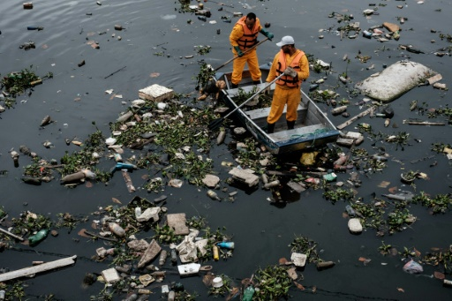
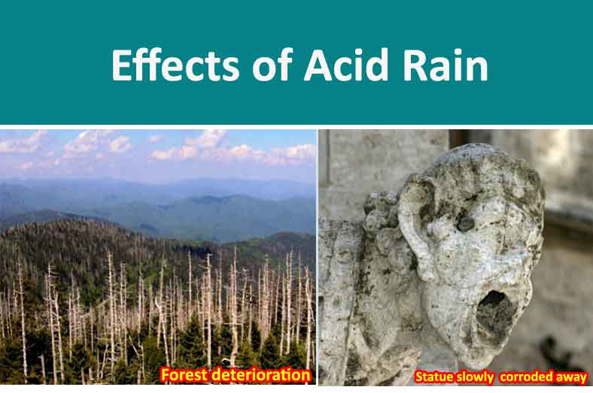

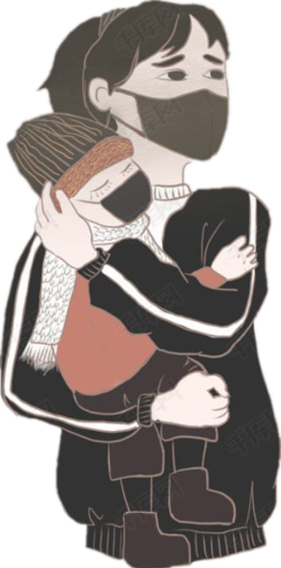
If I can't see you through the air that we breathe
I cannot bathe you in a river gone black
I cannot hold you in a poison rain
What will love in the future be

Slide 17

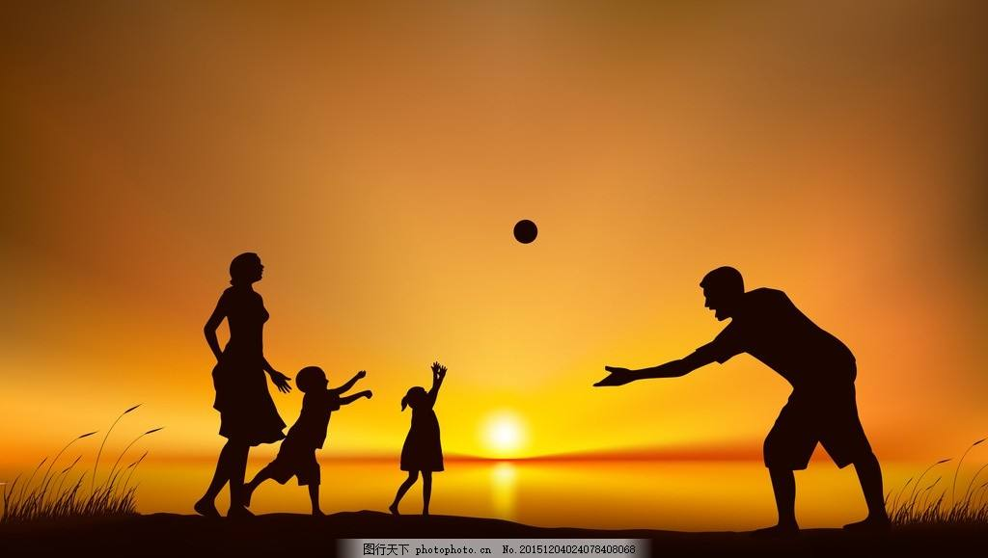

Is there in the future
for you and for me
Will we make it a different story?

Slide 18
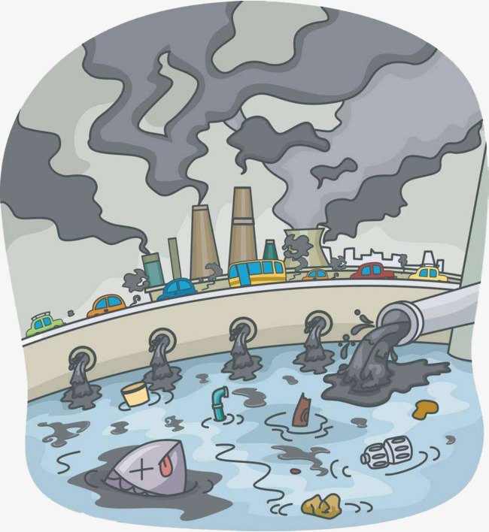

I cannot bathe you in a river gone black
I cannot hold you in a poison rain
If I can't see you through the air that we breathe
What will love in the future be
love

Slide 19

Will we make it a different story?

Slide 20


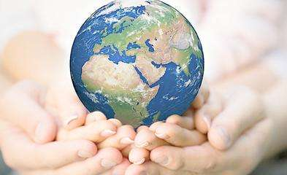

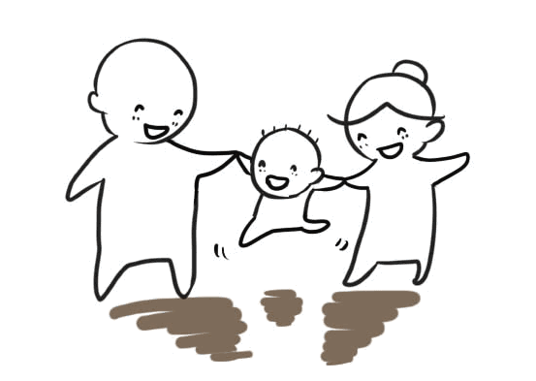

Is there in the future for you and for me?

Slide 21


