Slide 1



主题：国家与民族
Dear boys and girls,
Would you like to know more about France?
Then, come with me
Sincerely,
华南师范大学外文学院
许旦星

Slide 2

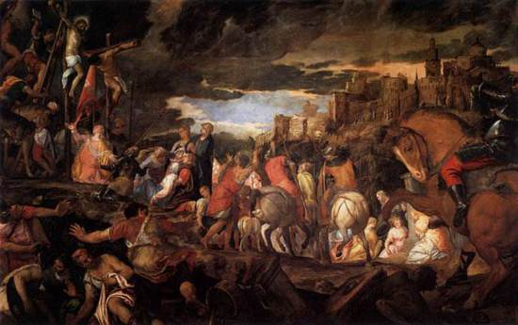
France
the Great French Revolution (1789)
Viva La Vida
By Coldplay

Slide 3
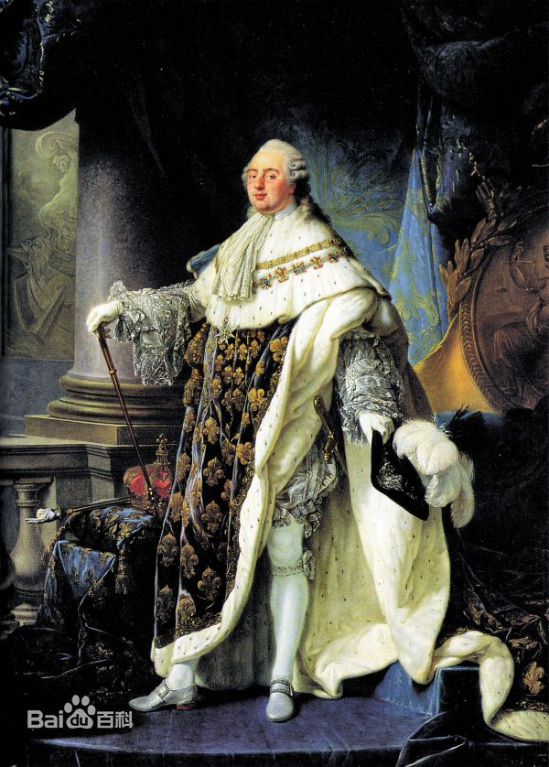
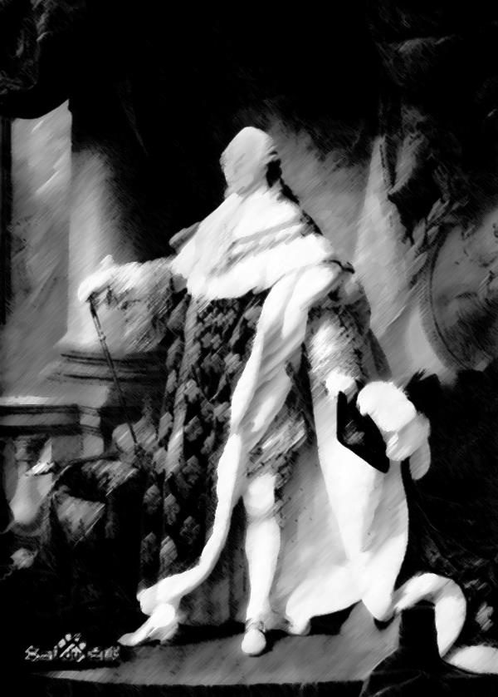
The story of
King Louis XVI
I used to roll the dice
Feel the fear in my enemy’s eyes

Slide 4
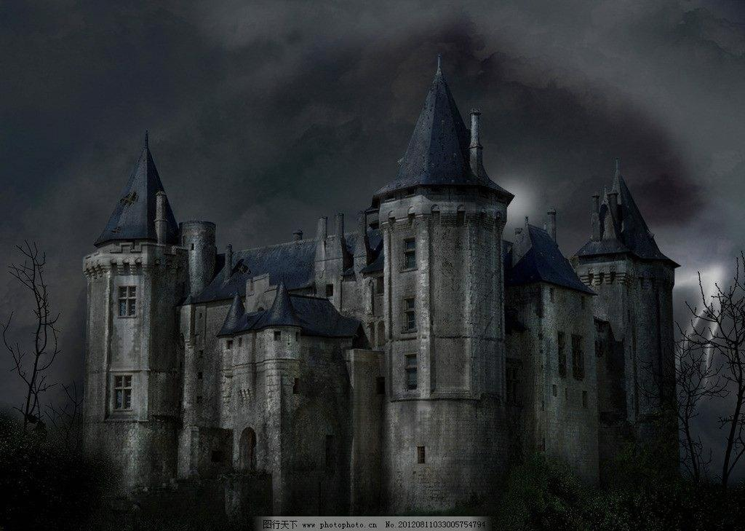
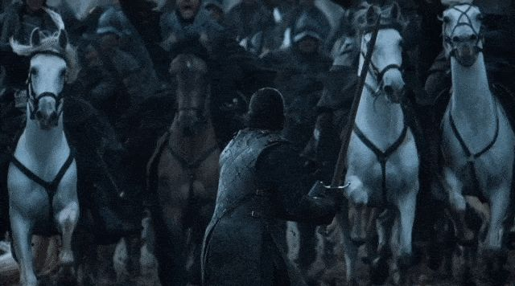
Listen as the crowd would sing:
"Now the old king is dead! Long live the king!"

Slide 5
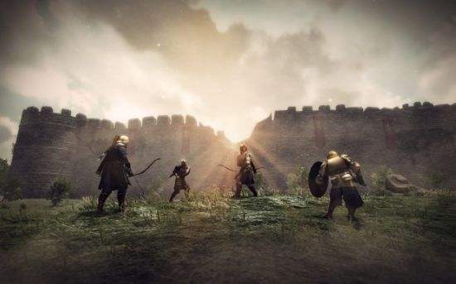
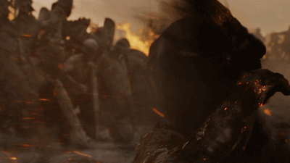
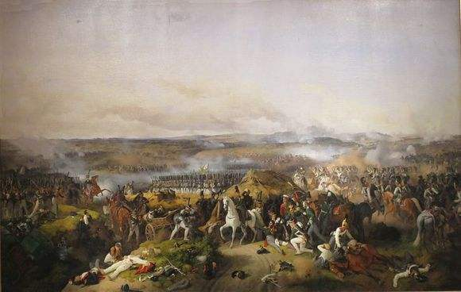
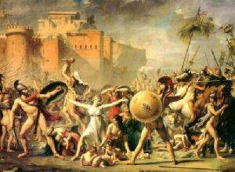
And I discovered that my castles stand
Be my mirror my sword and shield
I hear Jerusalem bells a-ringing
One minute I held the key
Next the walls were closed on me
Upon pillars of salt, pillars of sand
My missionaries in a foreign field
Roman Cavalry choirs are singing

Slide 6
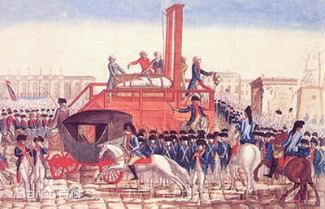
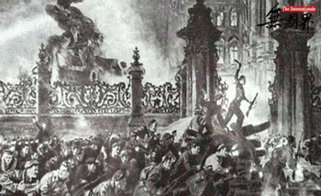
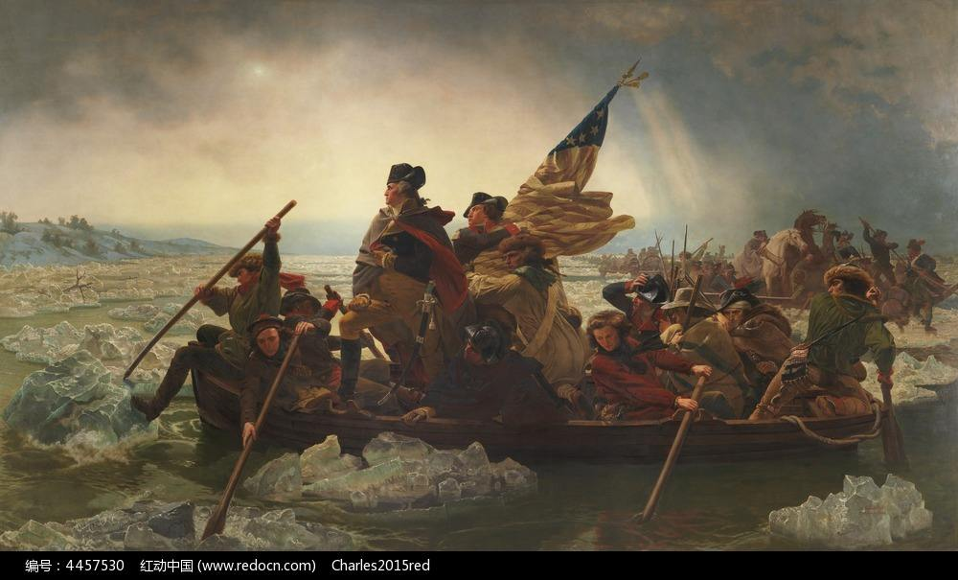
"That was when I ruled the world
For some reason I can not explain
"Once you go there was never, never an honest word

Slide 7
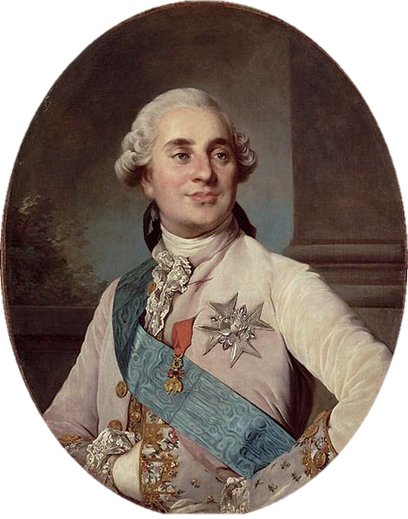
Louis's indecisiveness and conservatism made people of France view him as a symbol of the perceived tyranny
In a context of civil and international war, Louis XVI was suspended and arrested at the time of the Insurrection of 10 August 1792
……

Slide 8
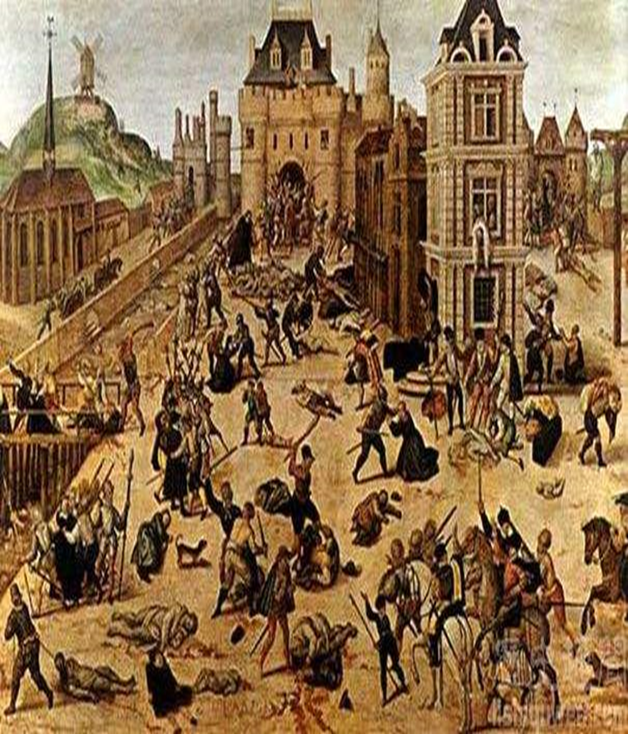
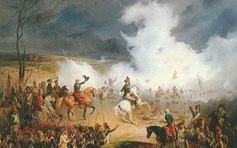
It was the wicked
and wild wind
Blew down the doors
to let me in
Shattered windows
and the sound of drums
People could not
believe what I'd become

Slide 9
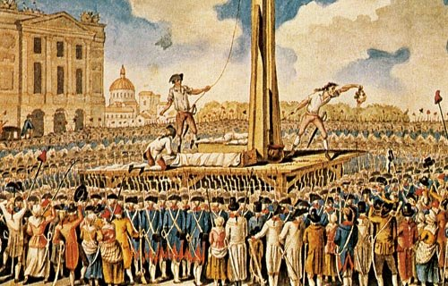
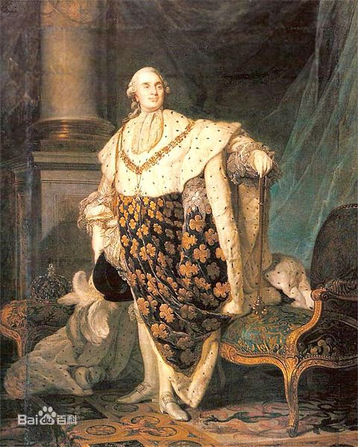
Revolutionaries Wait
For my head on a silver plate
Just a puppet on a lonely string
Oh who would ever want to be king?

Slide 10
Be my mirror my sword and shield
I hear Jerusalem bells a-ringing
Roman Cavalry choirs are singing
My missionaries in a foreign field

Slide 11
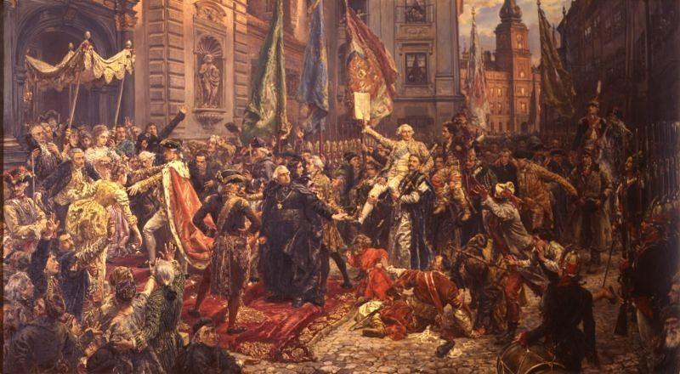
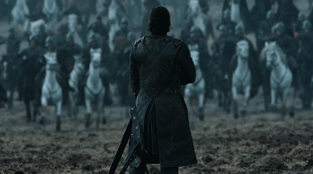
For some reason I can not explain
Never an honest word
I know Saint Peter won't call my name
But that was when I ruled the world

Slide 12
Dear boys and girls,
Hope you can know more about France,
after watching the video
Sincerely,
华南师范大学外文学院
许旦星
Music : Viva da vida
By: Coldplay

