Slide 1
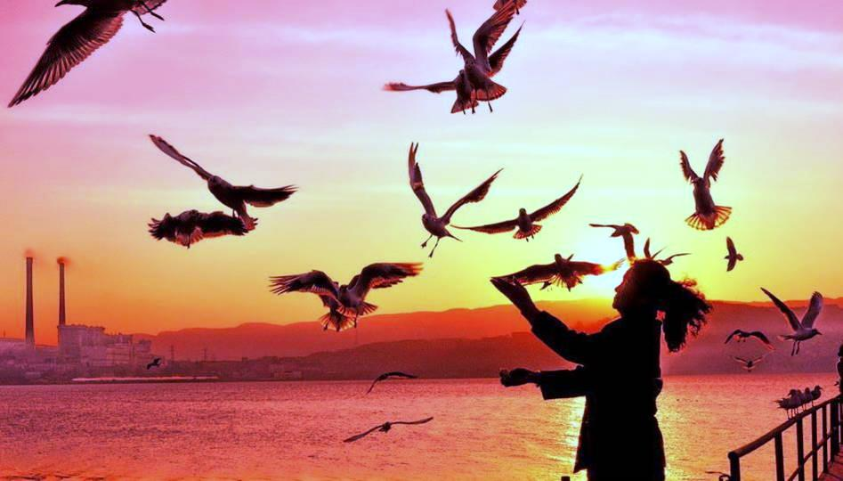
Human and Nature
作者：方怀蔚
单位：华南师范大学外文学院

Slide 2
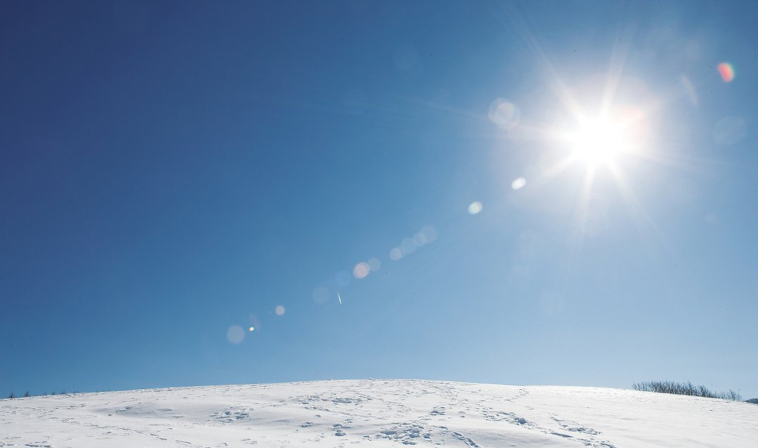
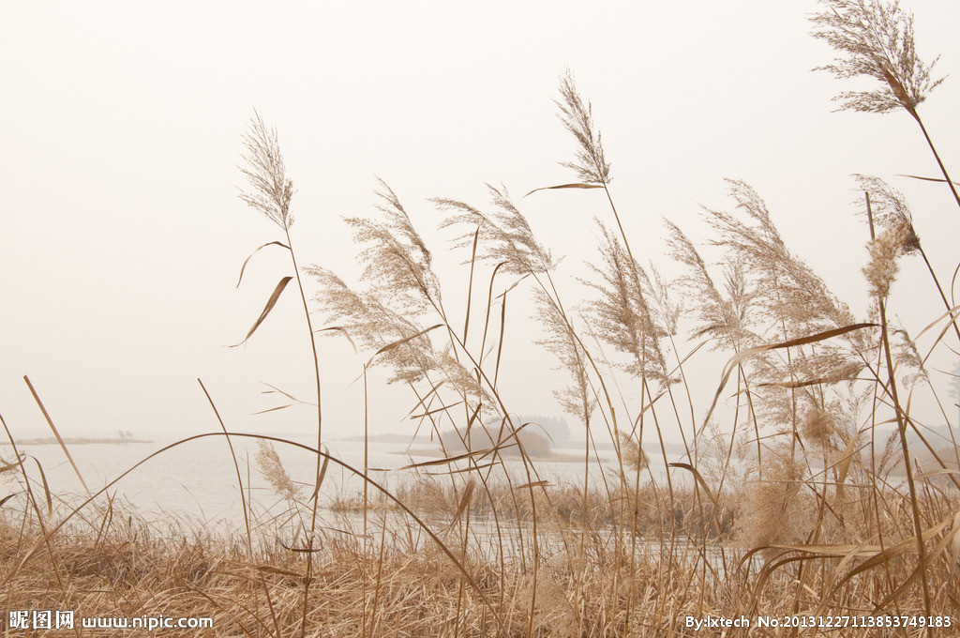
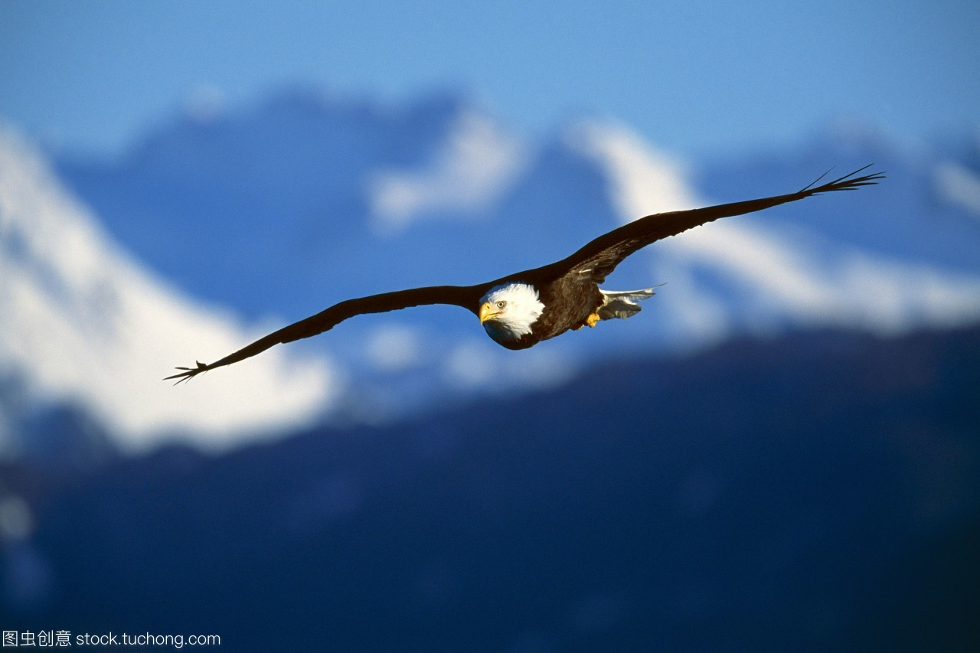
Birds flying high
You know how I feel
Reeds driftin' on by
You know how I feel
Sun in the sky
You know how I feel

Slide 3
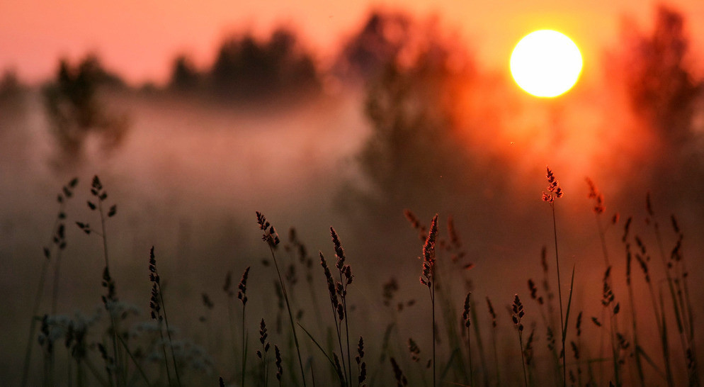
It's a new life
For me
I'm feeling good
And I' m feeling good
It's a new dawn
It's a new day

Slide 4
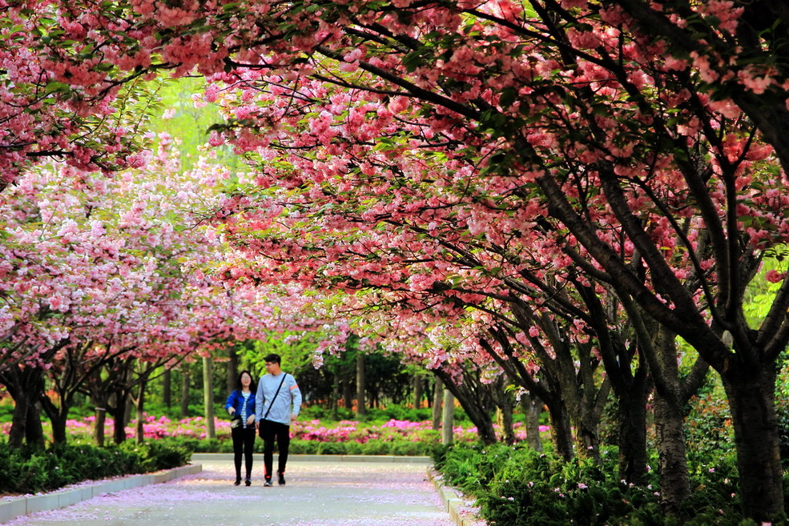
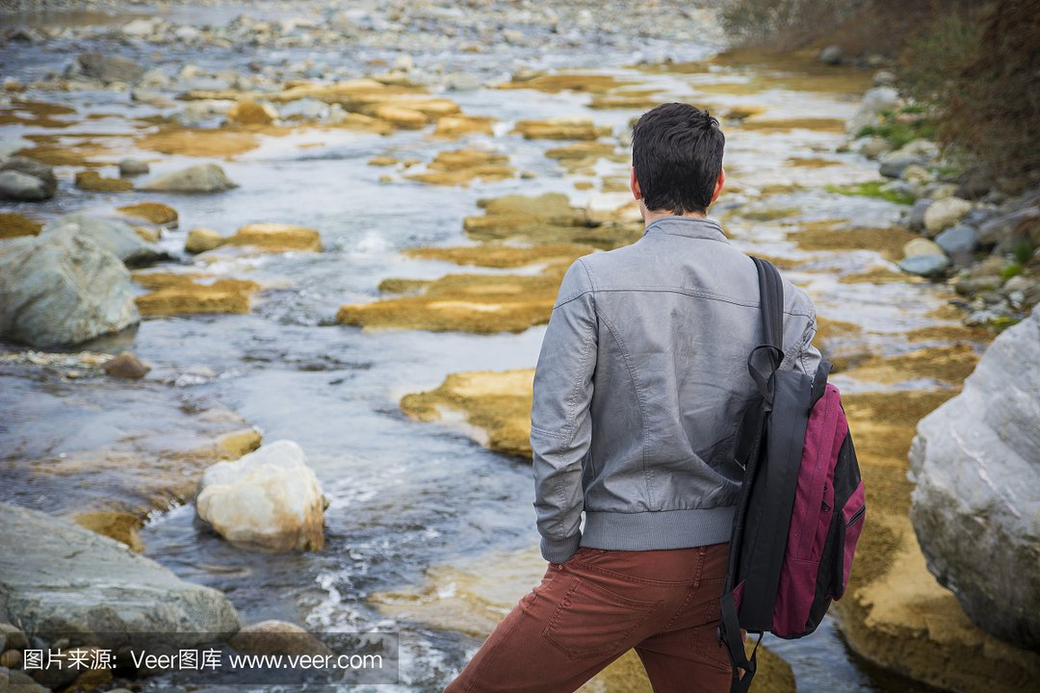
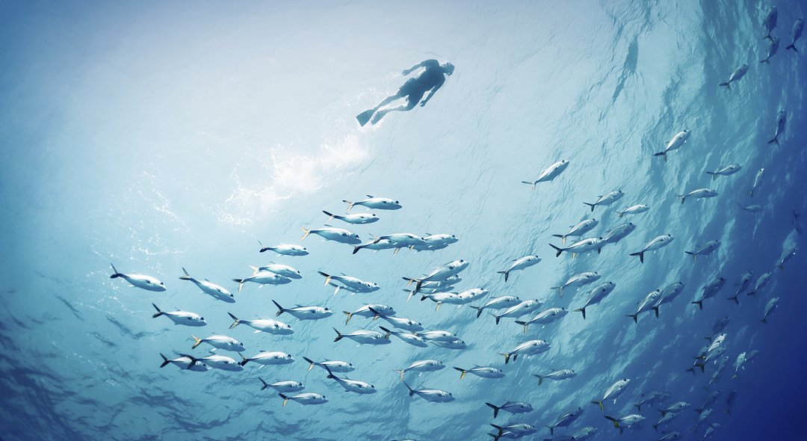
River running free
You know how I feel
Fish in the sea
You know how I feel
Blossom on the tree
You know how I feel

Slide 5
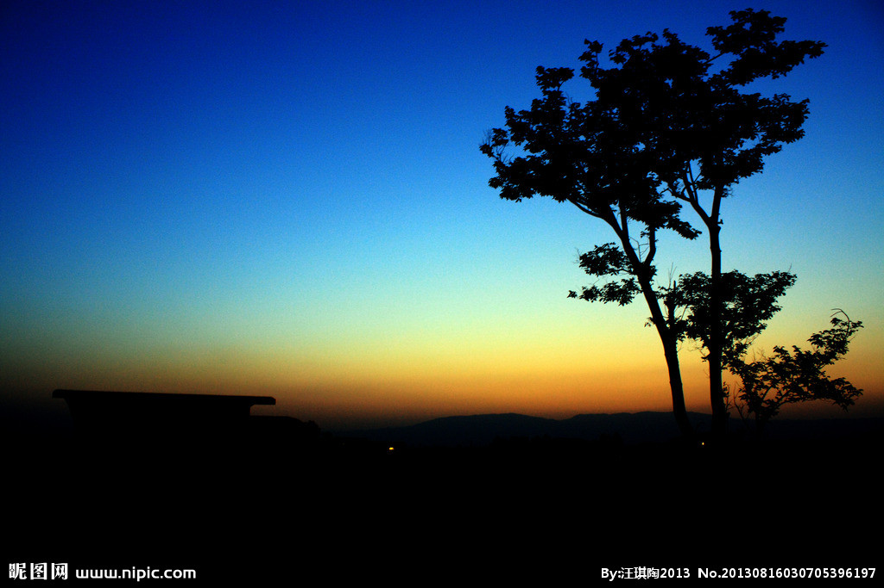
It's a new dawn
It's a new day
It's a new life
For me
And I'm feeling good

Slide 6
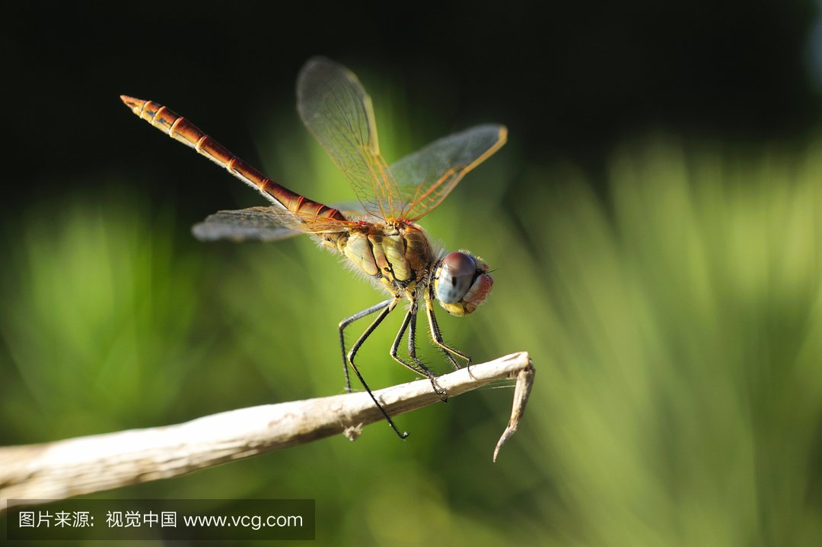
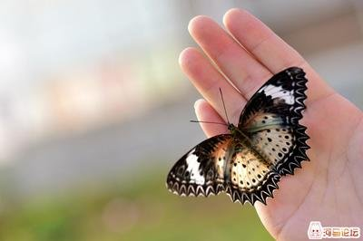
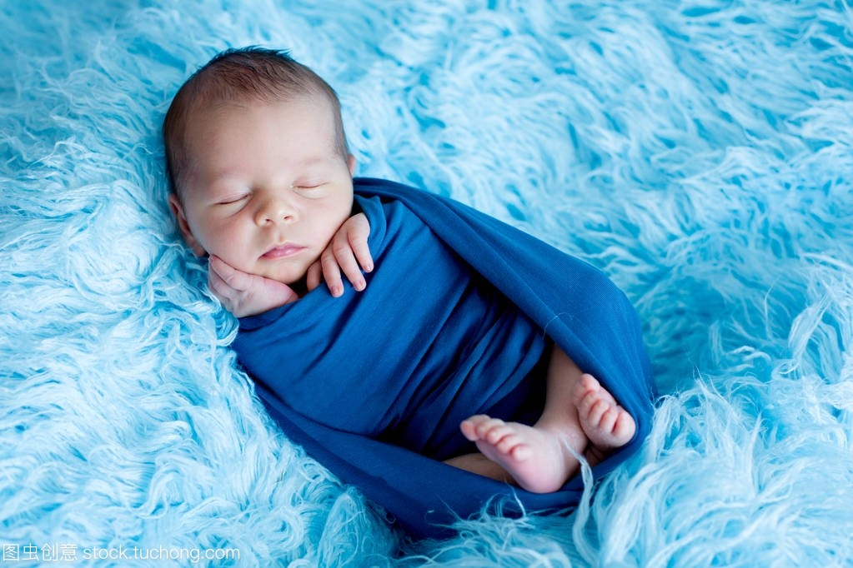
Butterflies all havin' fun
you know what I mean
Sleep in peace when the day is done
that'swhat I mean
Dragonfly out in the sun
you know what I mean, don't you know

Slide 7
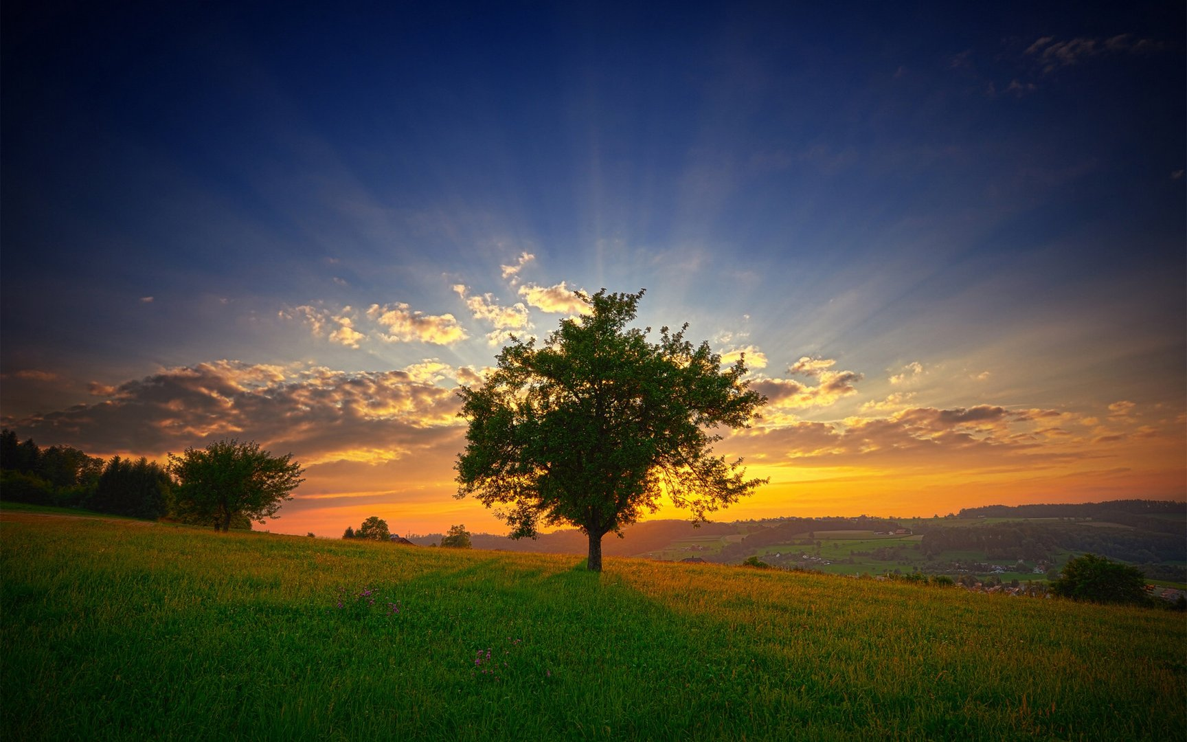
And a bold world
For me
And this old world is a new world
For me

