Slide 1


Animals and Plants
Song: Everything at once
Singer: Lenka
单位：华南师范大学外文学院
作者：陶蕾

Slide 2
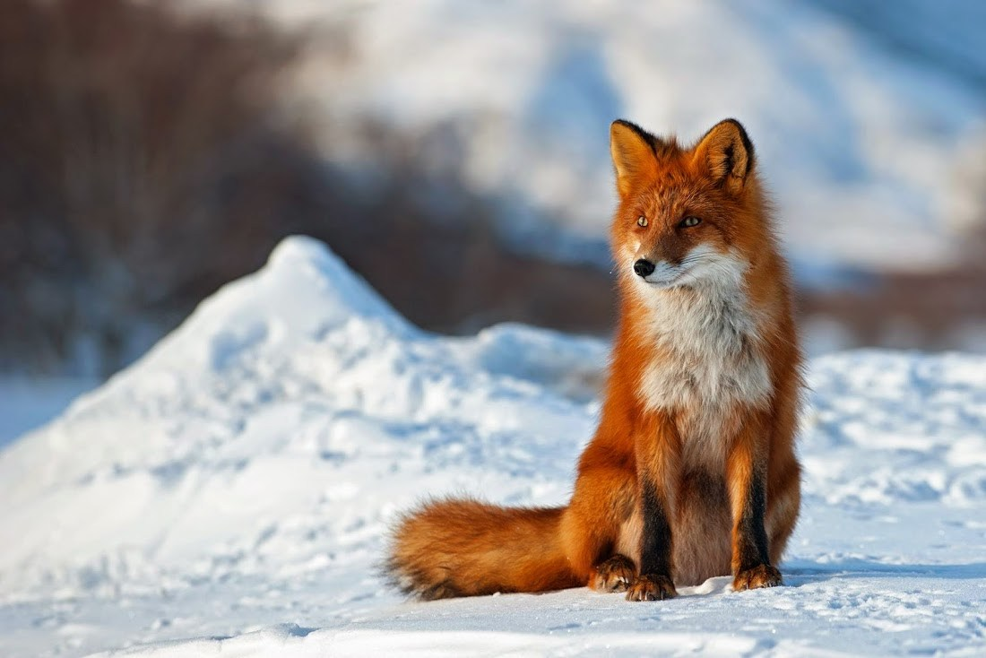
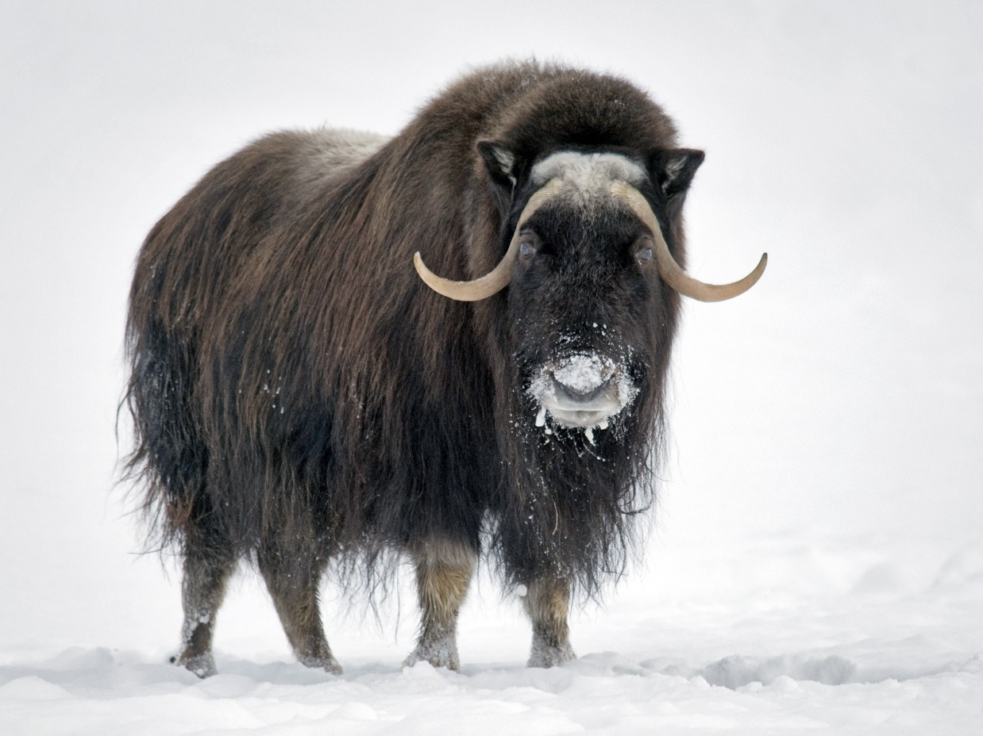
As sly as a fox
As strong as an ox

Slide 3
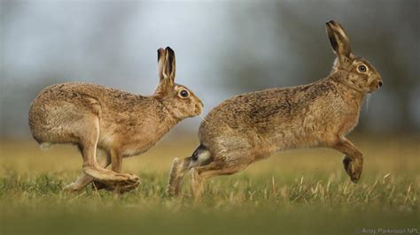
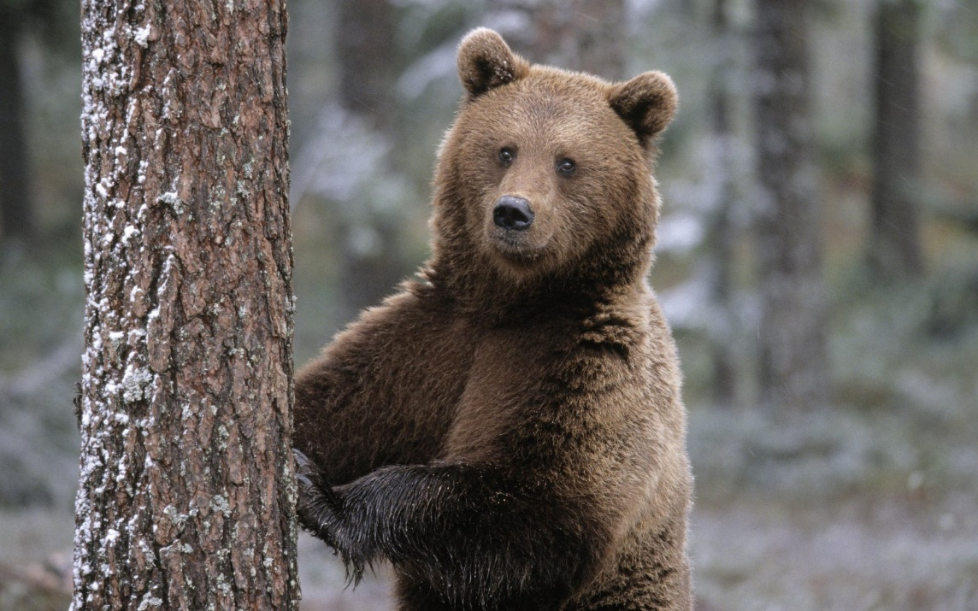
As fast as a hare
As brave as a bear

Slide 4
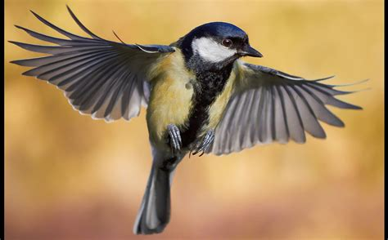
As free as a bird
As neat as a word

Slide 5
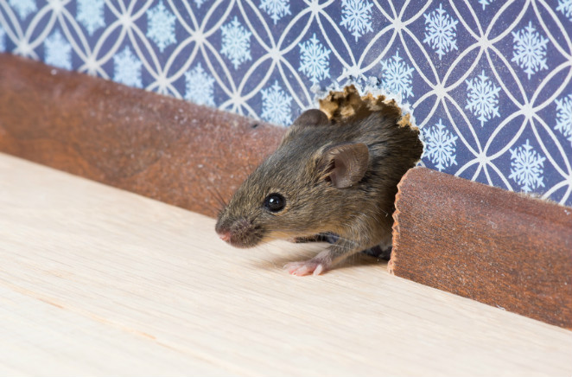
As
quiet
as
a
mouse
As
big
as
a
house

Slide 6
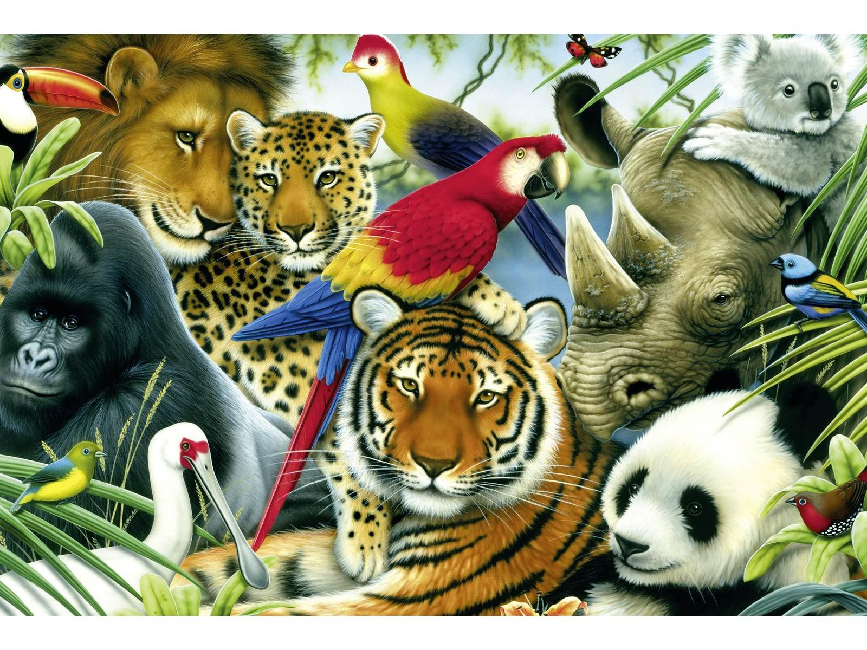
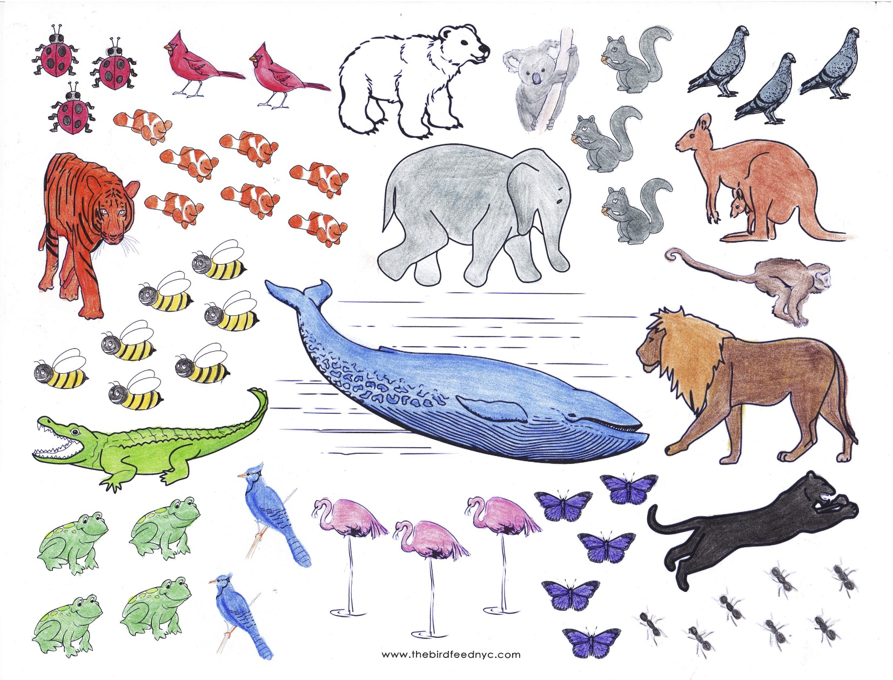
All I wanna be

Slide 7
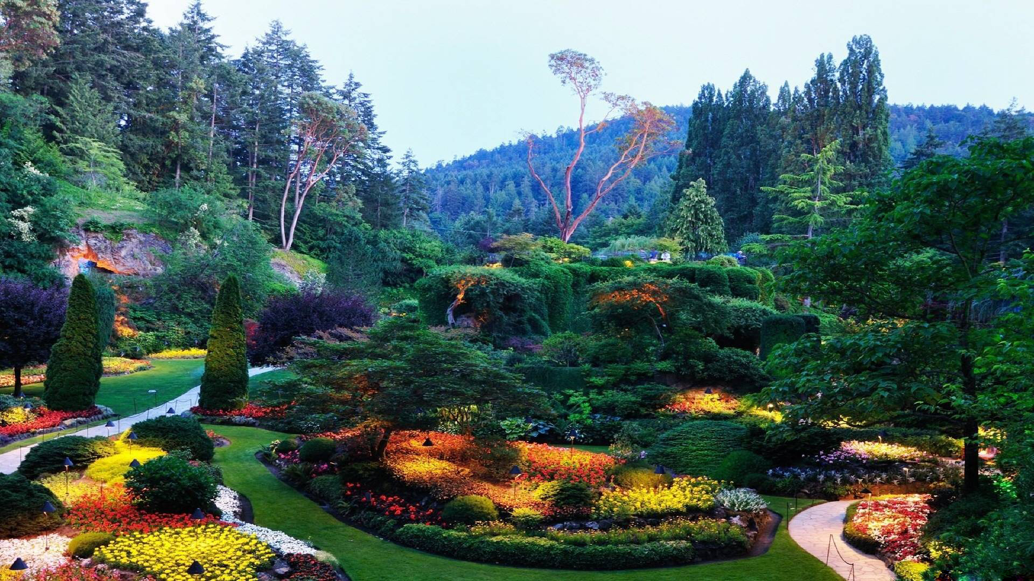
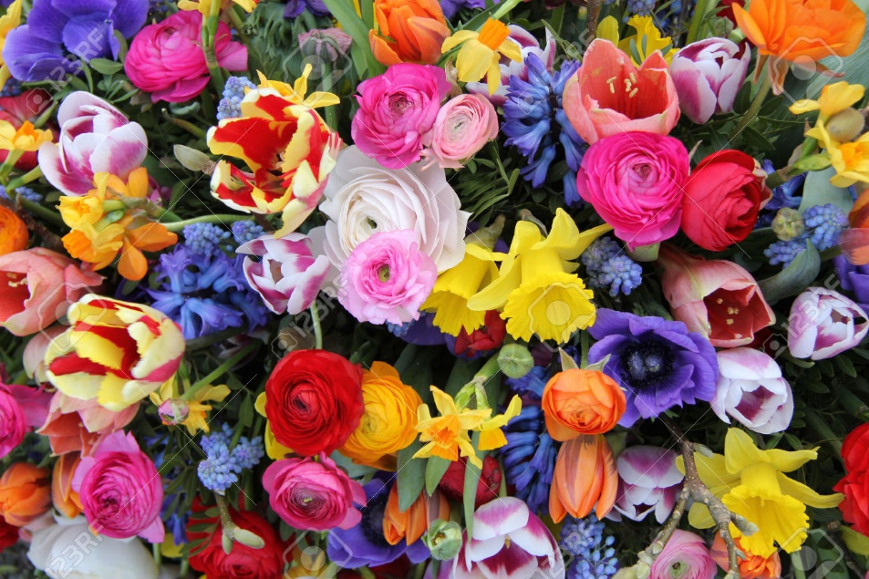

All I wanna be
is
everything

Slide 8
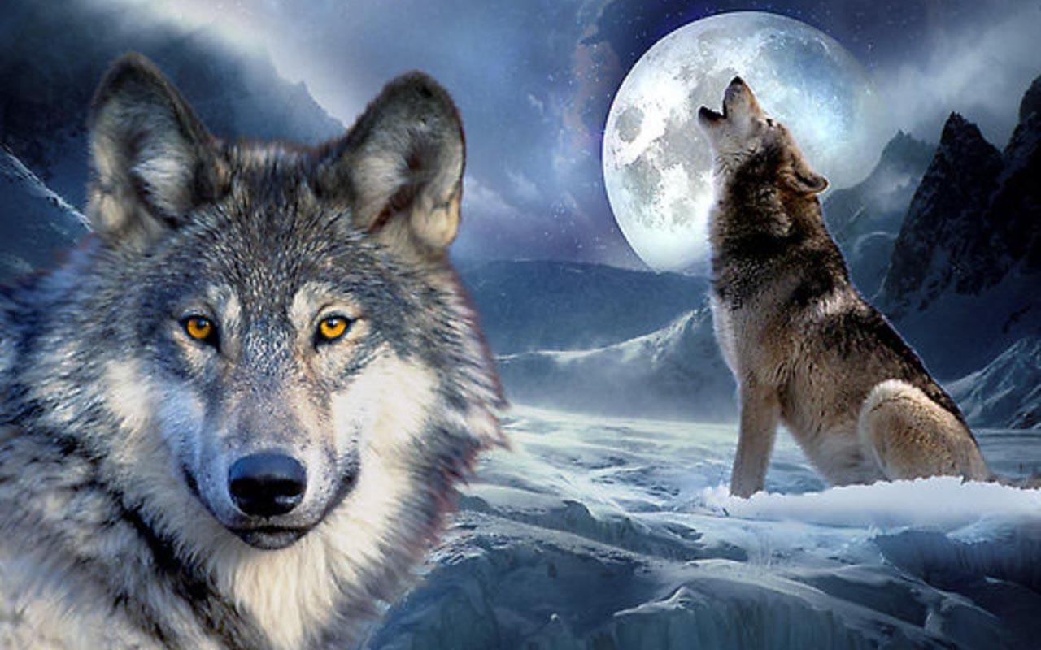

As mean as a wolf
As sharp as a tooth

Slide 9
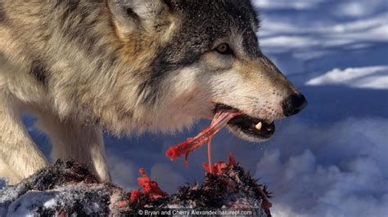
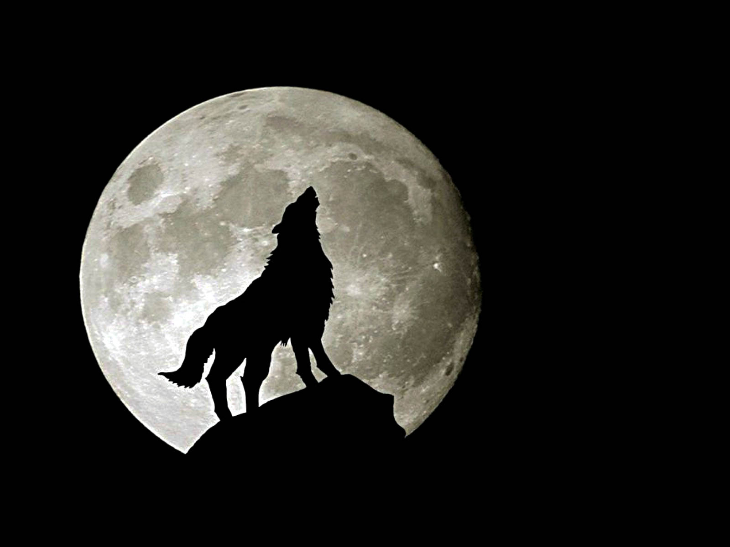
As deep as a bite
As dark as the night

Slide 10
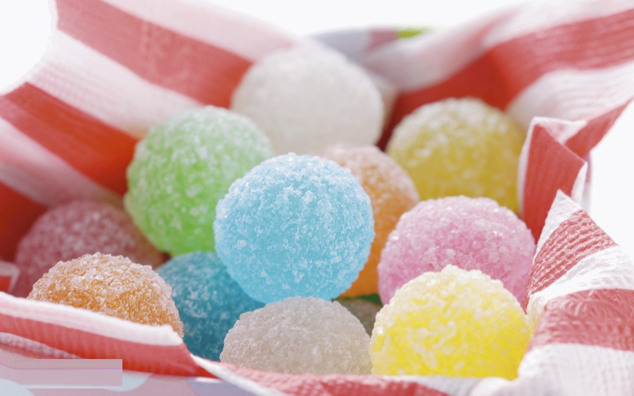
As sweet as a song
As right as a wrong

Slide 11
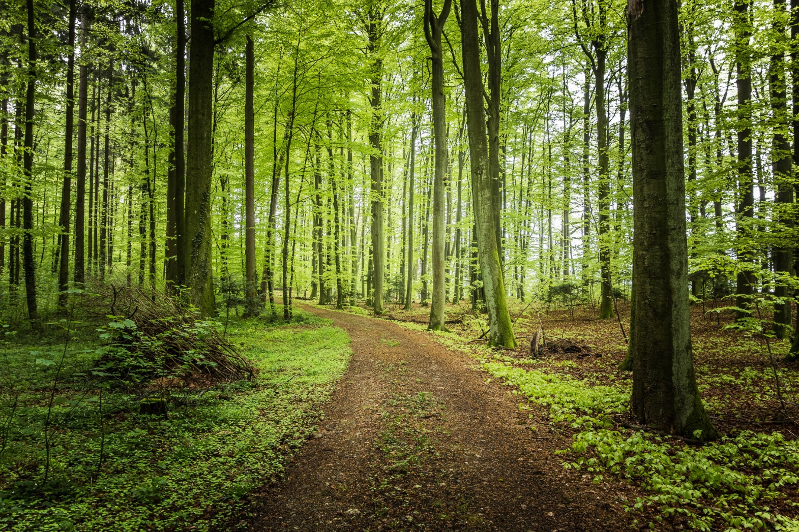
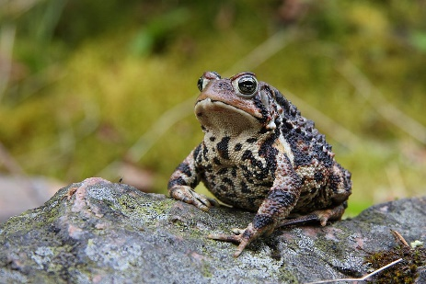
As long as a road
As ugly as the toad

Slide 12
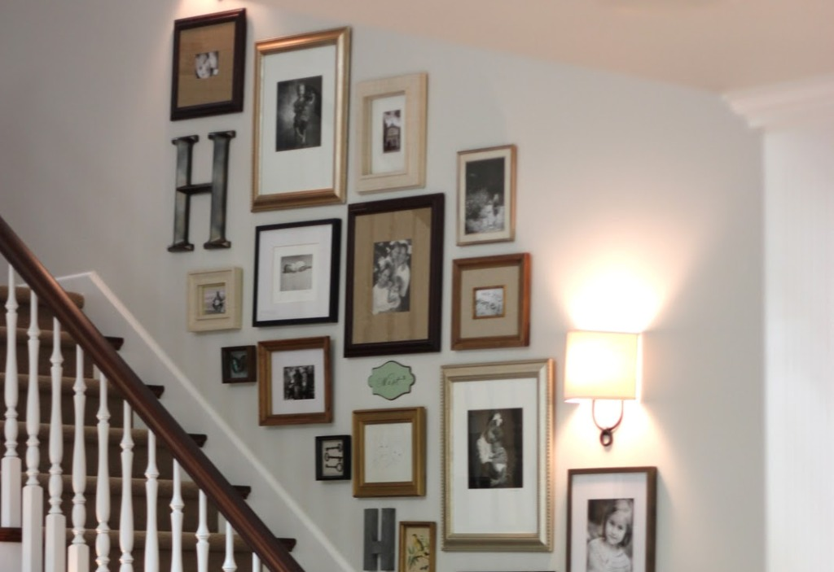
As pretty as a picture
hanging from a fixture

Slide 13

Strong like a

Slide 14
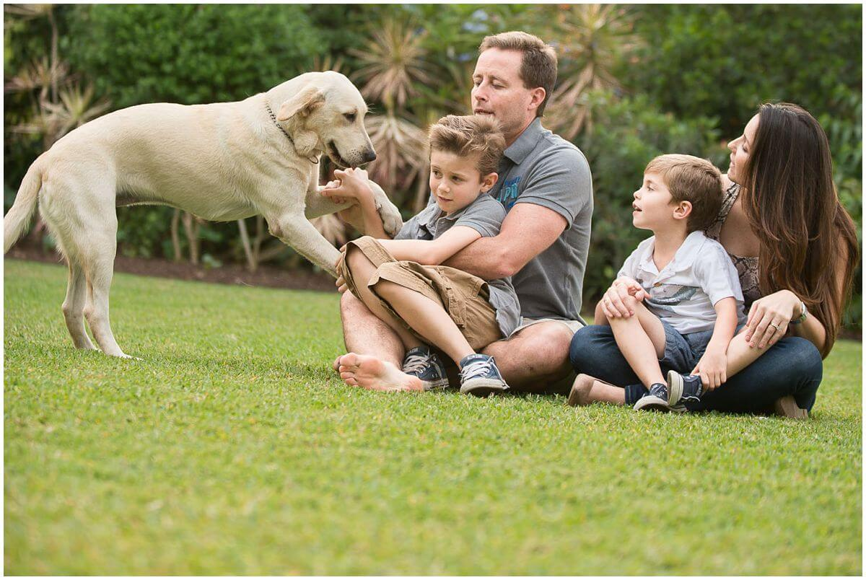
Strong as I wanna be

Slide 15
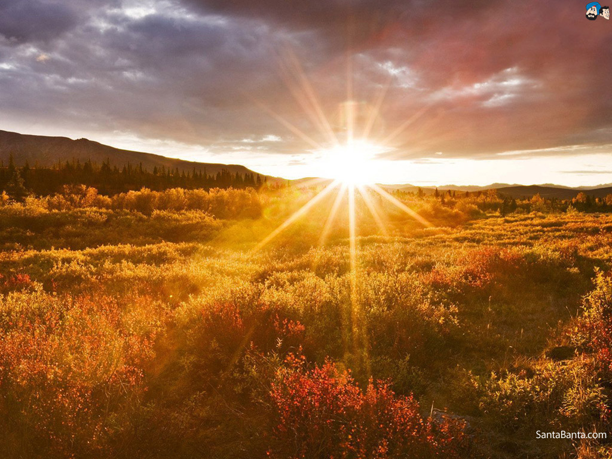
Bright as day as light as play

Slide 16
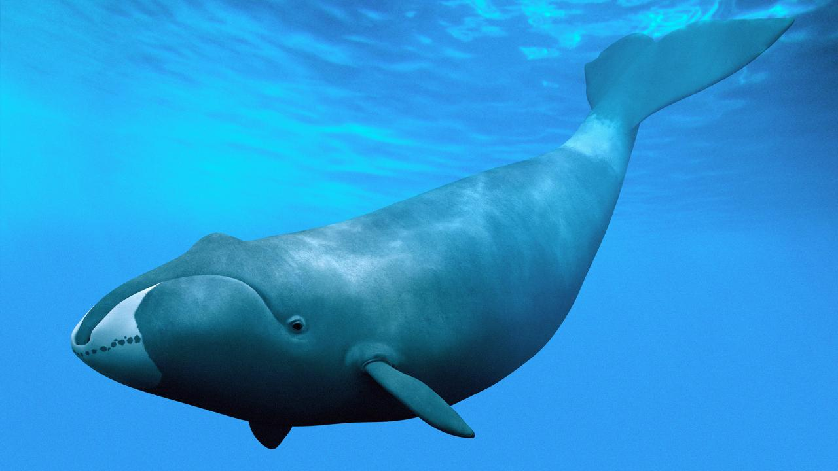
As hard as nails
As grand as a whale

Slide 17
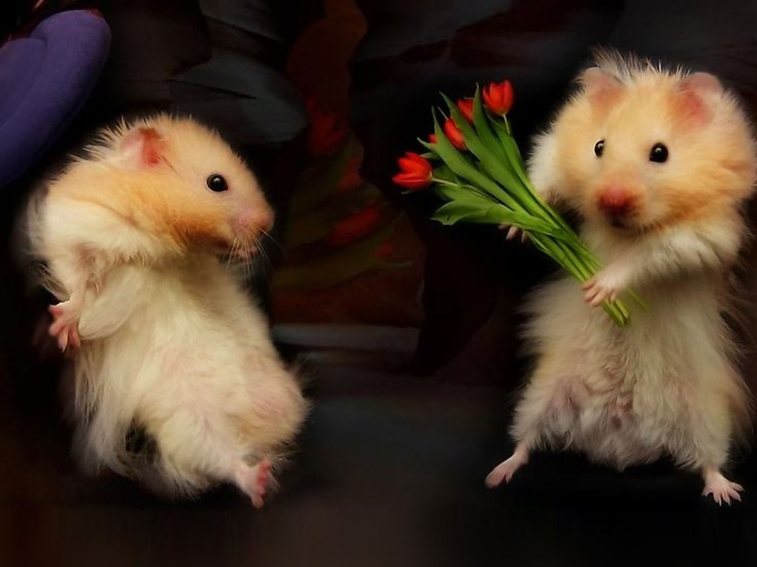
All I wanna be

Slide 18
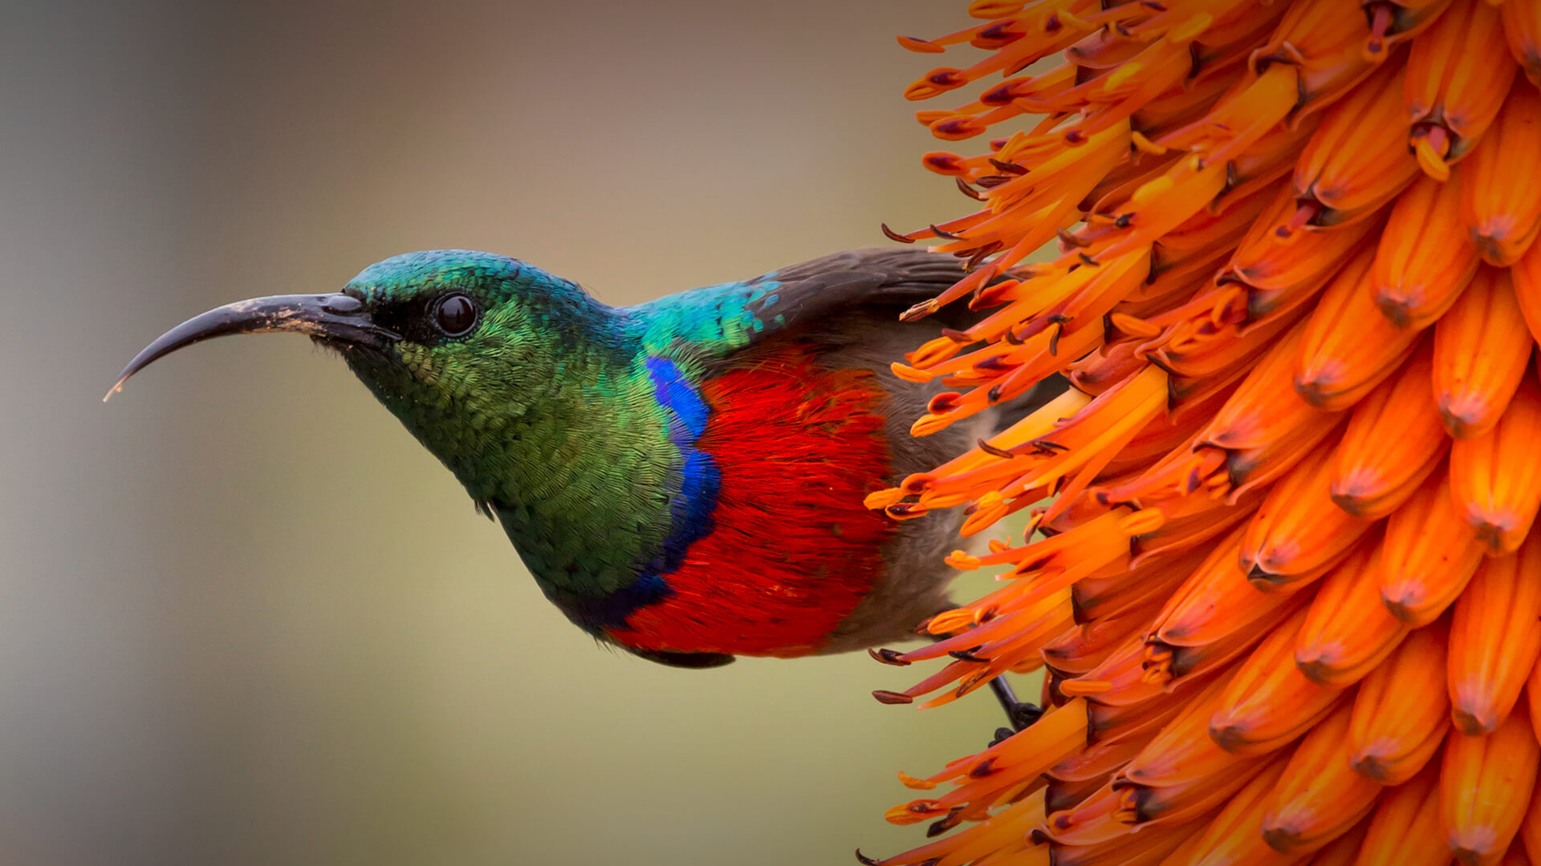

Slide 19
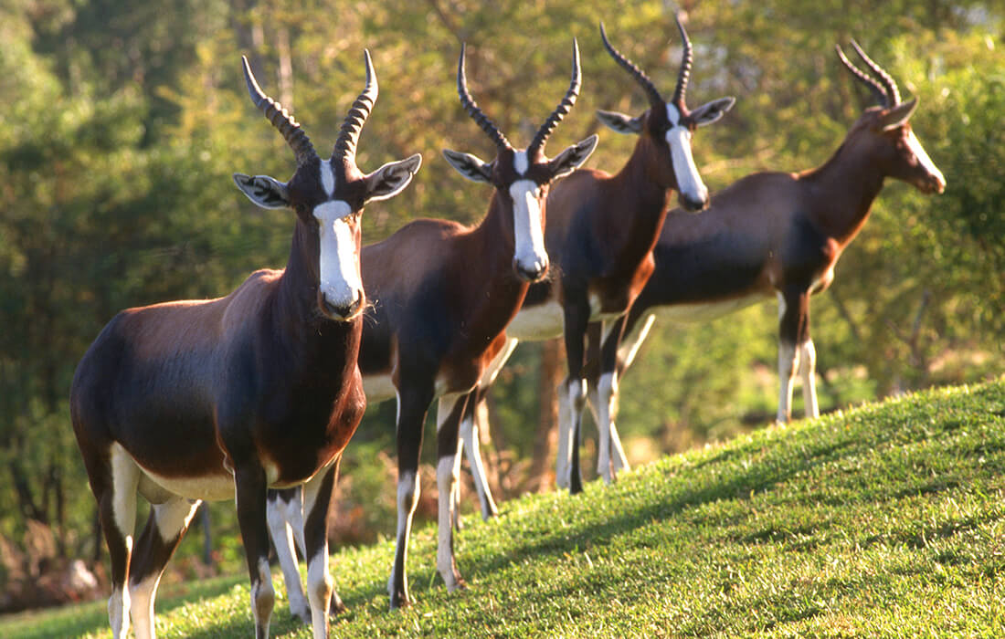

Slide 20
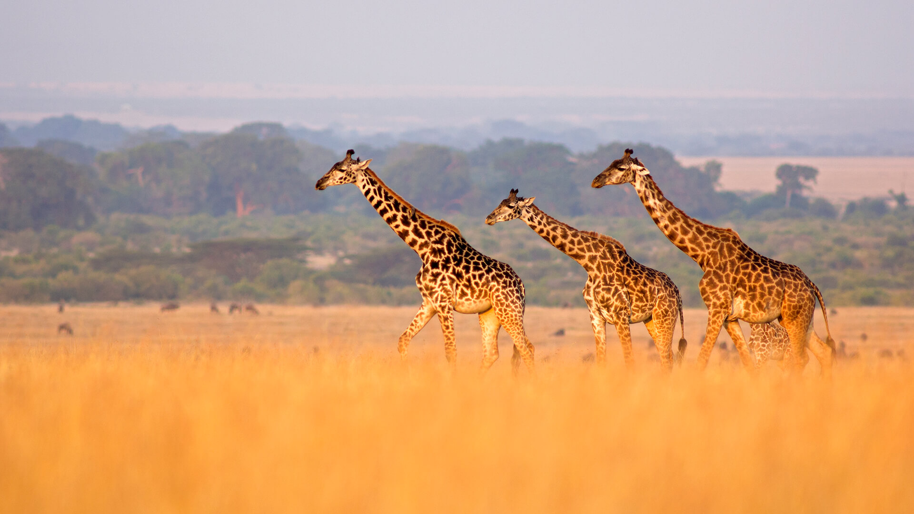

Slide 21
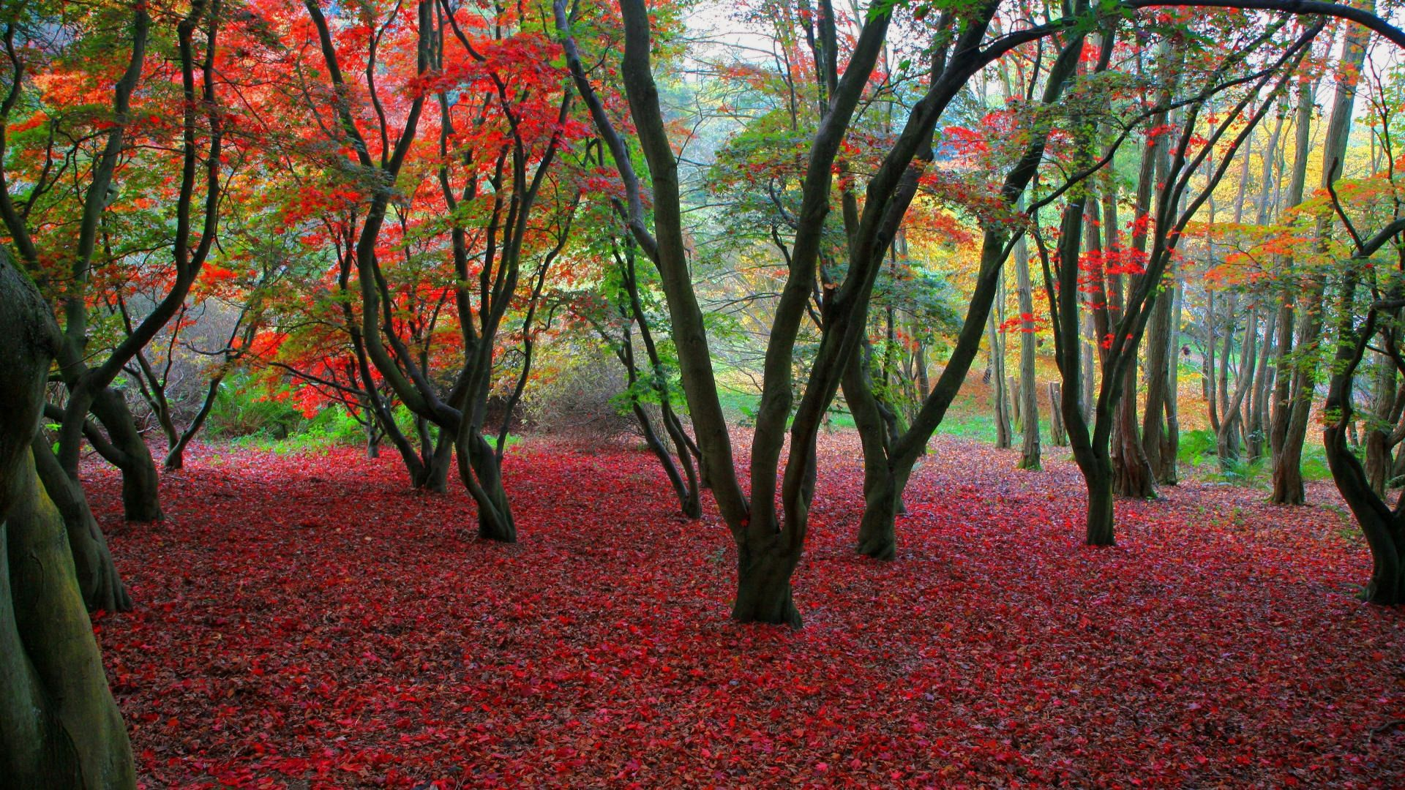

Slide 22
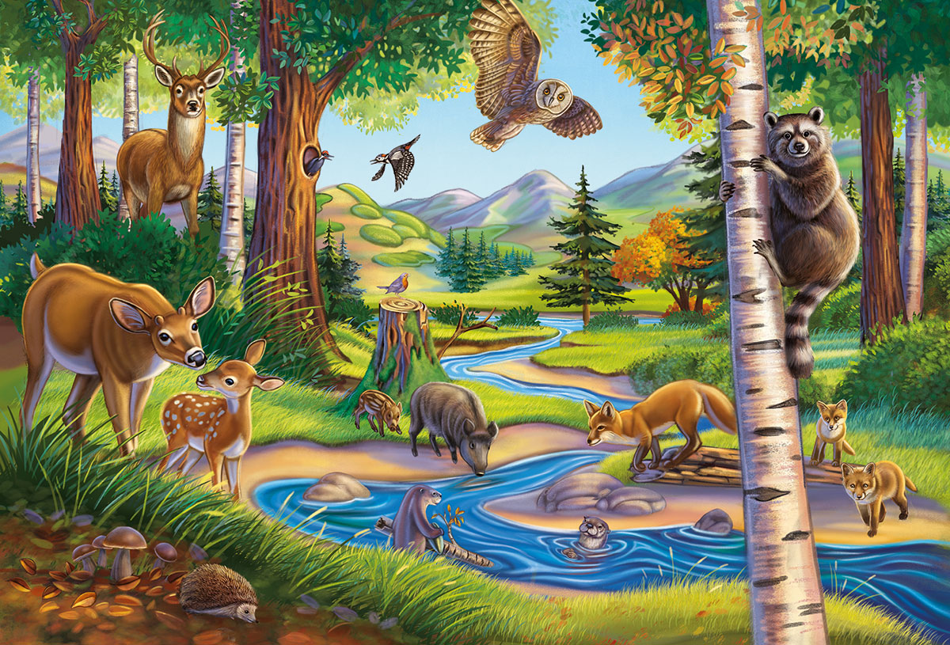
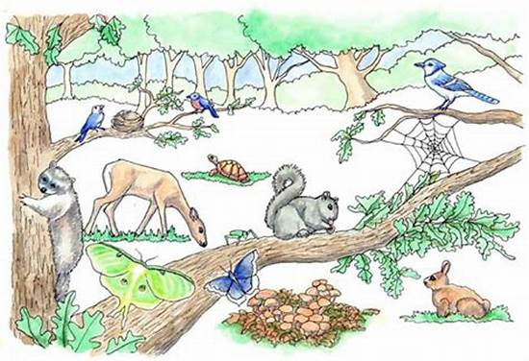
Everything at once

