Slide 1



Body
Language
人教版必修4 Unit4
作者：蓝明慧
单位：华南师范大学外文学院
If you are happy and you know it

Slide 2




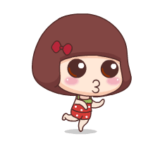

Slide 3



If you are happy and you know it,
clap your hands

Slide 4


If you are happy and you know it,
clap your hands

Slide 5


If you are happy
and you know it,
and you really
want to show it

Slide 6
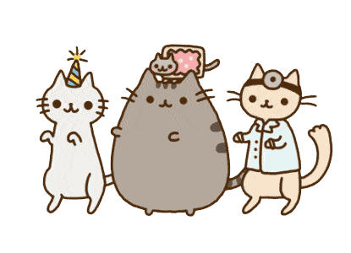
If you are happy and you know it,
clap your hands

Slide 7

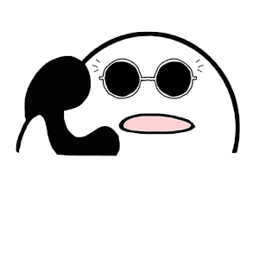

If you are happy
and you know it,
stomp your feet

Slide 8


happy
If
you
are
know
and
it
you
stomp your feet

Slide 9
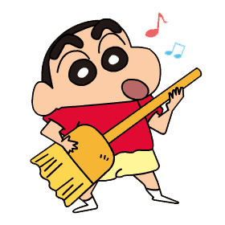
If you are happy
and you know it,
and you really
want to show it

Slide 10
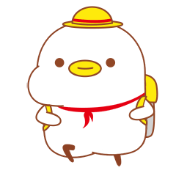
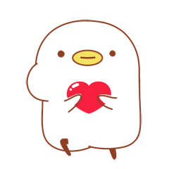
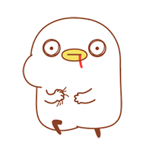
If you are happy and you know it,
stomp your feet

Slide 11

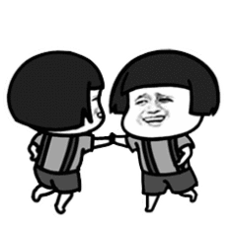
If you are happy
and you know it
turn
around

Slide 12


If you are happy
and you know it,
turn around

Slide 13

If you are happy and you know it,
and you really want to show it

Slide 14
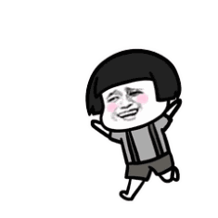
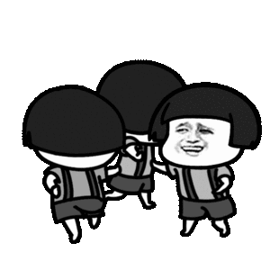
If you are happy and
you know it,
turn around

Slide 15



If you are happy and you know it, nod your head

Slide 16


If you are happy and you know it,
nod your head

Slide 17

If you are happy and you know it,
and you really want to show it

Slide 18



If you are happy and you know it,
nod your head

Slide 19

If you are happy and you know it,
shake
legs
your

Slide 20
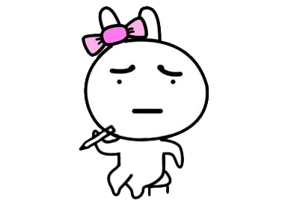
If you are happy and you know it,
Shake your legs

Slide 21
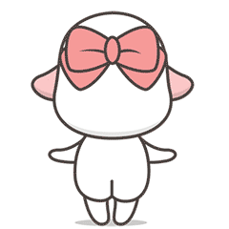
If you are happy and you know it,
and you really want to show it

Slide 22

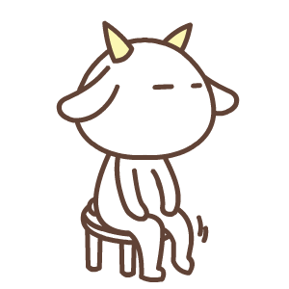
shake your legs
If you are happy and you know it,

Slide 23
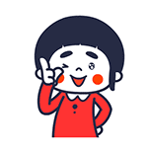
If you are happy and you know it,
snap your fingers

Slide 24
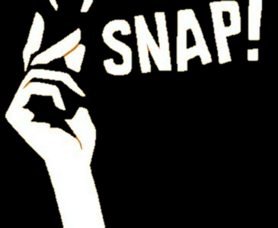
If you are happy and you know it,
snap your fingers

Slide 25

If you are happy
and you know it,
and you really
want to show it

Slide 26
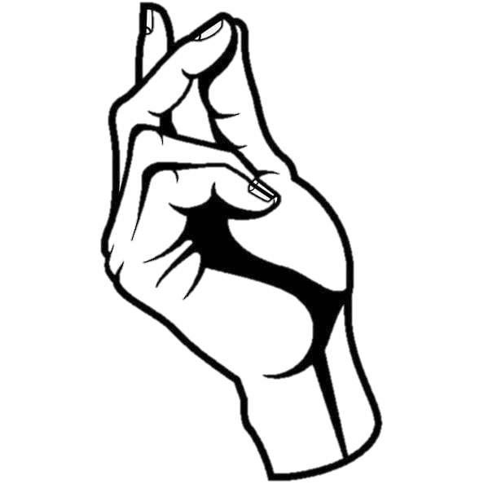
snap your fingers
If you are happy and you know it,

Slide 27

If you are happy and you know it, and you really want to show it
If you are happy and you know it, clap your hands

