Slide 1
Communications
Using the Internet
作者：傅日红
单位：华南师范大学外文学院

Slide 2
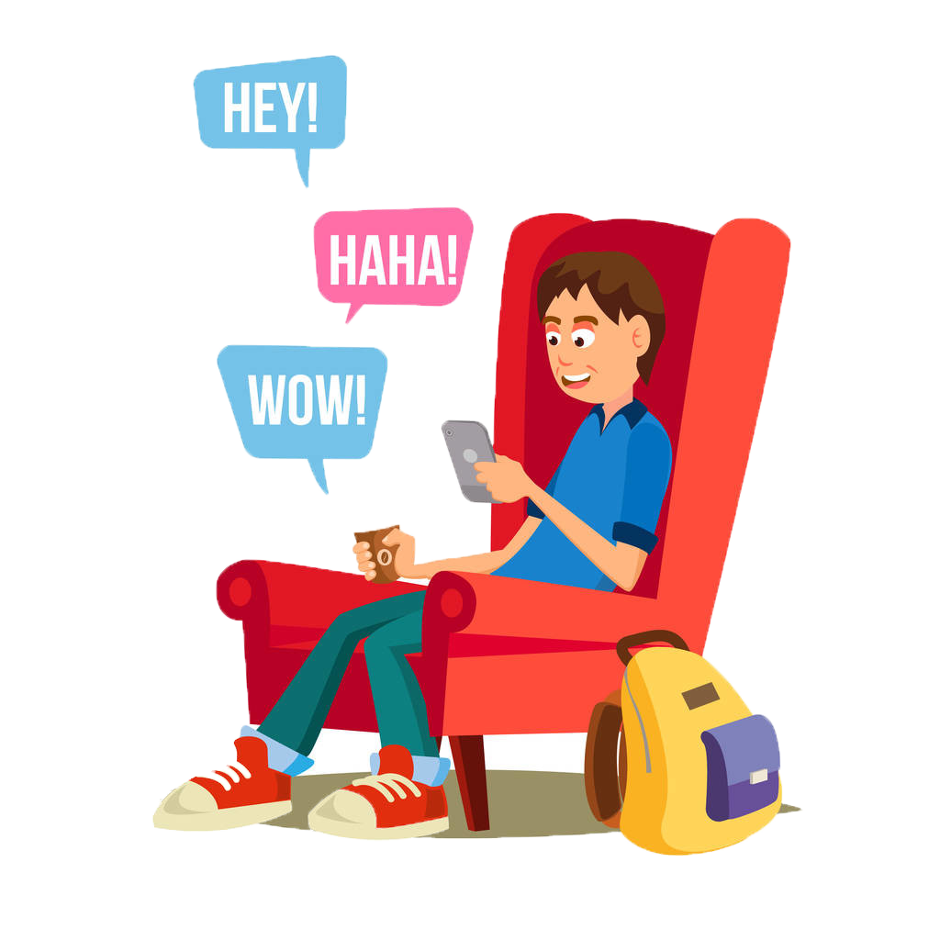
Wherever I go
Whatever I do
CUZ BABY
it’s always better with you
Stay
By
My
Side

Slide 4
In the middle of the pouring rain…

Slide 5
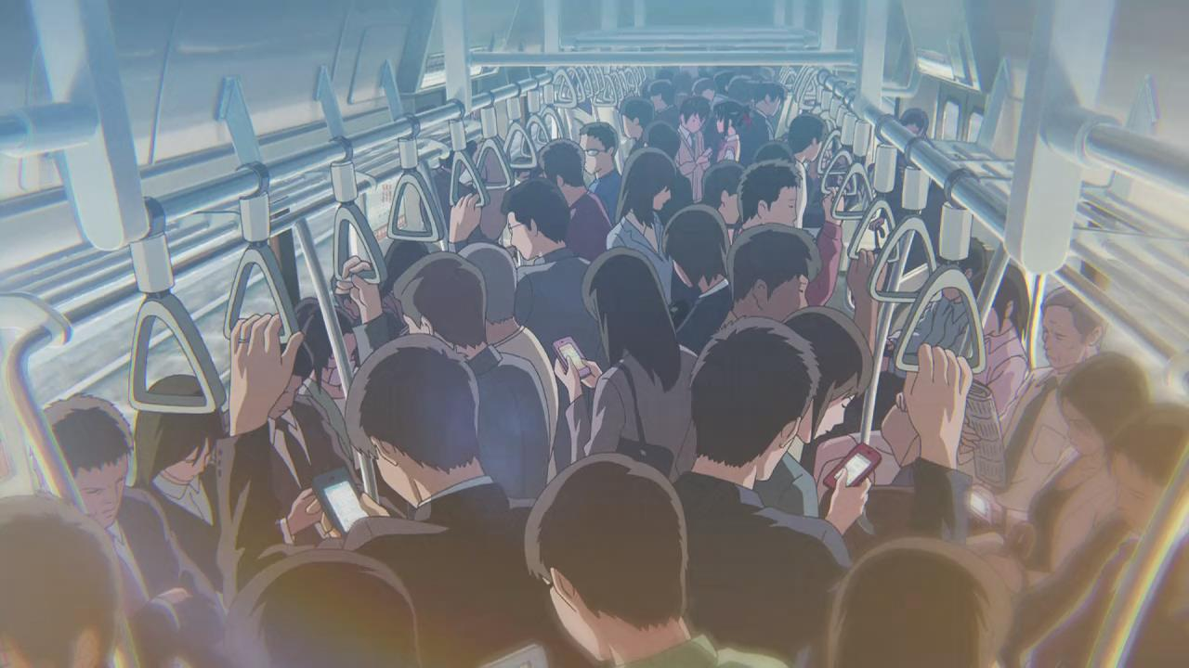
On a crowded subway train…

Slide 6
When I
to go insane…
just about

Slide 7
You
Make it
Go away…

Slide 8
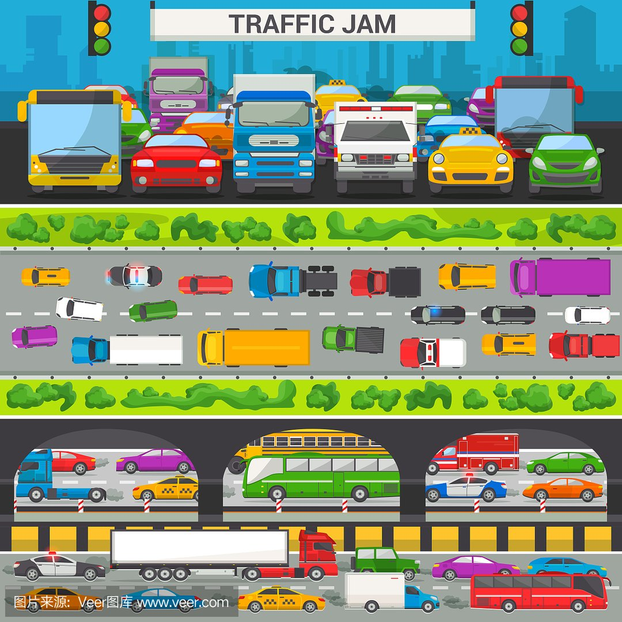
Monday morning
In a traffic jam…
And I am going to
be late again!!!

Slide 9
The world is getting underneath my skin…

Slide 10
I see your smiling…

Slide 11
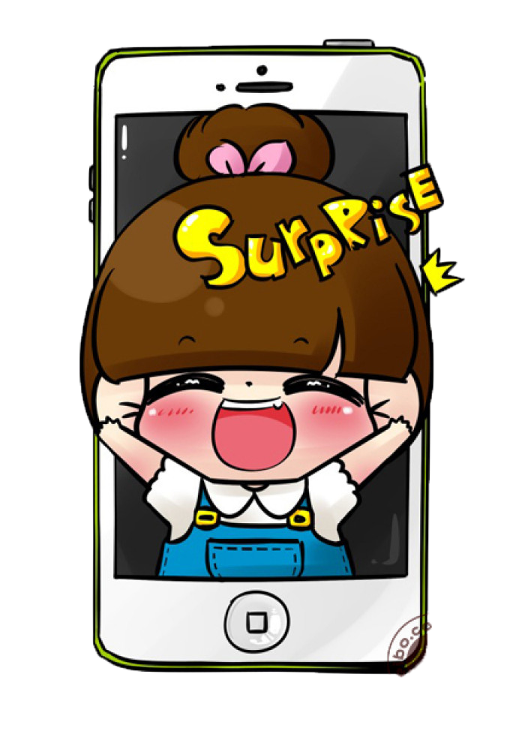
And , know that…
It’s going to be Ok!

Slide 12
Wherever I go
Whatever I do
CUZ BABY
it’s always better with you
Stay
By
My
Side

Slide 13
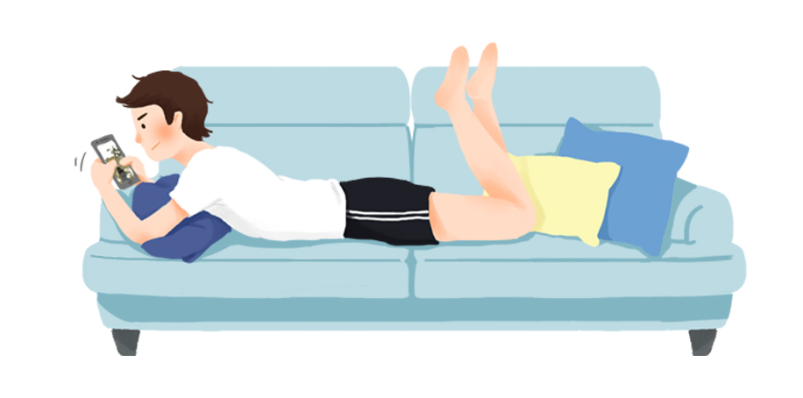
Girl,
when I am alone…
You’re where I belong
Cause Baby, it’s always better with you…
Ooooh…Ooooh…
Baby, it’s always better with you…

Slide 14
……
You make a bad day better than good…

Slide 15
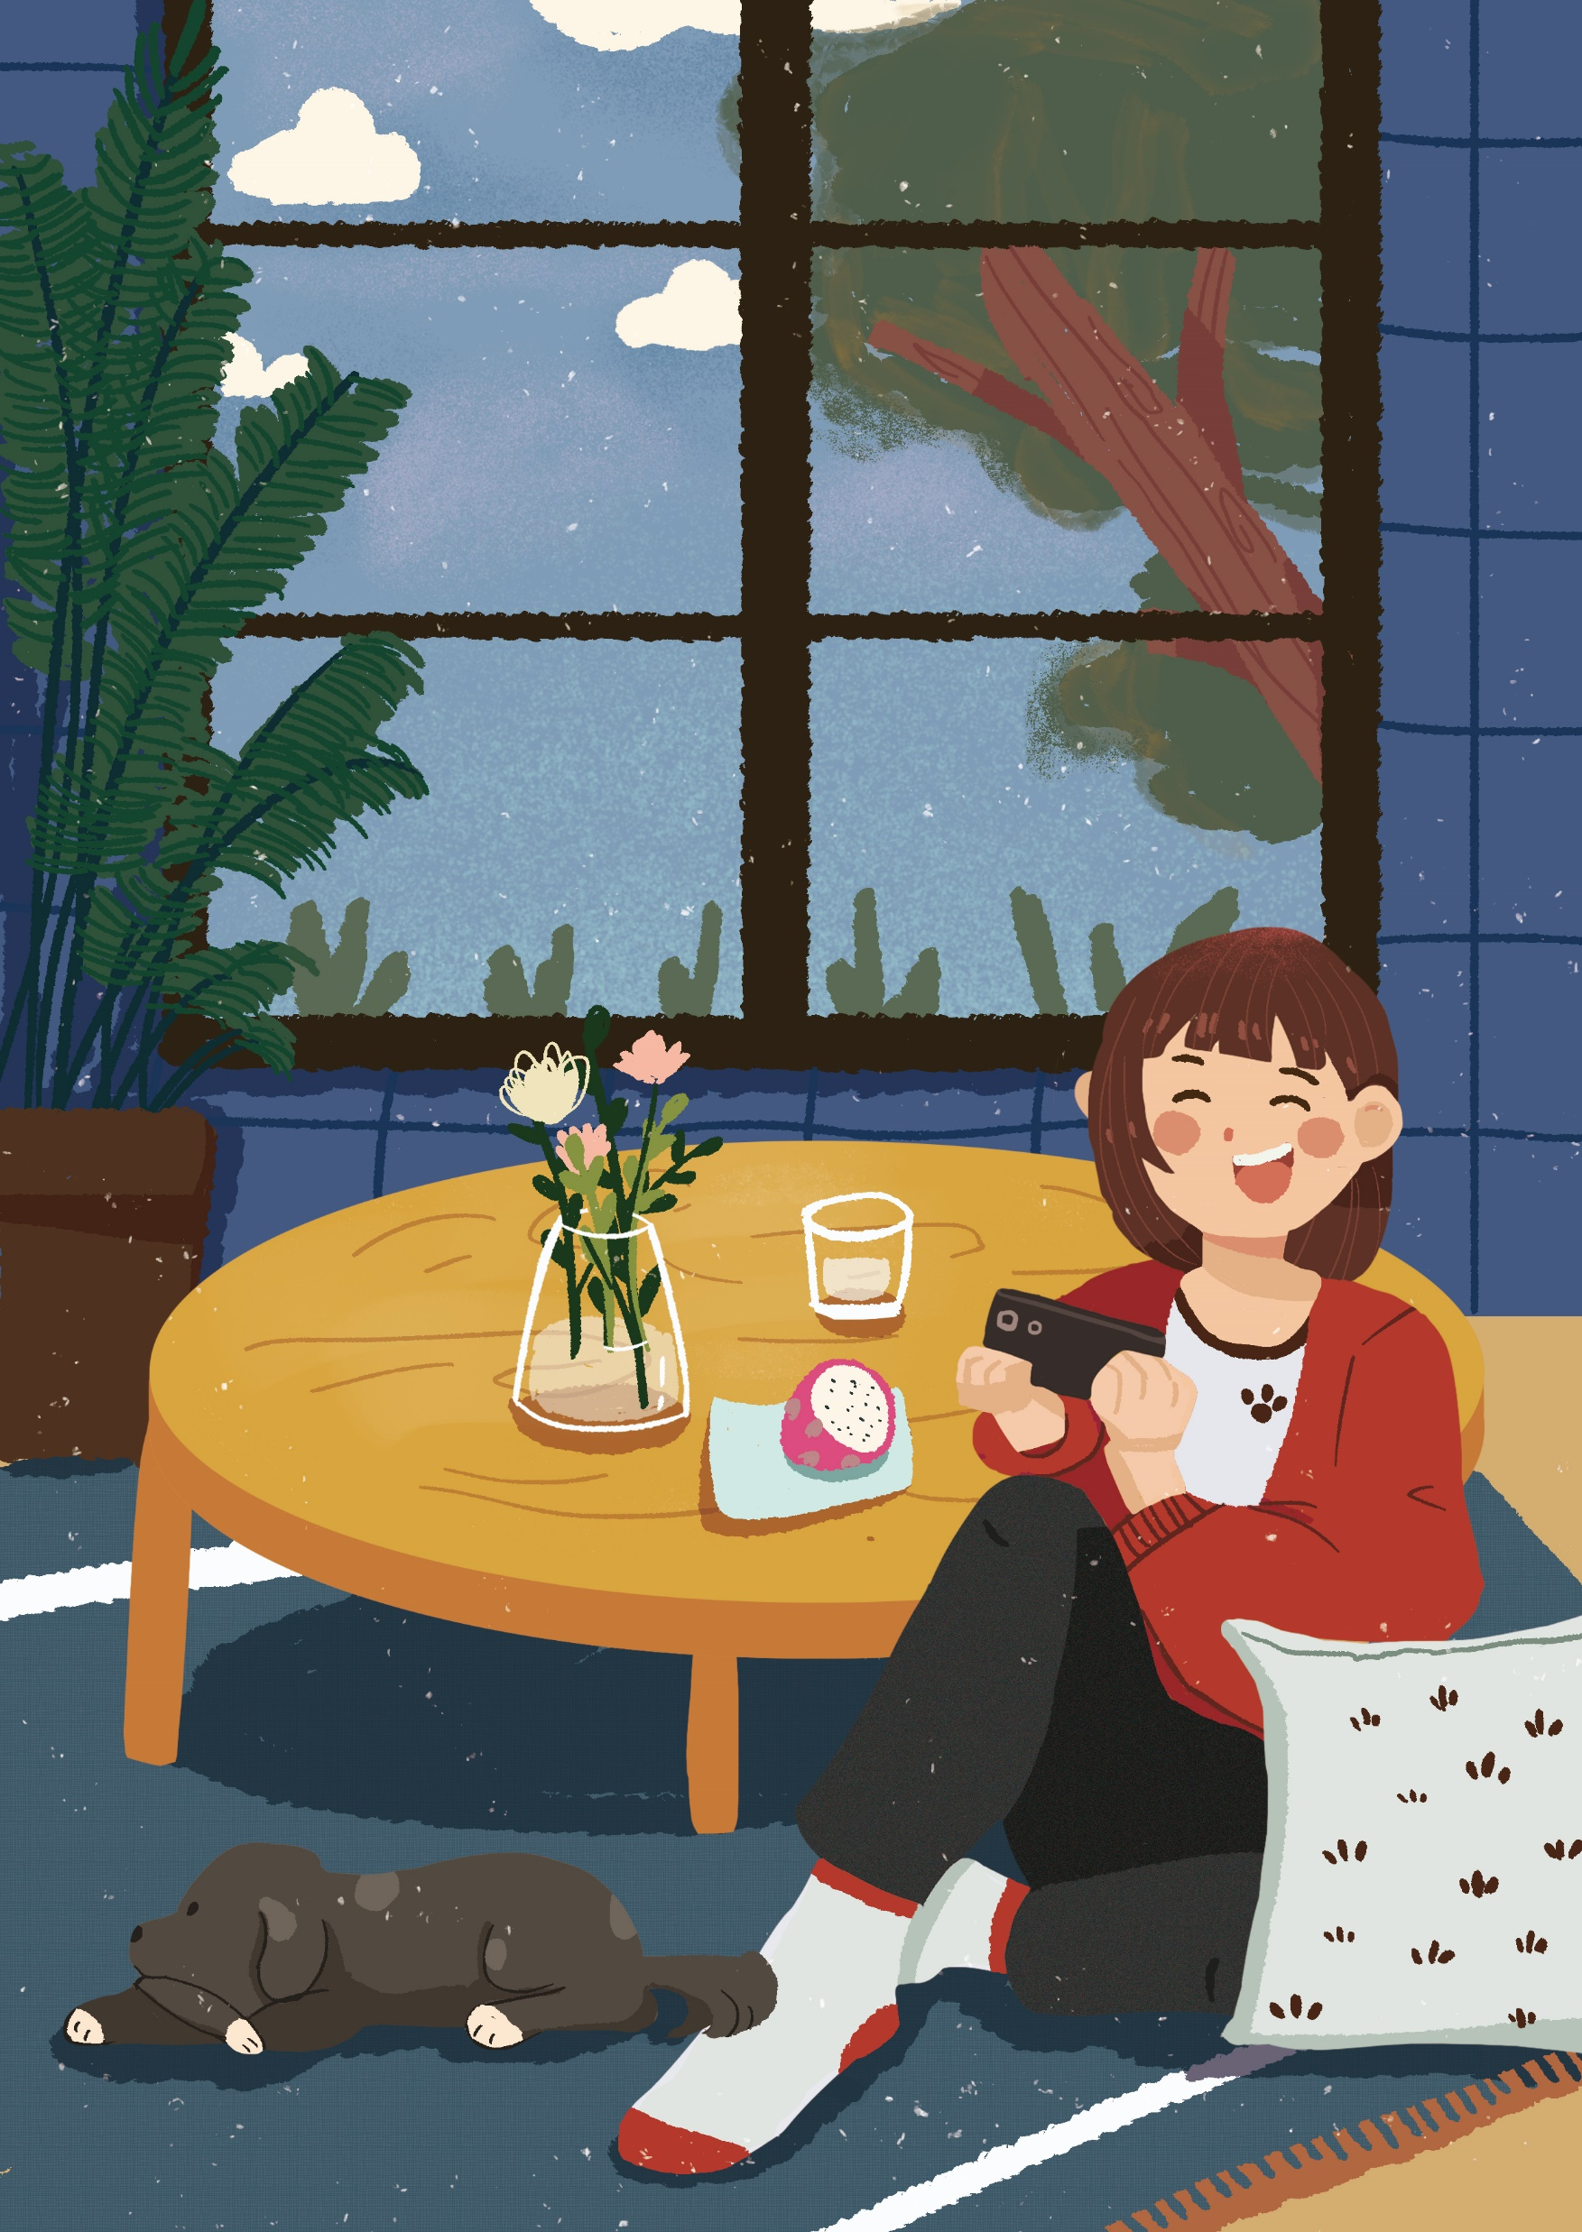
You understand when I’m misunderstood…
You make me feel better than
I should…

Slide 16
Like no one else ever do…

Slide 17
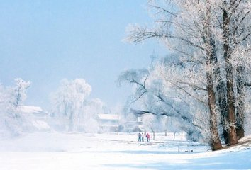
And girl you show me things I never see…
If you were never there to see them with me…

Slide 18
You are my sanity
And
everything will be okay…
And when I get a little too crazy...

Slide 19
Wherever I go
Whatever I do
CUZ BABY
it’s always better with you
Stay
By
My
Side

Slide 20
Girl, when I am alone
You’re where I belong
Cause Baby, it’s always better with you…
Oh…
Oh…
Oh…
Oh…
Baby, it’s always better with you…

Slide 21
Girl,
It doesn’t matter where we go…
1
Jan Feb Mar Apr
2
May Jun Jul
3
Aug Sep Oct Nov
Cuz you always make it feel like it’s home!!!
When I’m with you……
Ooooh…Ooooh…Ooooh…

Slide 22
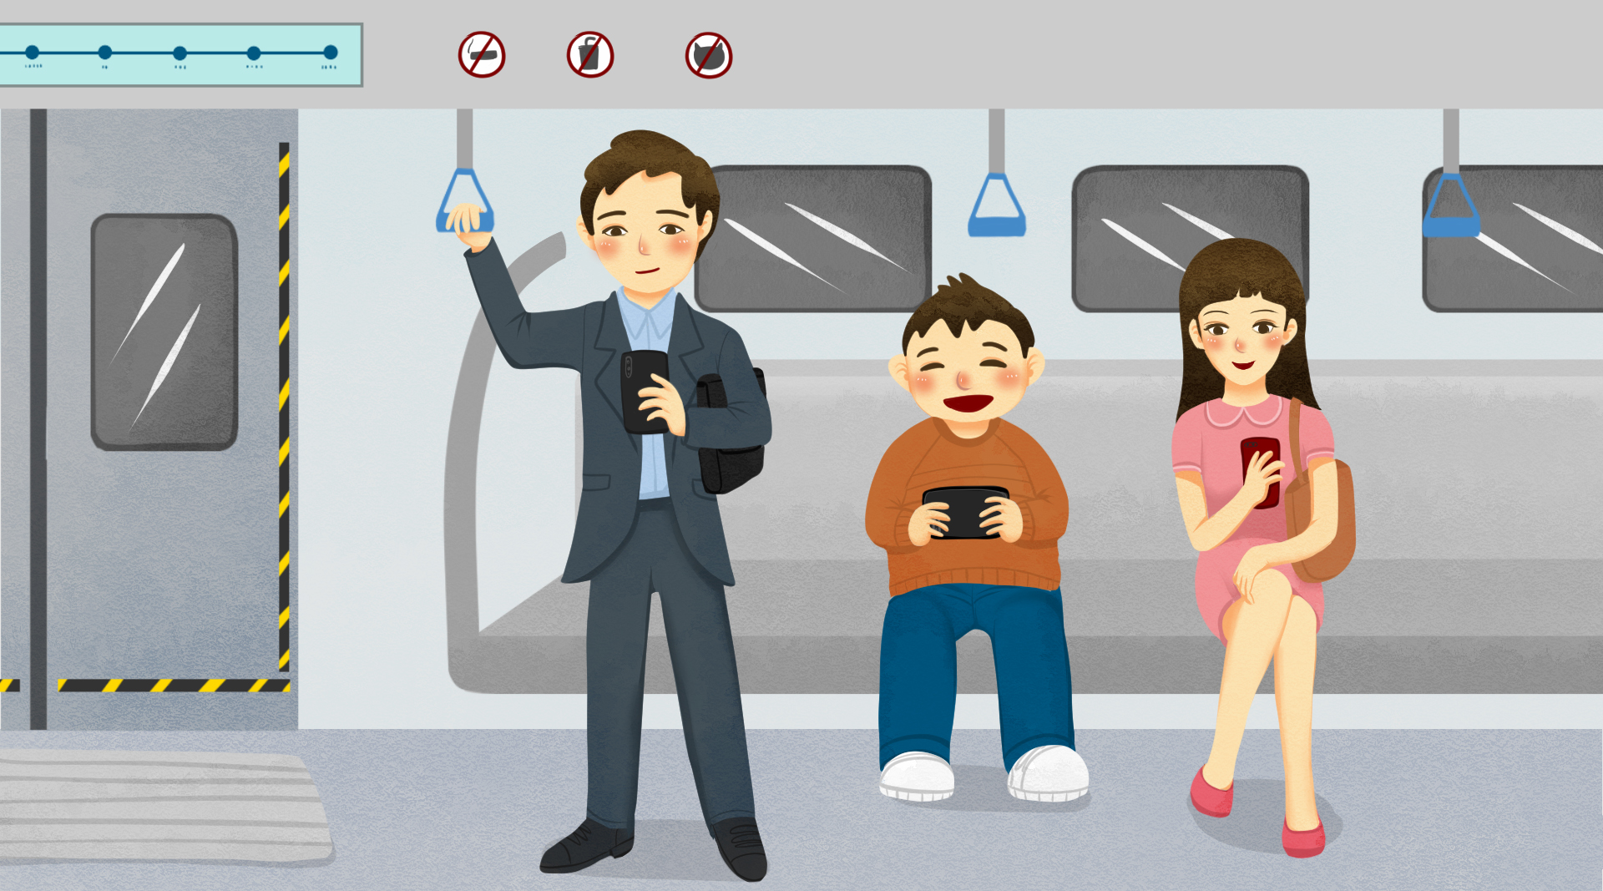
Wherever I go…
Wherever I do…

Slide 23
Stay by my side…
Cuz baby, it’s always better with you…

Slide 24
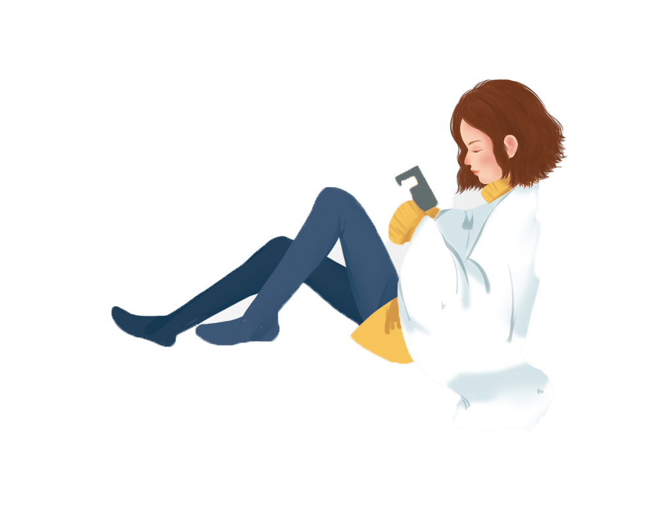
Girl, when I am alone
You’re where I belong
Cuz baby, it’s always better with you
Wherever I go
Whatever I do
Stay by my side
Baby, it’s always (better with you)…
Wherever I go
Whatever I do
You’re where I belong
Baby, it’s always better…

Slide 25
It’s always, better with you…

Slide 26
Thanks

