Slide 1


Making
phone
calls
歌曲：《 Hello 》 Adele
作者： 李勉宜
单位： 华南师范大学外文学院

Slide 2
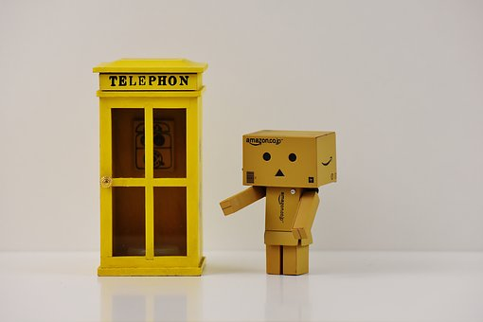
Hello
It’s me

Slide 3

I was wondering
if after all these years
you'd like to meet
To go over everything

Slide 4

They say that time’s
supposed to heal ya
but I ain't done
much healing

Slide 5


Hello
Can
you
hear
me

Slide 6


I'm in California dreaming about who we used to be when we were younger and free
I've forgotten how it felt before the world fell at our feet
There's such a difference between us and a million miles

Slide 7
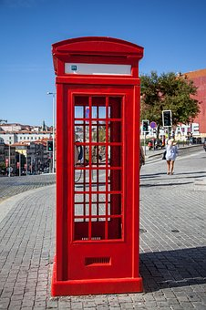
Hello from the other side
I must've called a thousand times to tell you
I'm sorry, for everything that I've done
But when I call you never seem to be home

Slide 8
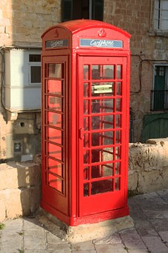
Hello from the outside
At least I can say that I've tried to tell you
I'm sorry, for breaking your heart
But it don't matter, it clearly doesn't tear you
apart anymore

Slide 9

Hello, how are you
It's so typical of me
to talk about myself
I'm sorry, I hope that you're well
Did you ever make it out of that town
Where nothing ever happened
It's no secret that the both of us are running out of time

Slide 10

So hello from the other side
I must've called a thousand times to tell you
I'm sorry for everything that I've done
But when I call you never seem to be home

Slide 11

Hello from the outside
At least I can say that I've tried to tell you
I'm sorry, for breaking your heart
But it don't matter
it clearly doesn't tear you apart anymore
But it won't
anymore
anymore
anymore

