Slide 1
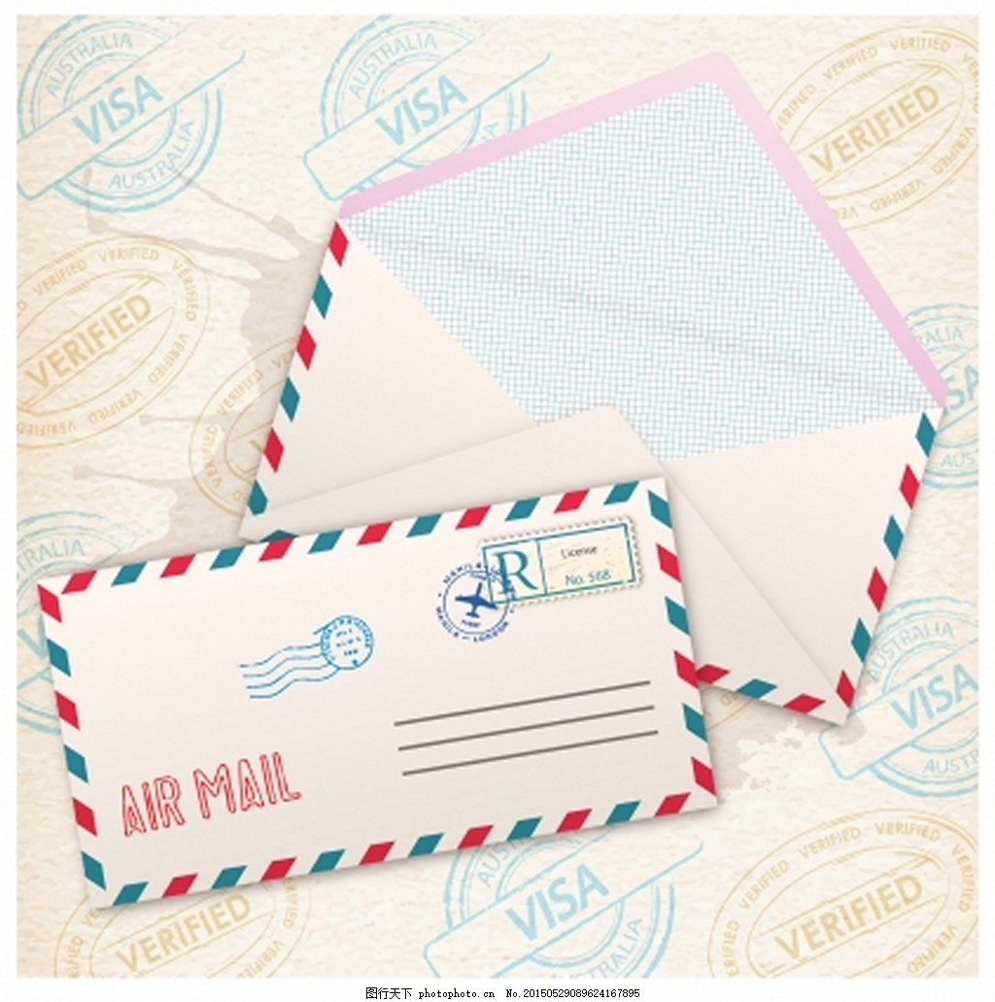

Communications
华南师范大学外文学院
王亮丽

Slide 2


Hello
Do you remember me
I am your long lost pen pal
It must have been ten years ago we last wrote
I don’t really know what happened
I guess life came in the way
Let me know if you’re still alive
Let me know if you ever used that knife or not

Slide 3

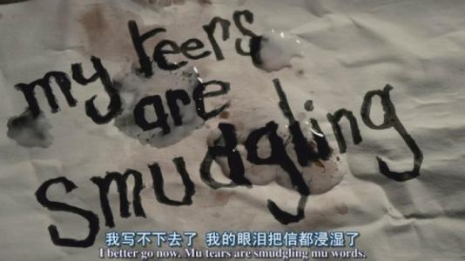
Hello
Yes I remember you
I’ve got a husband and two children now
I work as an accountant and make fairly
good money
I still have your letters, you used a pink pen to
write them
And you would comfort me
when my tears would stain the ink
And I would send you mix tapes with
Kate Bush on

Slide 4
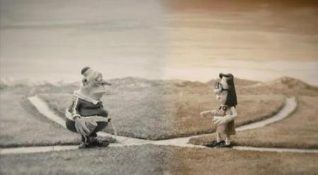
I have to admit I sometimes lied in those letters
Tried to make life better than it was
I still wasn’t kissed at sixteen
And I still need a friend

Slide 5
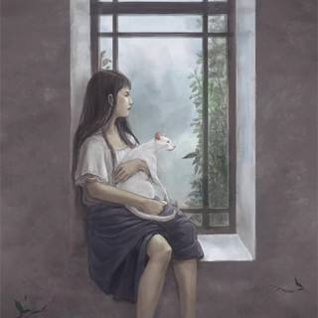
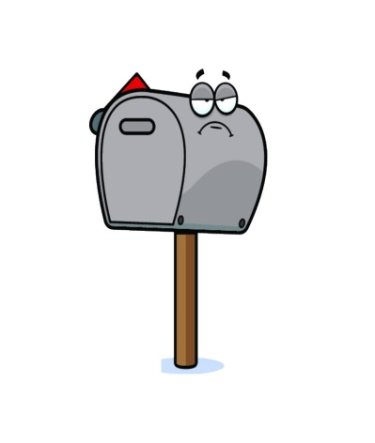
There was this letter
I never told you this back then
But it would be fair to say it saved my life
I sat in the window
The only one left out from a party again
Pretty sure I didn’t have a single friend
Then I checked the mailbox

Slide 6
Dear long lost penpal
I was lying the whole time
I’m really a 46 years old man named Luke
I have three children
and a wife, she doesn’t care
And I hope you don’t resent me
And I hope you do not hate me
For trying to find my way back to what it’s like
to be young

Slide 7
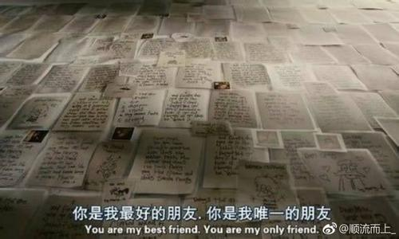
I have to admit I sometimes lied in those letters
Tried to make life better than it was
I still wasn’t kissed at sixteen
And I still need a friend

