Slide 1
Asking the way song : Where can I go?
作者：黄雅文
单位：华南师范大学外文学院

Slide 2


Tell me where can I go

Slide 3

There's no place I can see

Slide 4

Where to go where to go

Slide 5

Every door is closed for me

Slide 6
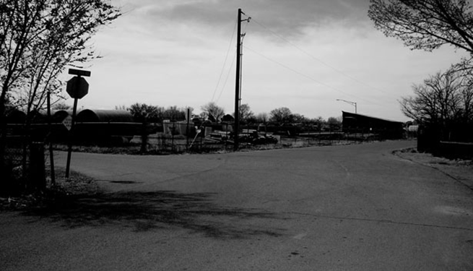
To the left to the right

Slide 7

It's the same in every land

Slide 8
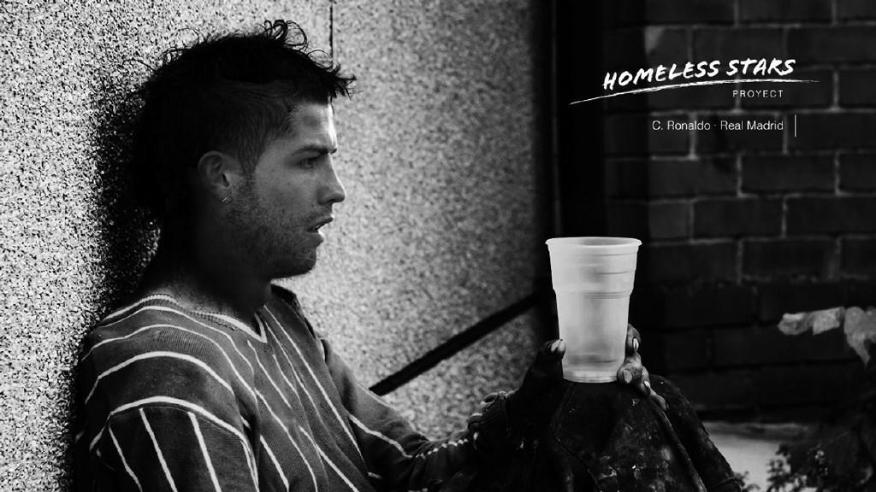
There is nowhere to go

Slide 9
And it's me who should know

Slide 10

Won't you please understand

Slide 11

Now I know where to go

Slide 12
Where my folk proudly stand

Slide 13
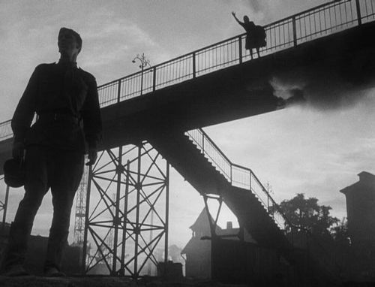
Let me go let me go

Slide 14

To that precious promised land

Slide 15
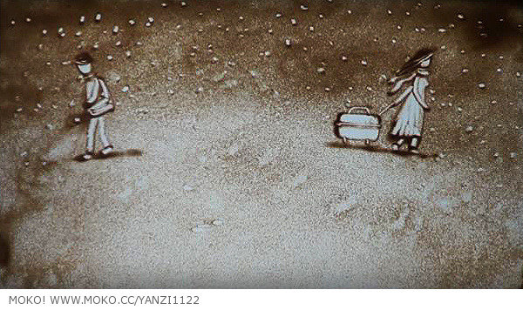
No more left no more right

Slide 16

Lift your head and see the light

Slide 17
I am proud can't you see
For at last I am free
No more wandering for me

