Slide 1
Modes of Transportation
华南师范大学外文学院
杨扬

Slide 2
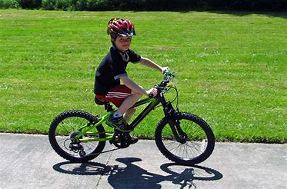
I ride on a bike.

Slide 3
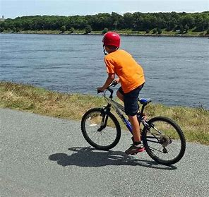
Faster!
Faster!
Faster!
I ride on a bike, but I want to go faster! Faster! Faster! Faster!

Slide 4
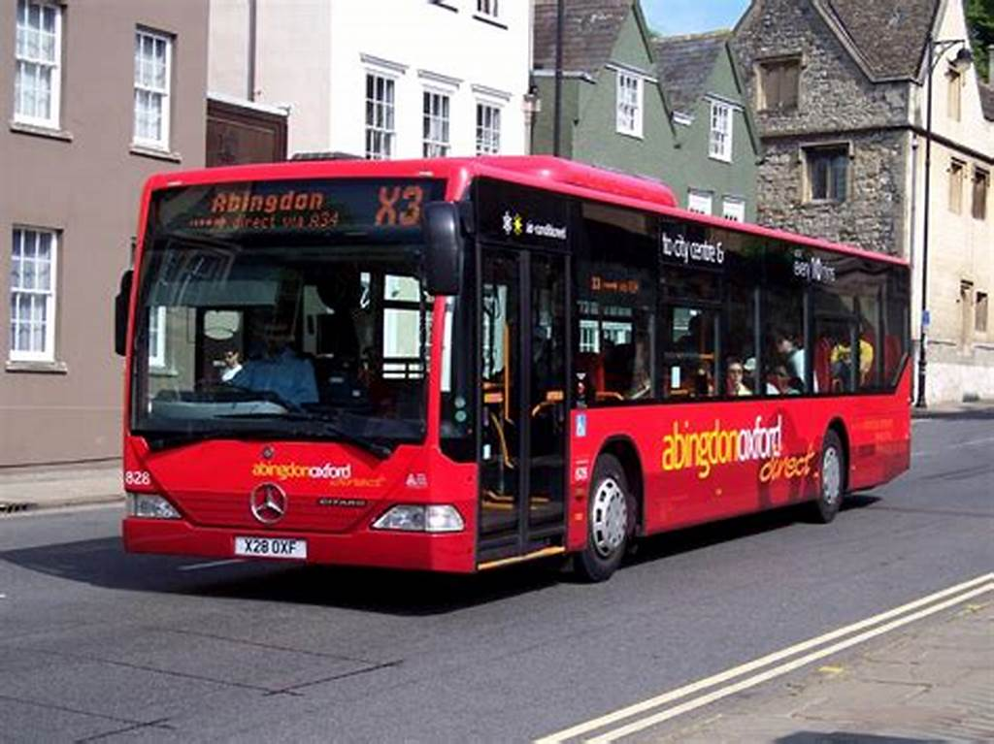
I ride on a bus.

Slide 5
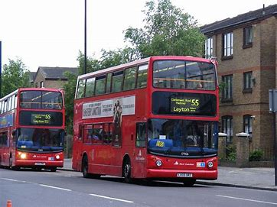
Faster!
Faster!
Faster!
I ride on a bus, but I want to go faster!
Faster! Faster! Faster!

Slide 6
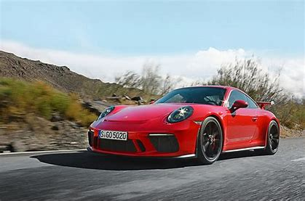
I ride in a car.

Slide 7
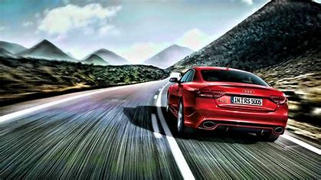
Faster!
Faster!
Faster!
I ride in a car, but I want to go faster! Faster! Faster! Faster!

Slide 8
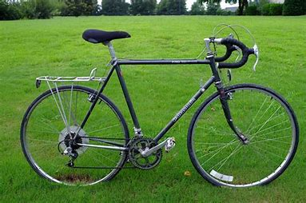
Bike! Bike!

Slide 9
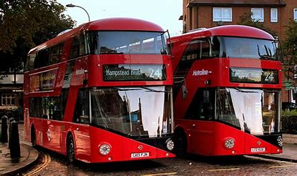
Bus! Bus!

Slide 10
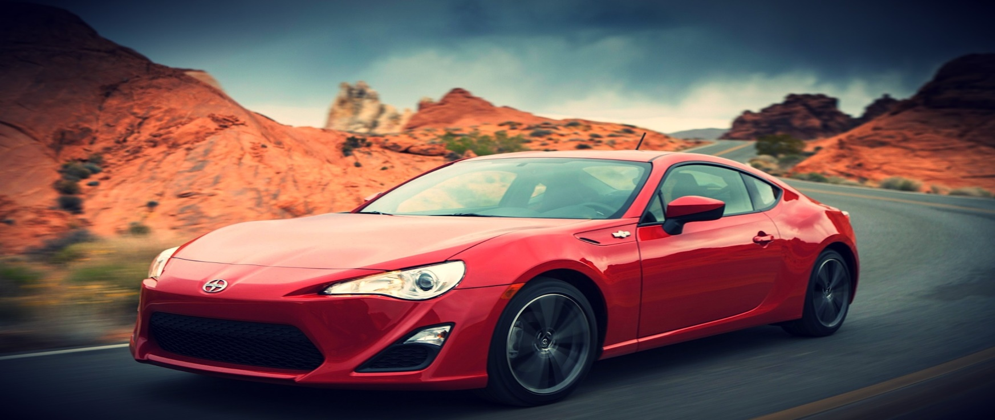
Car! Car!

Slide 11
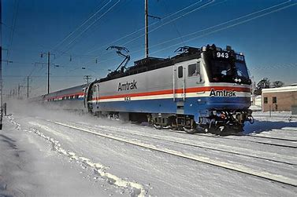
Train! Train!

Slide 12
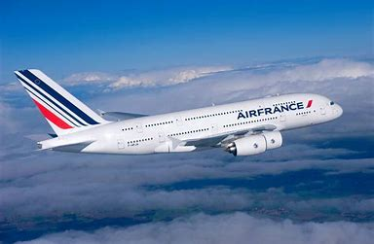
Plane! Plane!

Slide 13
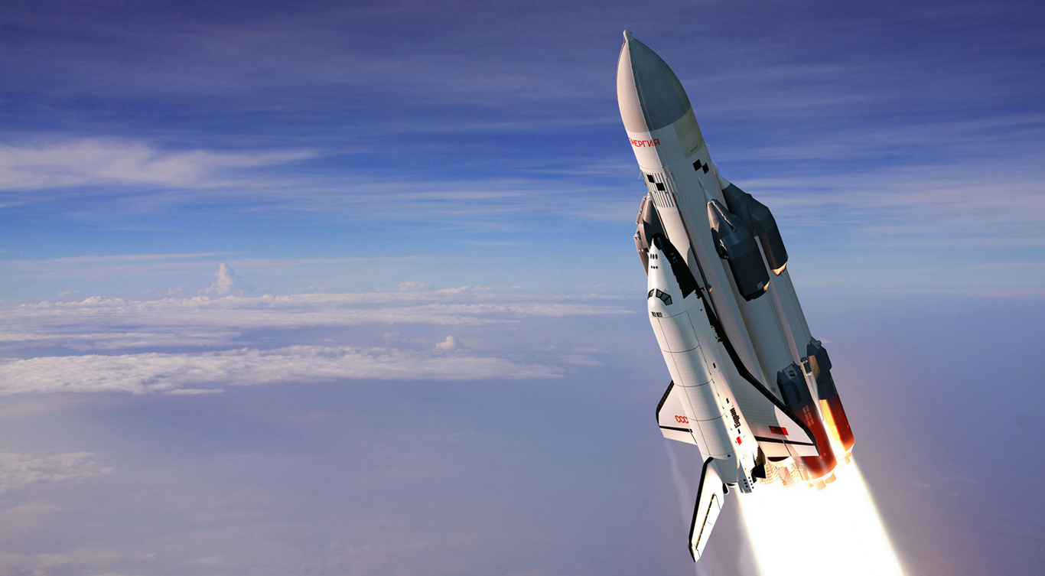
Rocket! Rocket!

Slide 14
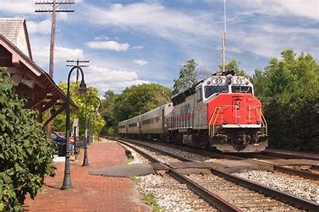
I ride on a train.

Slide 15
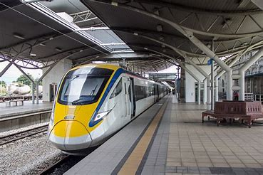
Faster!
Faster!
Faster!
I ride on a train, but I want to go faster! Faster! Faster! Faster!

Slide 16
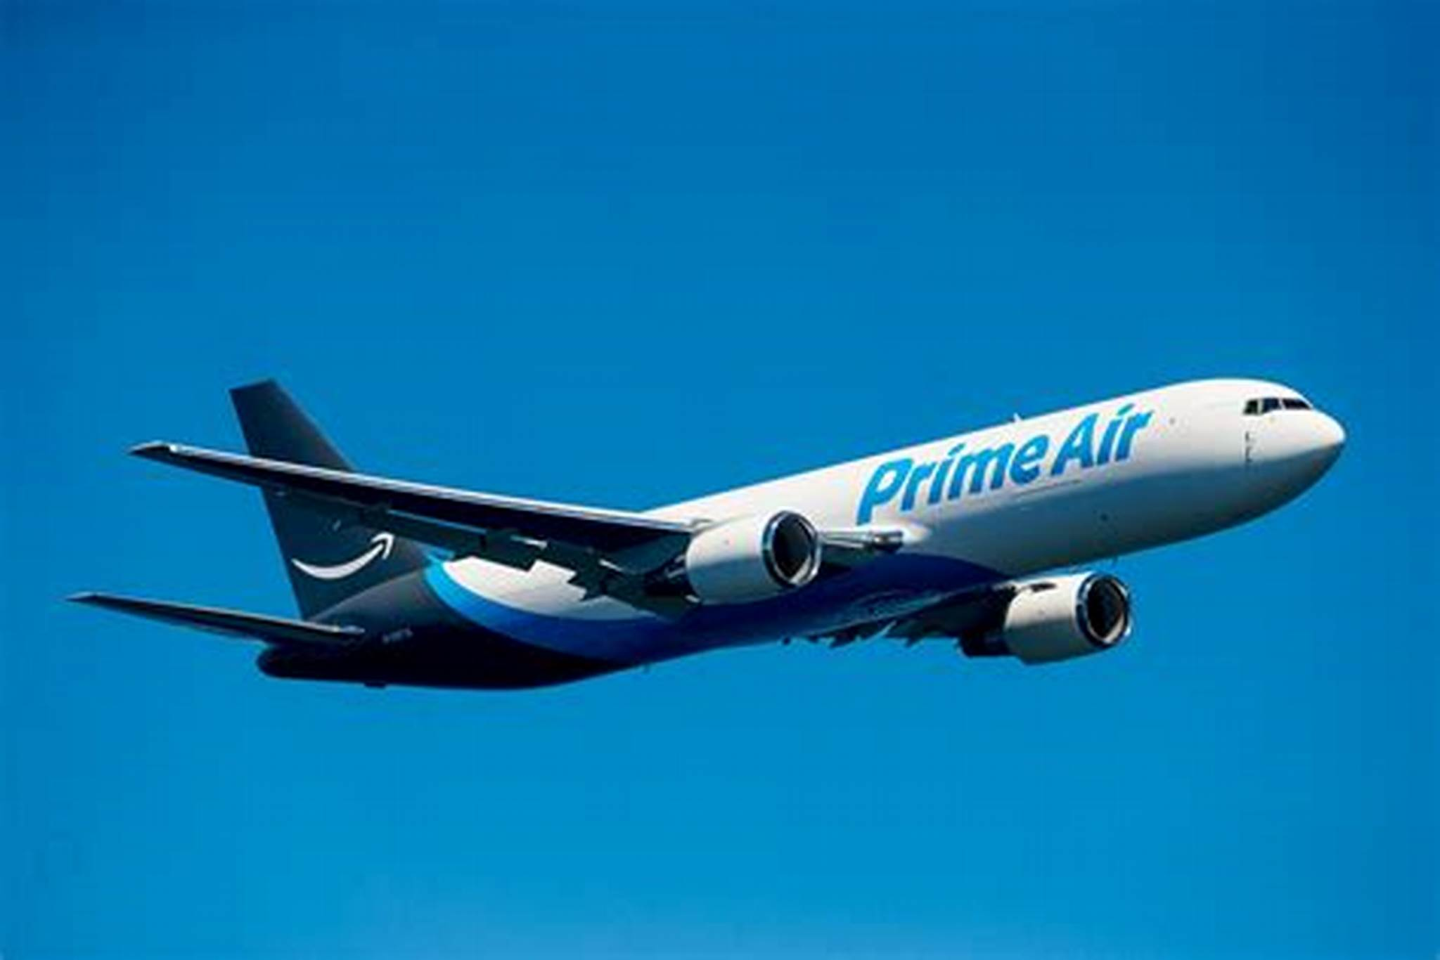
I fly on a plane.

Slide 17
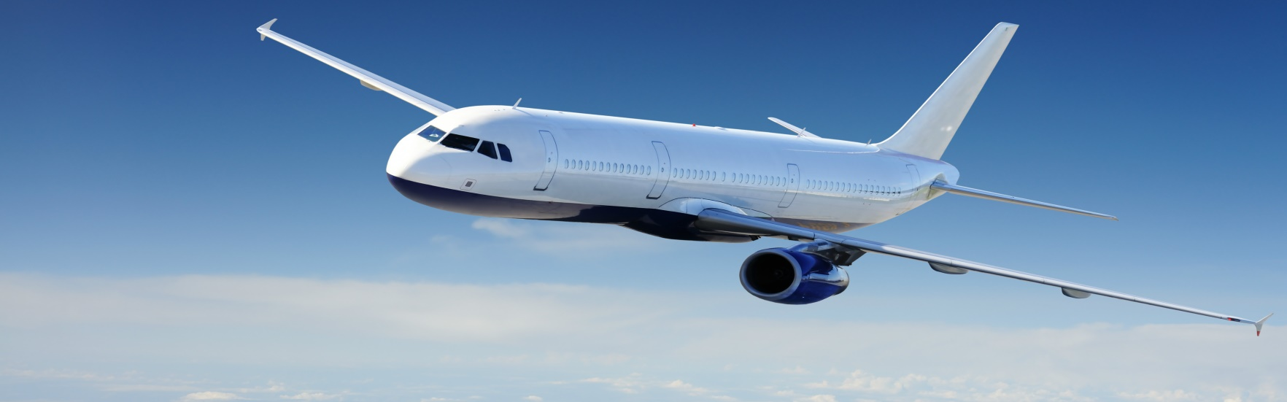
Faster!
Faster!
Faster!
I fly on a plane, but I want to go faster! Faster! Faster! Faster!

Slide 18


Slide 19


Slide 20


Slide 21


Slide 22


Slide 23


Slide 24


Slide 25


Slide 26


Slide 27


Slide 28
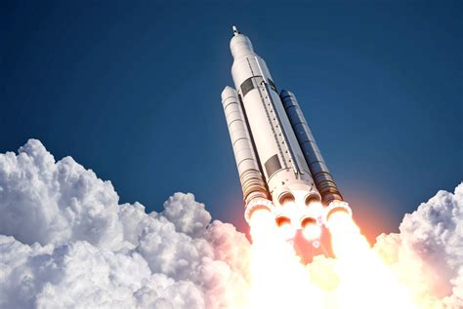
Go!

Slide 29
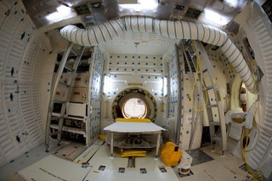
I fly in a rocket.

Slide 30
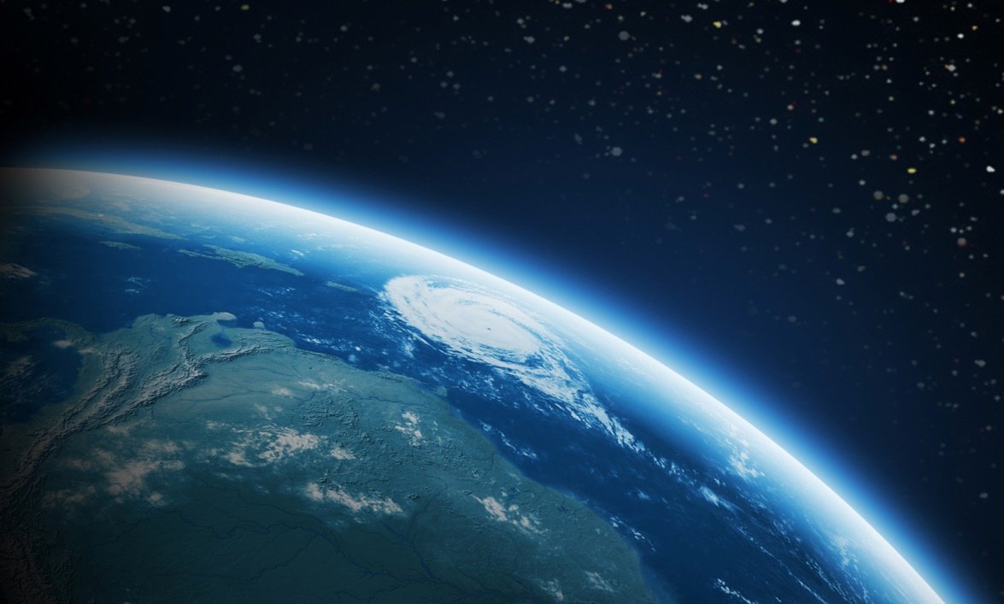
I fly into space in a rocket.

Slide 31
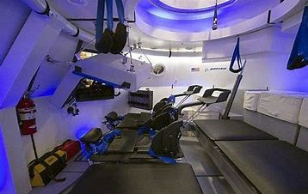
I fly in a rocket.

Slide 32

I fly into space in a rocket.

