Slide 1
Topic: Dance and Music
Song: Dance with my father again
Singer: Celine Dion
作者：卢晓晴
单位：华南师范大学外文学院

Slide 2
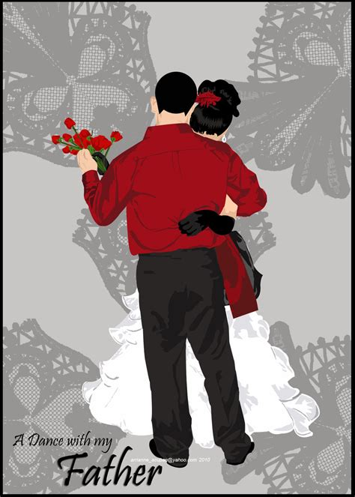
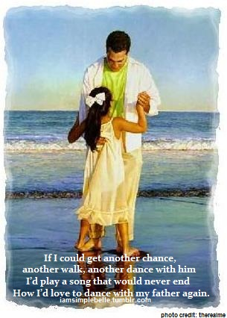
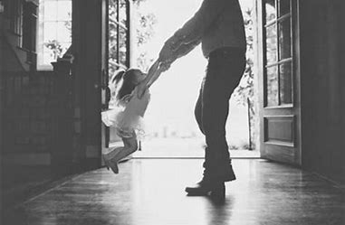
Dance with my father again

Slide 3
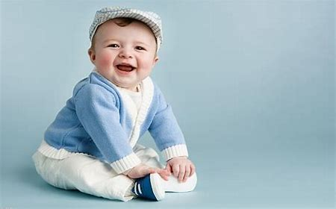
Back when I was a child
before life removed all the innocence

Slide 4
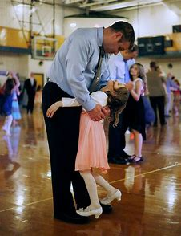
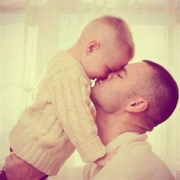
My father would lift me high
and dance with my mother
and me and then

Slide 5
Spin me around
till I fell asleep

Slide 6
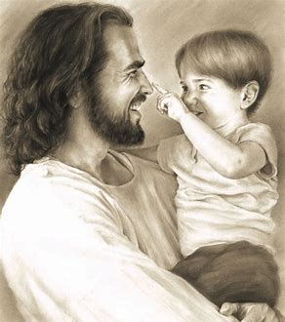
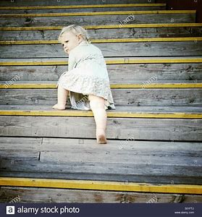
Then up the stairs
he would carry me

Slide 7
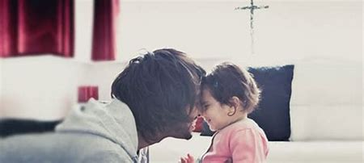
And I knew for sure
I was loved

Slide 8
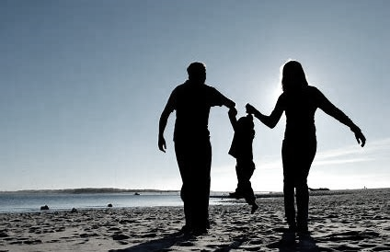
If I could get another chance

Slide 9
Another walk,
another dance with him

Slide 10
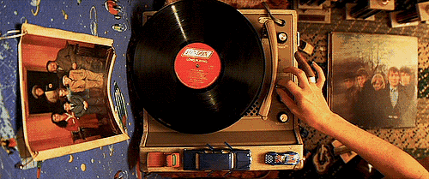
I'd play a song that would never ever end

Slide 11
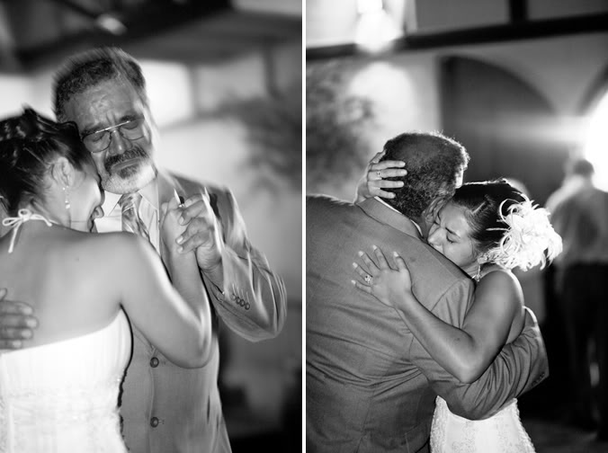
How I'd love love love…

Slide 12
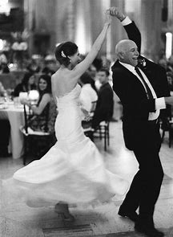
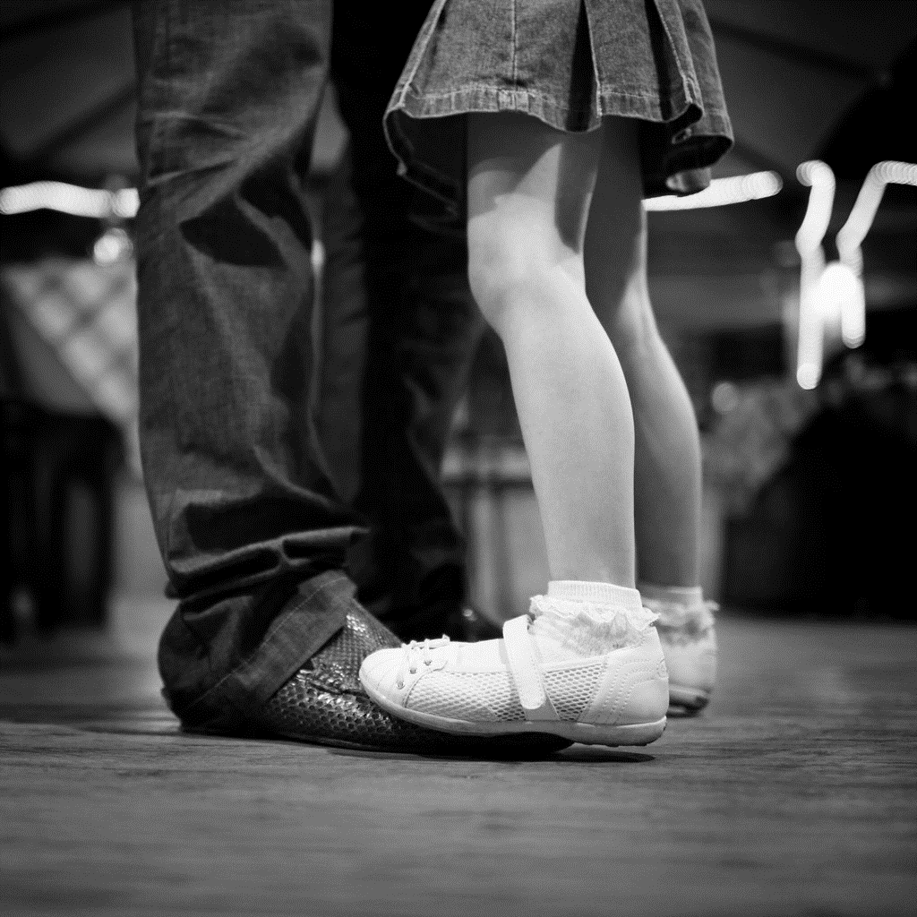
To dance
with my father again

Slide 13
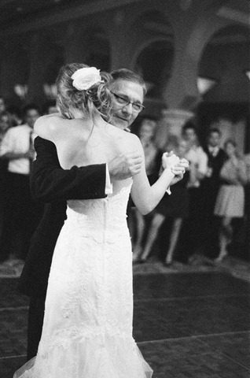
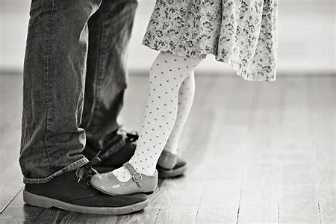

Slide 14
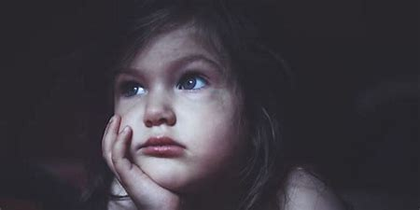
When I and my mother would disagree

Slide 15
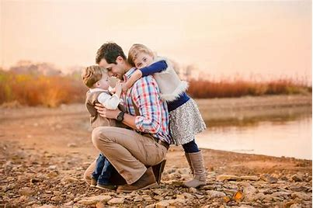
To get my way
I would run from her to him

Slide 16
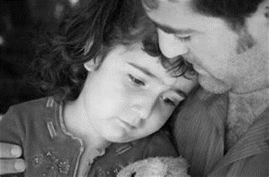
He’d make me laugh just to comfort me

Slide 17
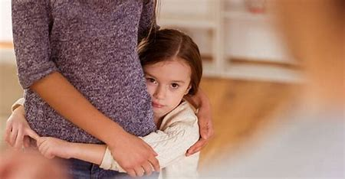
Then finally make me do
just what my mama said

Slide 18
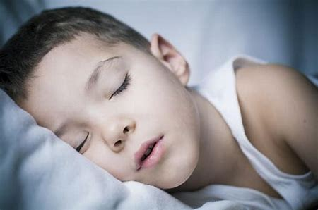
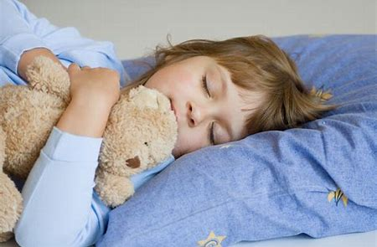
Later that night when I was asleep

Slide 19
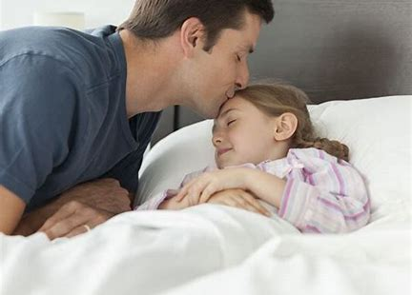
He left a dollar under my sheet

Slide 20
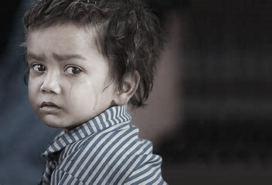
Never dreamed that he would be gone from me

Slide 21
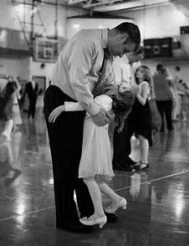
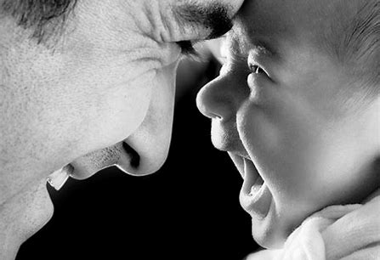
If I could steal one final glance,
one final dance with him
one final step,

Slide 22
I’d play a song that would never, ever end

Slide 23
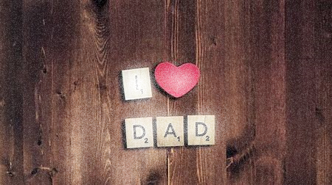
‘Cause I’d love, love, love

Slide 24
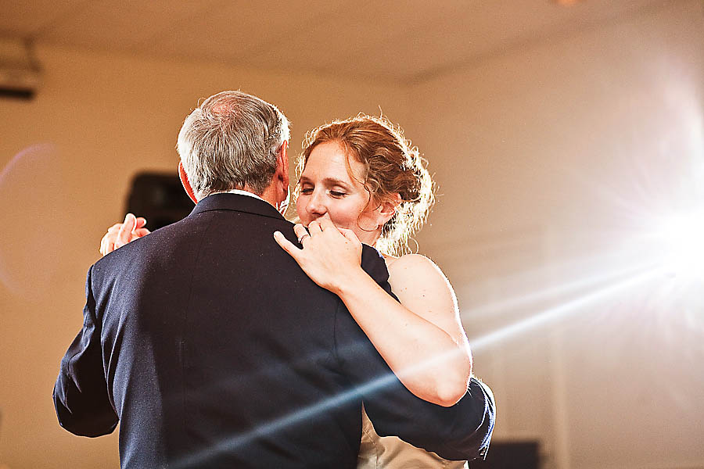
To dance with my father again

Slide 25
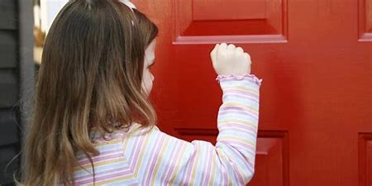
Sometimes I’d listen outside her door

Slide 26
And I’d hear how
my mama cried for him

Slide 27
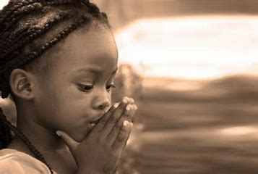
I pray for her even more than me

Slide 28
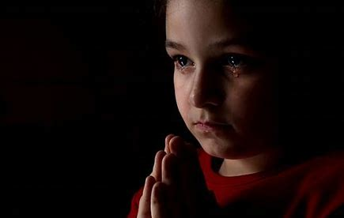
I pray for her even more than me

Slide 29
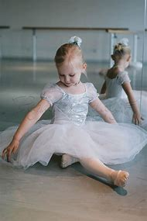
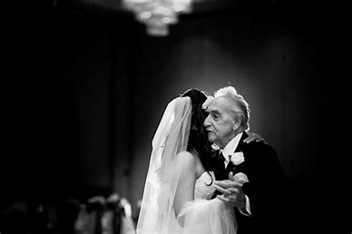

Slide 30
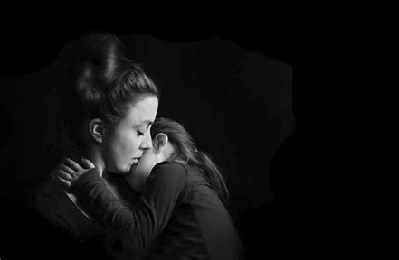
I know I’m praying for much too much

Slide 31
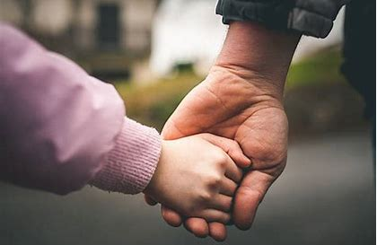
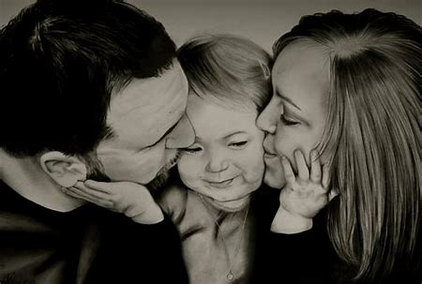
But could you send back
the only man she loved

Slide 32
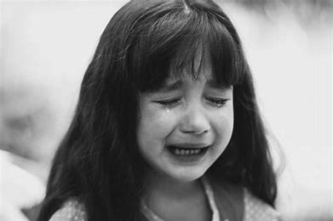
I know you don’t do it usually

Slide 33
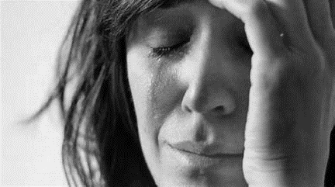
But dear Lord she’s dying

Slide 34
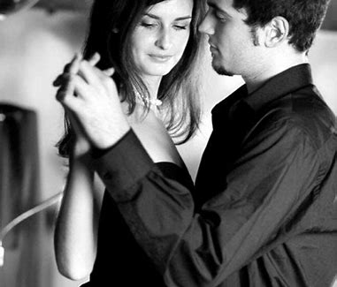
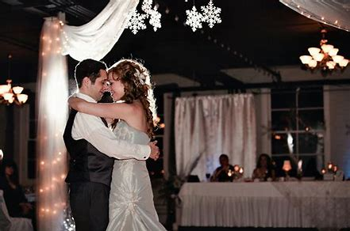
To dance with my father again

Slide 35
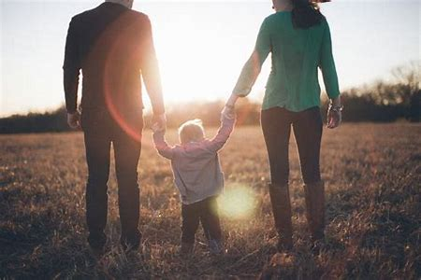
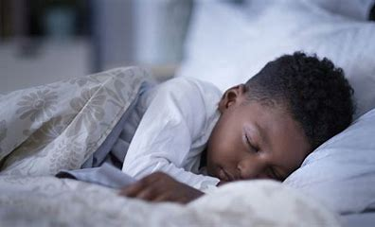
Every night I fall asleep
and this is all I ever dream

